Slide 1
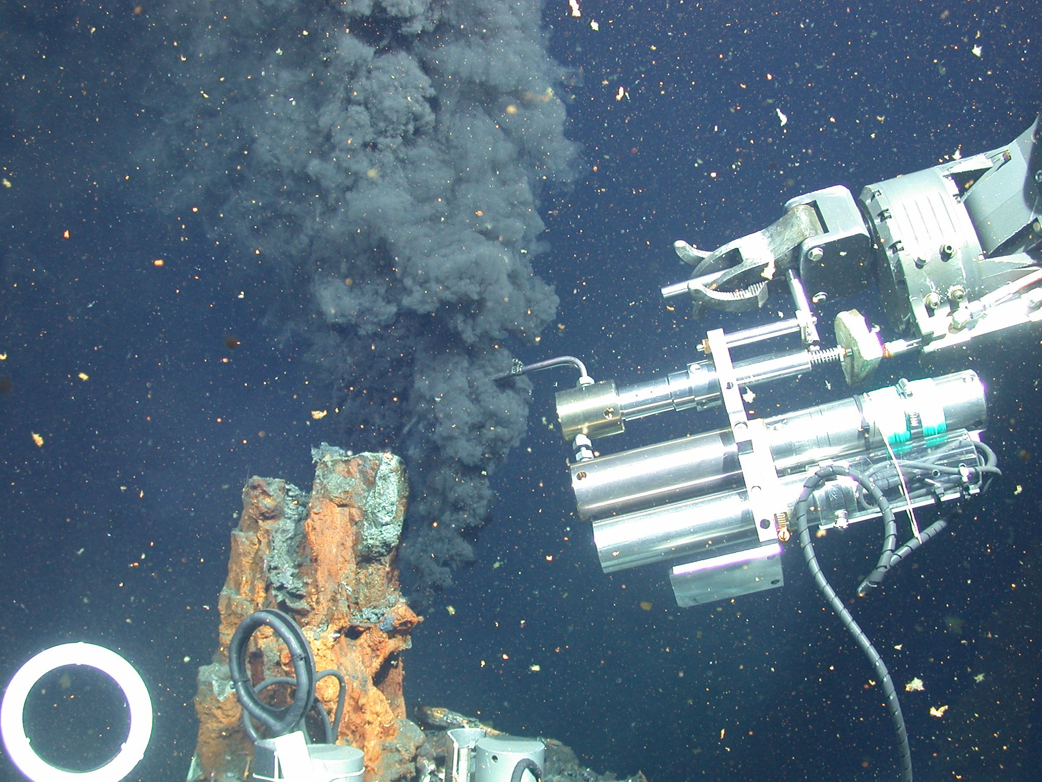

The need for broadly distributed high-quality samples of high-temperature hydrothermal fluids to define baseline fluid chemistry
Dr. Drew D. Syverson, University of North Carolina at Charlotte
Department of Earth, Environmental and Geographical Sciences

Slide 2
Sampling objectives for defining baseline chemistry from the Endeavour hydrothermal field:
Obtain high quality hydrothermal fluids sampled from each vent using isobaric gas-tight titanium samplers (Seewald et al., 2020).
  These samples collected from one vent can be used to derived end-member fluid compositions by extrapolation to zero Mg to account for any seawater mixing.

Slide 3
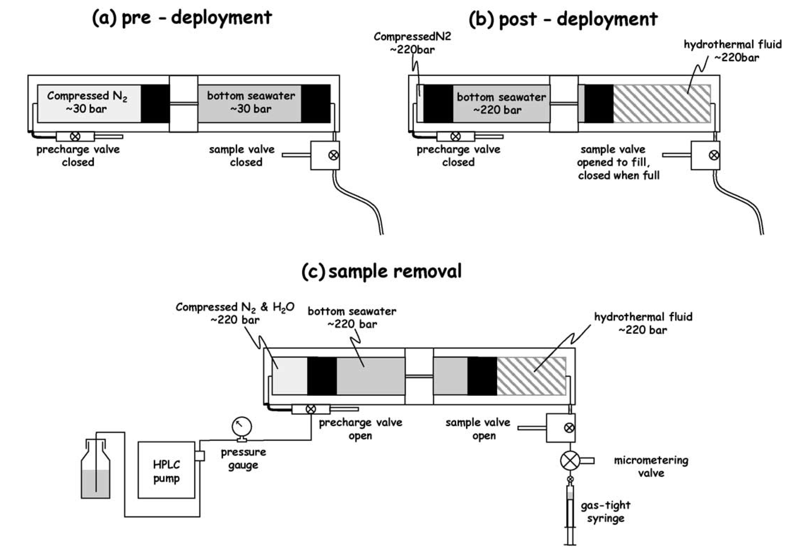
Seewald et al., 2001

Slide 4
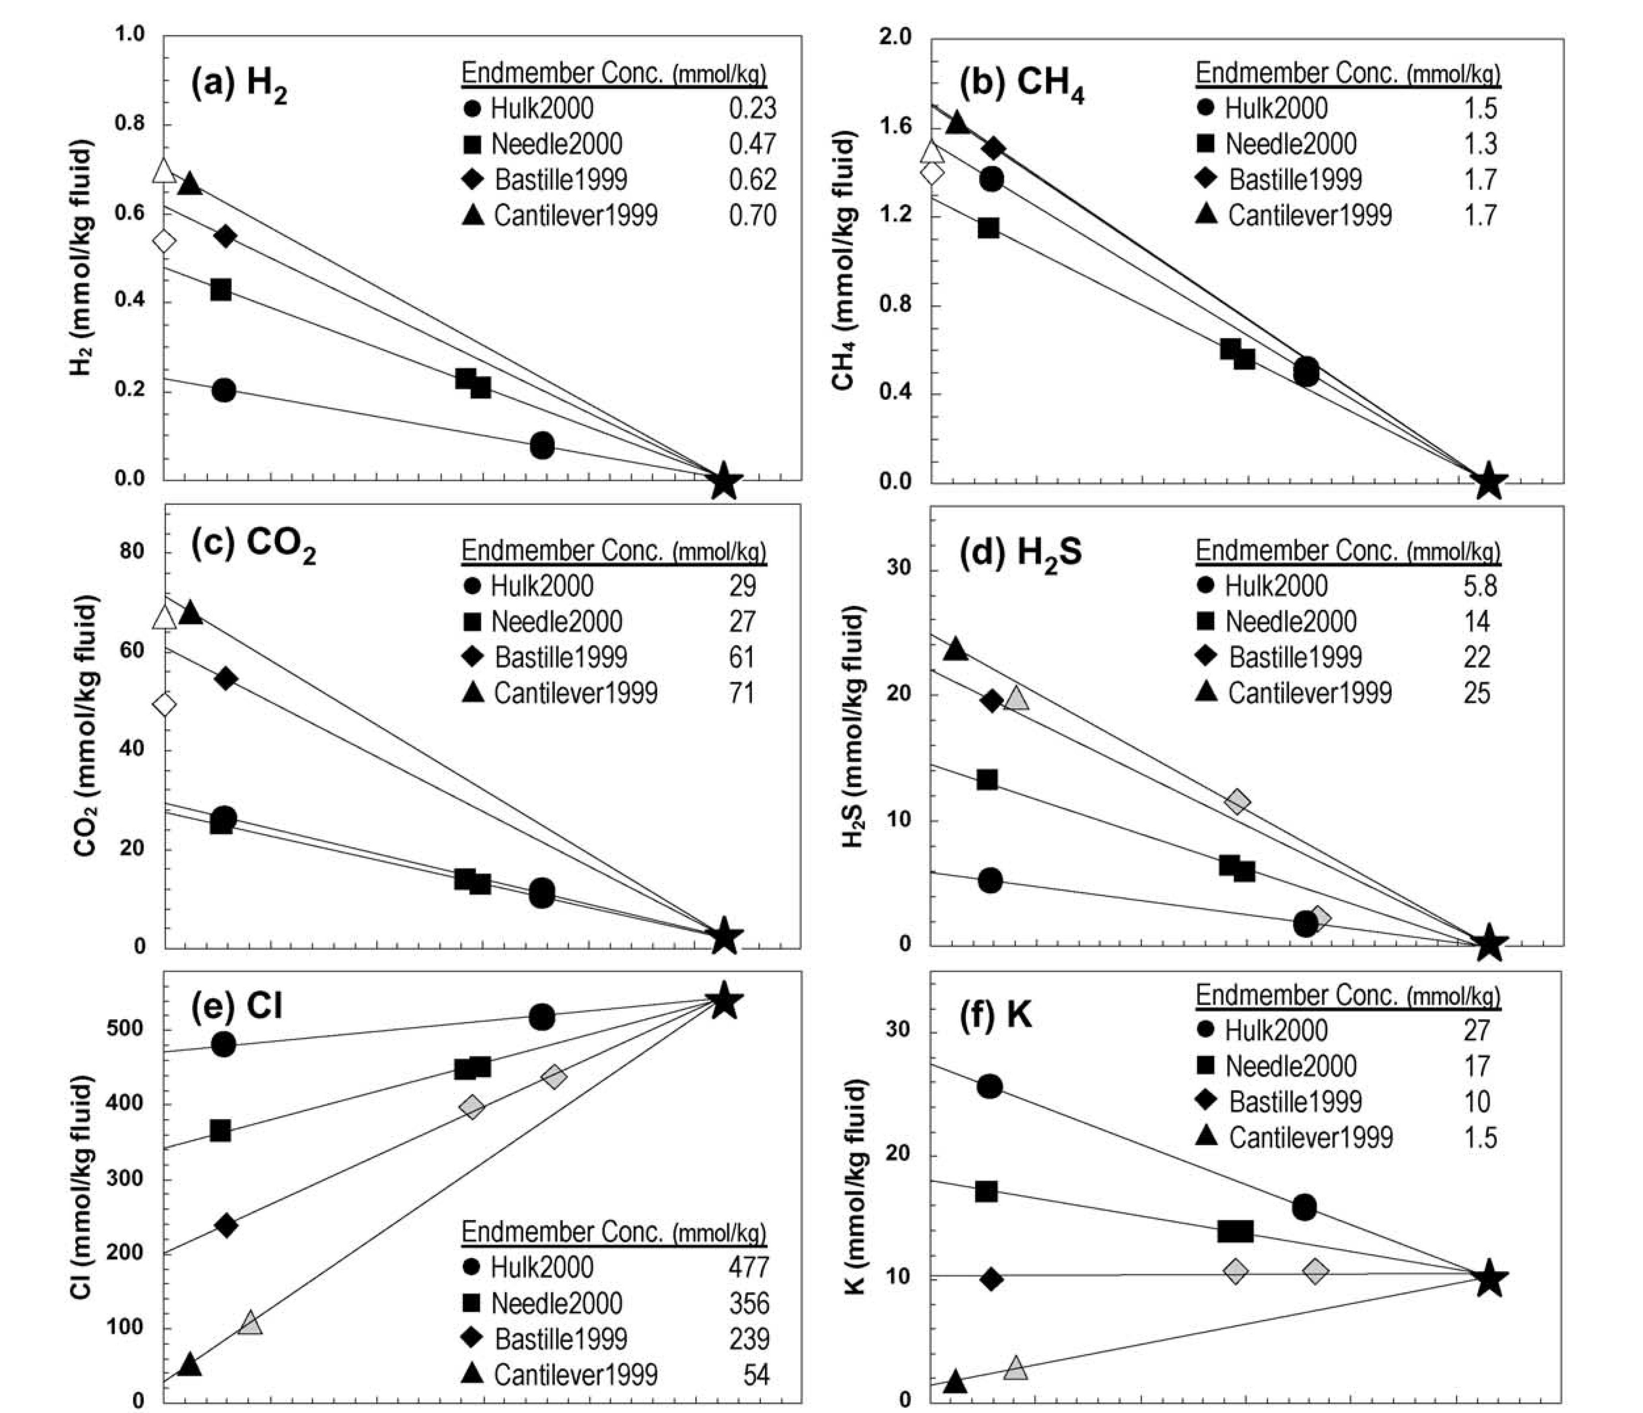
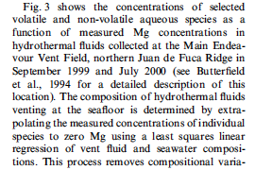
Seewald et al., 2001

Slide 5
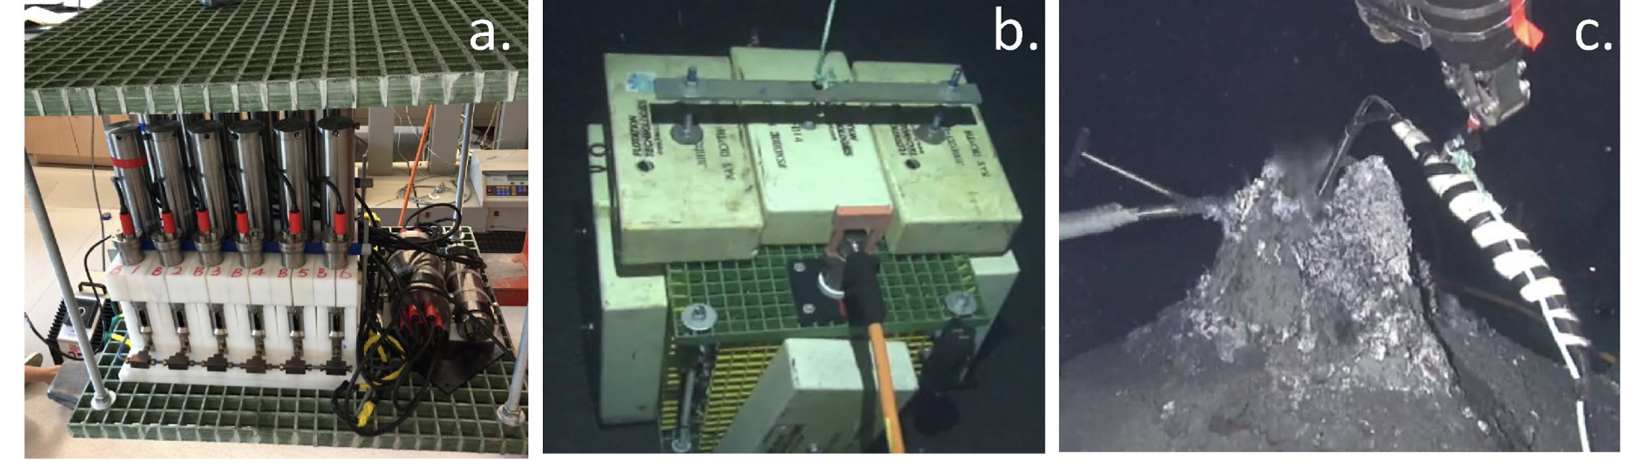
Remotely sampling vent fluids from the Endeavour hydrothermal field:
Seyfried et al., 2022

Slide 6
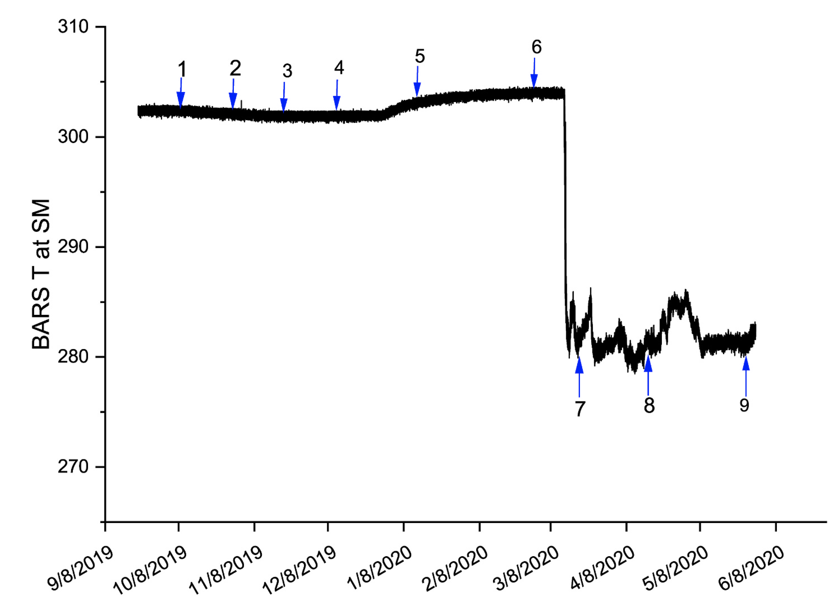
Remotely sampling vent fluids from the Endeavour hydrothermal field:
Seyfried et al., 2022

Slide 7
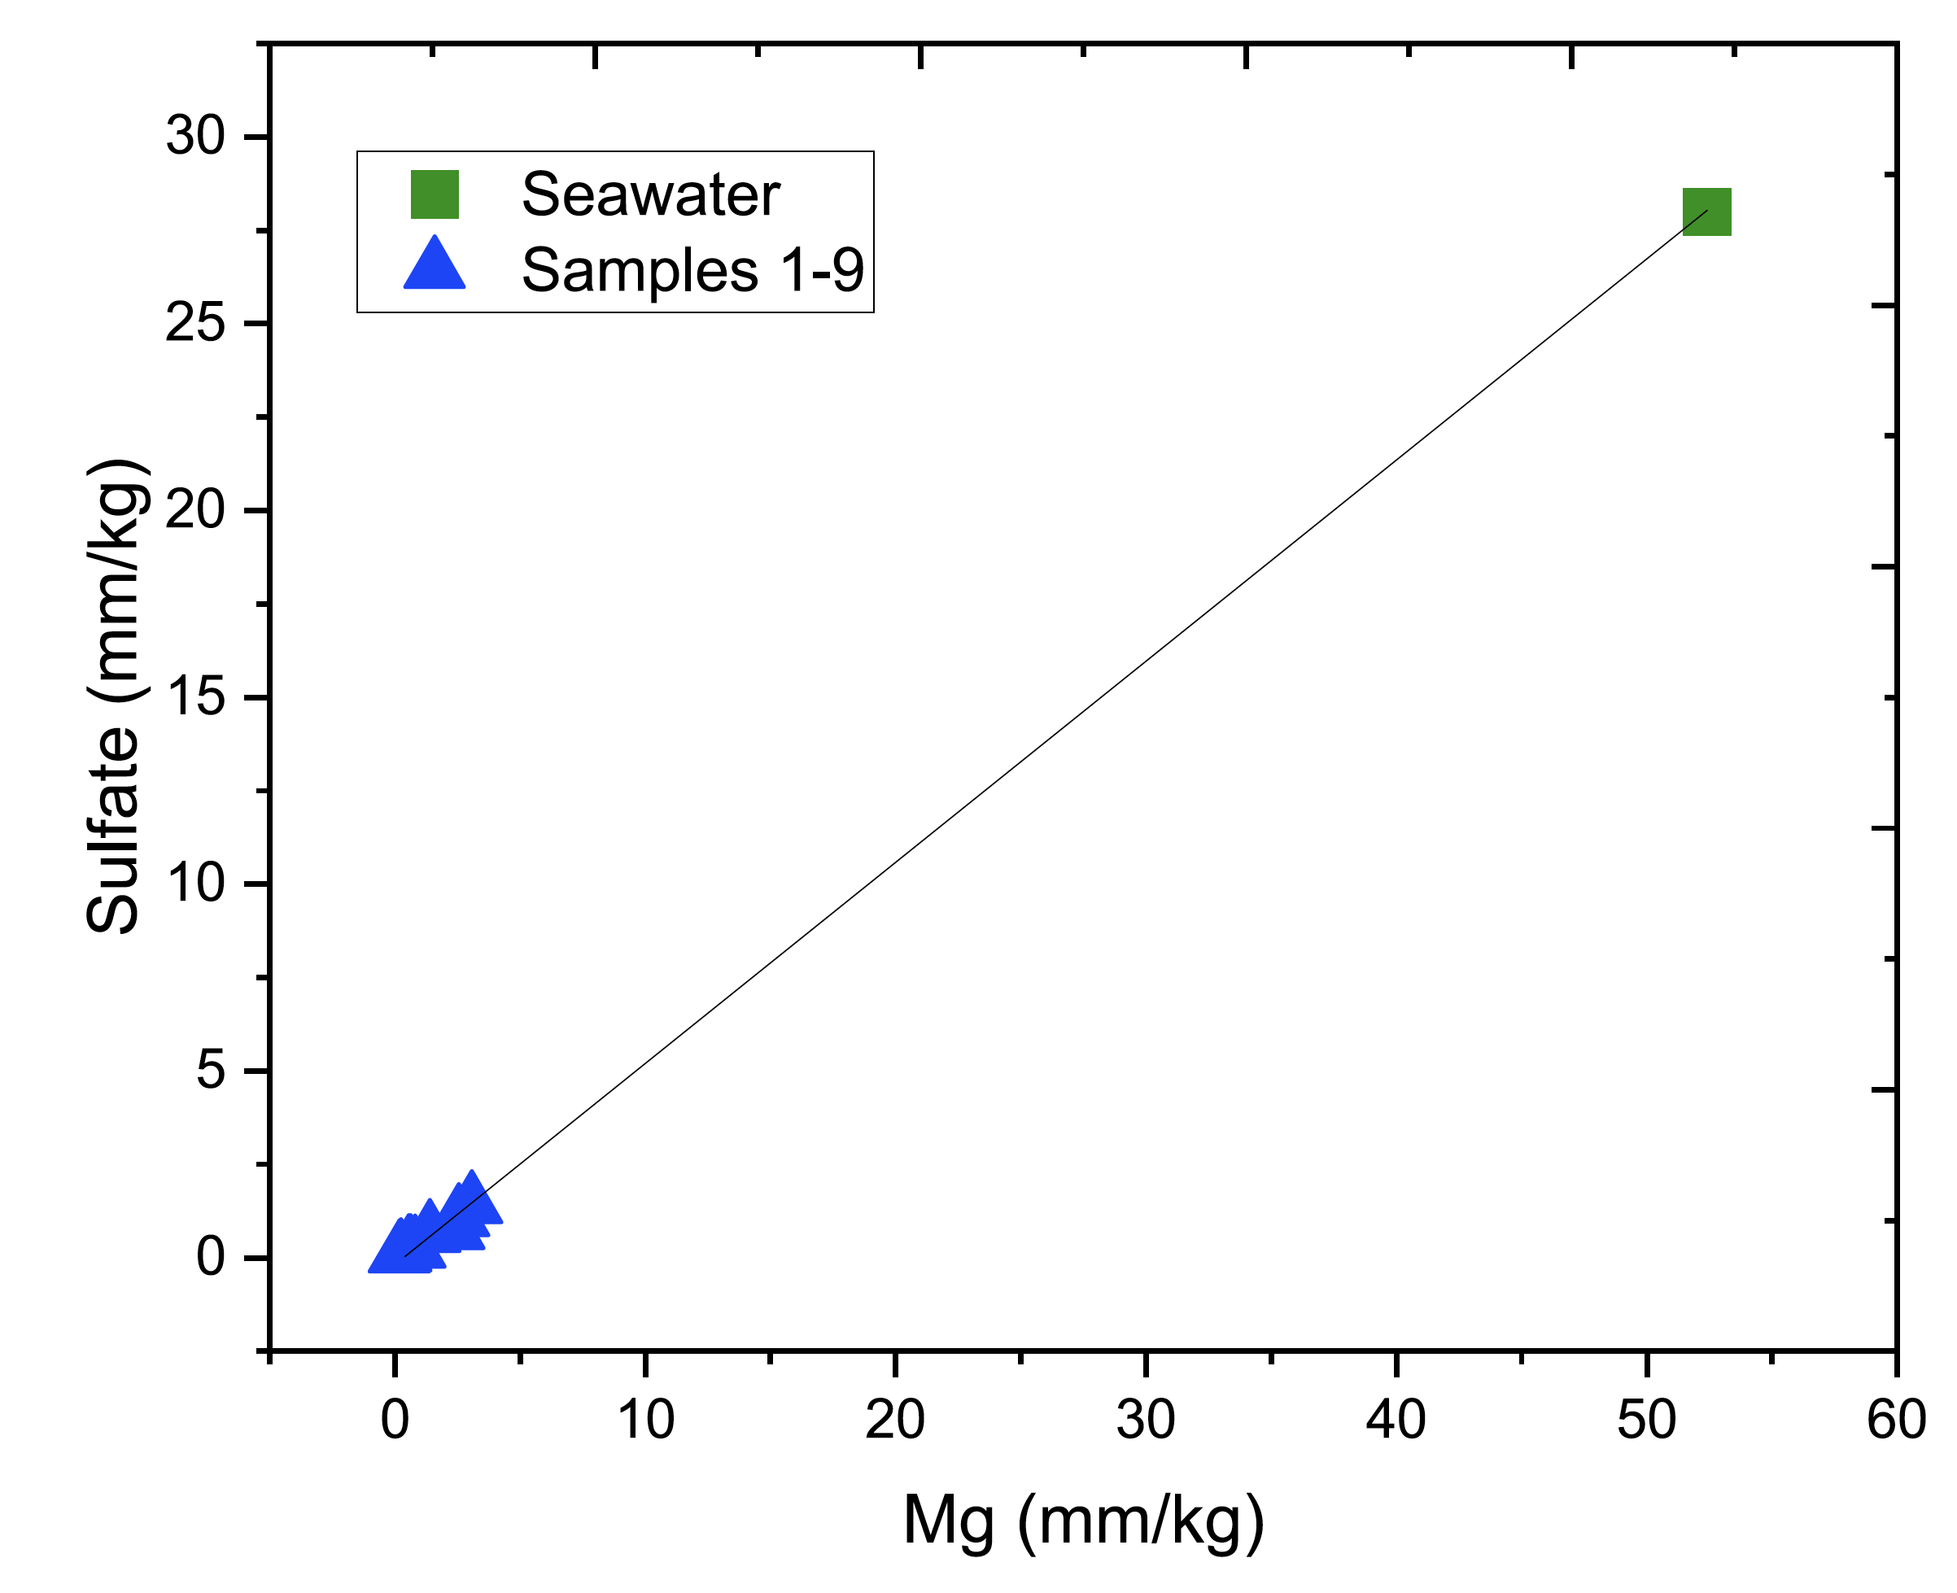
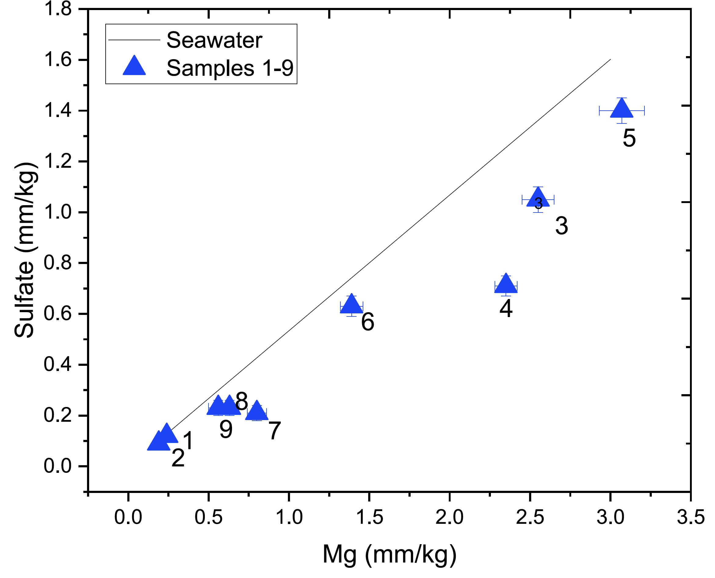
Remotely sampling vent fluids from the Endeavour hydrothermal field:
Seyfried et al., 2022

Slide 8
Sampling objectives for defining baseline chemistry from the Endeavour hydrothermal field:
Quantitatively recover dregs (mineral precipitate) in the isobaric gas-tight titanium samplers after sampling vents.
  Trace elements, such as zinc and osmium, are retained at proportions greater than 80% in the dregs fraction relative to hydrothermal fluid in the samplers.
  A large number of past studies focused on vent fluid chemistry did not analyze the dregs for trace element/metal chemistry.

Slide 9
Vent Fluid Os Concentration
In prep; Sharma et al., 2000 & 2007; Gannoun et al., 2007

Slide 10
Sampling objectives for defining baseline chemistry from the Endeavour hydrothermal field:
Take time-series sampling of hydrothermal fluids before and after an eruption at the seafloor.
  Most studies focused on interpreting vent fluid chemistry before and after an eruption event are usually limited by non-continuous time-series sampling.

Slide 11
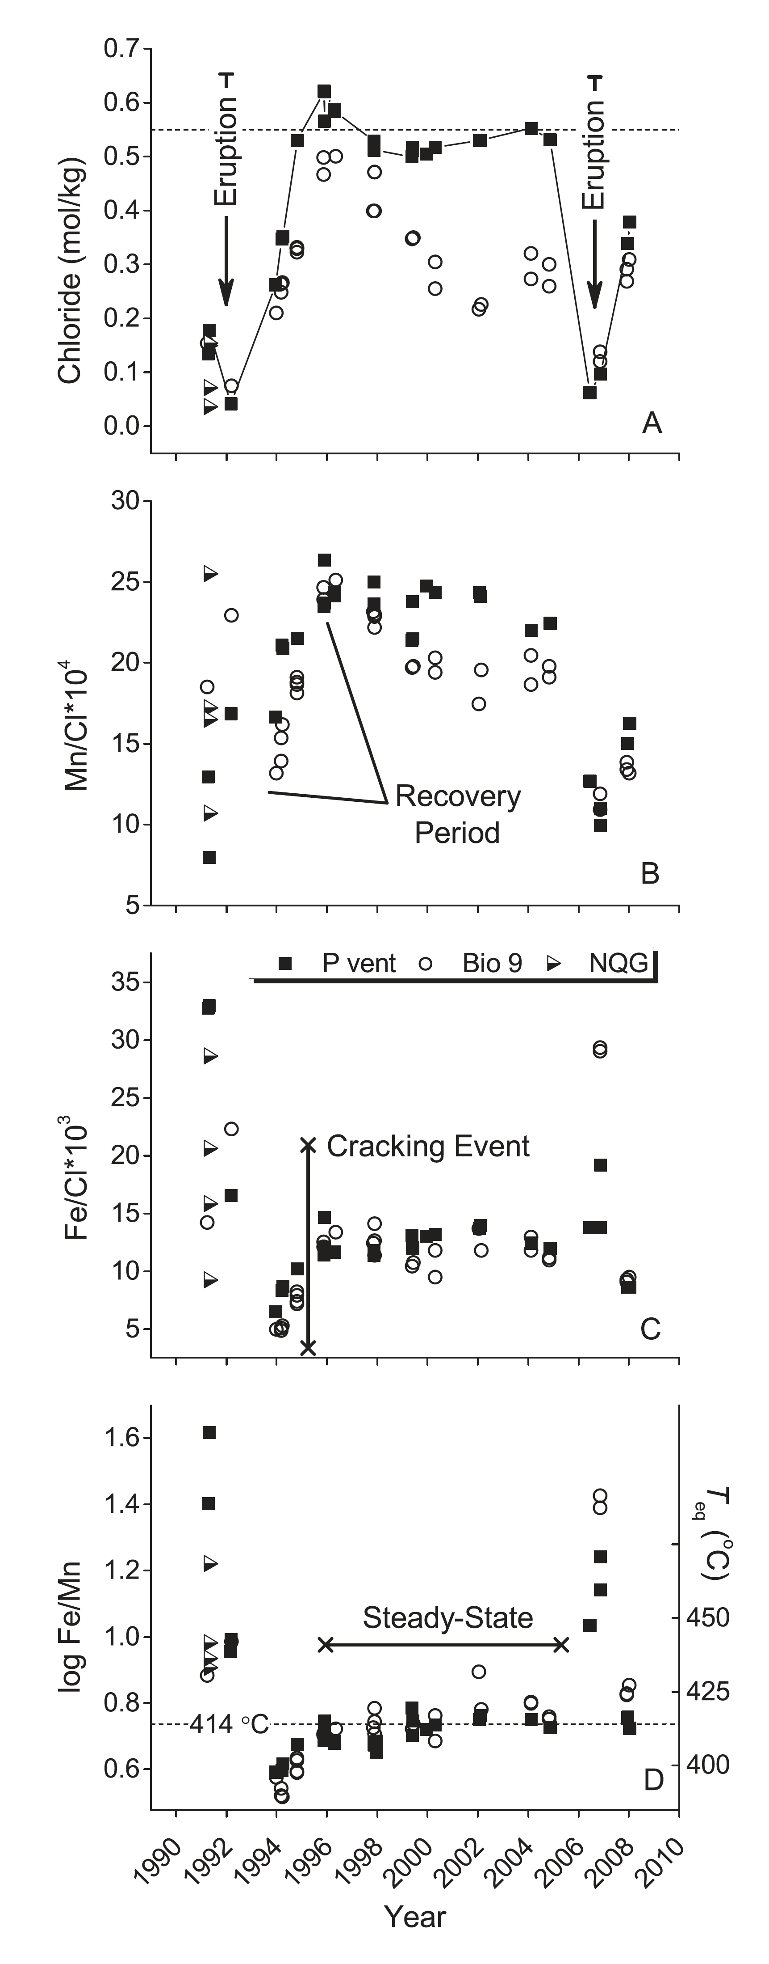
East Pacific Rise 9°N – Changes in fluid chemistry due to eruption events
Pester et al., 2013, Von Damm et al., 2005
Notes:
Figure 1. Time-series fl uid chemistry from vent structures P vent and Bio 9 (including Bio 9′) as well as N, Q, and G vents (data only available for 1991) at East Pacific Rise, 9°50′N. A: Dissolved chloride (dashed line represents seawater; solid line connects P vent data to guide eye). B: Mn/Cl ratios. C: Fe/Cl ratios. D: Fe/Mn ratios. Right axis defines temperature at time of last equilibration (Teq), calibrated
to 450 °C (Teq = 331.24 + 112.41*log [Fe/Mn]; Pester et al., 2011). Three general stages (eruption, recovery, and steady state) are indicated by fluid chemistry. After 1991–1992 eruptions, Teq was as low as ~390 °C, increasing to average steady-state value of ~414 °C (ca. 1996–2004) following seismic cracking event in 1995 (Sohn et al., 1998). Most of the eruptive-stage data do not fall within calibration
range of geothermometer. Time-series H2 and H2S, as well as raw Fe and Mn concentrations, are depicted in Figs. DR1A and DR5, respectively (see footnote 1).
The presence of microearthquakes may shed light on hydrothermal pathways by revealing zones of thermal cracking where cold sea water extracts heat from hot crustal rocks, as well as regions where magmatic and tectonic stresses create fractures that increase porosity and permeability. Here we show that hypocentres beneath a well-studied hydrothermal vent field on the East Pacific Rise cluster in a vertical pipe-like zone near a small axial discontinuity, and in a band that lies directly above the axial magma chamber. The location of the shallow pipe-like cluster relative to the distribution and temperature of hydrothermal vents along this section of the ridge suggests that hydrothermal recharge may be concentrated there as a consequence of the permeability generated by tectonic fracturing.

Slide 12
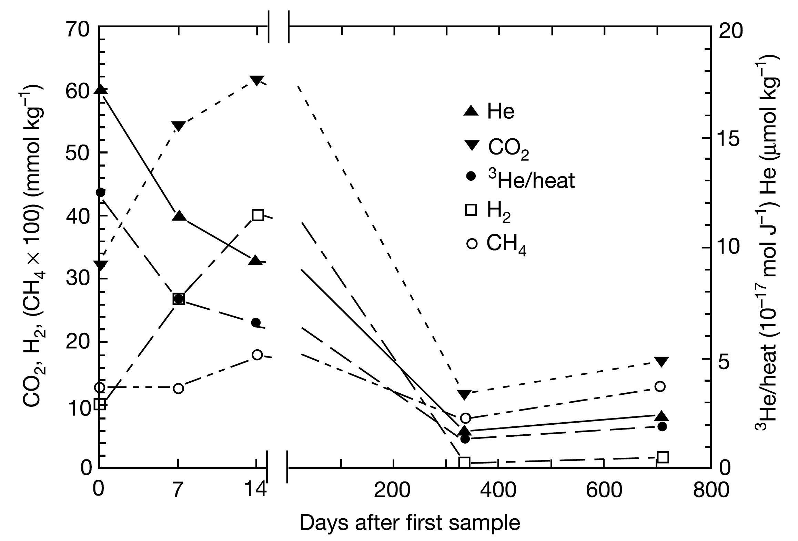
East Pacific Rise 9°N – Changes in fluid chemistry due to eruption events
Lilley et al., 2003
Notes:
At ‘A’ vent from EPR after the volcanic event in 1991, the rapidly changing volatile concentrations were associated with the emplacement of a dyke about 200m below the sea floor just two weeks before the collection of the first samples. The rapid decrease in 3He/heat ratio and corresponding increase in CO2 concentrations indicates that CO2 and He were differentially released during this magmatic event. These are the only volatile data documenting the early stages of such an event.

Slide 13
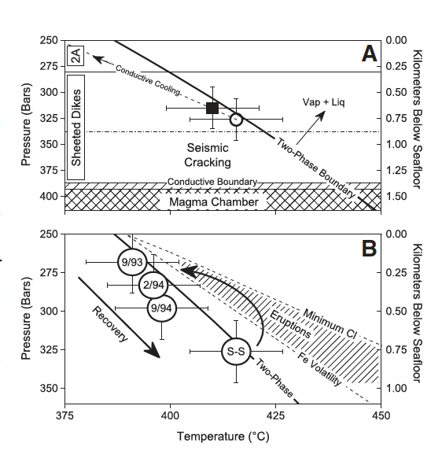
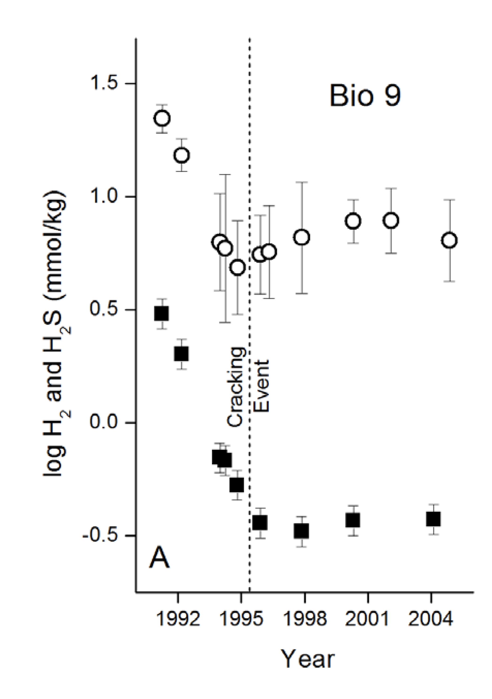
East Pacific Rise 9°N – Changes in fluid chemistry due to eruption events
Eruption Event
P vent and Bio 9 – Steady State
Pester et al., 2013
Notes:
Time-series H2 and H2S concentrations in Bio 9 vent fluid (Von Damm, 2000, 2004; Von Damm and Lilley, 2004, Table DR6). The greatest concentrations are observed during the 1991 eruption. Values subsequently decline until steady-state is achieved (see also Fig. 1).

Slide 14
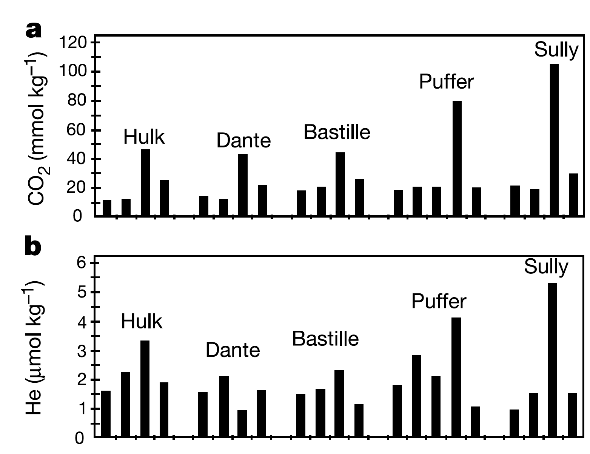
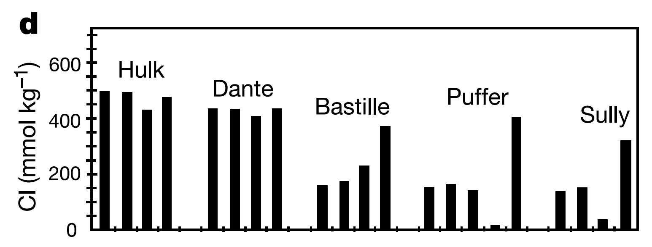
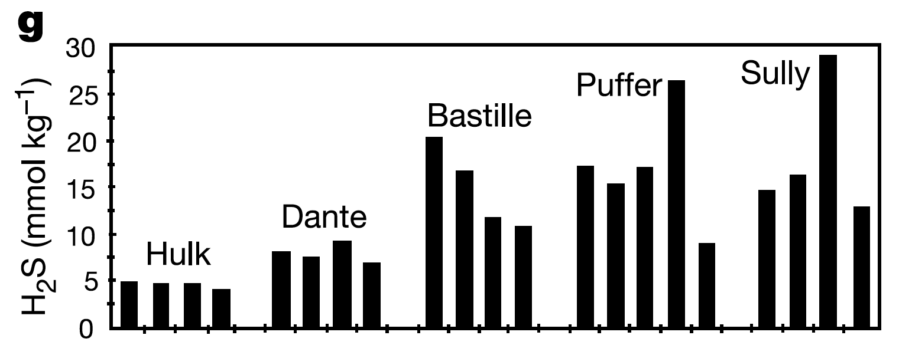

Main Endeavour Field – Changes in fluid chemistry due to eruption events
The earthquake swarm started on 8 June 1999
Lilley et al., 2003
Notes:
The earthquake swarm started on 8 June 1999. The 1999 fluid samples were collected in September with DSV Alvin using gas-tight titanium samplers.

Slide 15
Sampling objectives for defining baseline chemistry from the Endeavour hydrothermal field:
Consistently measure major, trace, and gas chemistry of vent fluids before and after an eruption.
  Collectively, these dissolved components can be used to decipher changes in pressure and temperature of the subseafloor reaction zone during magmatic activity.
  Redox sensitive metals and gases can be used to infer subseafloor reactions, such as either anhydrite-magnetite-pyrite or pyrite-pyrrhotite-magnetite equilibria.

