Slide 1
Two decades of second-by-second State of the Ocean monitoring with VENUS
Richard Dewey, Former ONC Associate Director, Science
Because we can [continuous power and (nearly) unlimited bandwidth]….
Configure instruments to sample continuously, saving all data at sufficient rates to support the broadest range of science investigation.
Initial awakening that ocean conditions are constantly changing.
As seconds turned into minutes, hours, days, months, and years, there were systematic/dynamic (interesting) variations across a wide range of temporal scales.
From our core (permanent) instrument platforms, ONC created “State of the Ocean” data products for quick assessment.

Slide 2
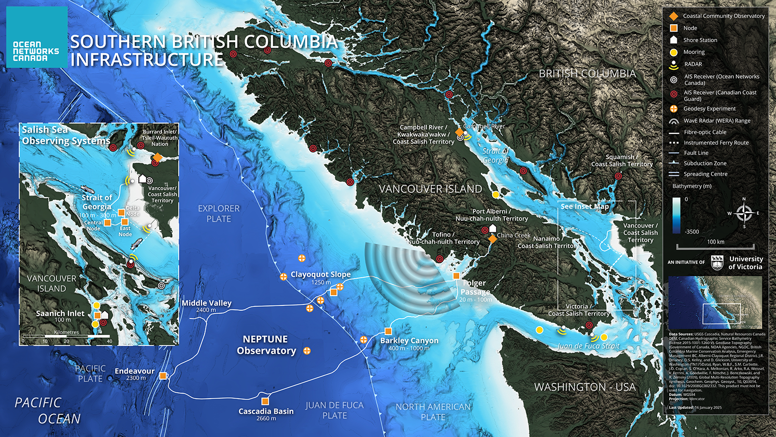

Slide 3
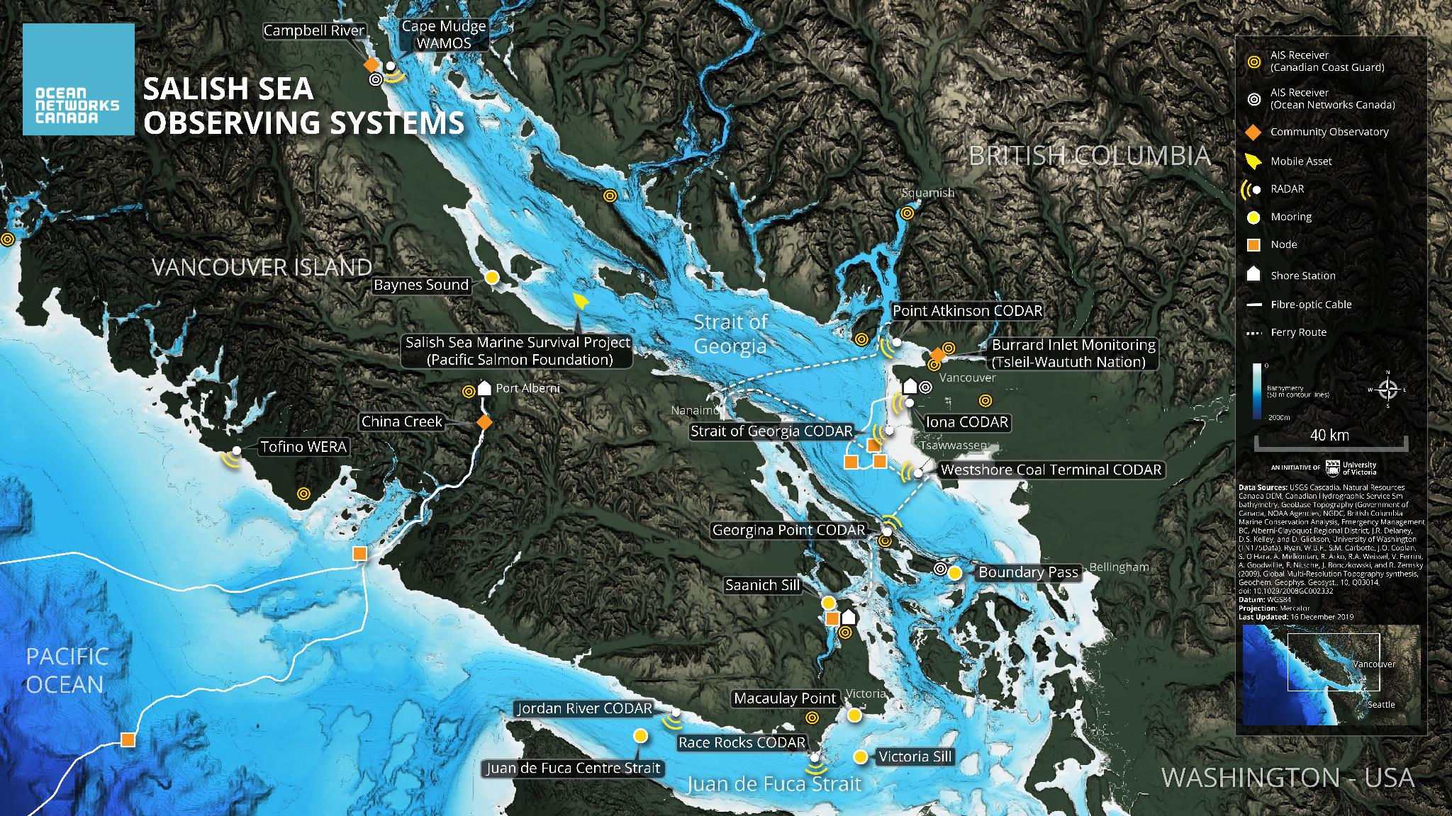

Slide 4
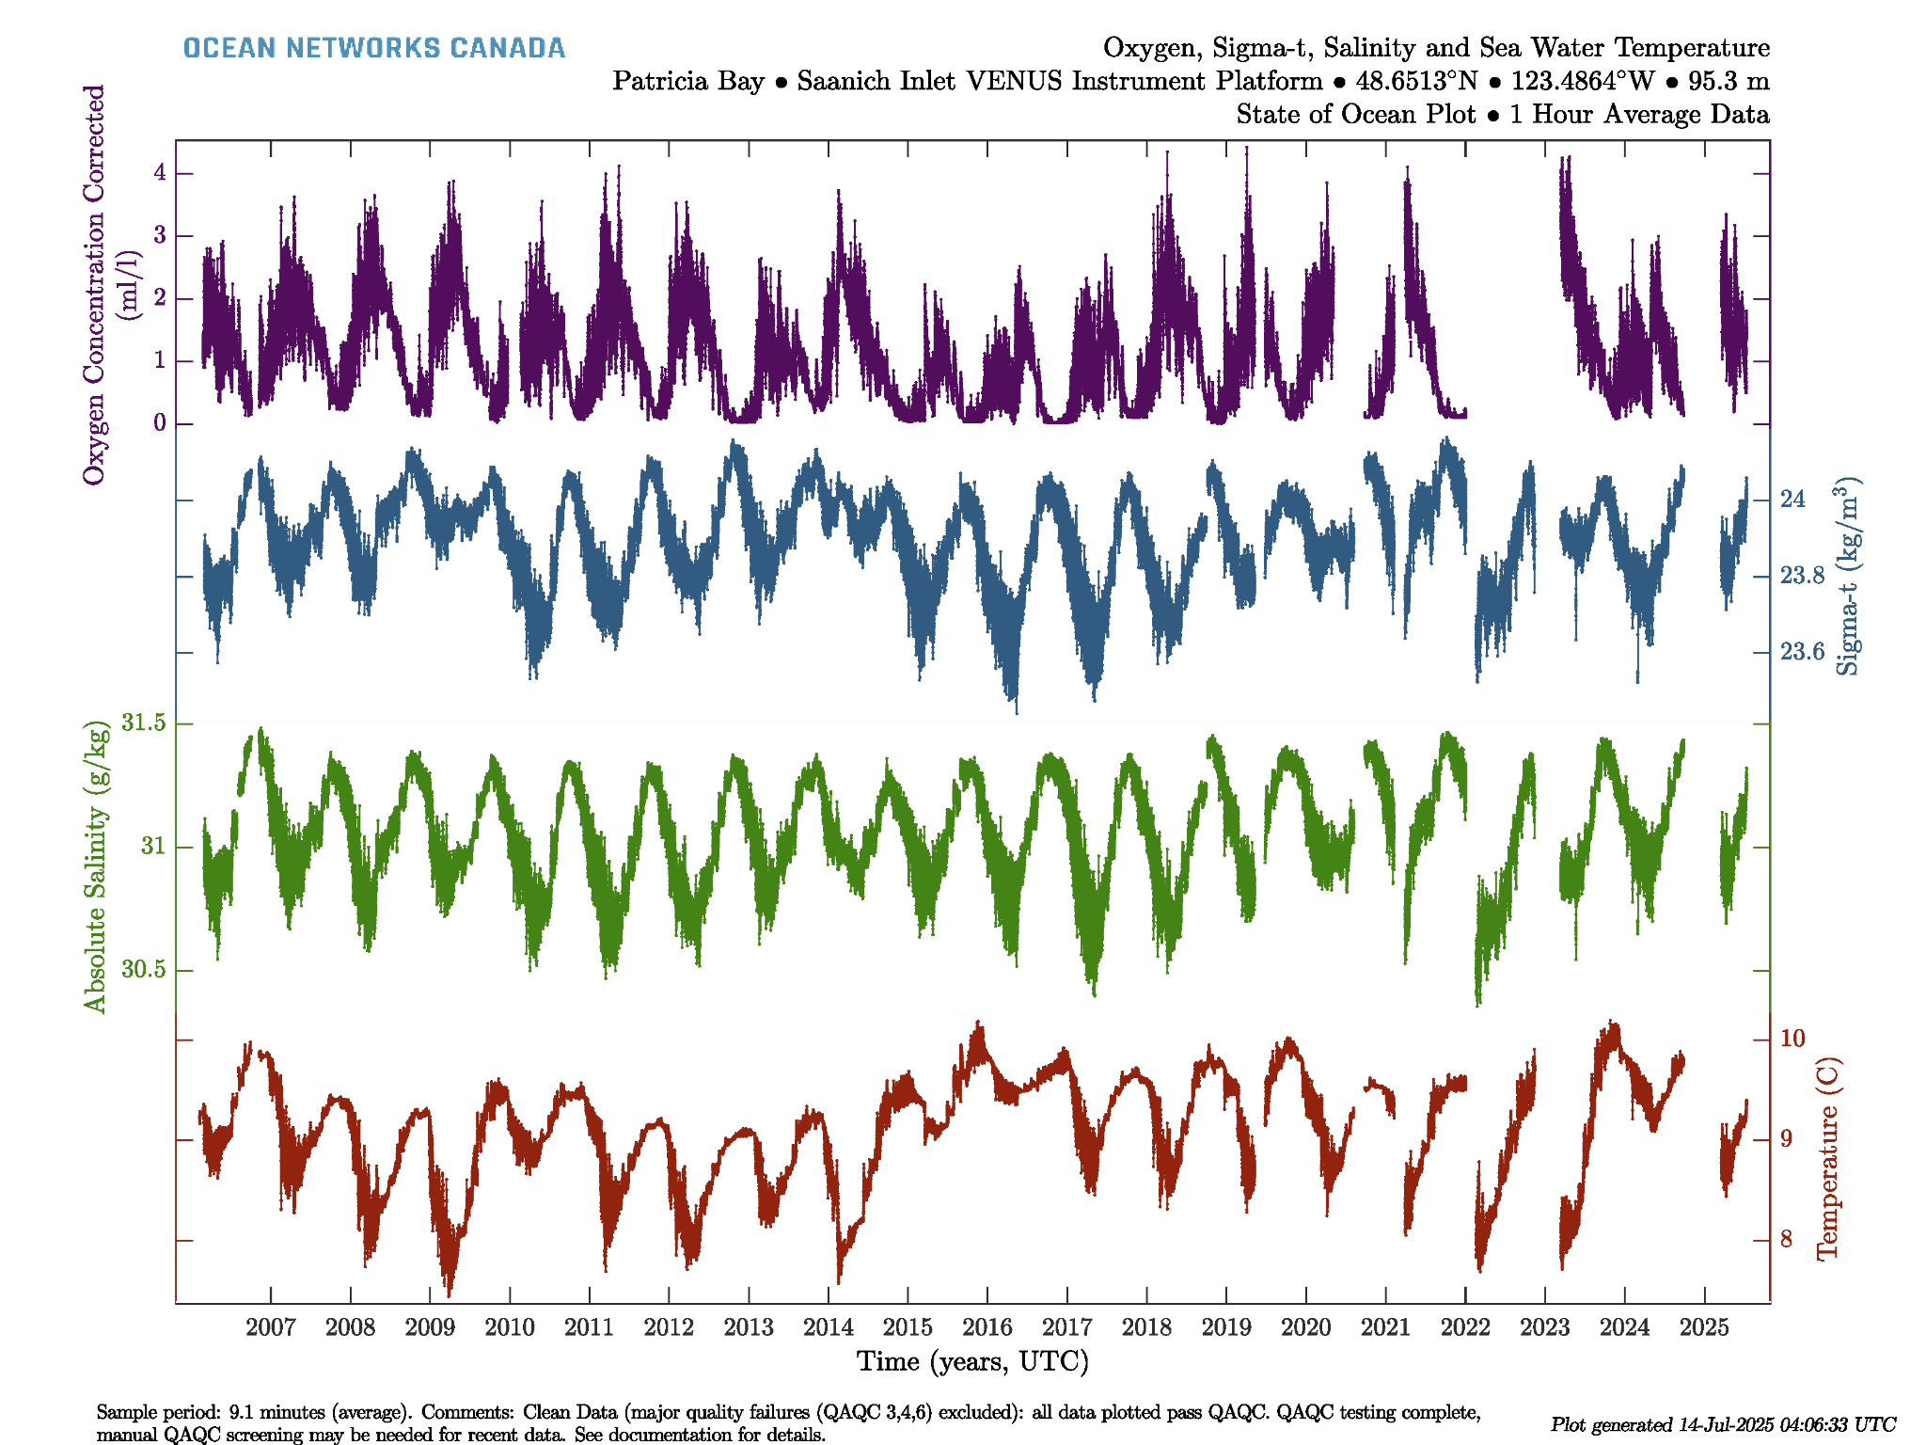
Saanich Inlet
VENUS Instrument Platform (VIP) CTD & Oxygen
At 100m depth
From February 2006 - July 2025 (19 full annual cycles)
Dominant signals are tidal (daily and fortnightly), seasonal, including summer/winter - warming/cooling, tidally modulated deep water renewal events, and major regional events (El Nino, La Nina, and “the Blob”)

Slide 5
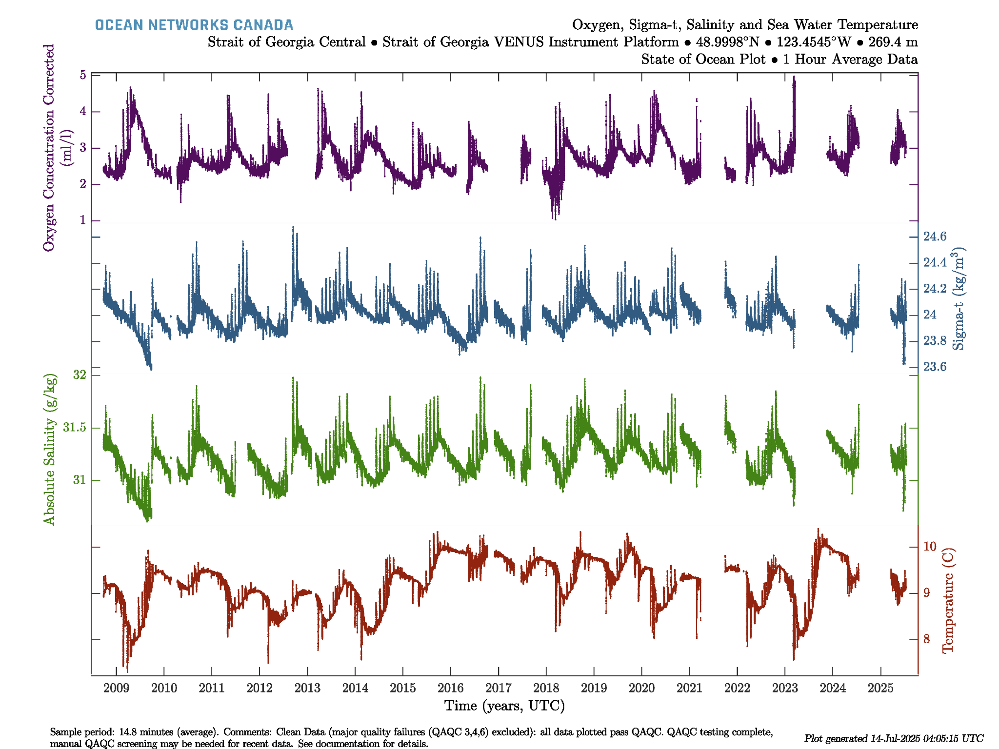
Strait of Georgia
VENUS Instrument Platform (VIP) CTD & Oxygen
At 300m depth
From Sept 2008 - July 2025 (16 annual cycles)

Slide 6
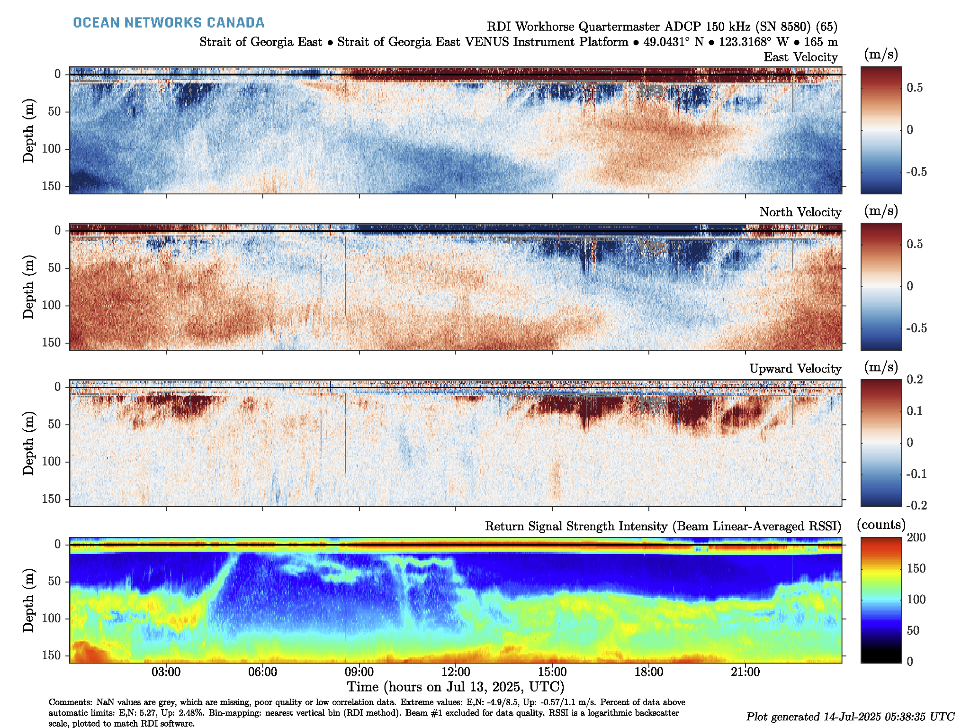
Strait of Georgia East
Acoustic Doppler Current Profiler (150kHz)
Depth: 165m)
Tides, internal waves, intrusions, and diel zooplankton migration

Slide 7
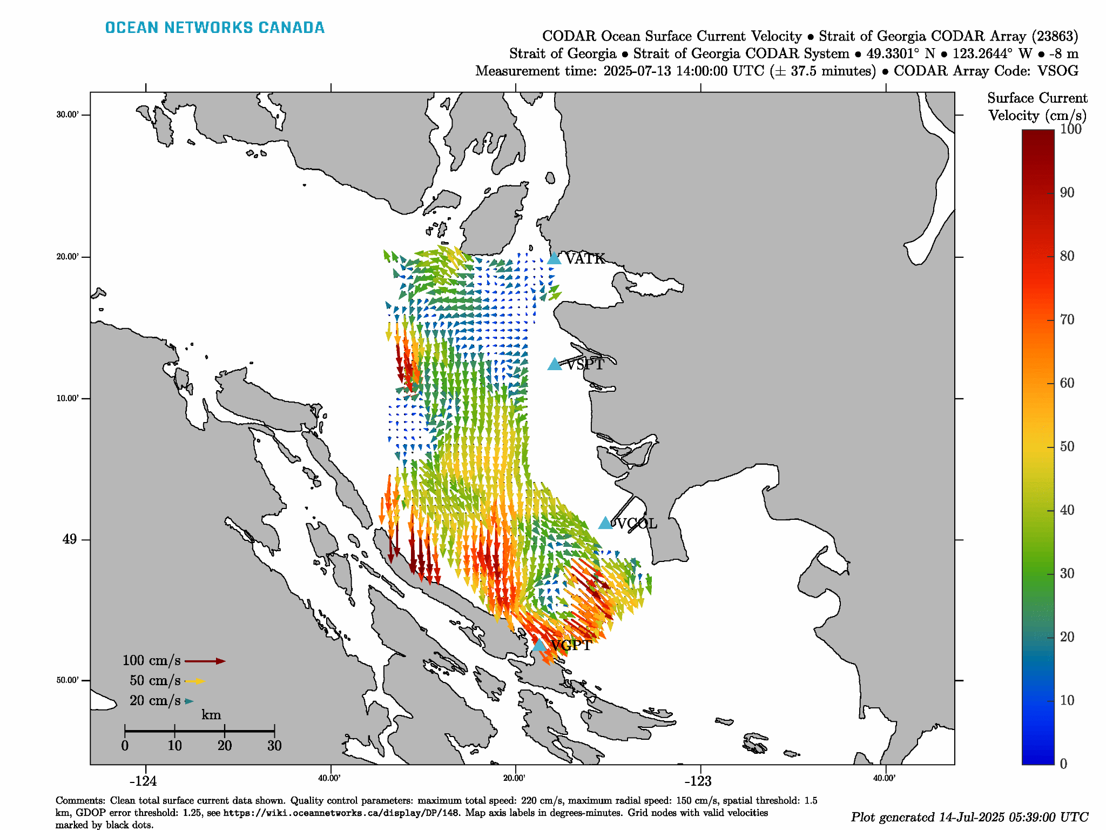
Strait of Georgia
CODAR
Surface Currents (hourly)

Slide 8
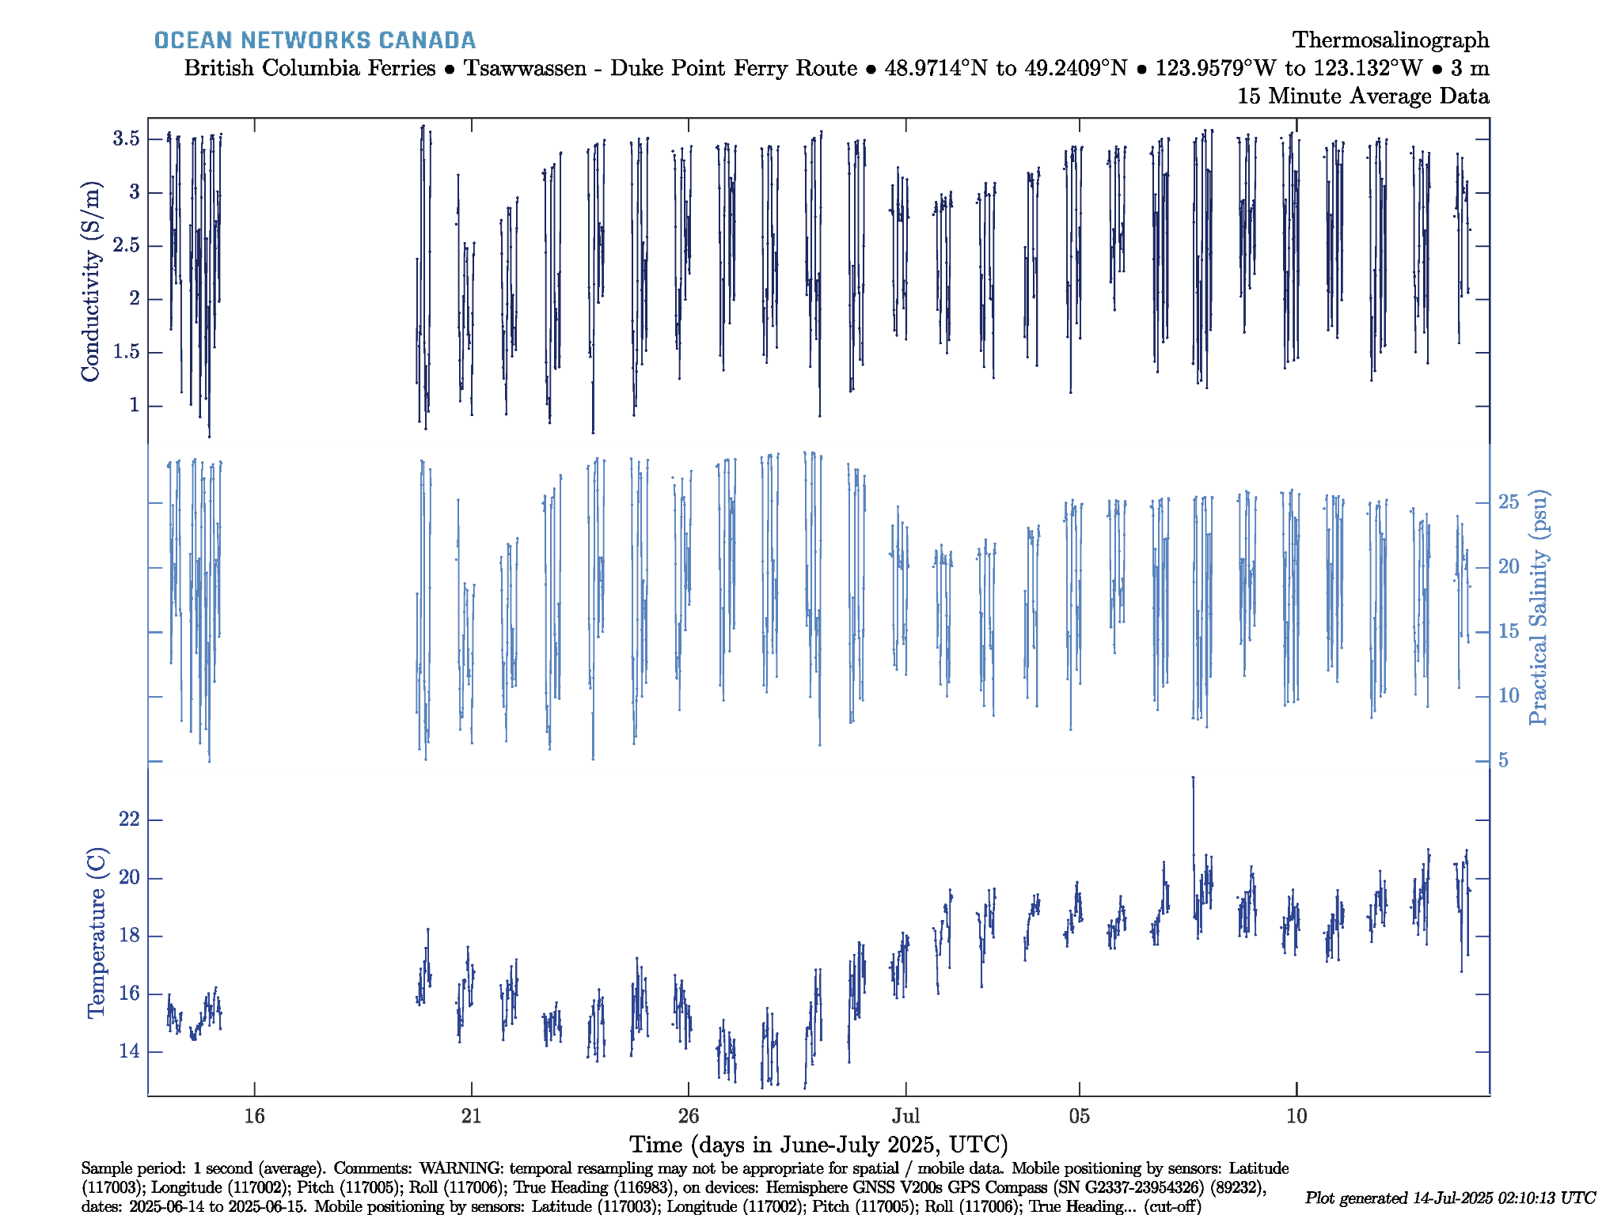
Strait of Georgia
BC Ferries Thermosalinograph
Duke Point to Tsawwassen
Crossing the Fraser River Plume several times per day.

Slide 9
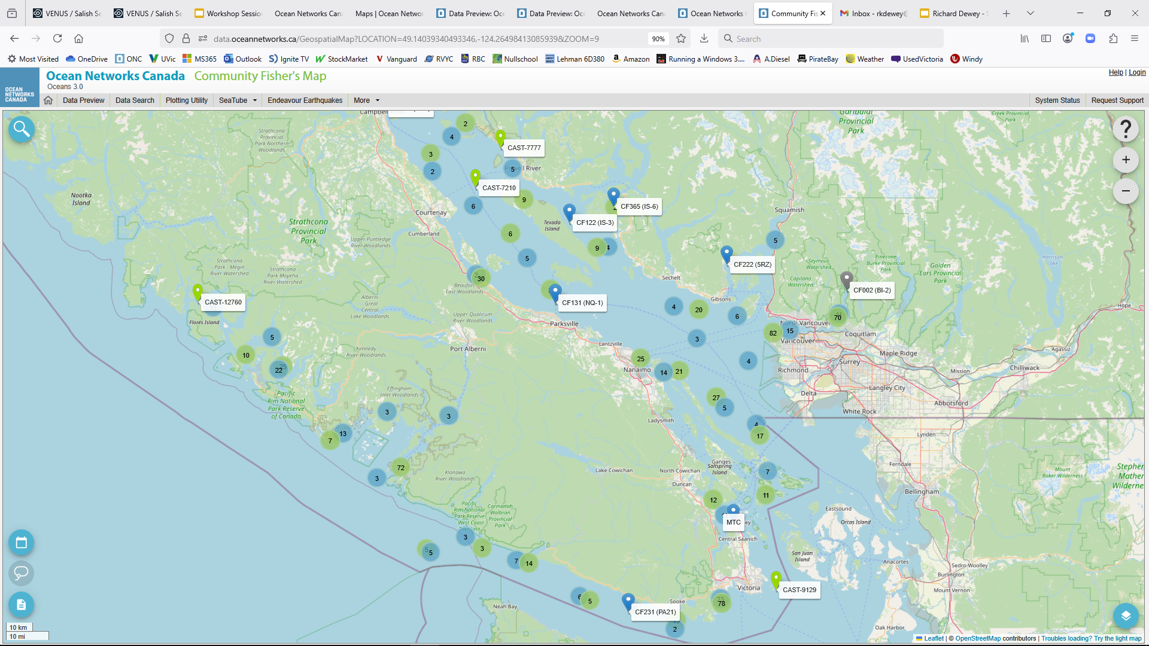

Slide 10
ONC State of the Ocean - Salish Sea
Cabled systems continue to provide real time, high-resolution, long-term time series, capturing essential oceanographic events
Surface ocean systems (CODAR and BC Ferries) provide regional patterns
Limited duration “experiments” include the Delta Dynamics Laboratory and Forensic Studies
Community programs helping fill in water column data

