Slide 1


Circulation Processes in the Salish Sea
Rich Pawlowicz
University of British Columbia

Slide 2
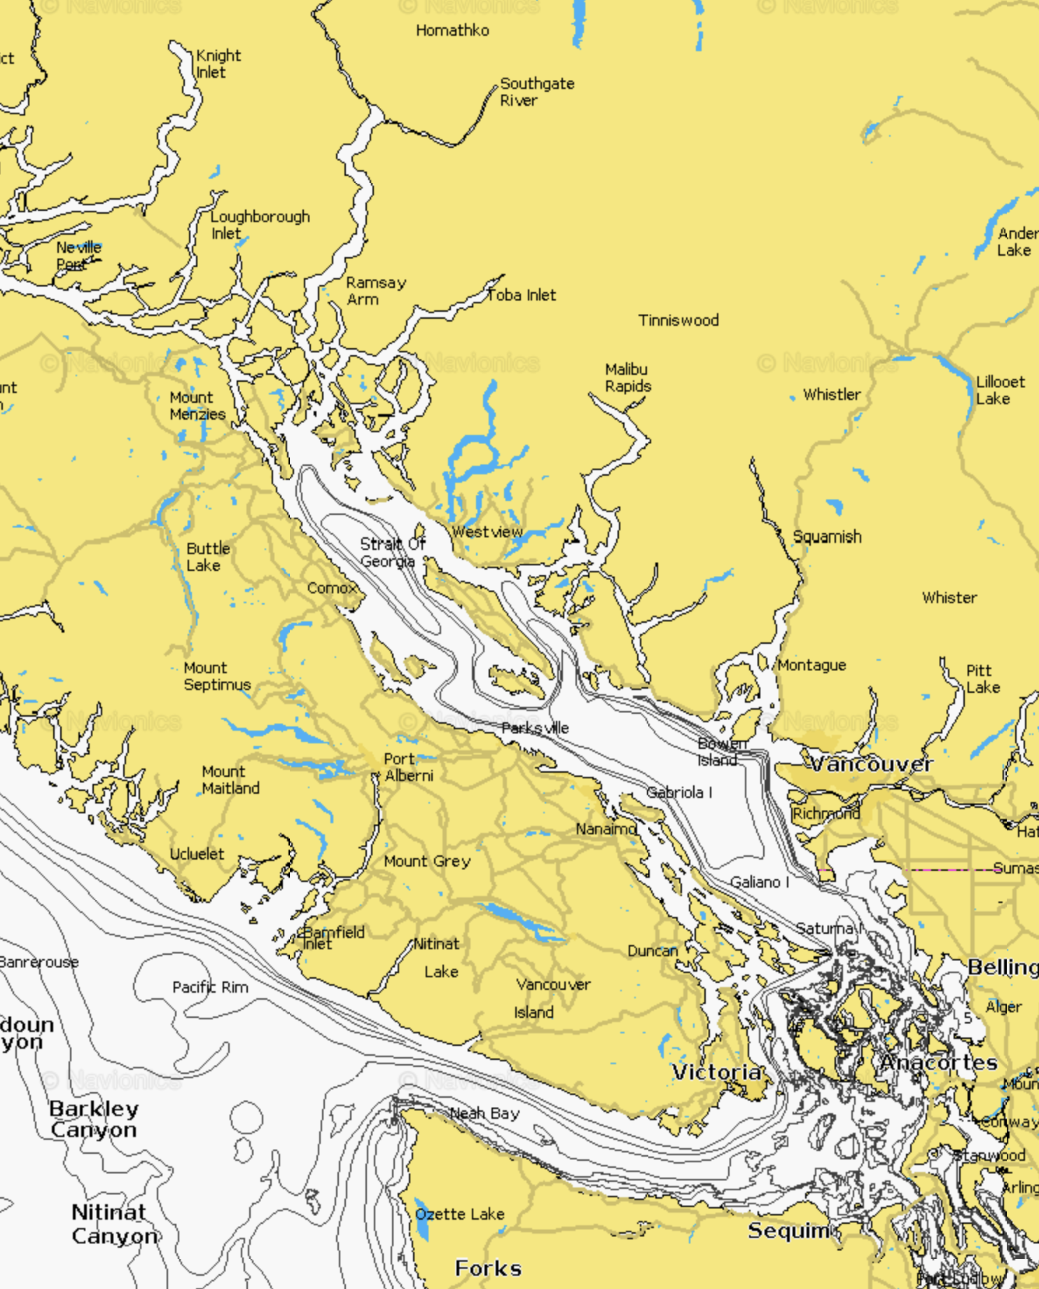
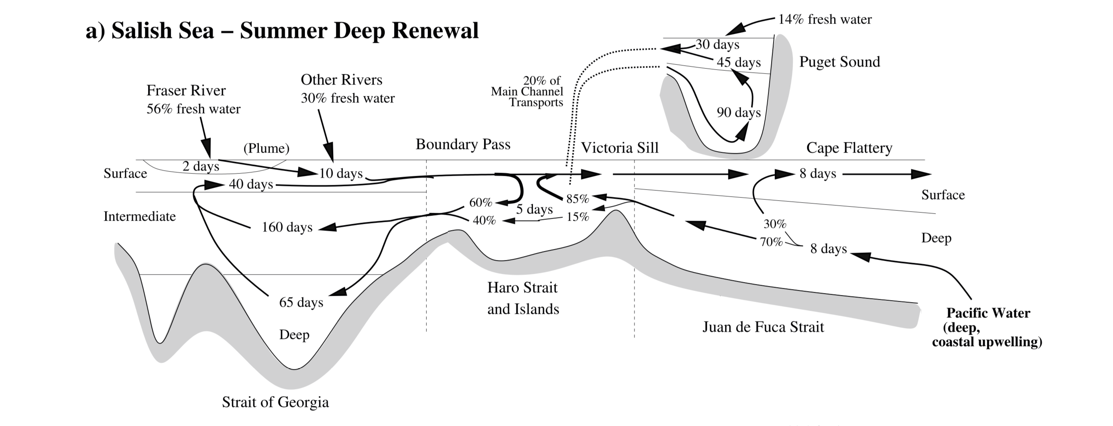
What we know
Pawlowicz, Hannah and Rosenberger, Lagrangian observations of estuarine residence times, dispersion, and trapping in the Salish Sea, Estuarine Coastal and Shelf Sciences, 2019

Slide 3
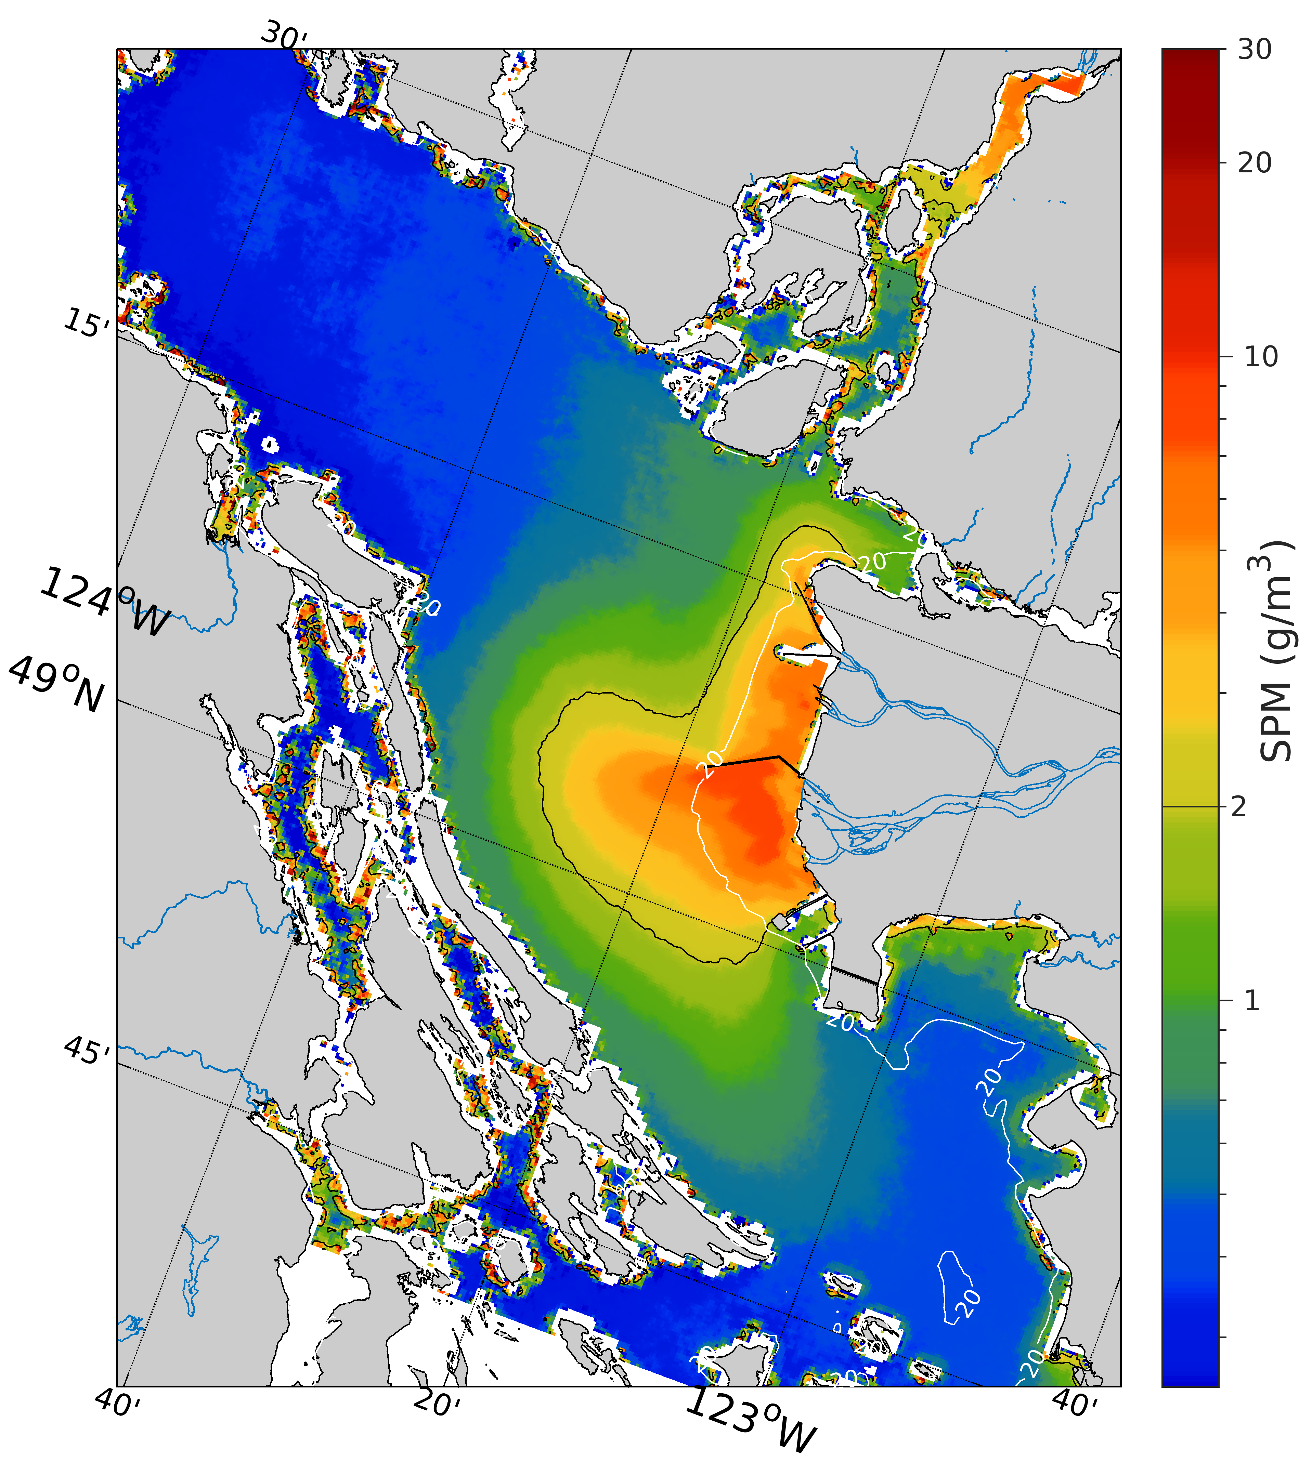
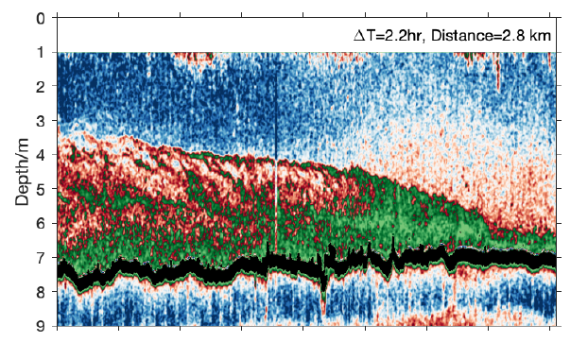
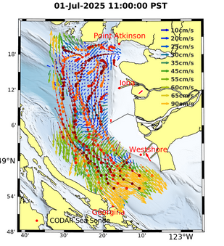
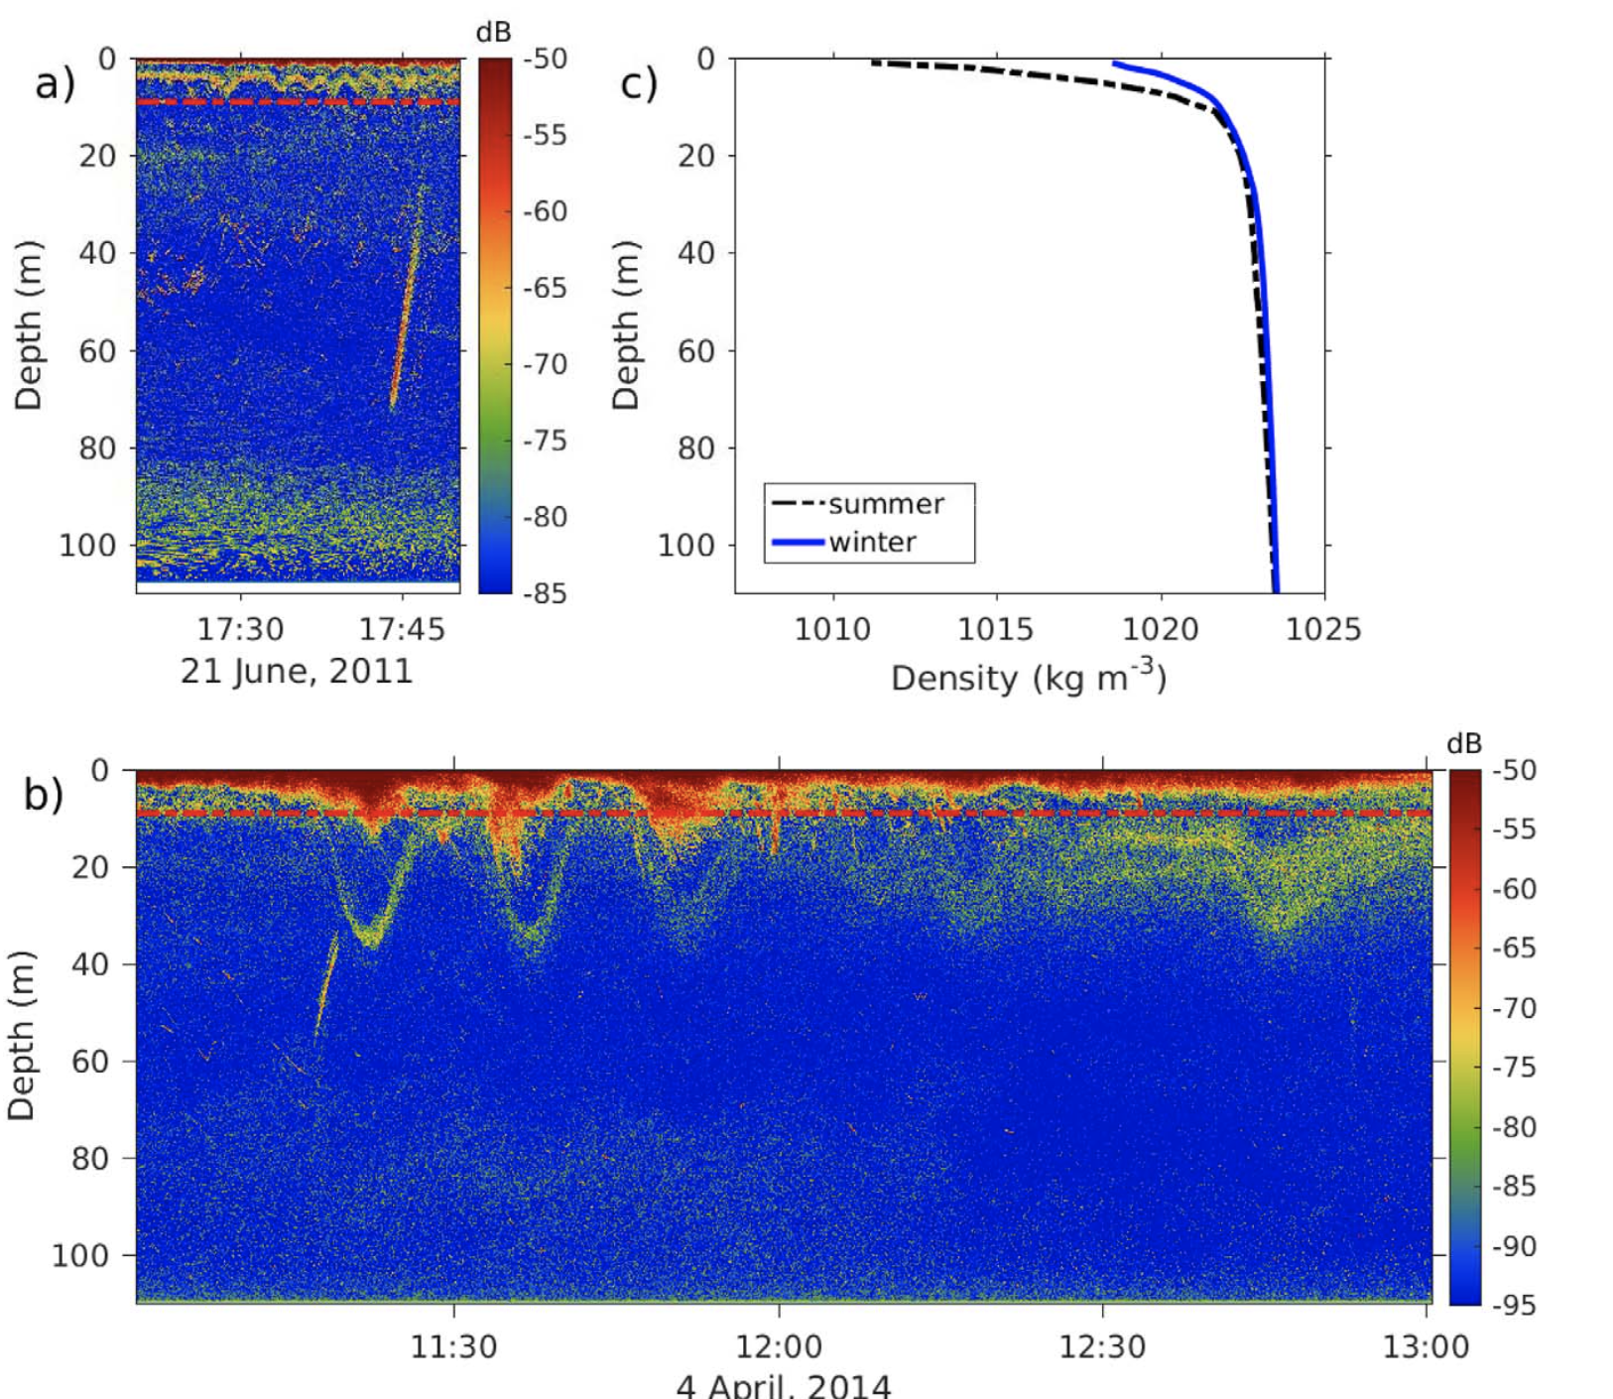
Surface Processes (SoG)
0-50m depth
Fraser River Plume Dynamics
Salt wedge Dynamics in Fraser River
Sediment Transport (Fraser River to SoG)
Effects of outflow winds (Howe Sound)
Sea Breeze/Land Breeze effects
Non-linear Internal Wave generation/propagation
Discovery Passage outflow (ECVI current)
Wind-driven Upwelling
Nutrient entrainment to surface (estuarine upwelling), also Alkalinity Enhancement
Diel Cycling of O₂
HF radar (expansion?)
Ferry systems (N-SoG?)
Node ADCP/echo sounder
CitSci/CF CTD
Aerial Drone surveys?
River moorings?
Additional weather stations?
Profiling moorings?
Operational Now-cast model?

Slide 4
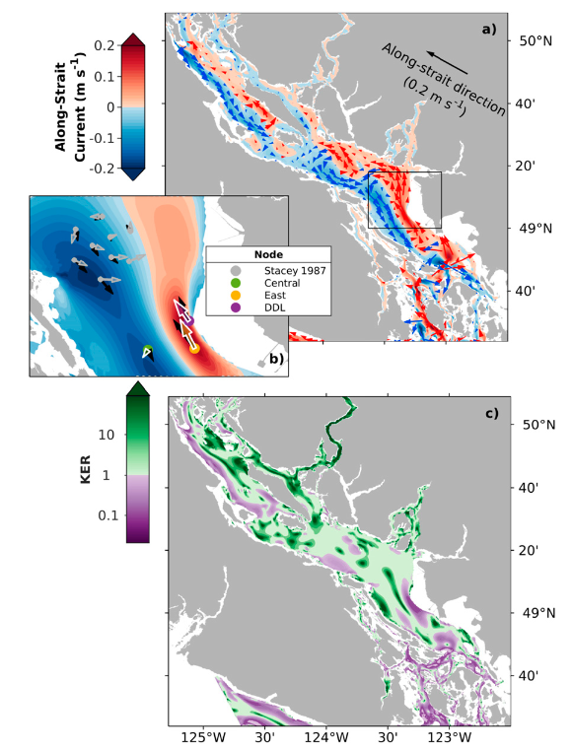
Intermediate Processes (SoG)
50-200m
Sediment resuspension
Eddies and dispersion
Inlet inflows/outflows (including Van Harbour)
Fraser Ridge overflows
Fraser Boundary current
ECVI coastal current
Acoustic tracking of floats
Acoustic Tomography?
BBL node deployments
ADCP moorings (Central/East node), elsewhere?
CitSci/CF CTD
Iona node?
Operational Now-cast model?

Slide 5
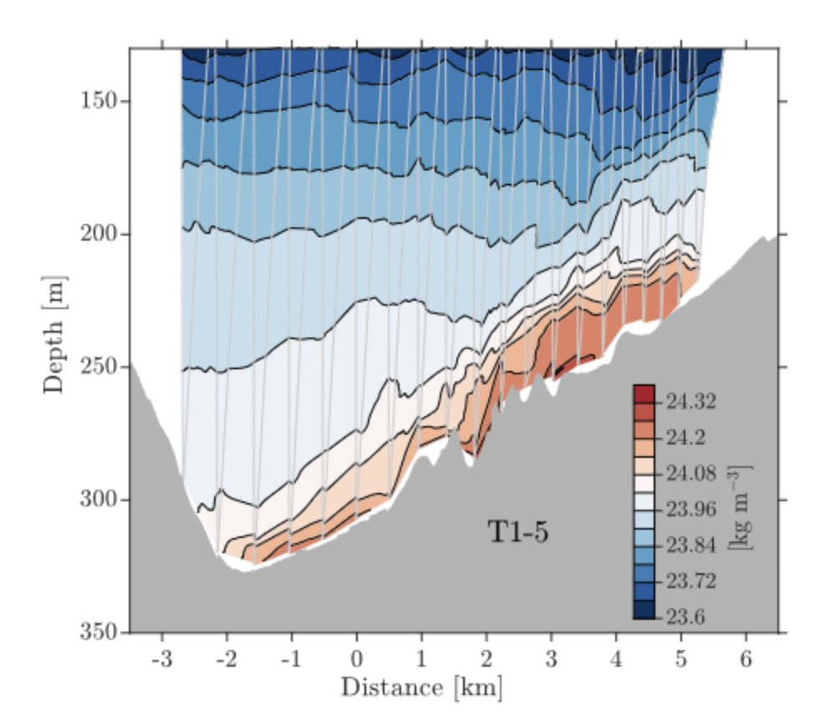
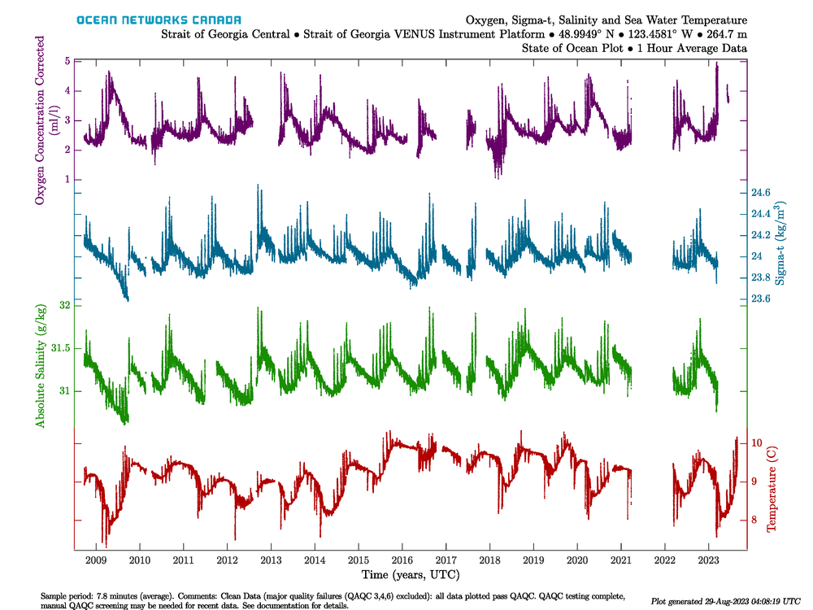
Deep Processes (SoG)
200-430m
Rotating Gravity Current (southern SoG)
Northern SoG renewal
Long-term monitoring of water properties (climate studies)
Sediment resuspension and burial
Central node
BBL node deployments?
Northern SoG node?
BBL node?
DTS cabling?
Short vertical density moorings?
Operational Now-cast model?

Slide 6
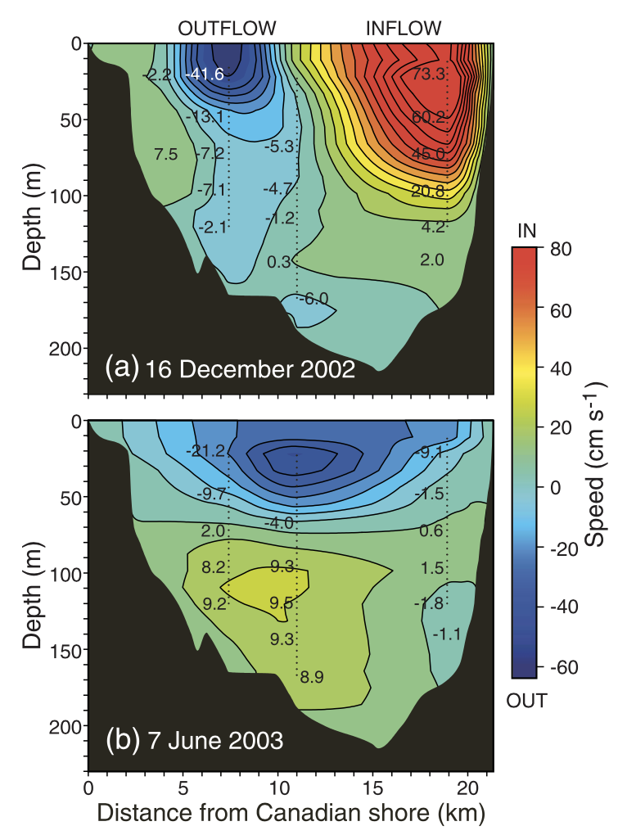
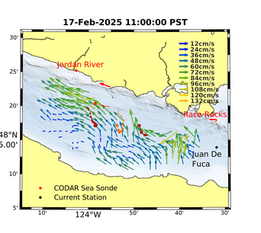
Juan de Fuca Strait
0-250m
HF radar
Bottom node?
Bottom pressure array?
Flow-thru system at Race Rocks?
Operational Now-cast model?
Rotating 2-layer exchange:
  Cross-channel flows
  Spring reversals (larval transport)
  Seasonal variability
  Internal tides
  Pacific inflow monitoring (incl. BGC parameters)
  BCG parameter export to shelf (nutrients, methane)
Surface wave dynamics

Slide 7
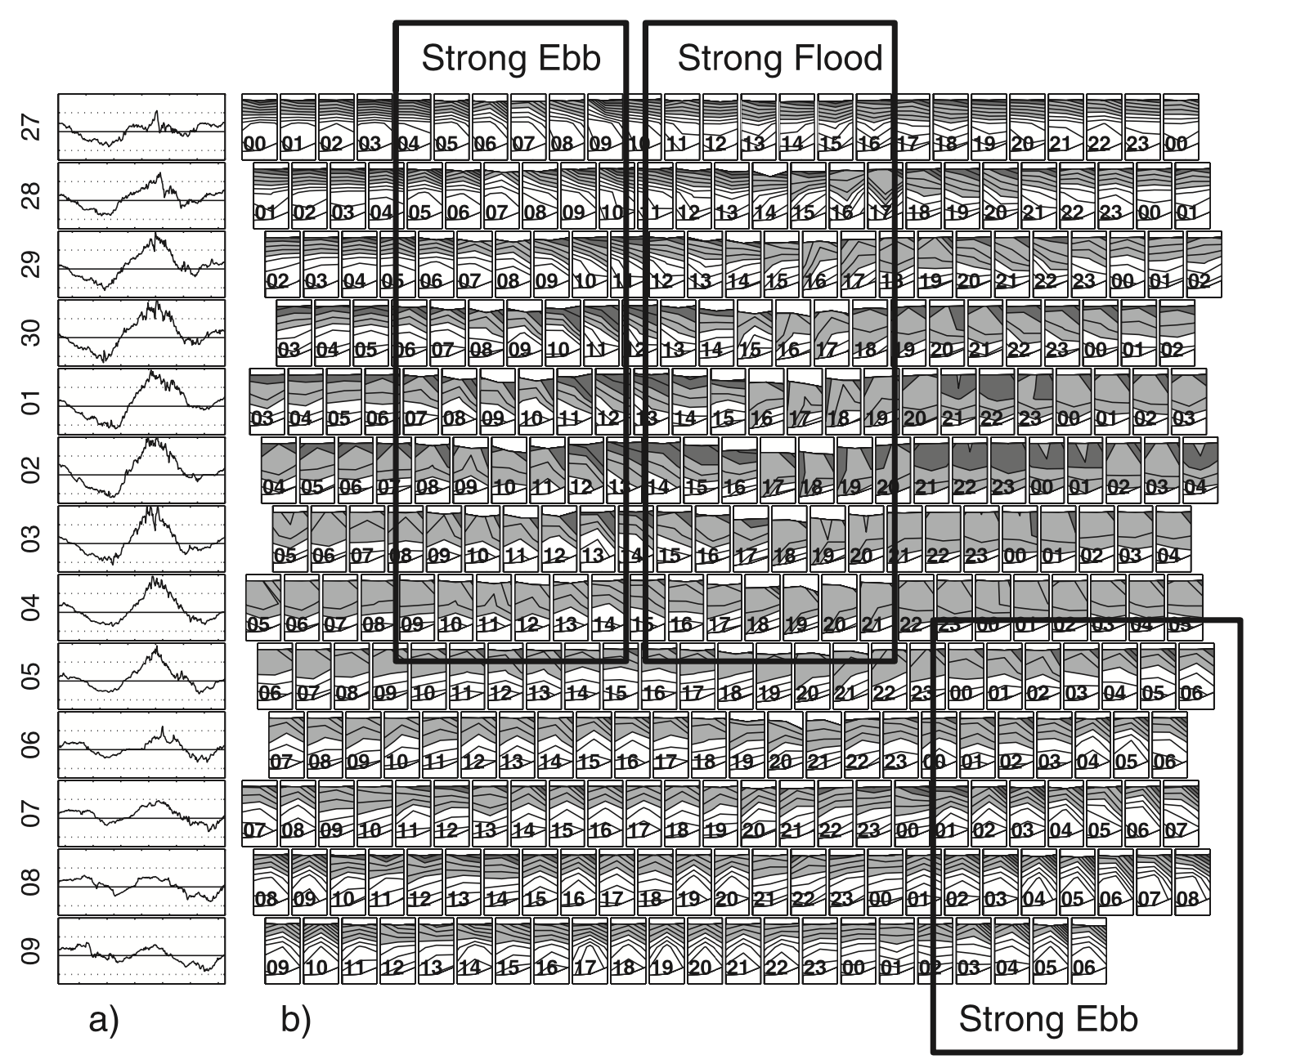
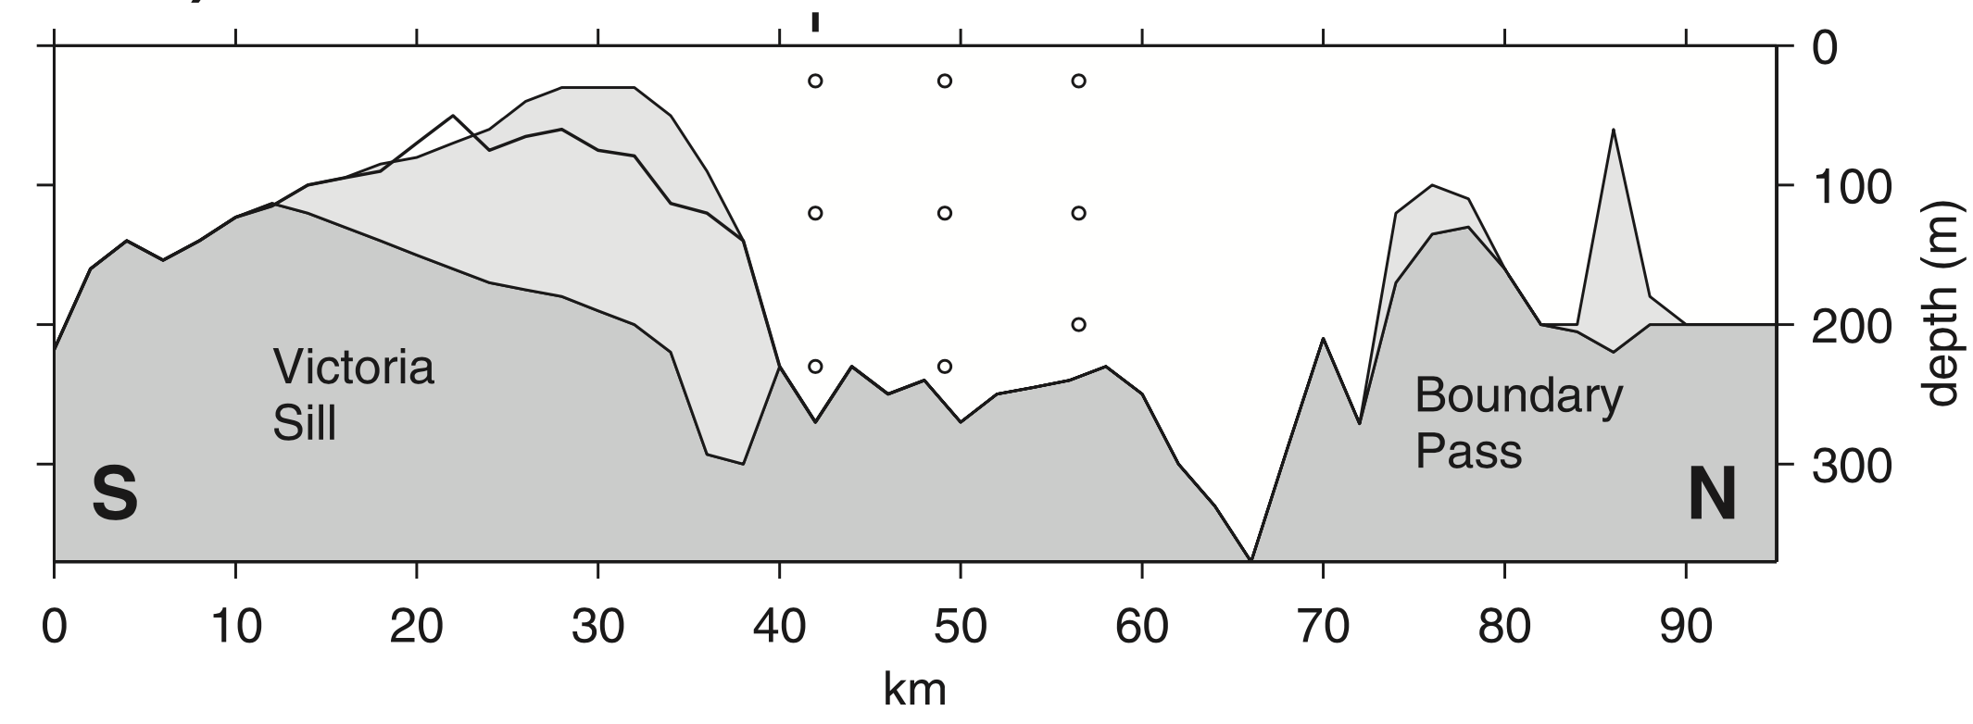
Haro/Rosario Straits
0-200m
Circulation (Rosario vs Haro sides)
Shear instabilities and turbulence case studies
Large-amplitude internal tides (Haro Strait)
Mooring arrays?
Drifter program?
Operational Now-cast model?

Slide 8
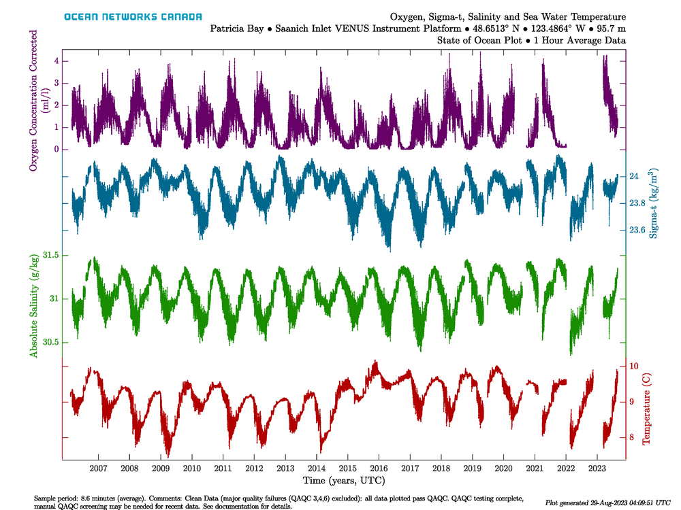
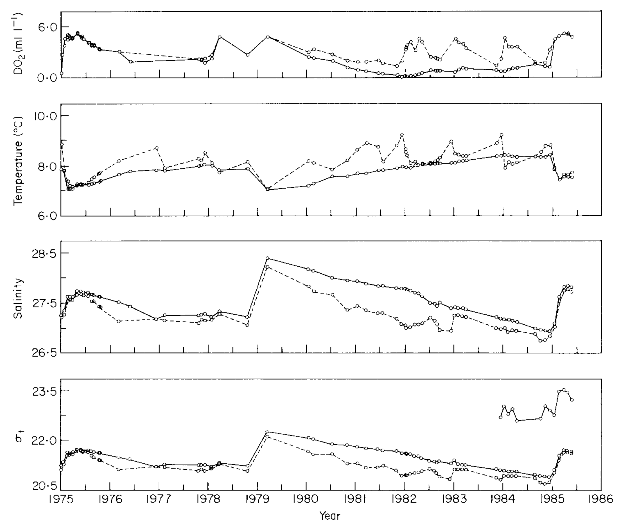
Salish Sea Inlets
0-10m, 10-670m
Annual Renewal?
Anoxia (Saanich, Indian Arm)
Howe Sound/Sechelt/Jervis/Toba/Bute?
Wind-driven surface circulation?
Stratified flow-over-a-sill? (Knight)
Puget Sound linkages?
Vancouver Harbour/Indian Arm exchange?
Saanich node
Monitoring of deep water?
CF CTD programs?
Operational Now-cast model?

