Slide 1
Monitoring plankton productivity and diversity in the Salish Sea
Akash Sastri^{1,2} and, Kelly Young¹
¹Institute of Ocean Sciences, Sidney, BC, Canada. E-mail: Akash.Sastri@dfo-mpo.gc.ca
²Department of Biology, University of Victoria, Victoria, BC, Canada.
VENUS Salish Sea Workshop
July 15-17, 2025
Victoria, BC

Slide 2
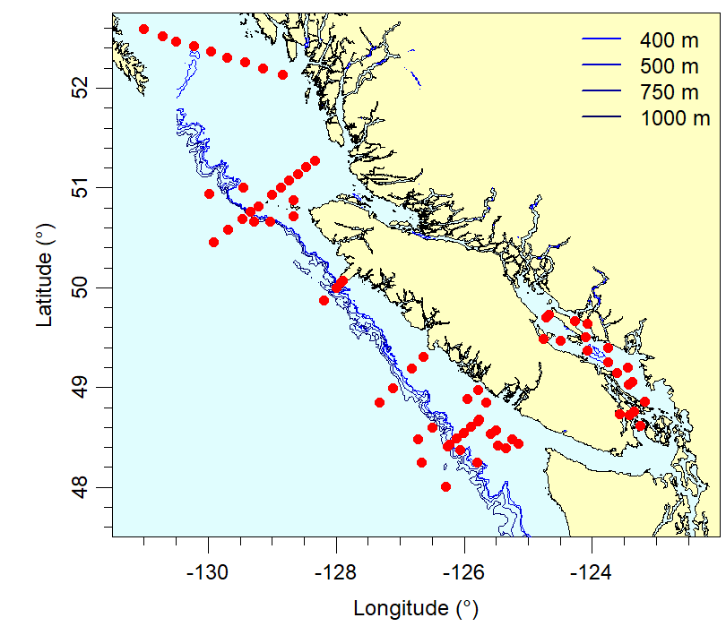
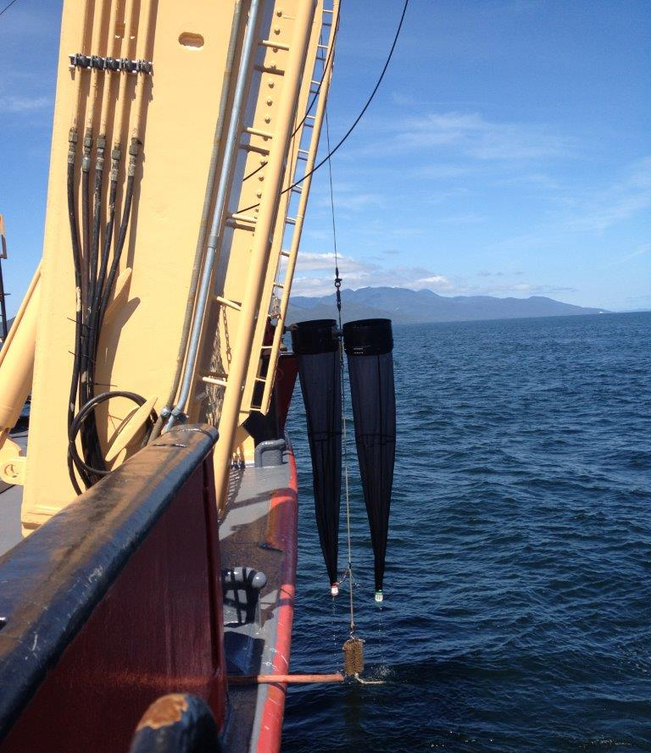
DFO Pacific Plankton Time Series
Time series duration:
Southern Vancouver Island > 40 years
Inner Line P ,Northern Vancouver Island. Strait of Georgia ~30 years
Hecate ~20 years
Sampling Frequency:
Seasonal (2-4 annual surveys), WCVI
Feb., May, and Aug., Line P
Biweekly-monthly, Strait of Georgia (since 2015)
Sampling & Enumeration:
Vertical plankton hauls, 250 m (or bottom) to surface; 236 μm mesh
Detailed taxonomic resolution (species, developmental stage)
Phytoplankton taxonomy: microscopy and HPLC
Hecate
NVI
SofG
SVI

Slide 3
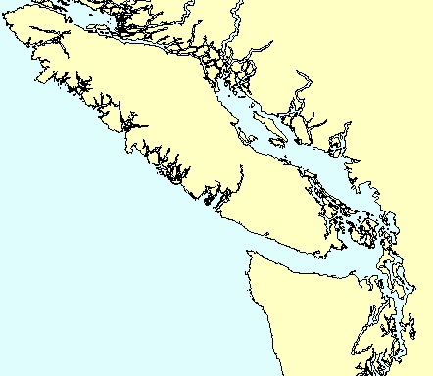
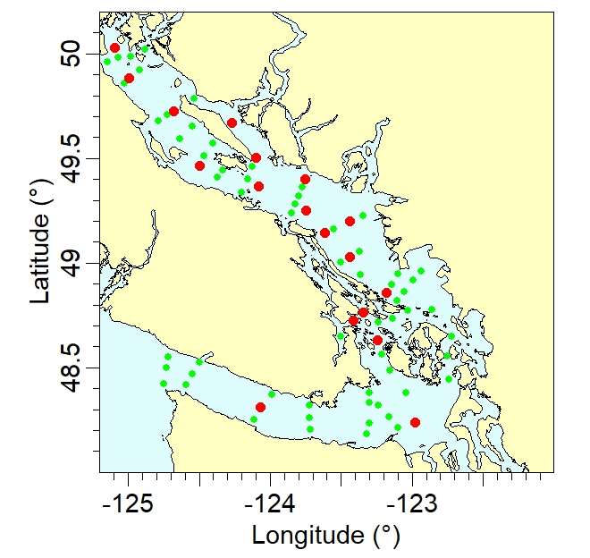
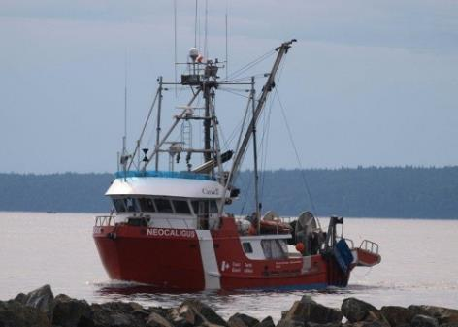
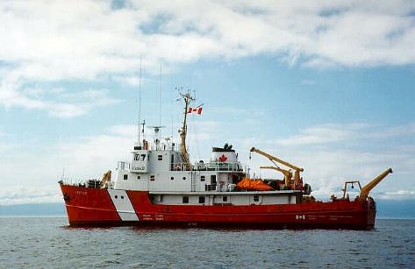
Salish Sea Monitoring Programs
Multiple programs:
a) quarterly biophysical (1996-)
b) biannual La Perouse (1995-)
b) biweekly-monthly, Neocaligus (2015-)
Core measurements:
CTD/Rosette
Phytoplankton pigments [HPLC]
Nutrients, Salinity, Dissolved oxygen
Phytoplankton and zooplankton taxonomy (red symbols)
CCGS Neocaligus
CCGS Vector
Notes:
20 zooplankton stations spread through the Strait (Yellow), additional CTD and water collections along the deep (Pink), based on Salish Sea Biophysical sampling grid.
Sampling on the Neocaligus and also on Vector, La Perouse/Line P May and Sept cruises.
Deep central and northern regions.

Slide 4
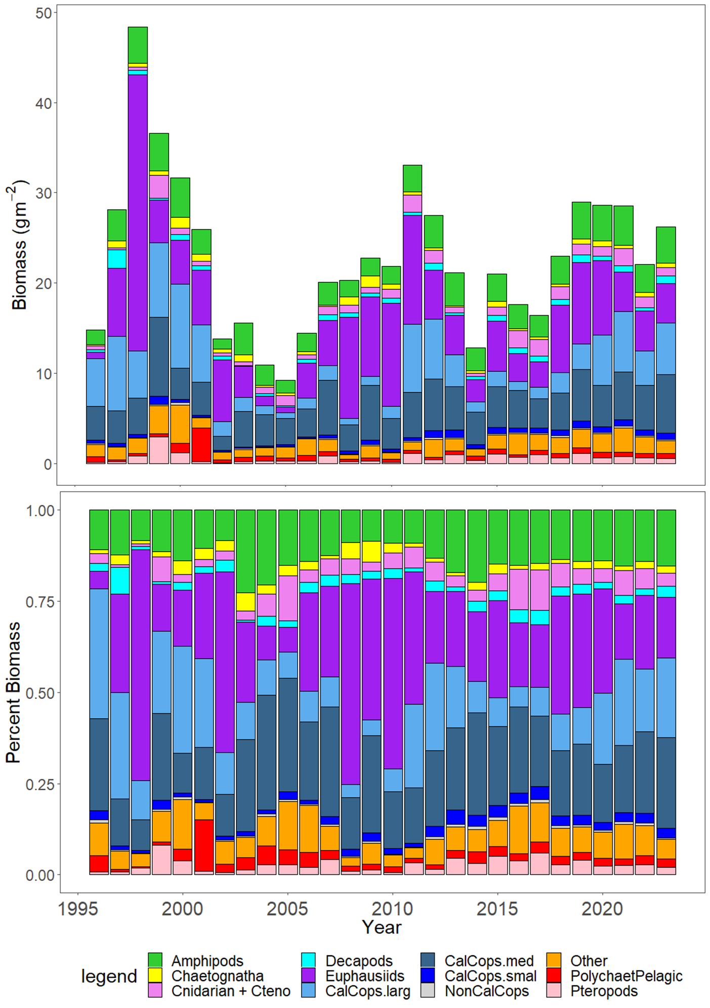
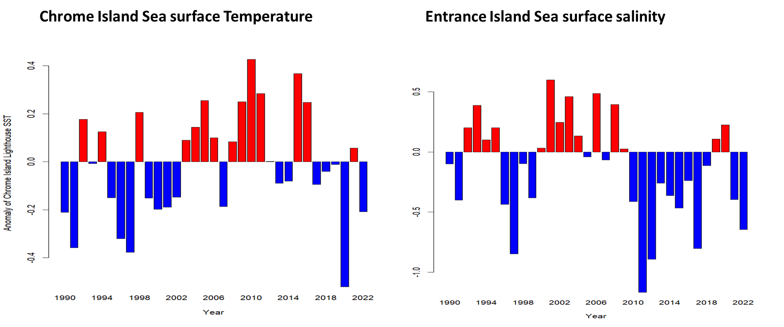
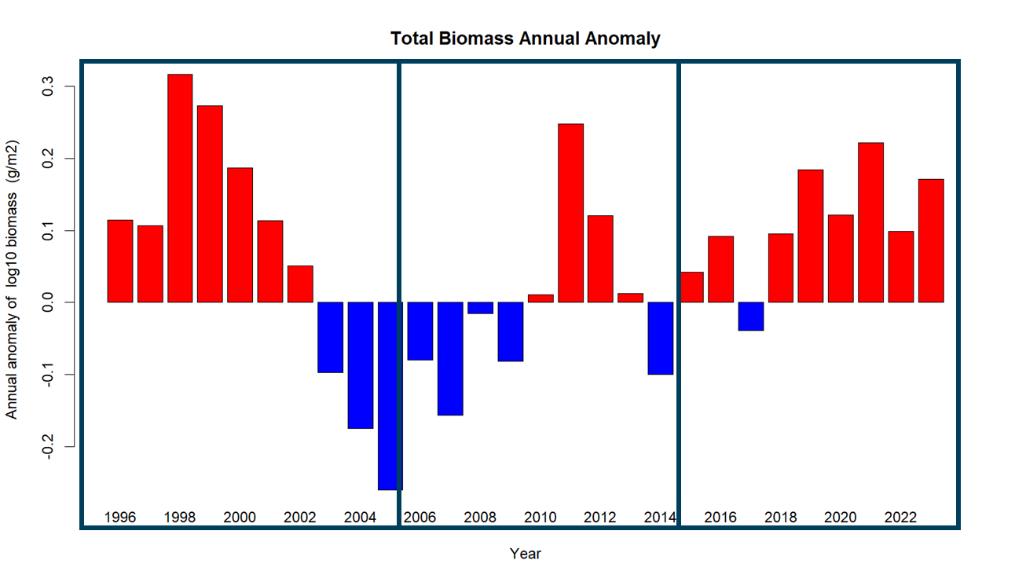
Strait of Georgia Zooplankton Time Series (1996- )
Abundance
Biomass

Slide 5
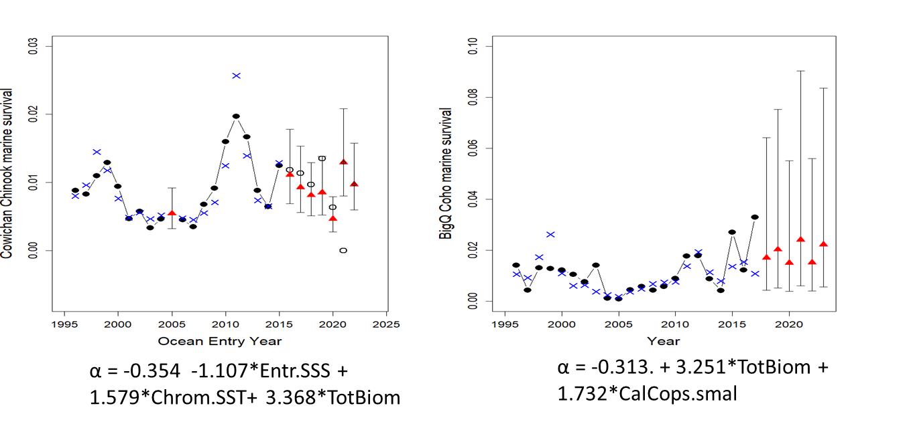
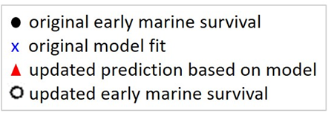
Zooplankton variability in the Strait of Georgia, Canada, and relationships with the marine survivals of Chinook and Coho salmon
R. Ian Perry, Kelly Young, Moira Galbraith, Peter Chandler, Antonio Velez-Espino, Steve Baillie
A
B
A: Cowichan Chinook early marine survivals compared with model estimates of early marine survivals based on Entrance Island sea surface salinity (Entr.SSS), Chrome Island sea surface temperature (Chrom.SST), total zooplankton biomass (TotBiom).
B: Big Qualicum hatchery Coho based on total zooplankton biomass (TotBiom) and small calanoid copepod biomass (CalCops.smal); These are also total marine survivals, derived from one year in the marine environment, where as the model estimates are based on zooplankton data from the first year in the marine environment.
Black dots and line: original marine survival data; open black circles: survivals estimated from incomplete returns (none currently available for Coho); blue crosses: model fits; red triangles and vertical lines: predicted marine survivals and their 95% prediction (updated from Perry et al., 2021)

Slide 6
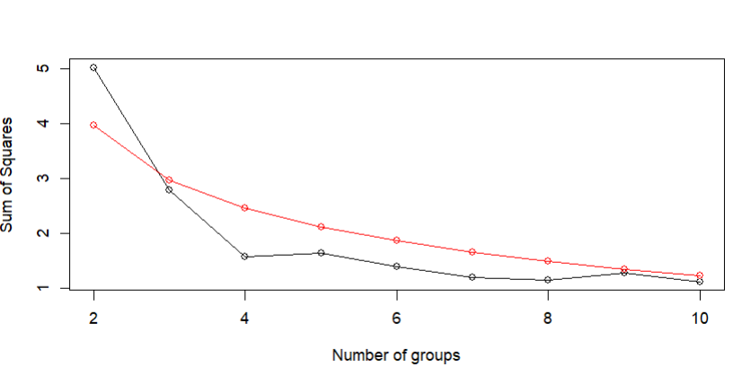
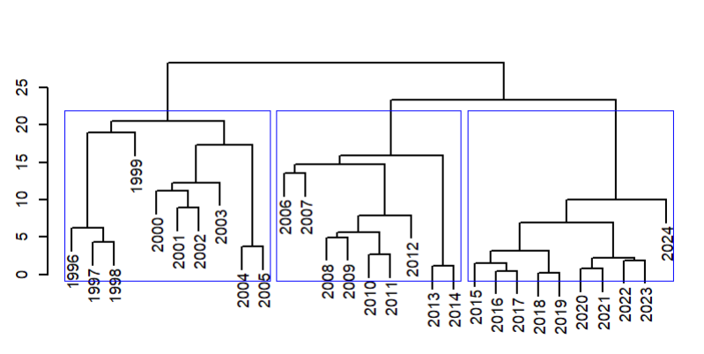
Chronological Clustering
Chronological clustering (i.e. keeping years adjacent) of zooplankton data
‘broken stick’ model of how many clusters are significant in our data – here indicates 3 (black line points above or closest to the red line).

Slide 7
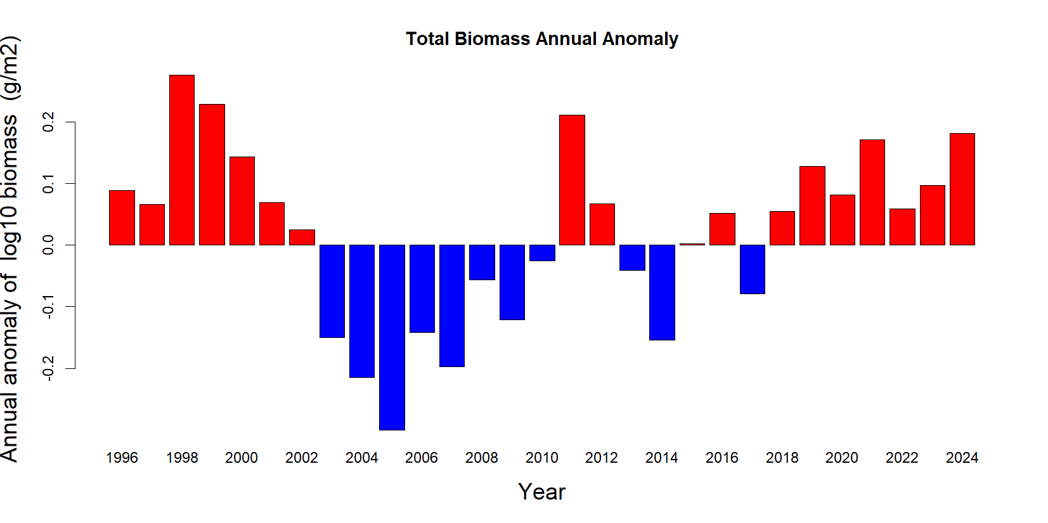
Chronological Clustering
Total zooplankton, Central and Northern Strait of Georgia, 1996 to 2024

Slide 8
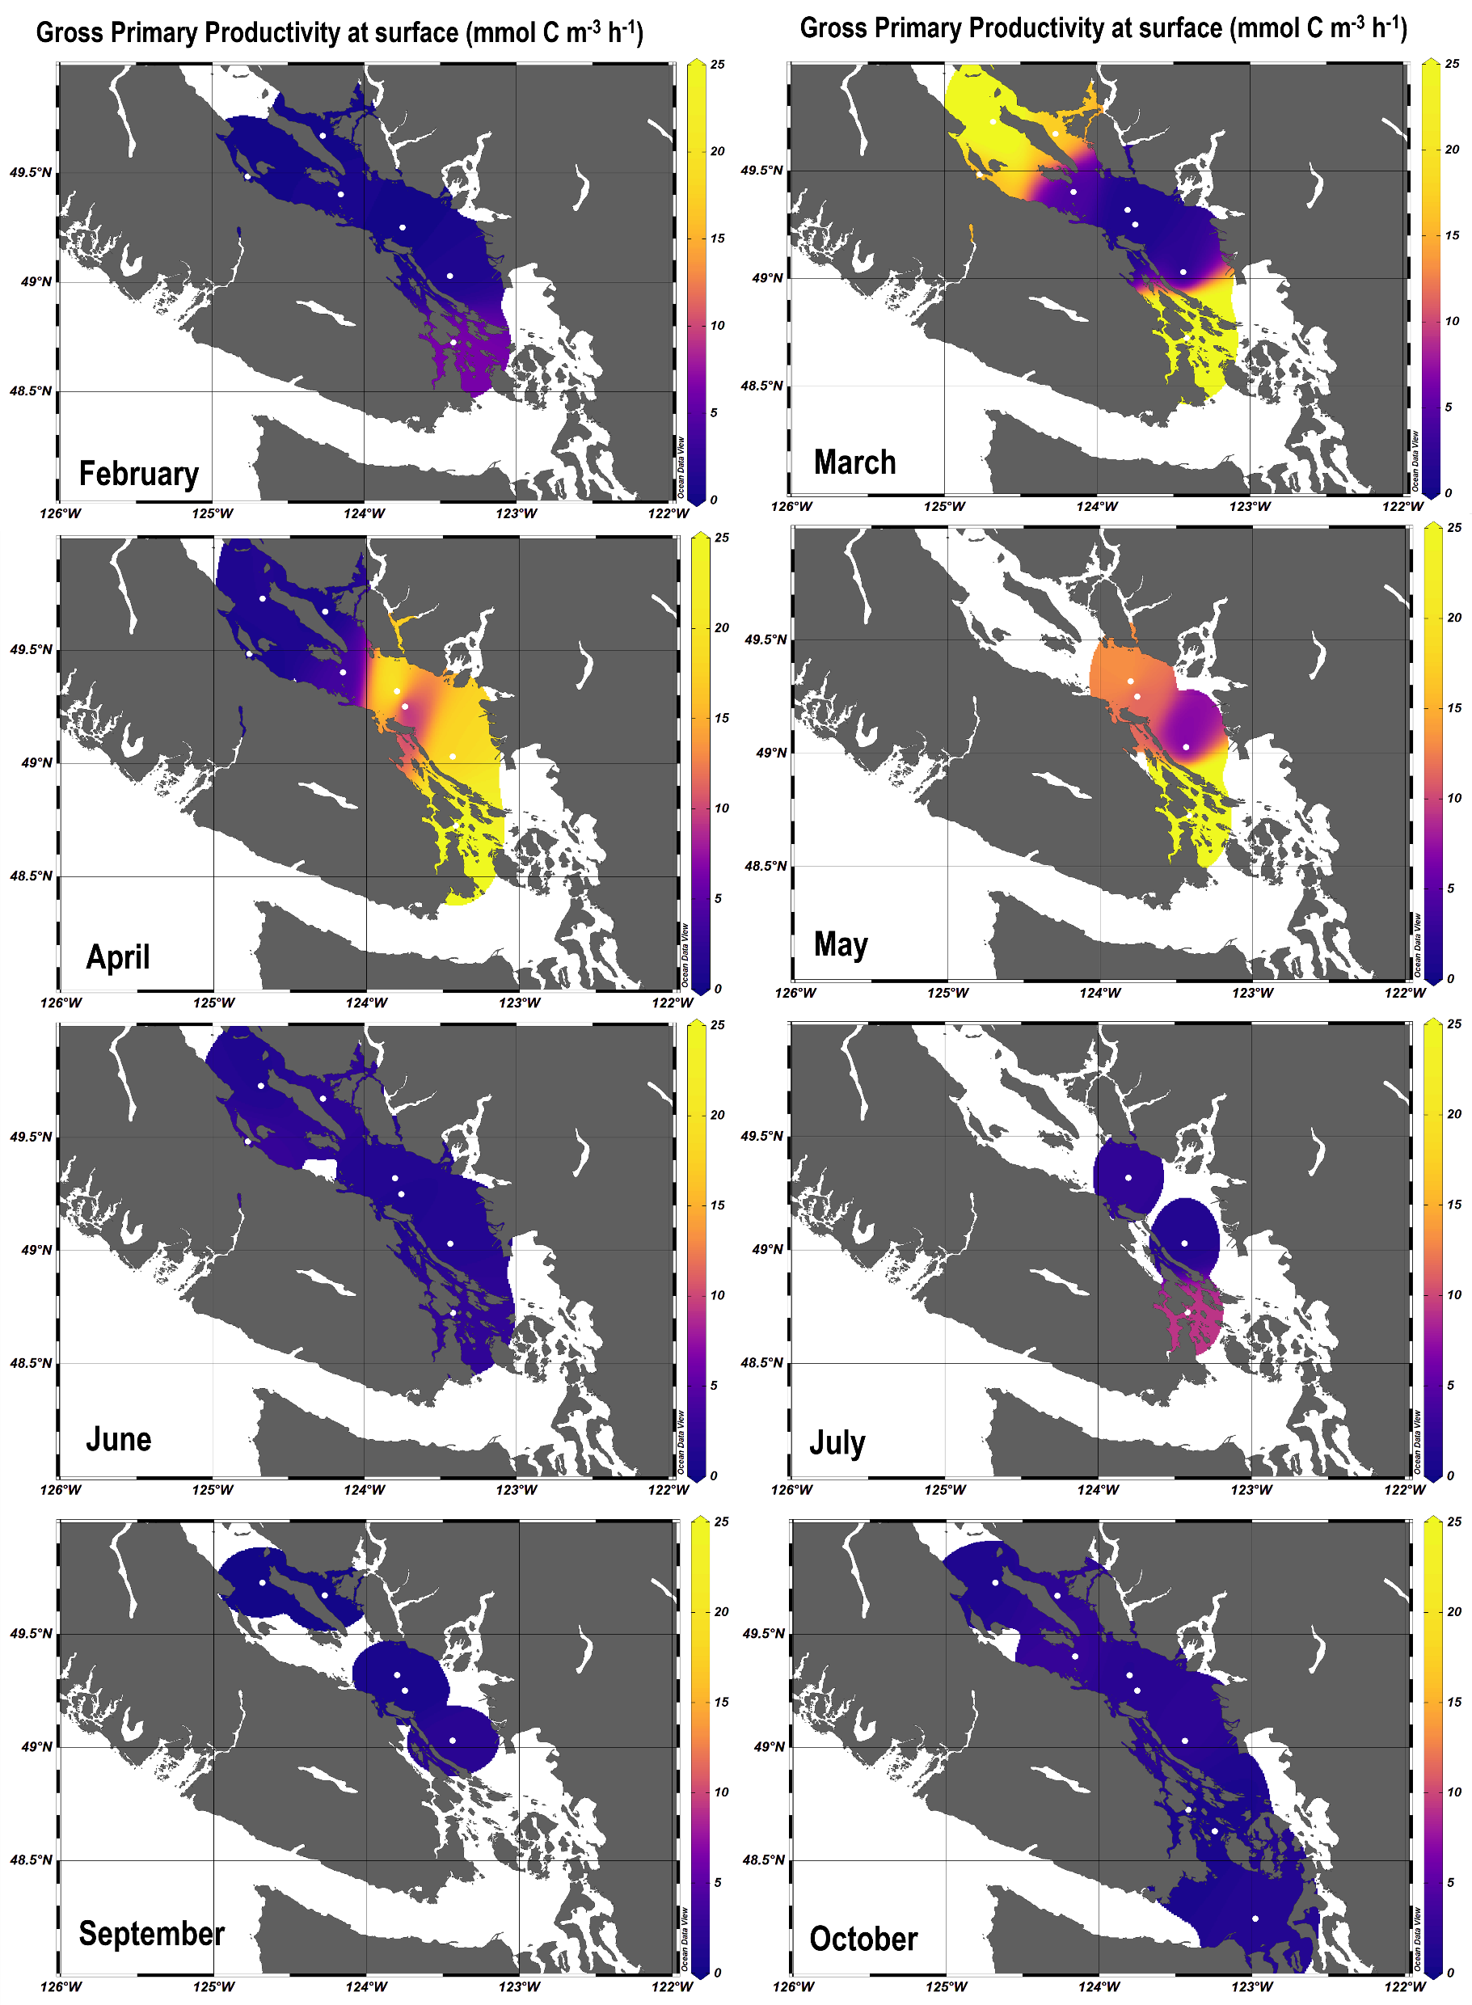
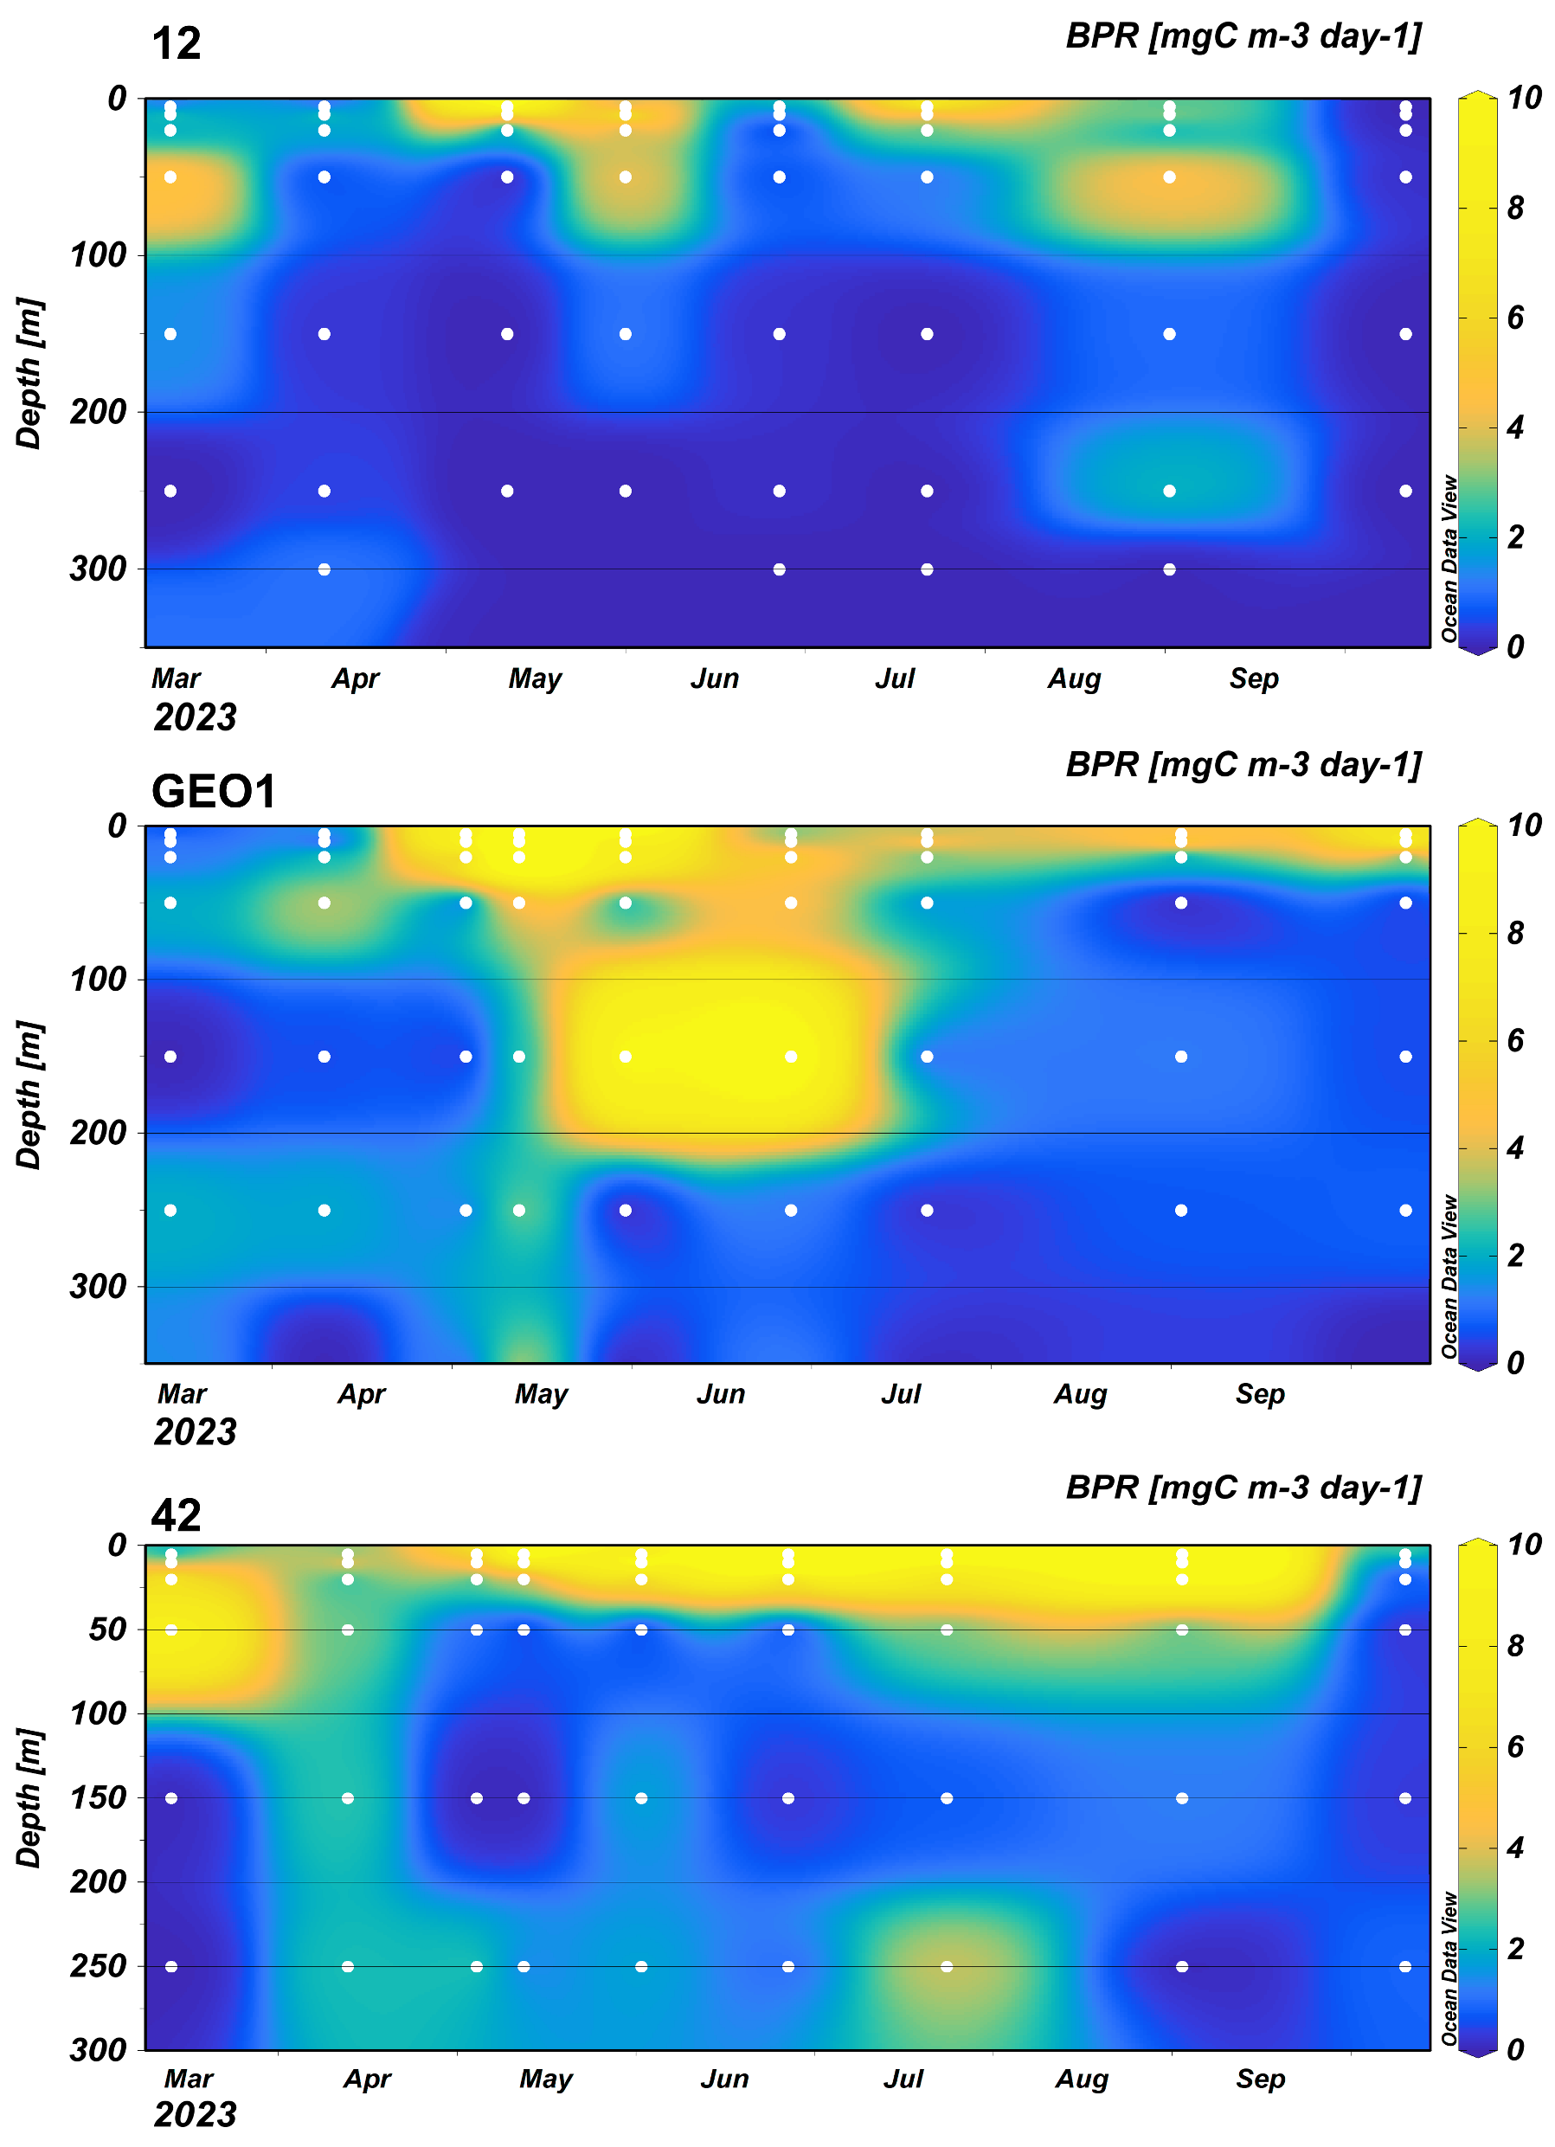
Primary and crustacean zooplankton production rates
GPP (mmol C m⁻³ hr⁻¹)
BPR (mg C m⁻³ day⁻¹)
New monthly production rate measurements:
Primary production rates (GPP):
  Single turnover active fluorescence
  Surface measurements at all stations
  Euphotic zone at three northern and central stations ( )
Crustacean zooplankton production rate (BPR):
  Chitobiase method (Sastri & Dower 2009)
  Full water column at three northern and central stations
Trophic transfer efficiency (%):
  Energy transfer between phytoplankton and zooplankton
  TTE varies seasonally: 3-37%
Kafrissen et al. 2024, 2025 State of the Pacific Ocean

Slide 9
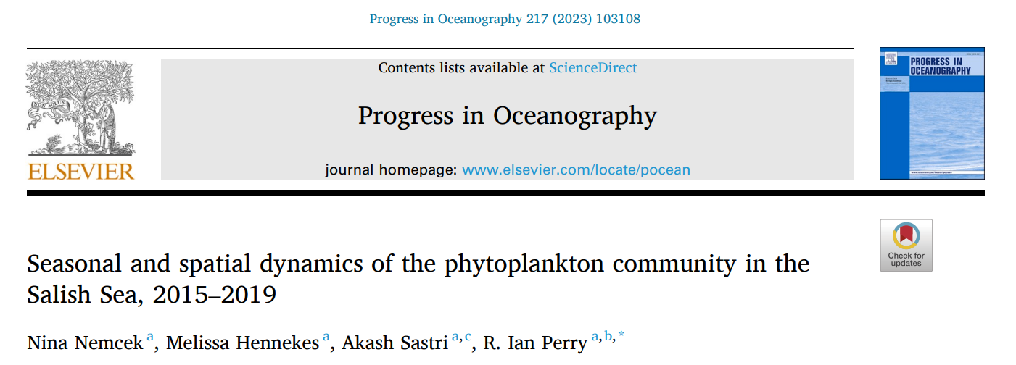
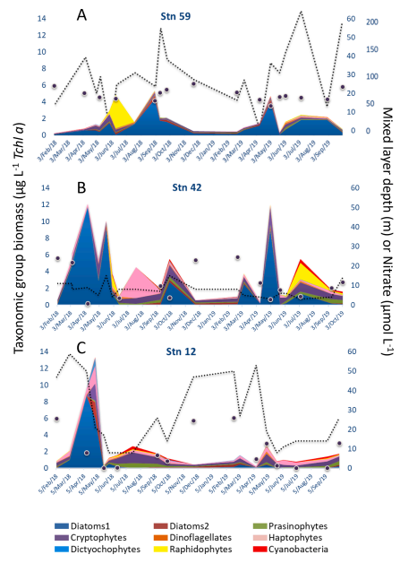
Phytoplankton Pigments: 2015-2019
Biweekly-monthly surface and 5m sampling for phytoplankton pigments (2015-2019, present) throughout the Salish Sea monitoring area
Developed a region-specific CHEMTAX matrix validated with microscopy
Characterized regional variability of seasonal cycle relative to stratification and nutrient availability
Developed a ‘bioregionalization’ of phytoplankton communities for the Salish Sea

Slide 10
Summary and ONC infrastructure
Long term plankton time series in the Salish Sea:
  Zooplankton composition/biomass demonstrate sensitivity to physical forcing
  Modelling of early marine survival of juvenile salmon
  Phytoplankton indicators of productivity and occurrence of Harmful Algal Blooms
Emerging time series and baseline development for zooplankton and phytoplankton monitoring:
  Pigment-based composition
  Community-level production rate measurements
  *Zooplankton and Phytoplankton imagery (2022-)
ONC-BC Ferries monitoring:
  Fine-scale spatial/temporal observations in the central SoG
  Complementary sampling platform (plankton productivity)
SoG East/Central platforms:
  Timing of renewal events and deep-water conditions (e.g. winter temperature/oxygen)
  Upward facing echosounders – resolution of deep and surface biomass validated with *imagery and net-plankton time series

Slide 12
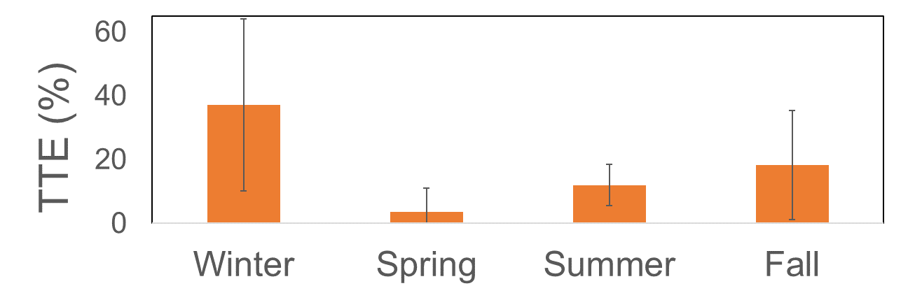
New monthly production rate measurements:
Primary production rates (GPP):
  Single turnover active fluorescence
  Surface measurements at all stations
  Euphotic zone at three northern and central stations ( )
Crustacean zooplankton production rate (BPR):
  Chitobiase method (Sastri & Dower 2009)
  Full water column at three northern and central stations
Trophic transfer efficiency (%):
  Energy transfer between phytoplankton and zooplankton
  TTE varies seasonally: 3-37%

