Slide 1
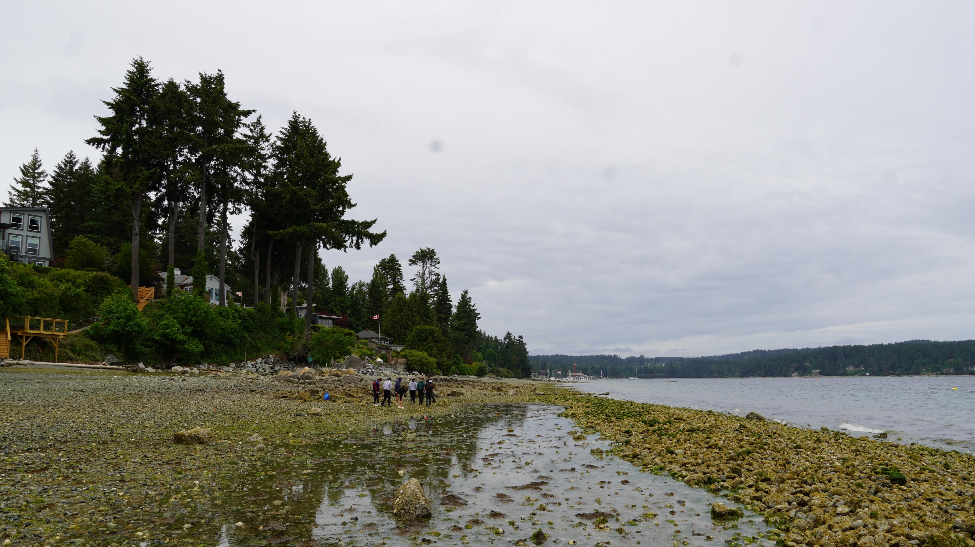

Tides and Teachings
Continuous Care and Renewal at a Salish Sea Clam Garden
Meghan Tomlin and Steven Henry Jr.
Malahat Nation

Slide 2
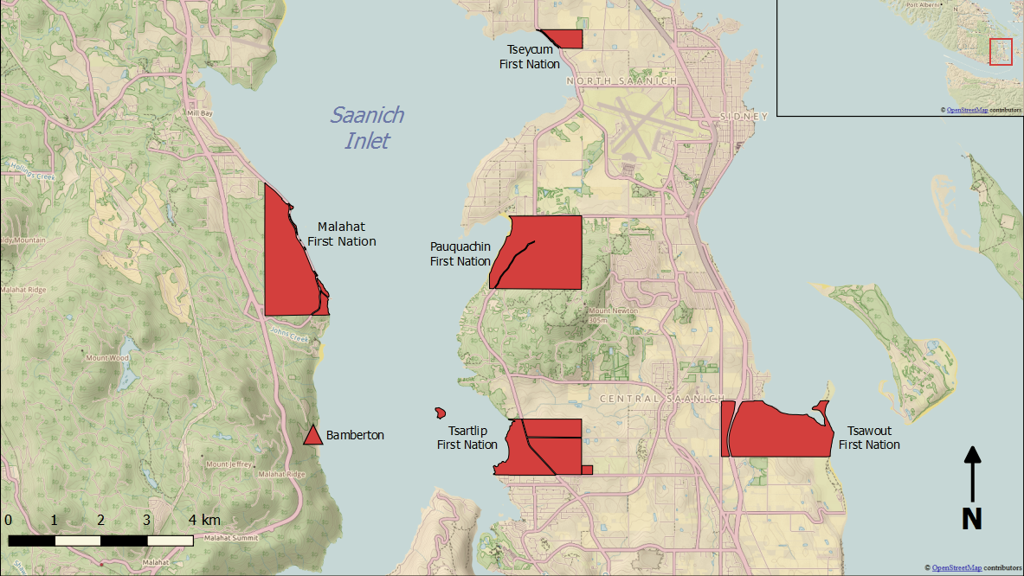
Verdier Beach Clam Garden
Notes:
Explain what a clam garden is

Slide 3
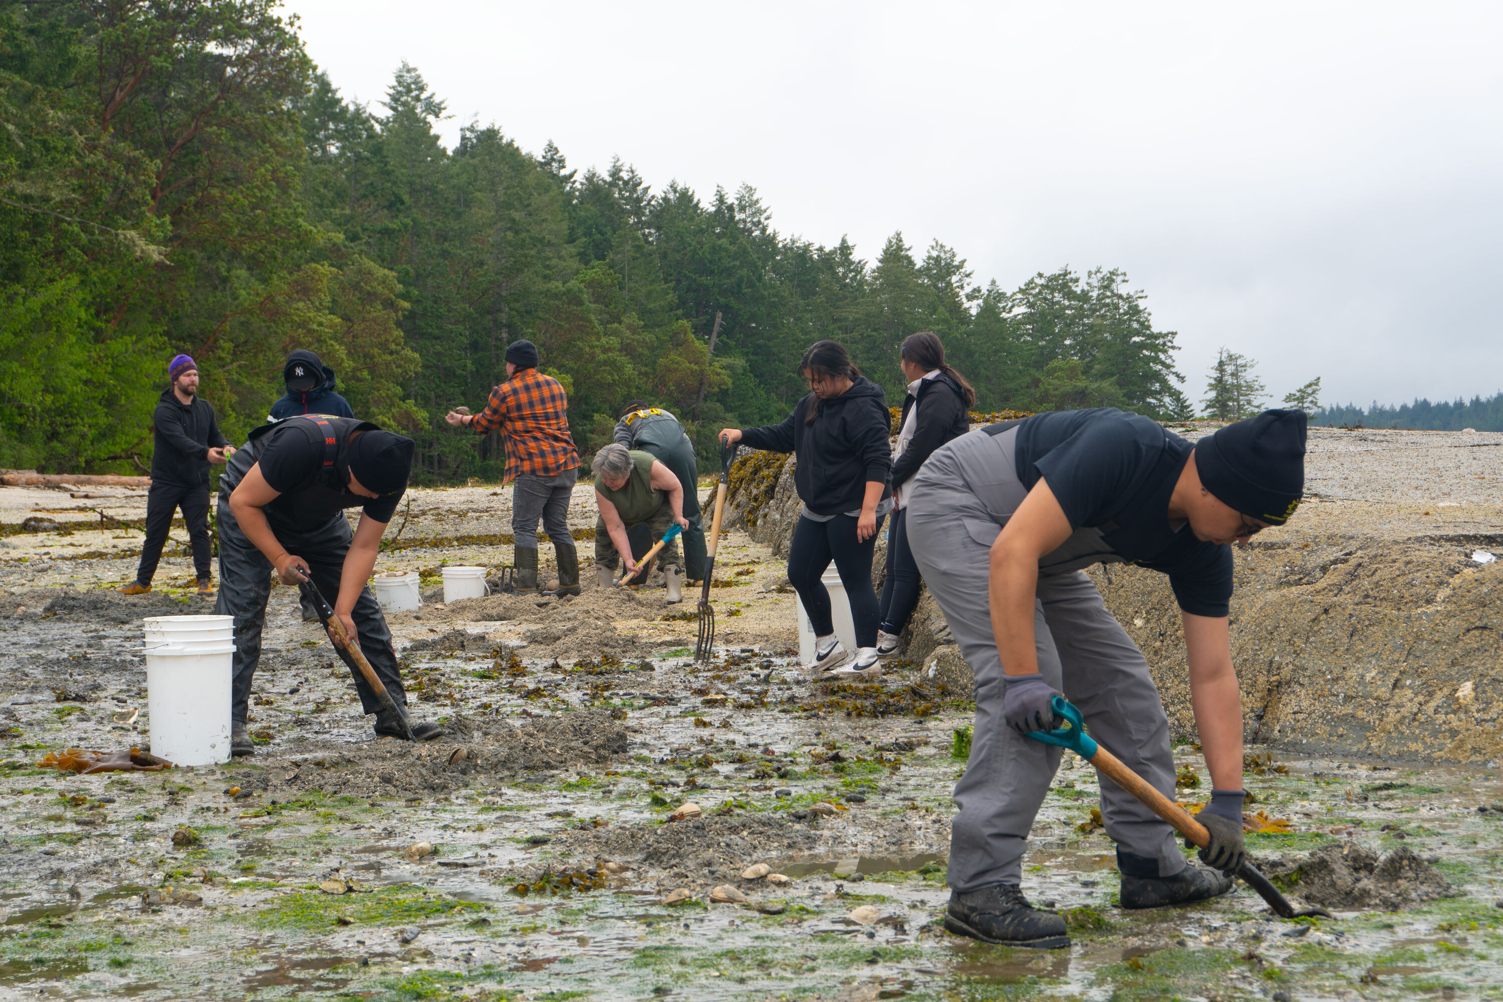
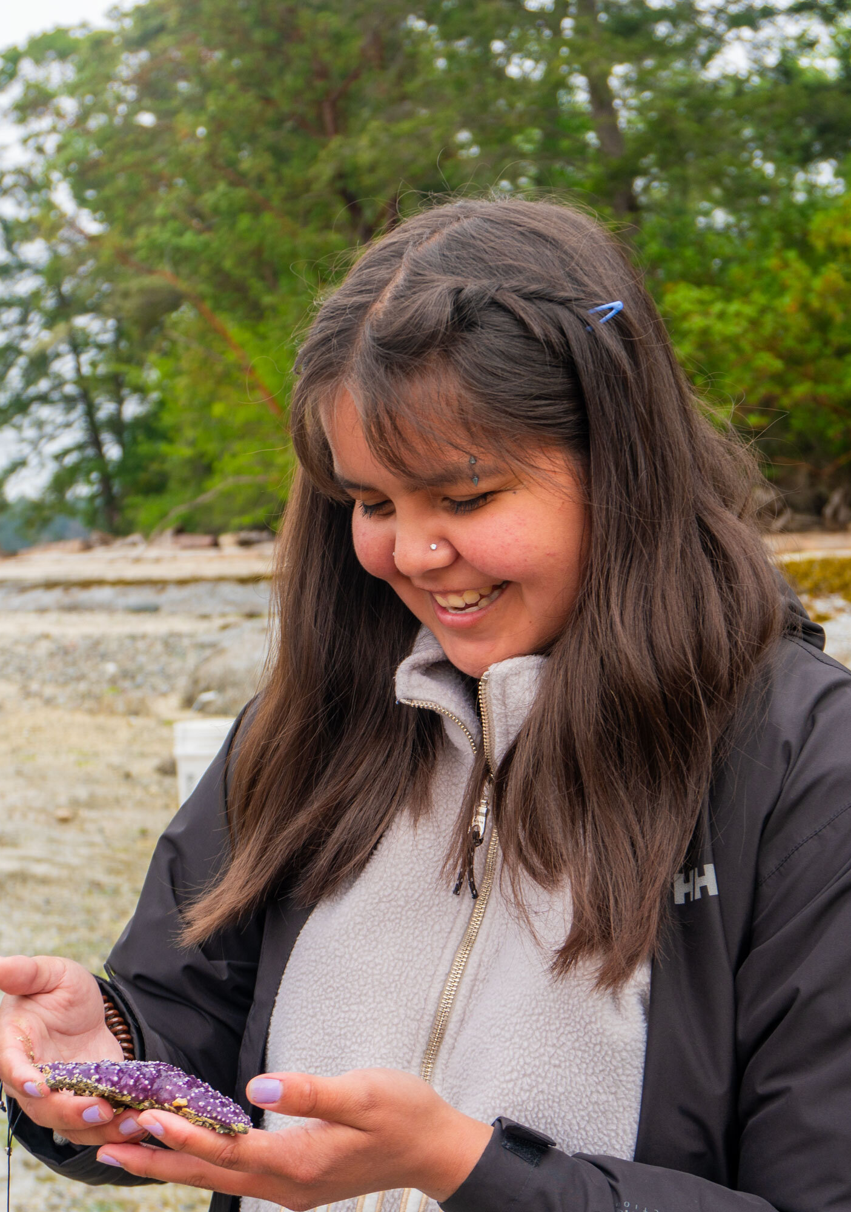
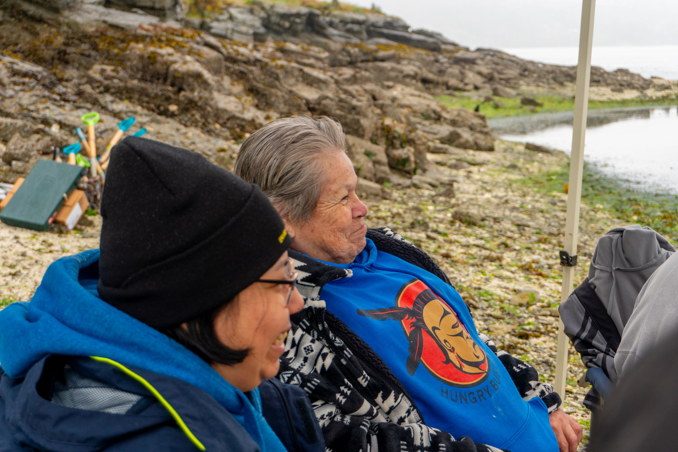
Malahat’s connection to clams
- W̱SÁNEĆ Nations are known as ‘Saltwater people’
- Malahat people have been stewarding clam gardens for thousands of years
- Malahat people rely on clam gardens for traditional foods
- “Clam gardens take care of us, so we take care of the clam gardens”
- Clams support other animal relatives and promote overall ocean health
- Harvesting clams brings people and communities together

Slide 4
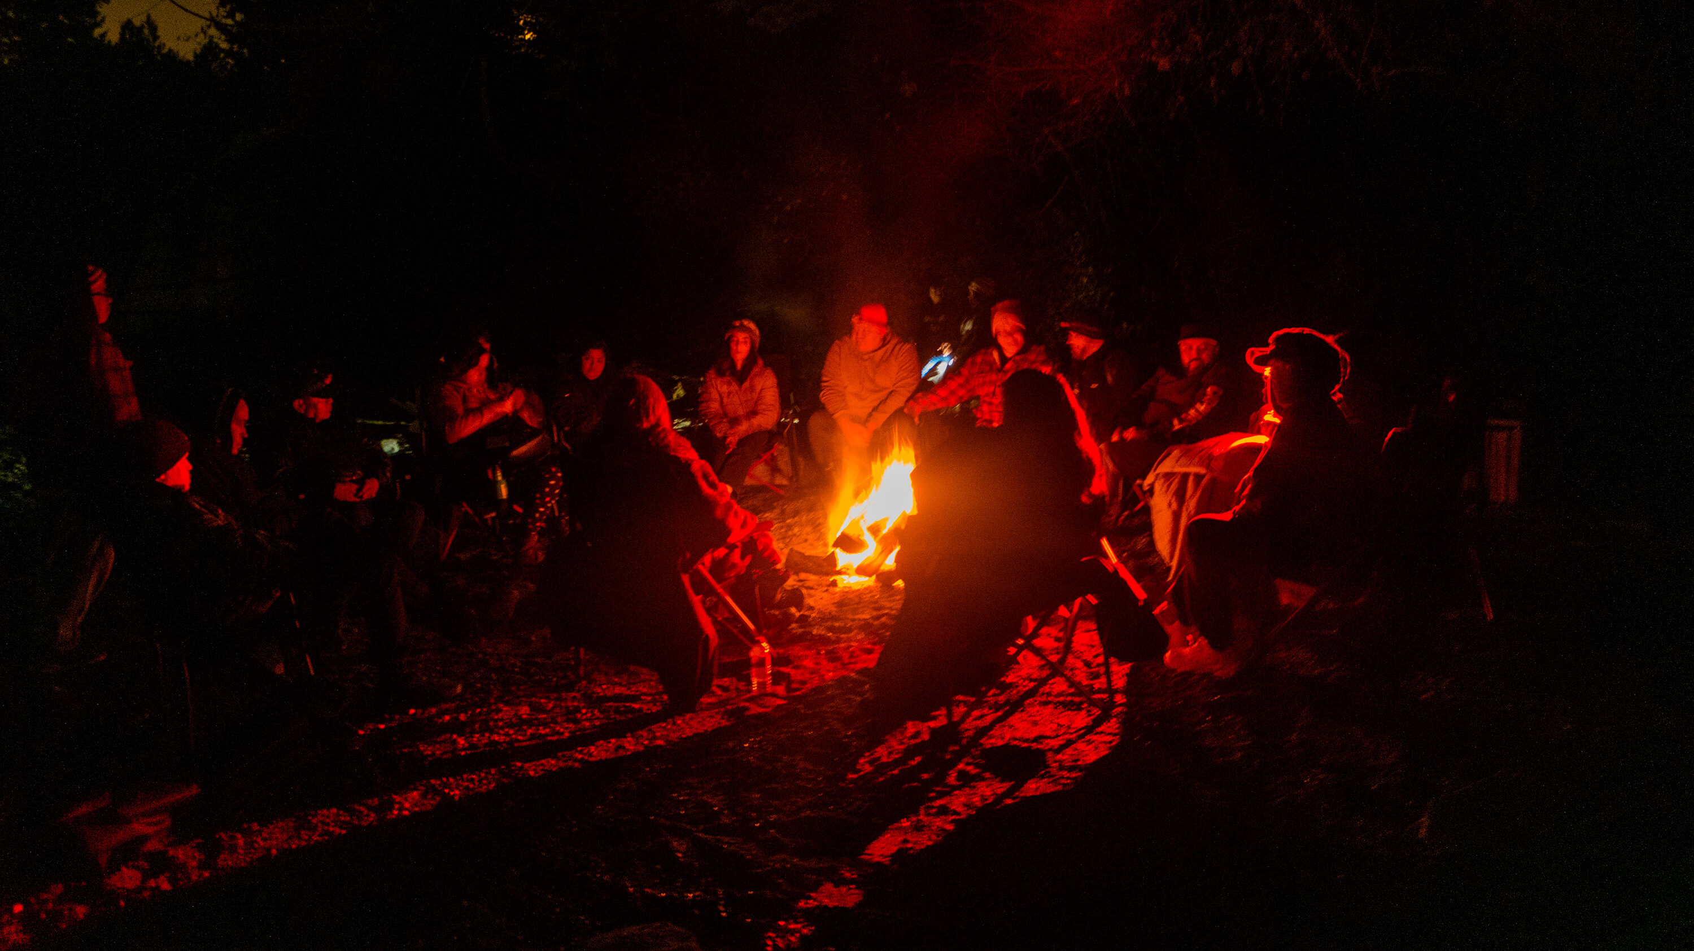

Elder Interviews
Sandy Joe, Feb 2023

Slide 5
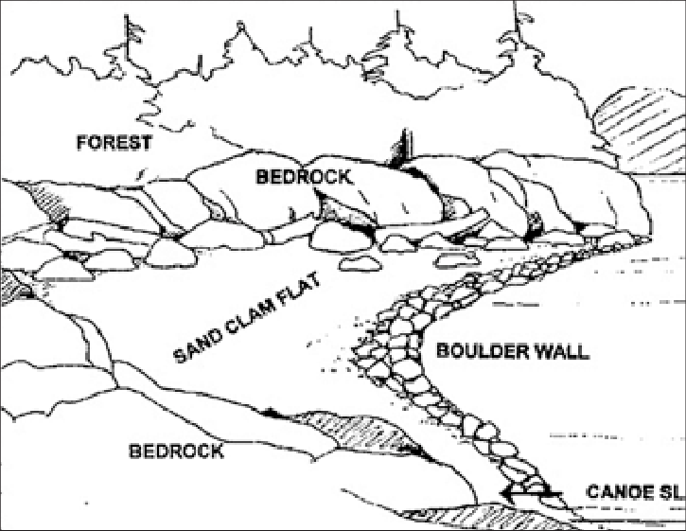
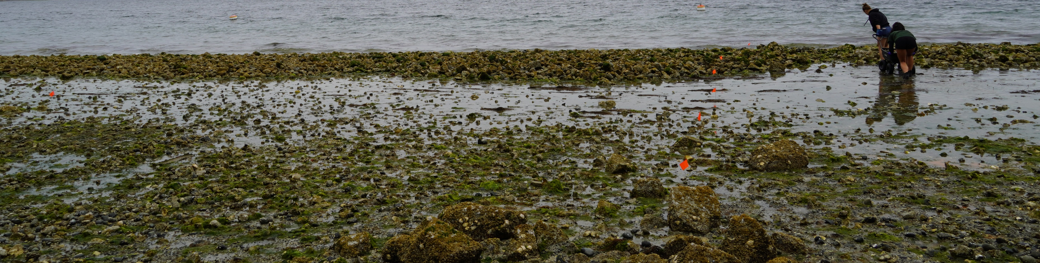
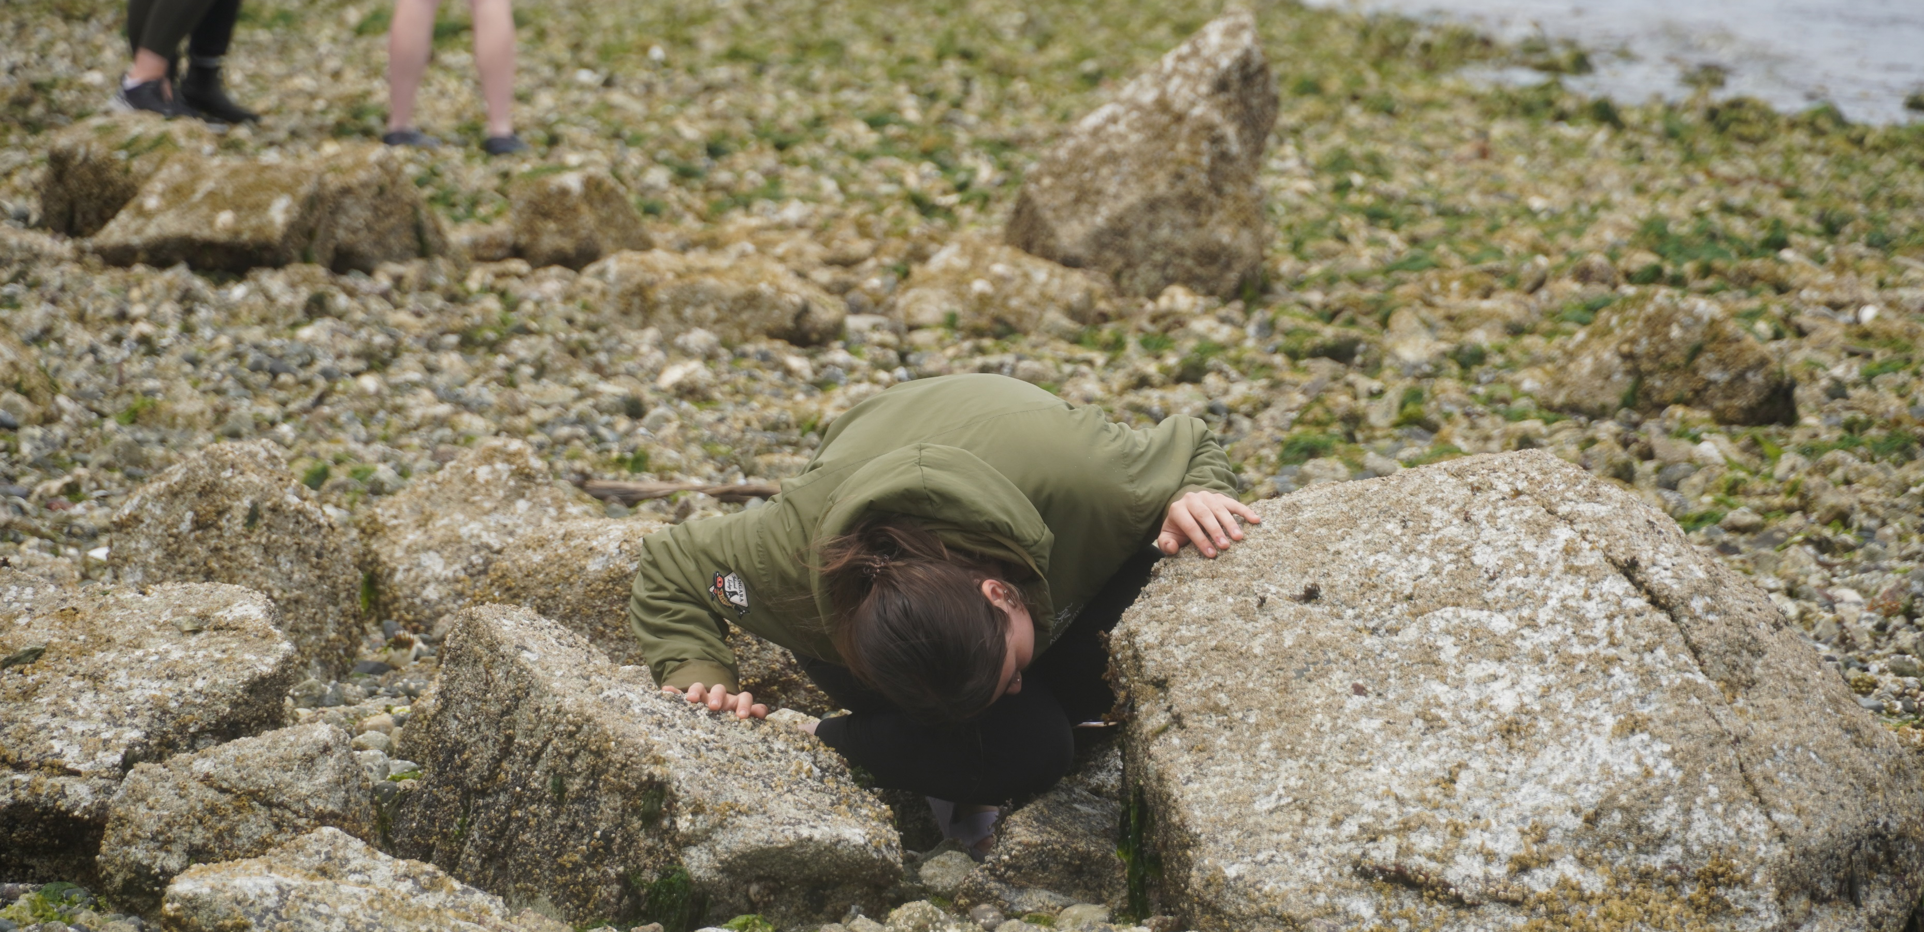
- legacy clam garden (age unknown)
- 2-4 m wide clam garden wall (boulders = increased habitat complexity)
- clam bed (shallow slope, pooled water hosts abundant sea life, grain sizes include pebble, sand, shell hash)
- clam garden research: faster clam growth rate, larger clams, greater density of clams, buffer for climate events
Verdier Beach Clam Garden
Harper, J. R. (1995). Drawing of a clam garden in the Broughton Archipelago [Drawing]. In M. L. Moss & H. P. Wellman (Eds.), The Magoun clam garden near Sitka, Alaska: Niche construction theory meets traditional ecological knowledge, but what about the risks of shellfish toxicity? (Fig. 4). Coastal and Ocean Resources, Inc., Sidney, BC. Reprinted on ResearchGate. https://doi.org/10.1111/faf.12516

Slide 6
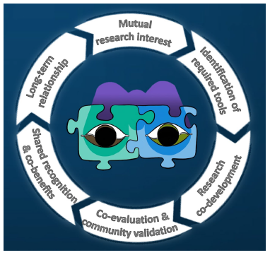
Two-Eyed Seeing Approach
- braiding together Indigenous Knowledge and western science
- grounded in reciprocity, relationship and community
-storytelling and generational knowledge transfer is important
-science is used as a tool
-build relationships with science organizations to collect accurate information and follow accepted scientific methodologies
Reid, A. J., Eckert, L. E., Lane, J.‑F., Young, N., Hinch, S. G., Darimont, C. T., Cooke, S. J., Ban, N. C., & Marshall, A. (2020). “Two‑Eyed Seeing”: An Indigenous framework to transform fisheries research and management. Fish and Fisheries, 21(5), 1–19. https://doi.org/10.1111/faf.12516

Slide 7
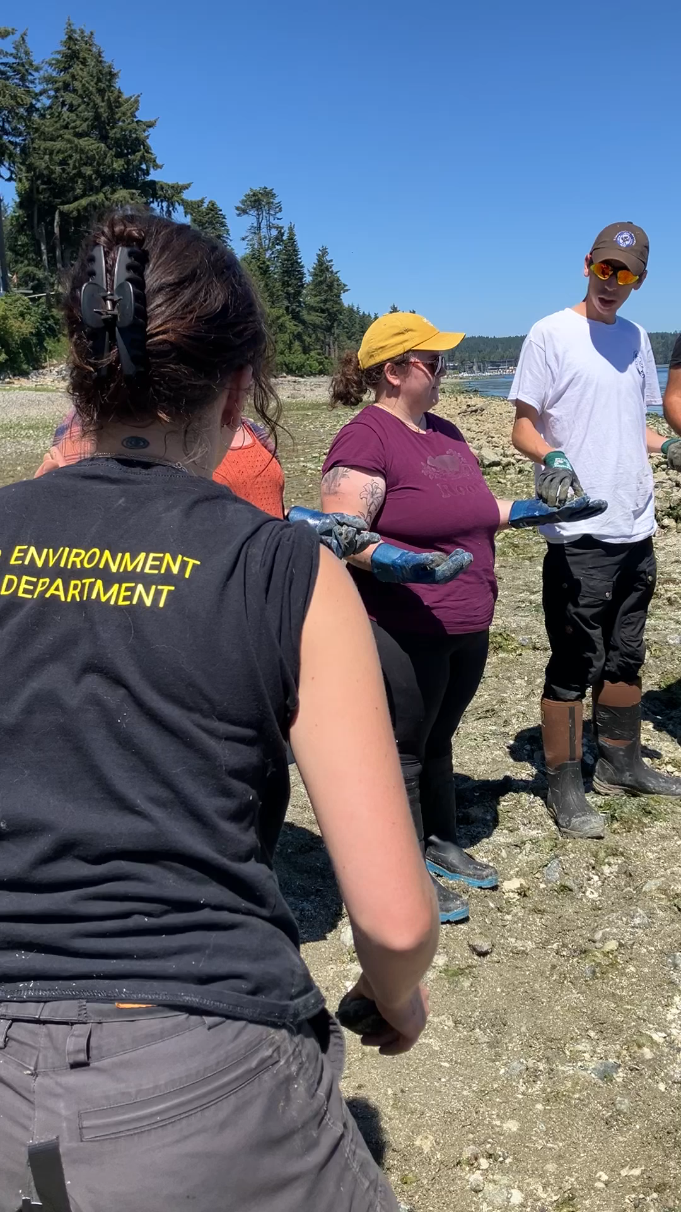
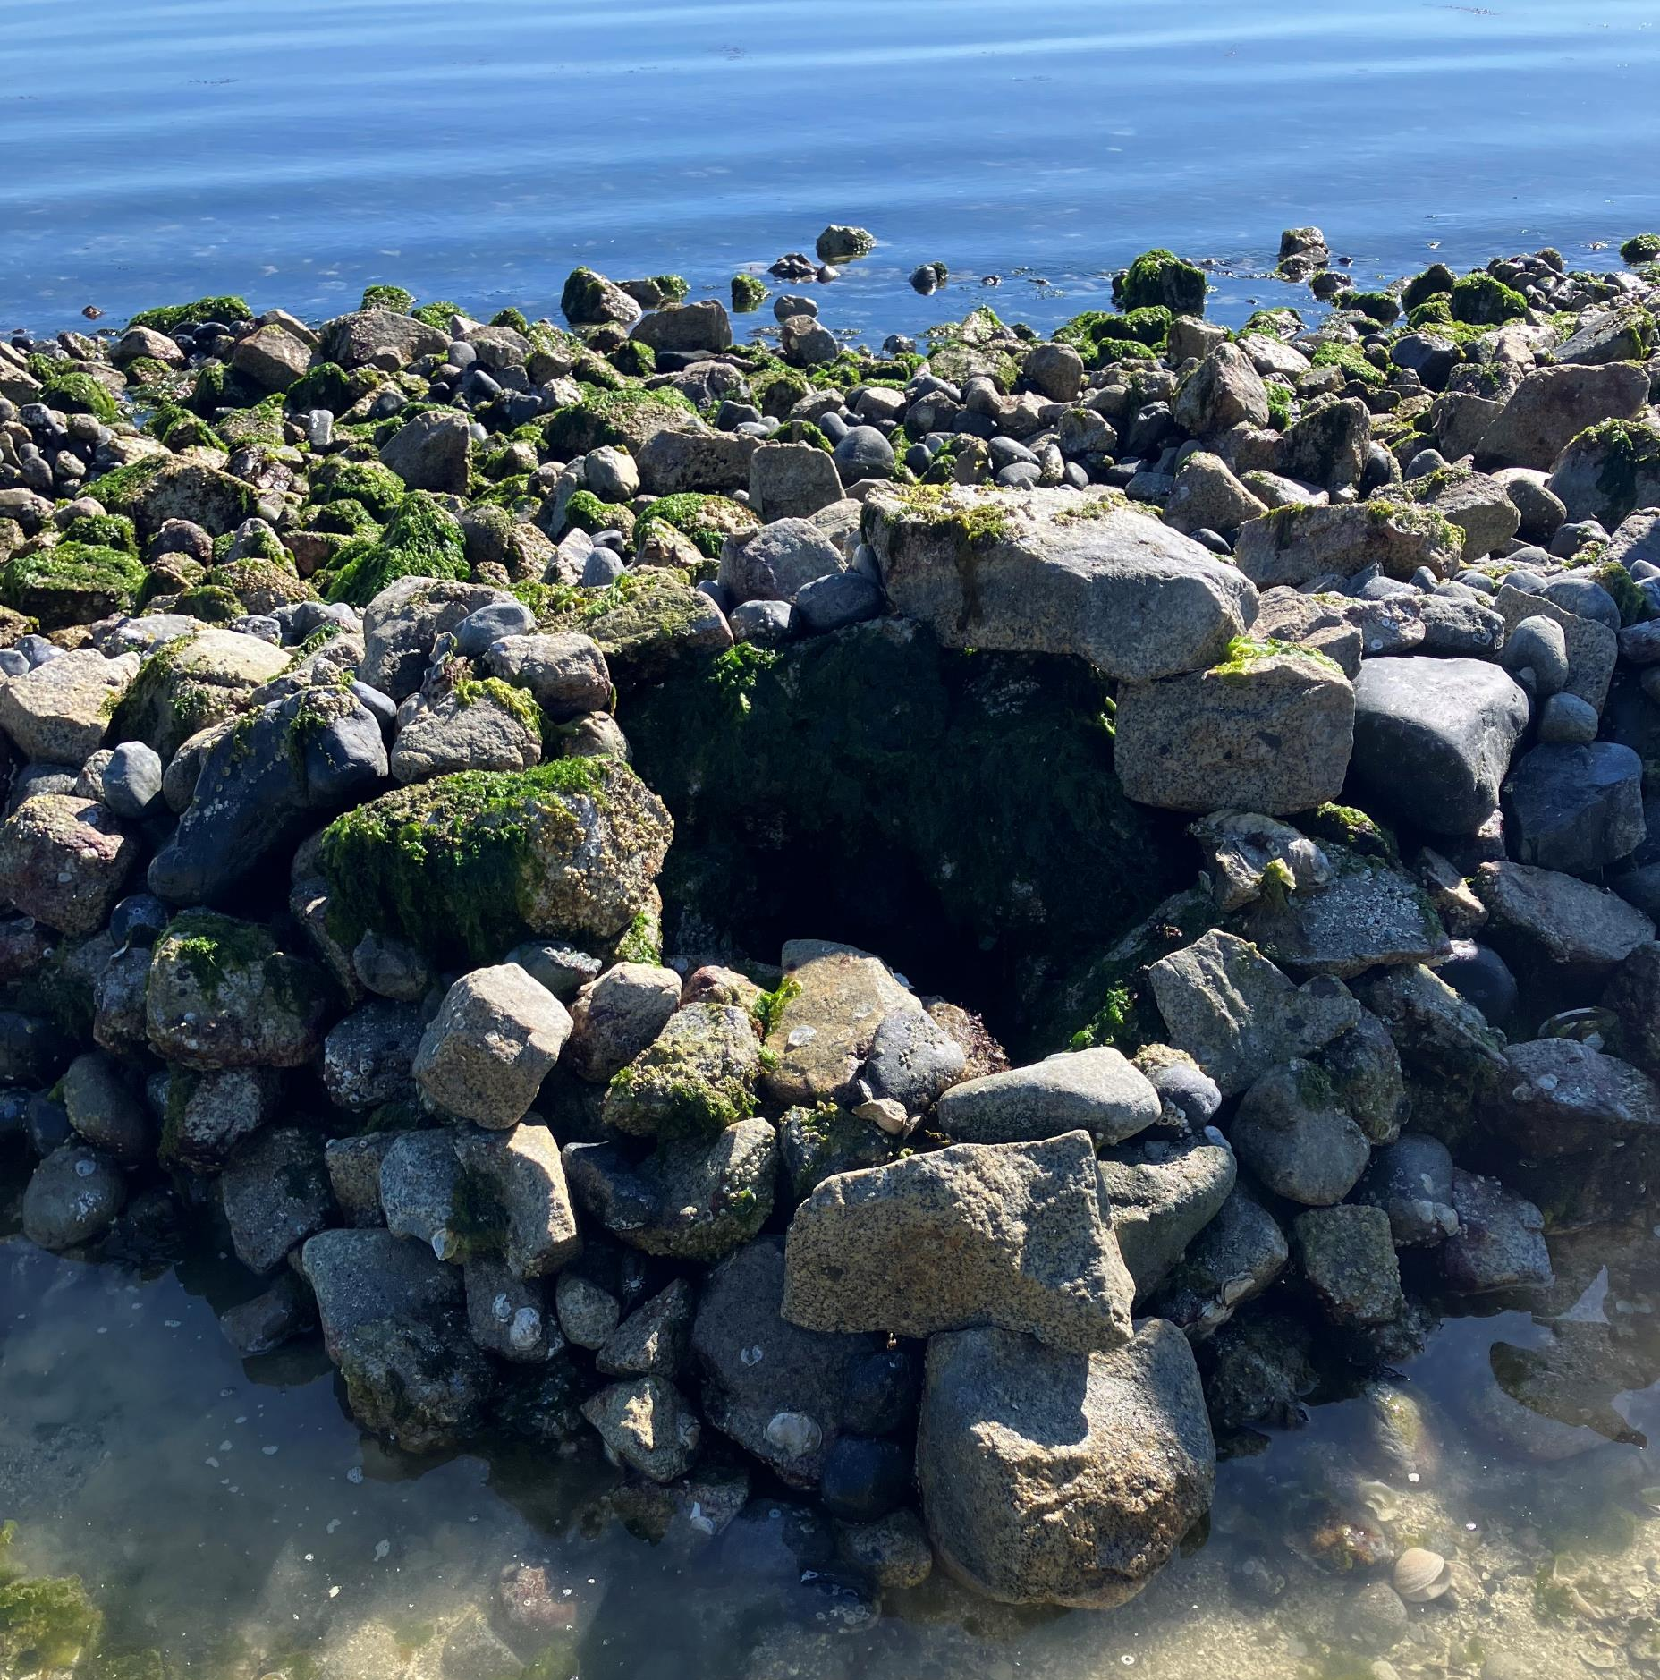
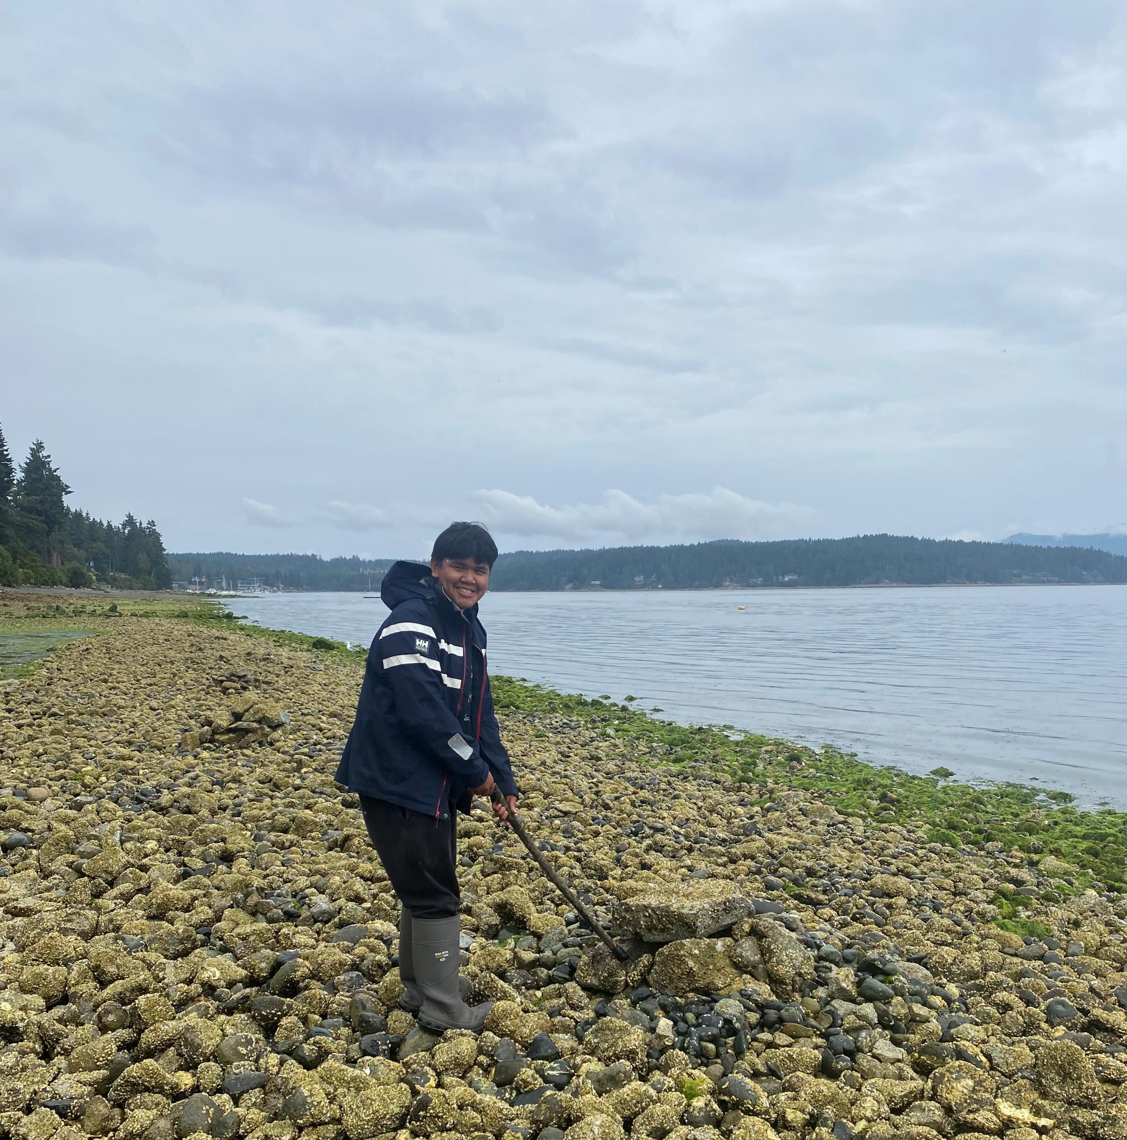
‘Taking care of the beach’
Nuts'a'maat shqwaluwun means ‘working together as one with good heart and mind’
Penelakut Elders shared their teachings how to make gaff hooks and build octopus traps
Malahat has been working with other Nations to create new cultural protocols grounded in our shared teachings
Continuous clam garden tending includes moving rocks, ‘fluffing’ the beach, and adding shell hash to the clam bed
Notes:
Nuts’a’maat shqwaluwun is the teaching that our people have been following for thousand of years
Gaff hooks are made of ocean spray wood because it is durable.
Since so much knowledge is lost Malahat has been working with other Nations to create new cultural protocols grounded in our shared teachings.

Slide 8
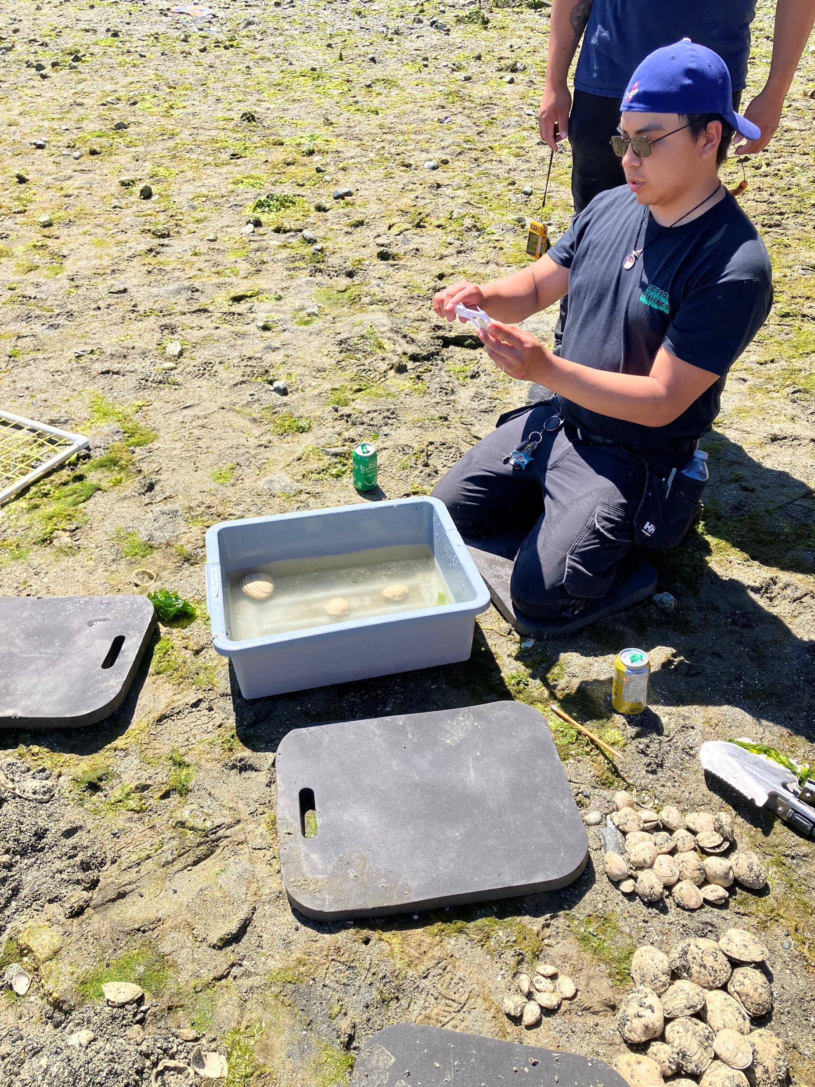
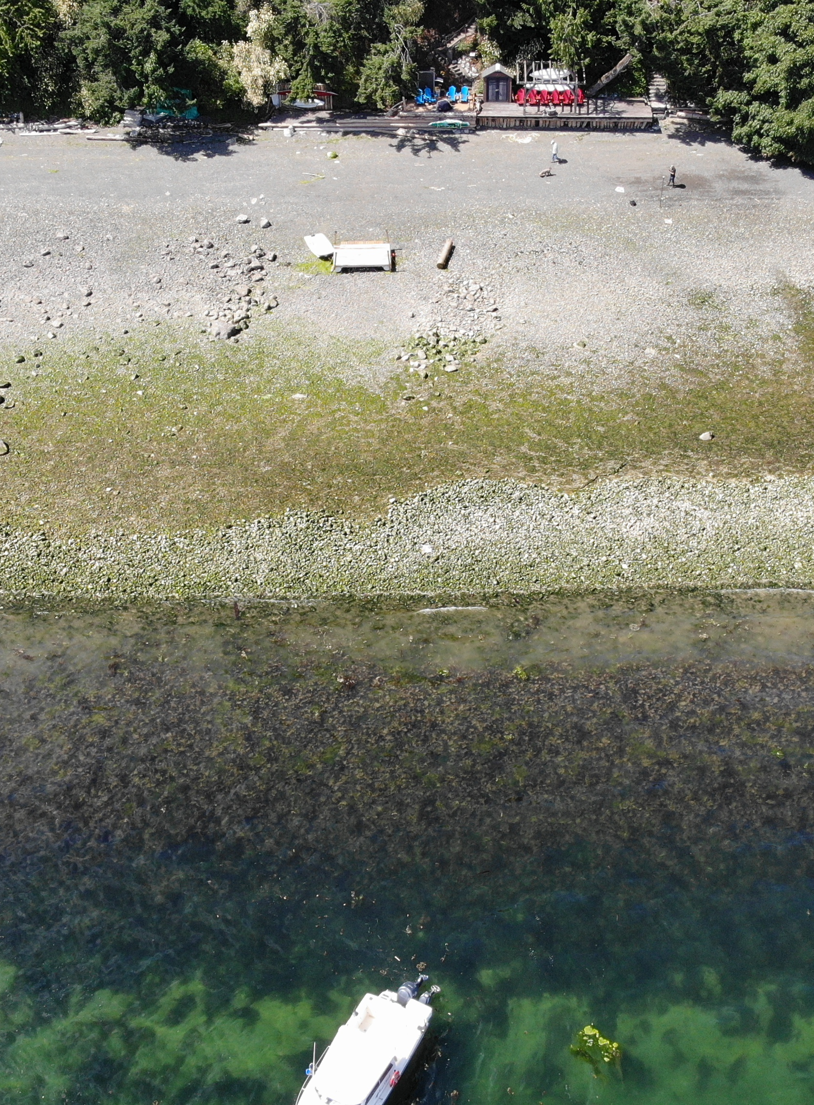
Drone Imagery and Intertidal Surveys
-High-altitude drone surveys are used to detect large-scale changes
-Low-altitude drone surveys are used to define syphon holes, sediment accumulations, and detect small-scale changes
-Intertidal surveys are based on DFO Marine Spatial Ecology and Analysis (MSEA) : Intertidal Biodiversity Survey Protocol
-Intertidal surveys are used to characterize and quantify the intertidal biological community and substrate
Notes:
-Survey Details:
Survey Type: photogrammetry
Resolution of orthomosaics: 0.05m
Drone Type: DJI Mavic 2 Enterprise
-Timeline:
2021-2022: preliminary exploration and surveyed the site to create orthomosaics
2023-current: pre and post Clam Garden restoration surveys, including high-low altitude surveys to experiment with change detection.
-Survey Types:
High-altitude: To compare 2021-2022 data with 2023-current data and detect large-scale changes.
Low-altitude: Experimental to try to define syphon holes, sediment accumulations, and other small-scale changes (based on DFO work)
-Drone Mapping Software used for autonomous flights to complete transects with consistent flight paths, imagery overlap, and altitude.

Slide 9
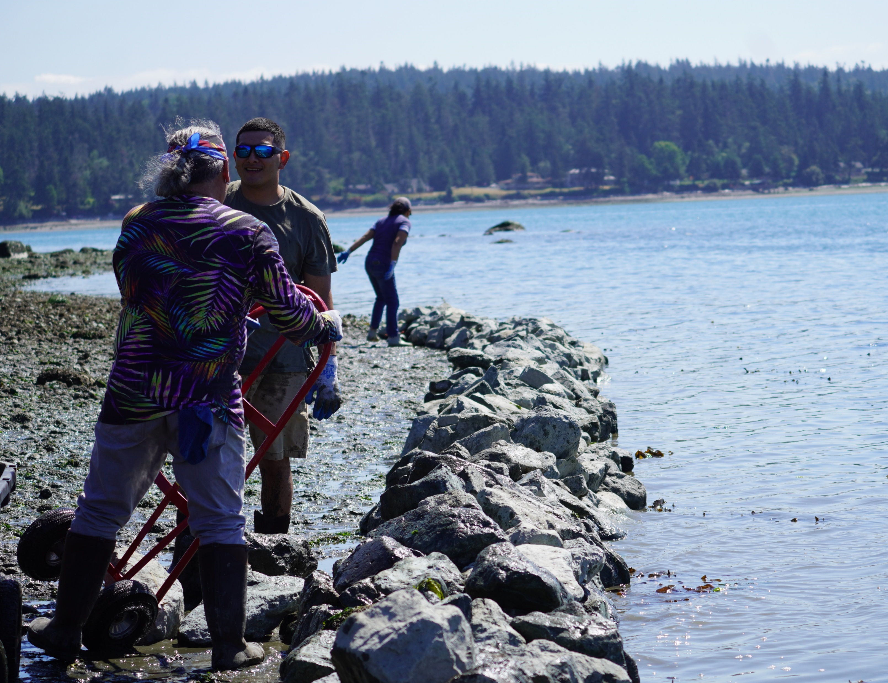
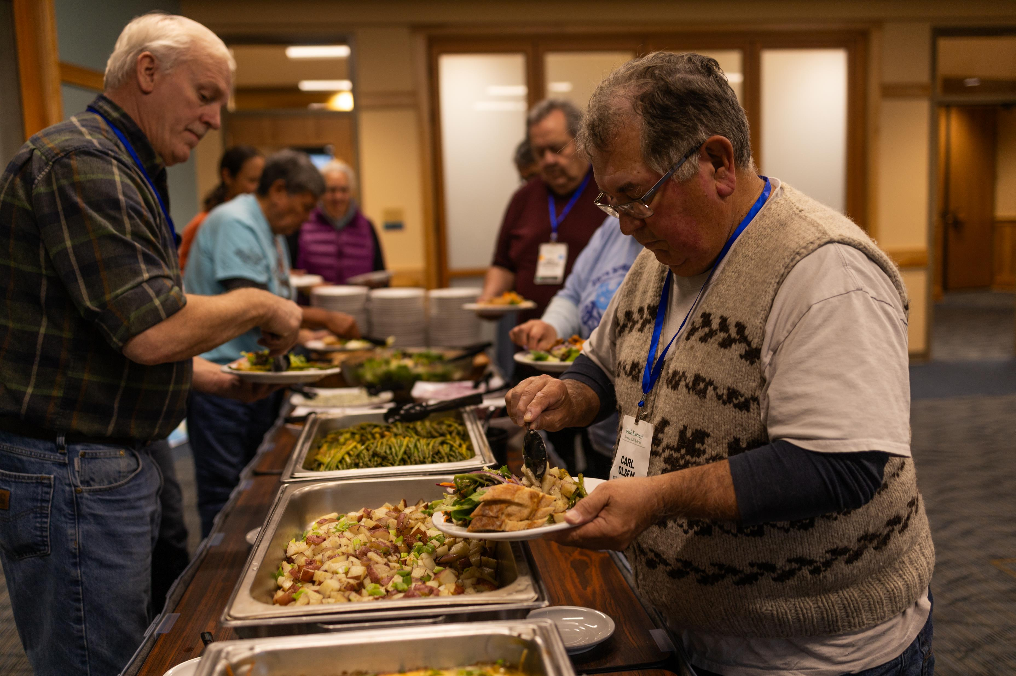
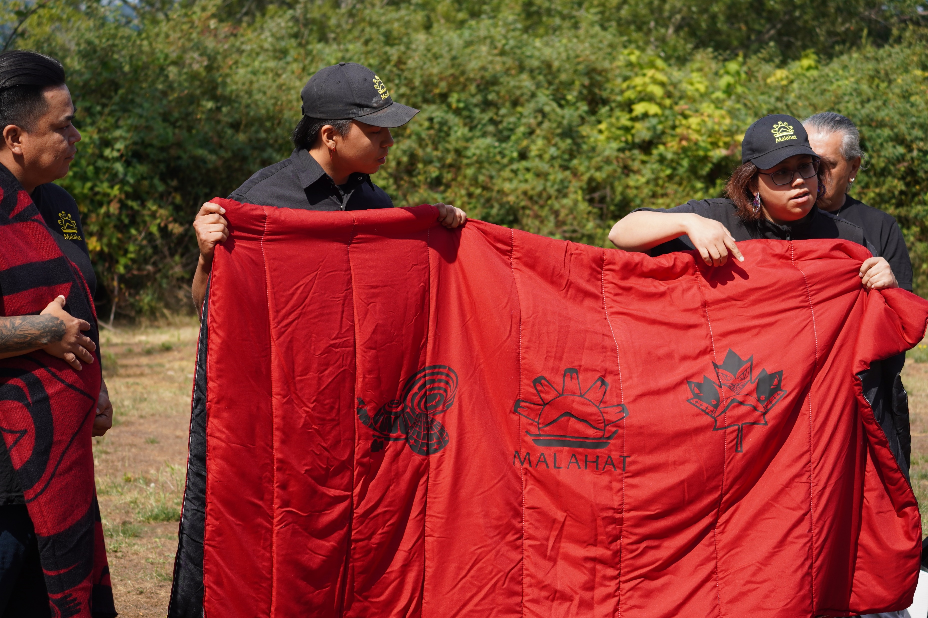
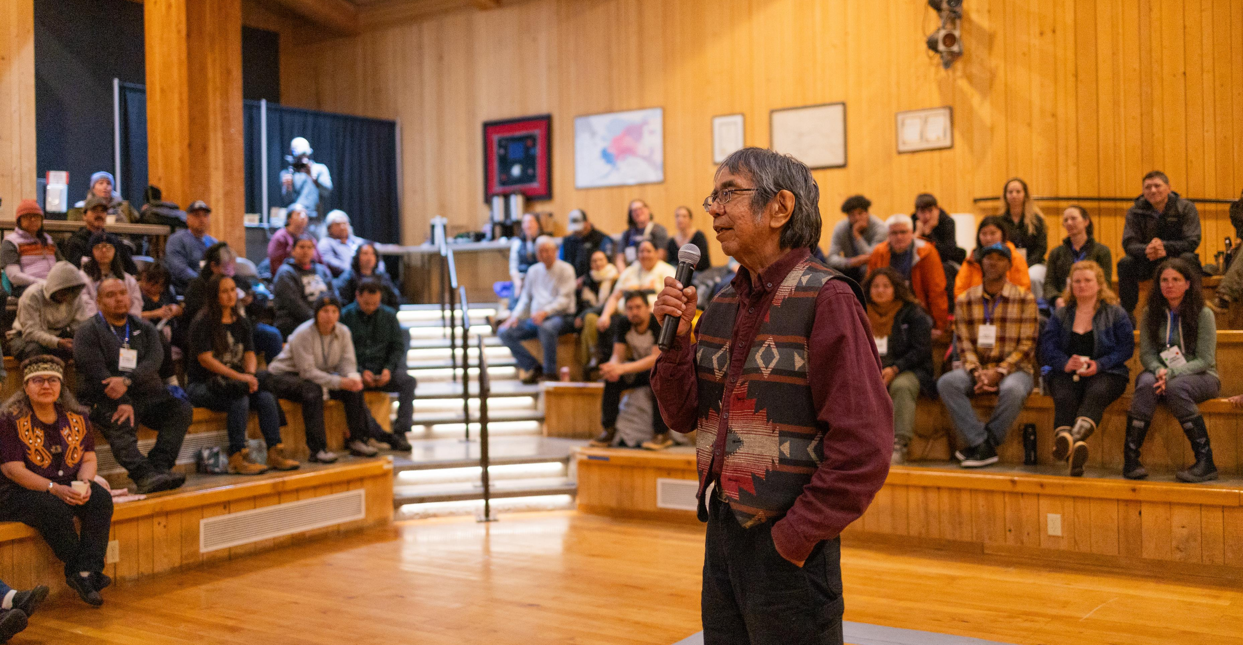
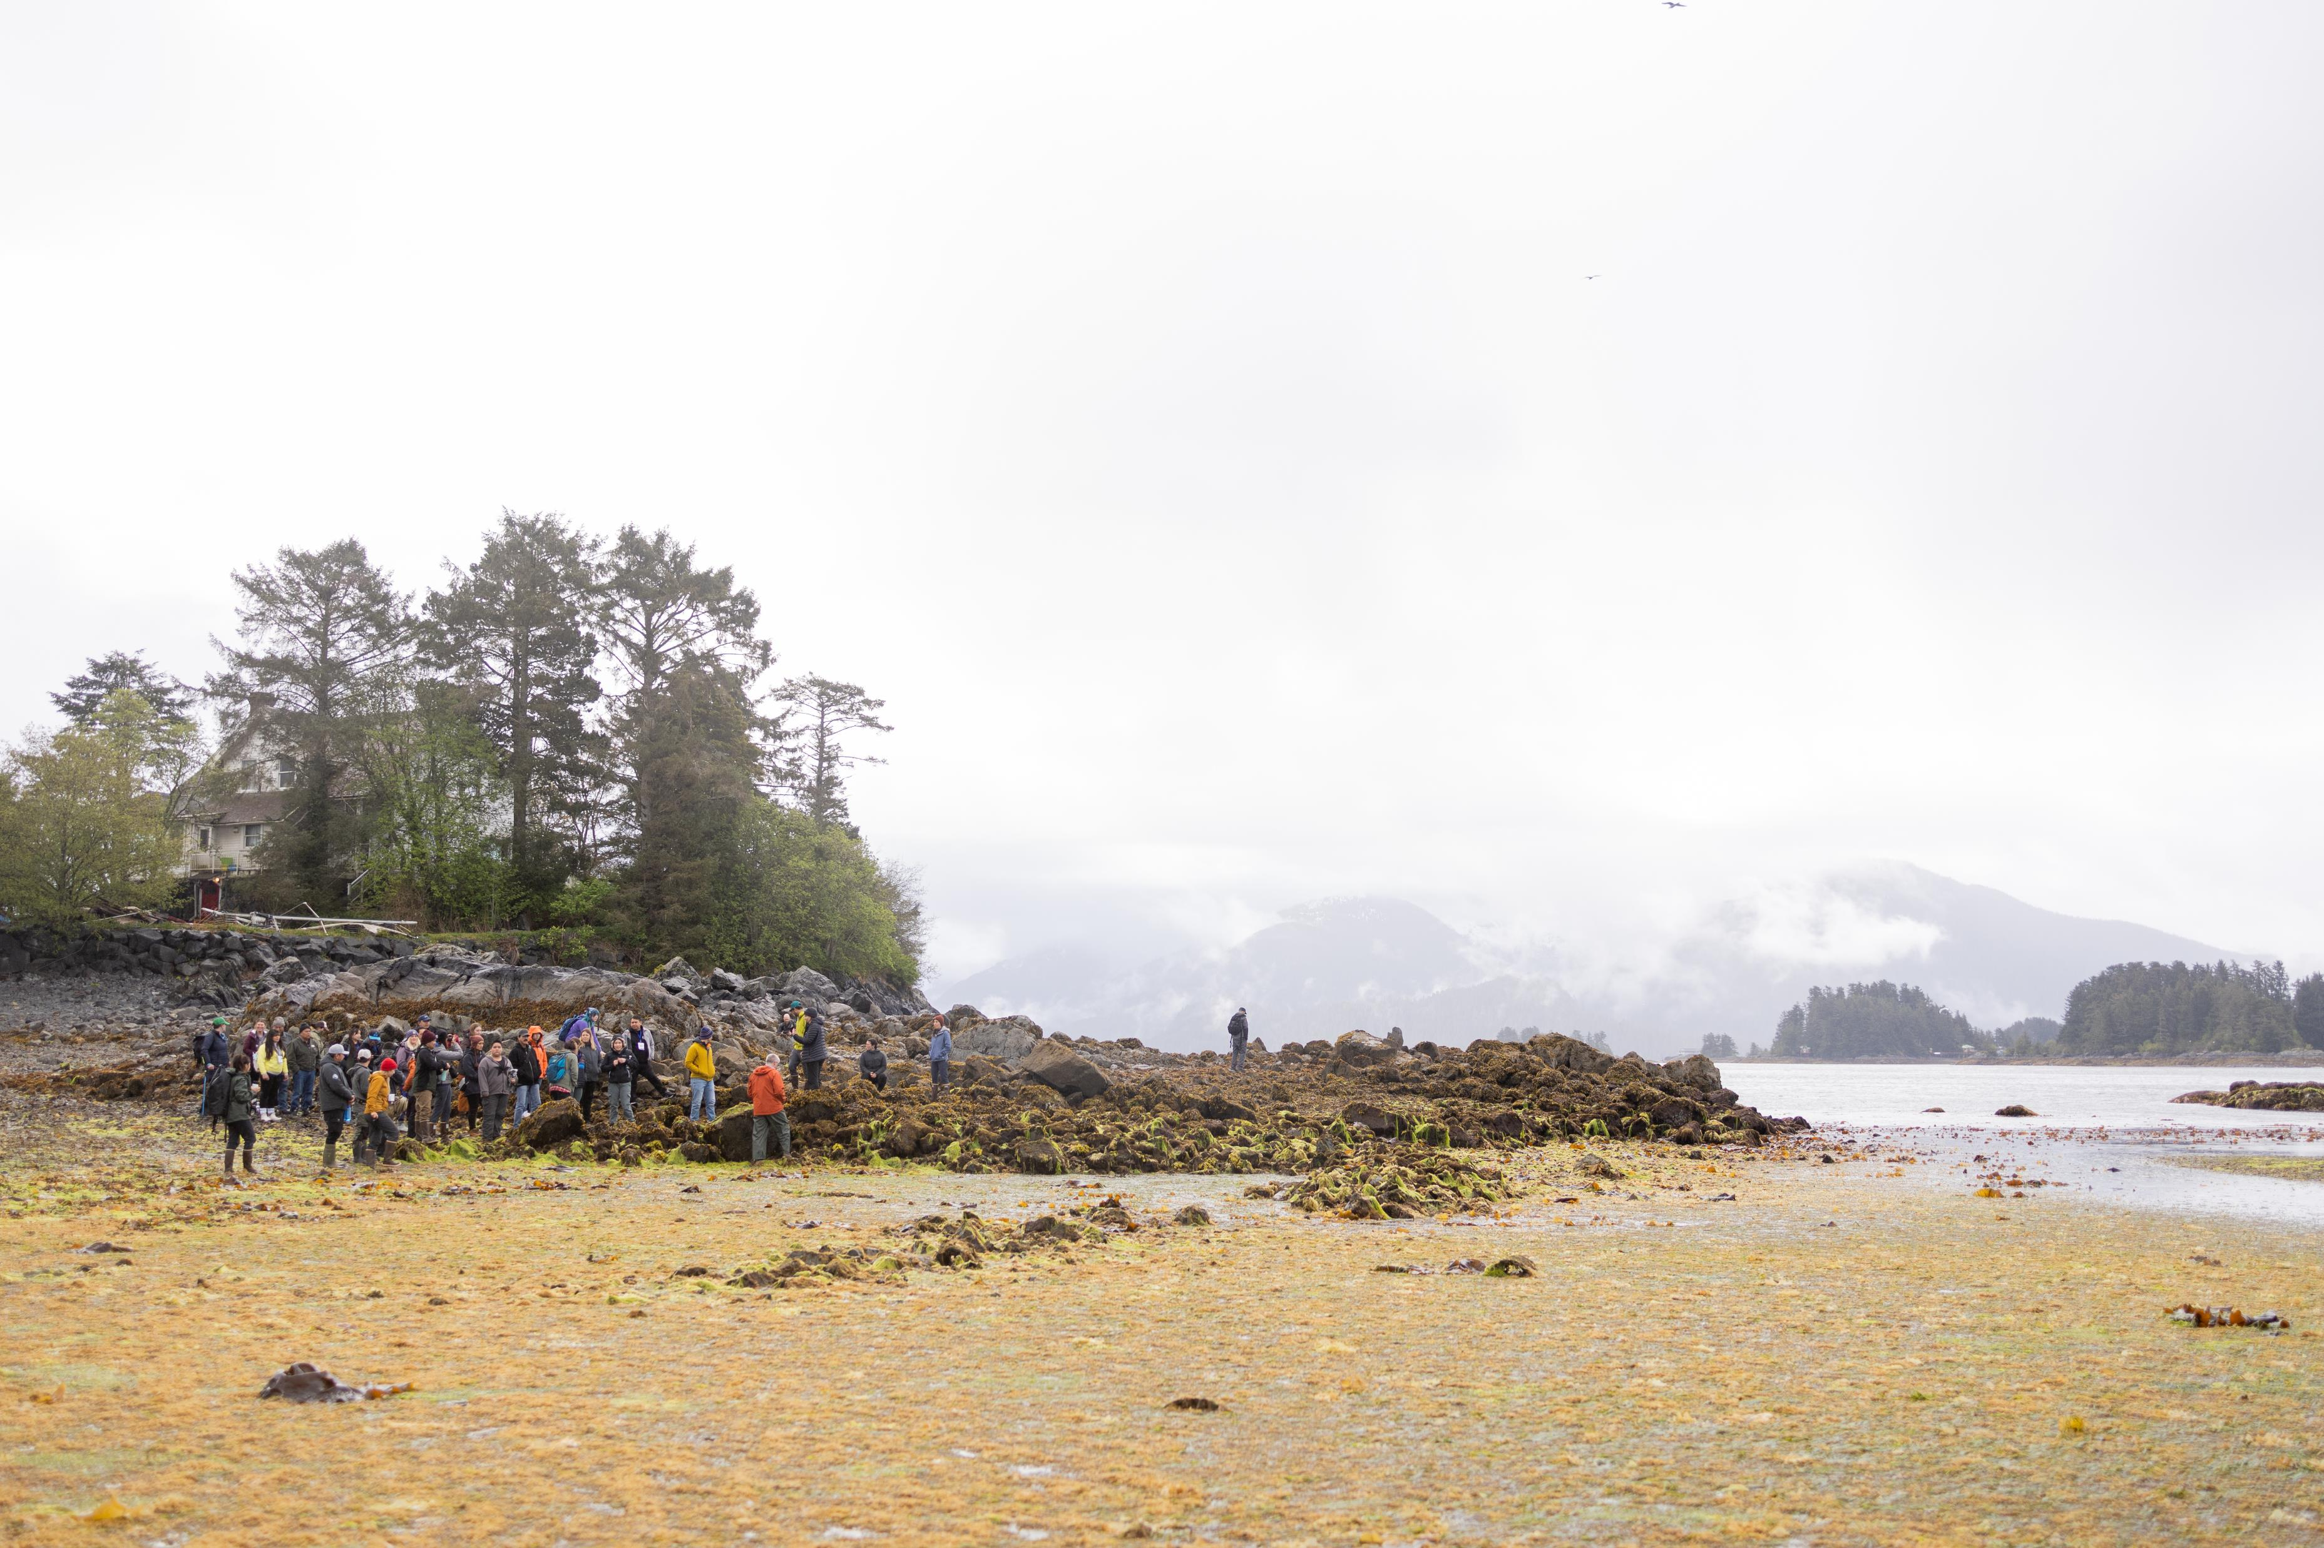
Relationship Building
Clam Garden Gathering with Swinomish Tribes, Washington, USA (August 2022)
Indigenous Aquaculture Collaborative Gathering, Sitka Alaska (May 2024)
Pauquachin Days Clam Garden Gathering, Vancouver Island (August 2025)

Slide 10
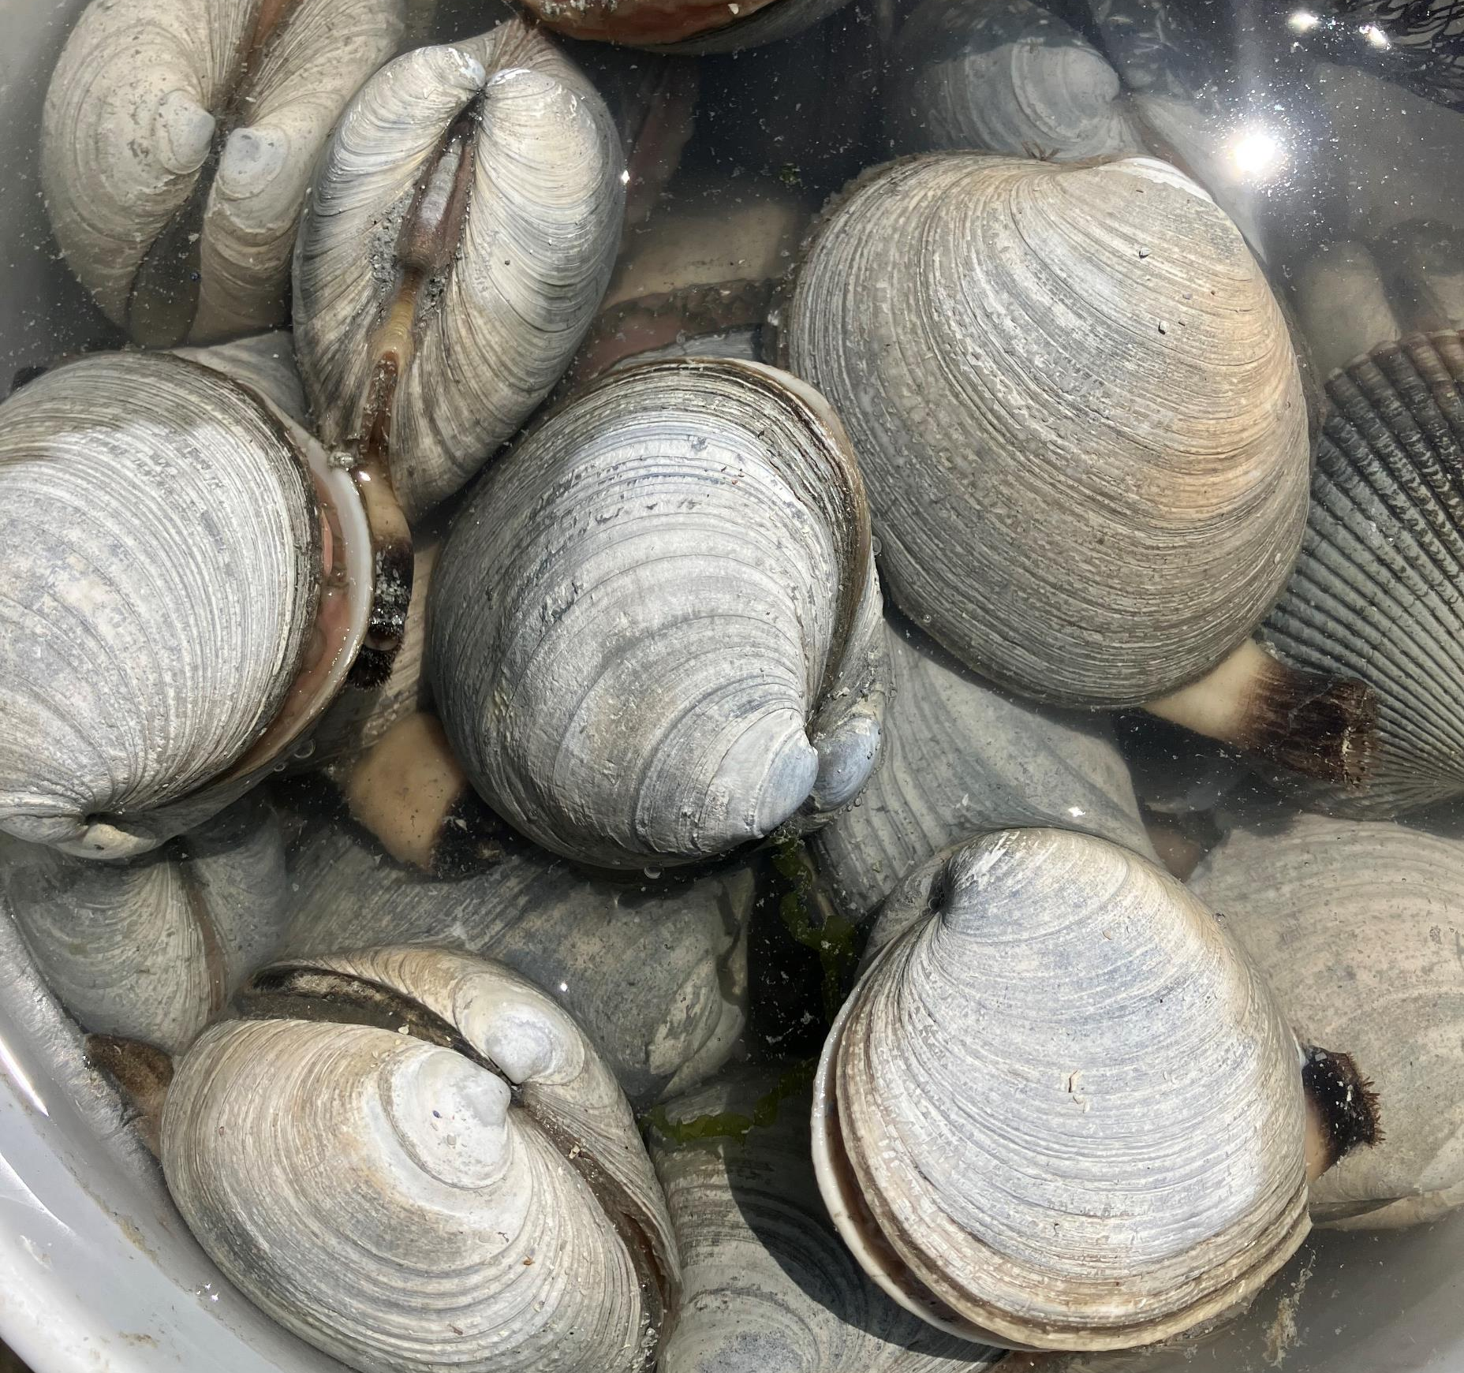
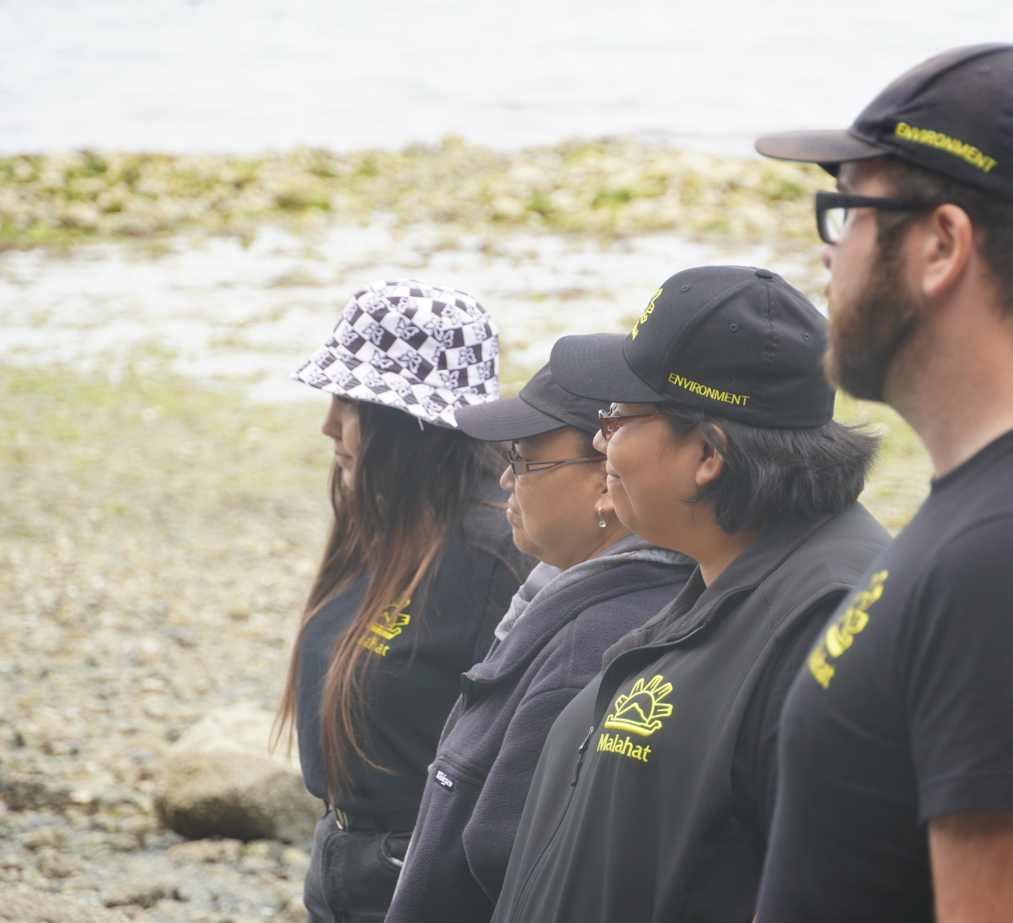
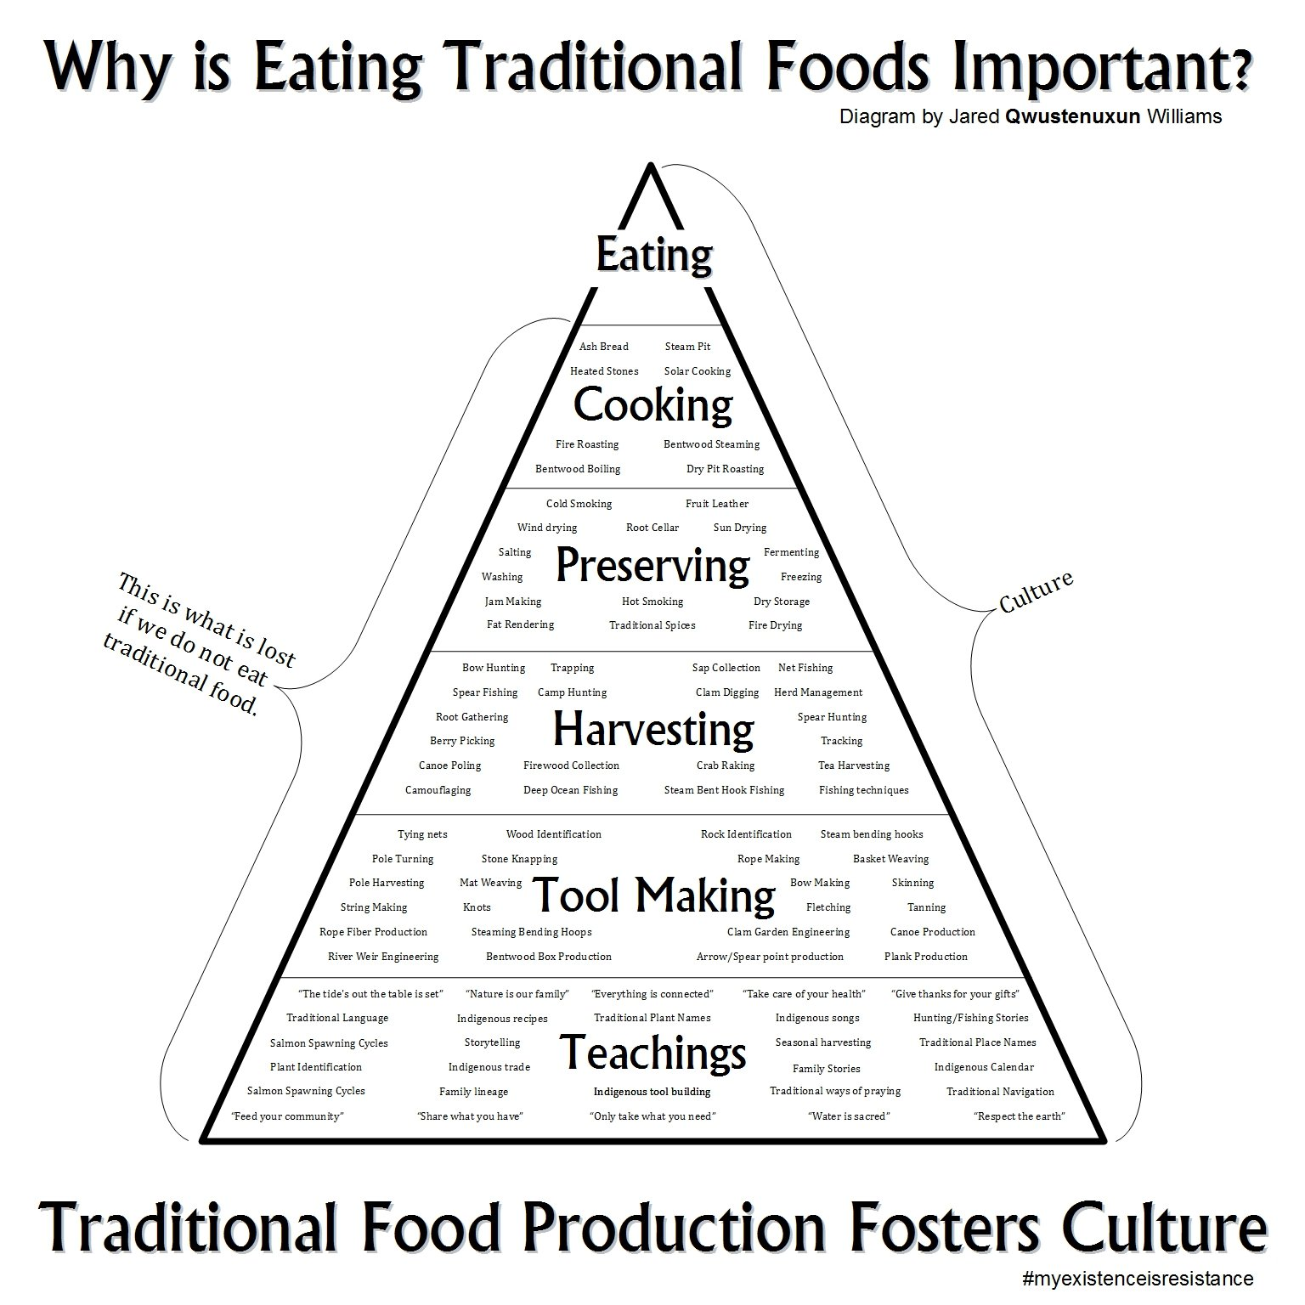
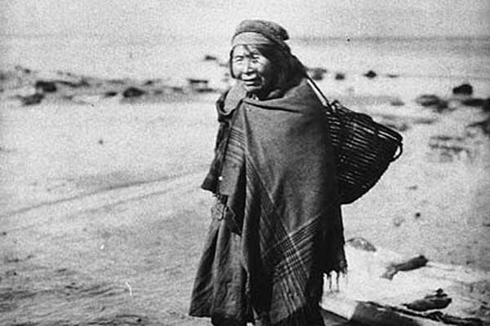
Why should we restore clam gardens?

Slide 11
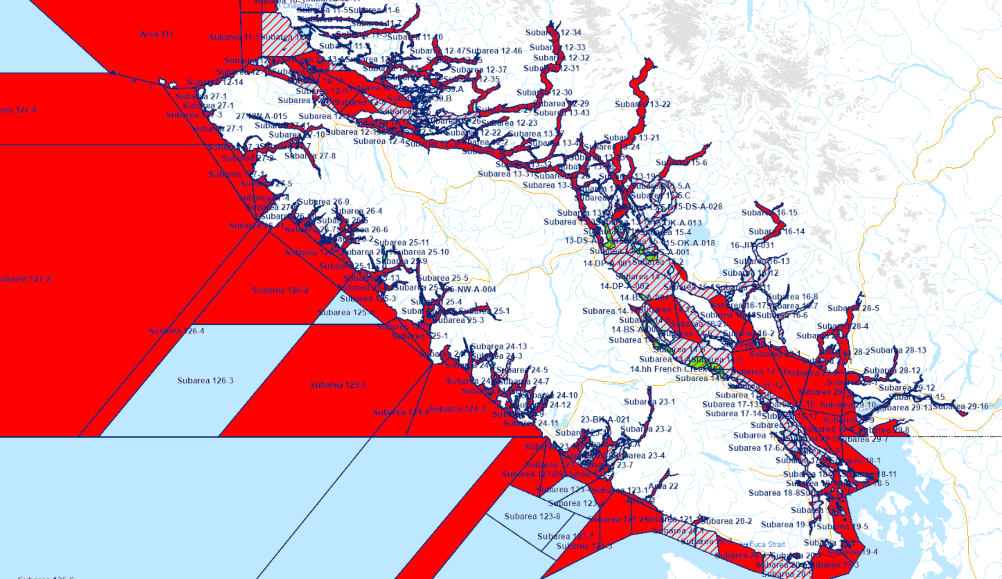
Fisheries and Oceans Canada. (n.d.). Shellfish harvesting map. Government of Canada. https://www.dfo-mpo.gc.ca/shellfish-mollusques/cssp-map-eng.html. Accessed November 2024.
How can ONC help?
will climate change increase the frequency of PSP related closures? can we make predictions?
better understanding of sources of chemical and biological contamination in the Salish Sea and how shellfish are impacted? which species are at risk?
how can we ensure that First Nations receive adequate data to harvest safe traditional foods from the Salish Sea?

Slide 12
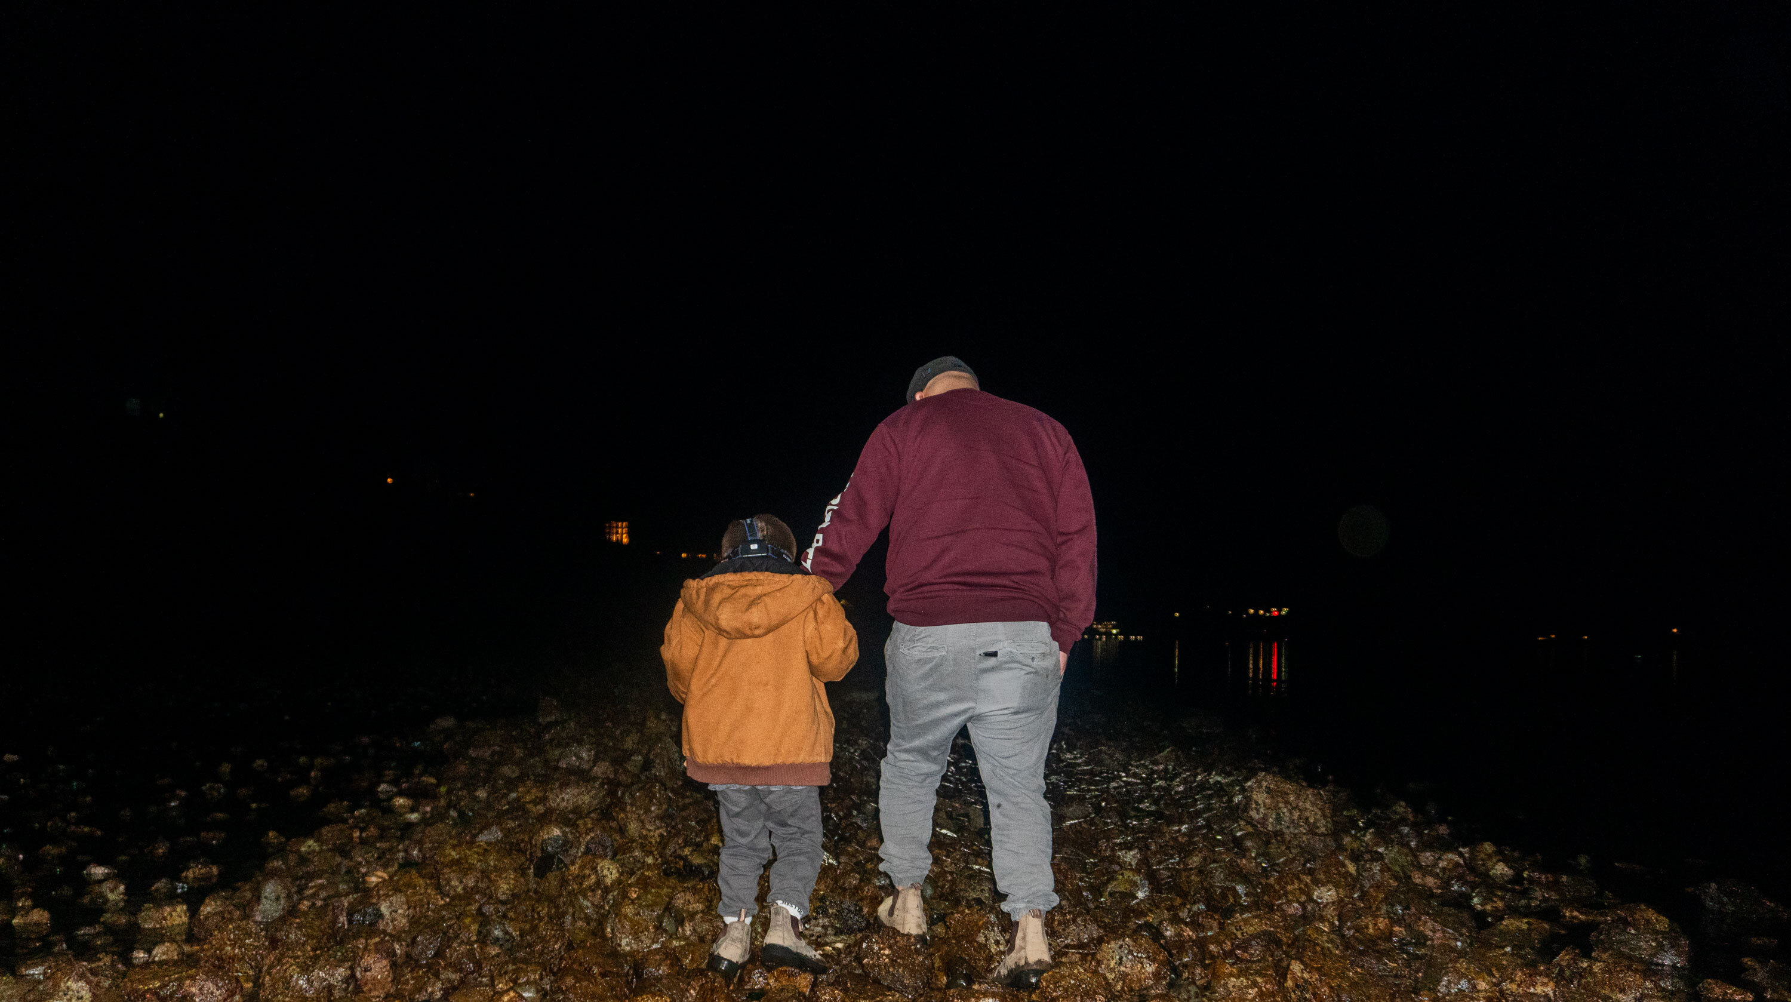
Huy ch q’u meghan.tomlin@malahatnation.com
Huy ch q’u
meghan.tomlin@malahatnation.com
steven.henry2@malahatnation.com
Huy ch q’u
meghan.tomlin@malahatnation.com

