Slide 1

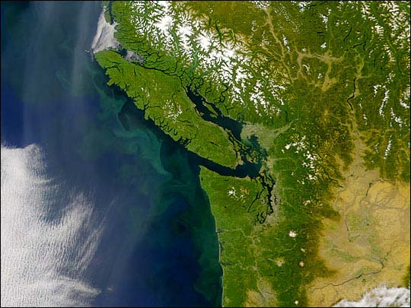

Active acoustics monitoring in the Salish Sea: Pacific hake, Pacific herring, euphausiids, and everything in-between
Stéphane Gauthier
NWFSC)
Midwater trawls (71)
FEAT team, JTC members

Slide 2
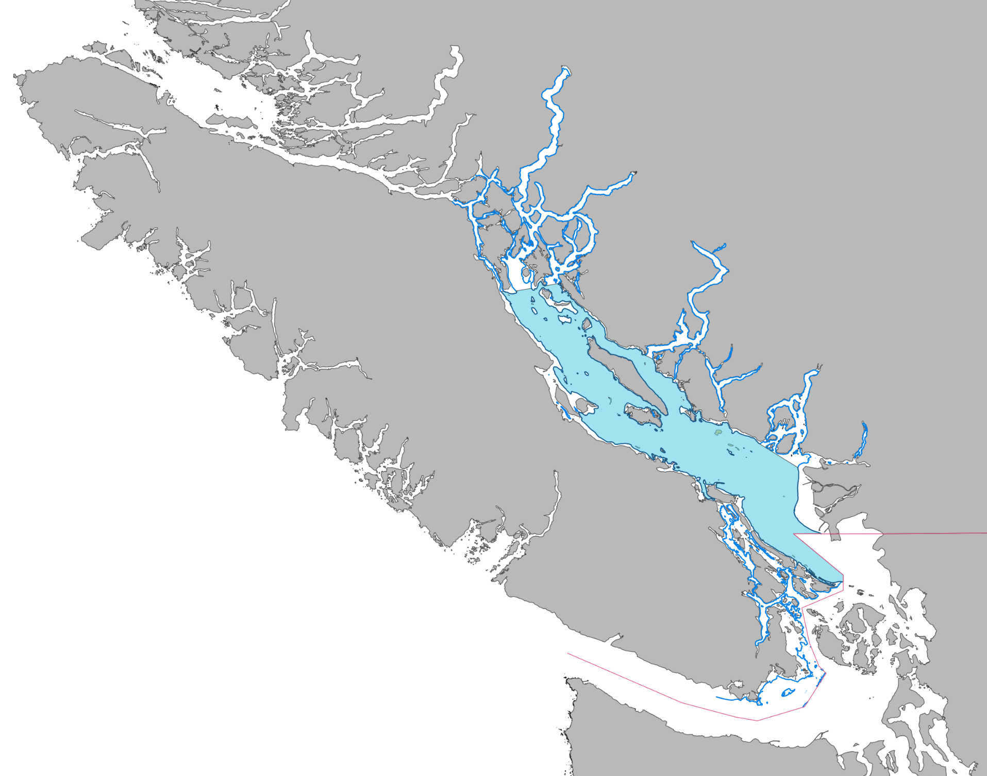

Slide 3
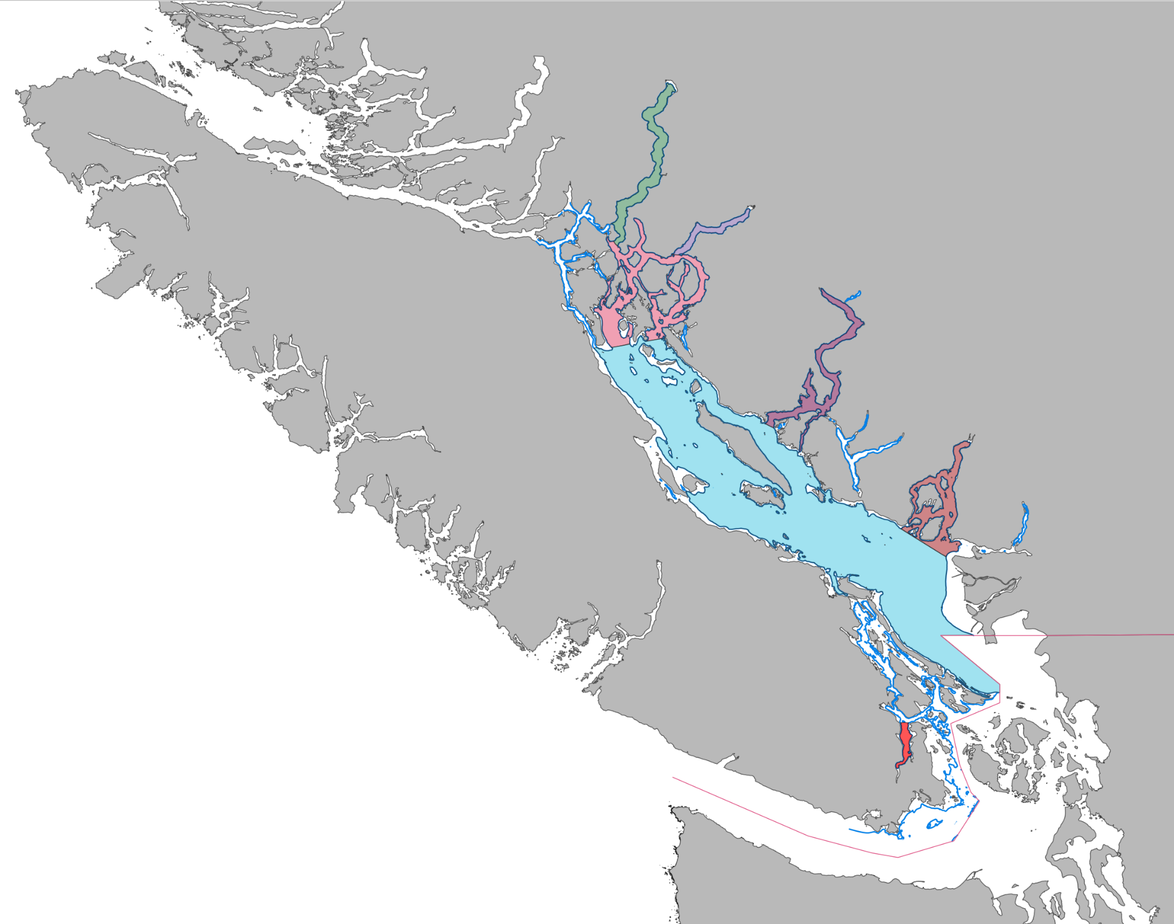
Bute Inlet
Toba Inlet
Jervis Inlet
Desolation Sound
Howe Sound
Saanich Inlet

Slide 4
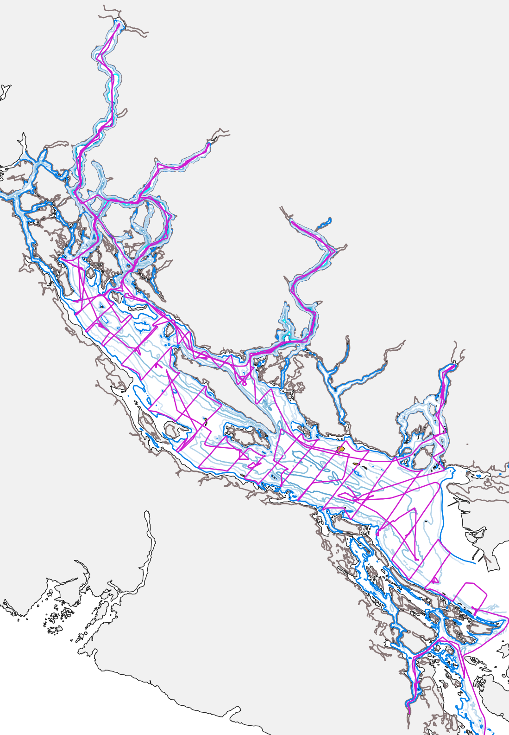
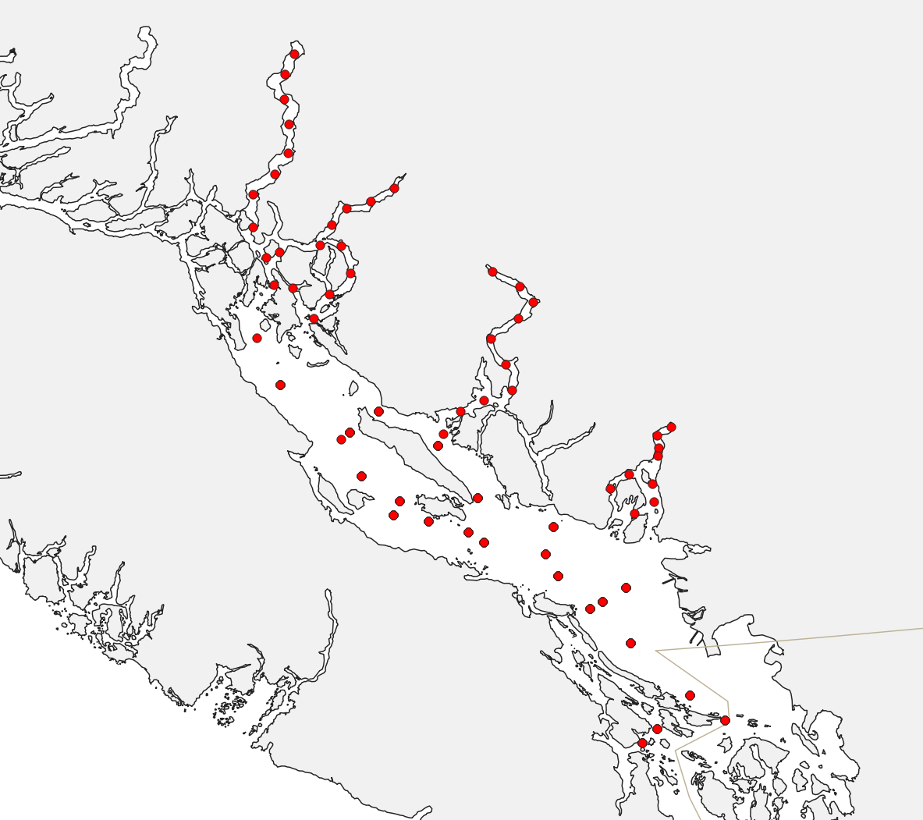
CTD stations as part of:
SOG Zooplankton sampling program
Inlets oceanography program

Slide 5
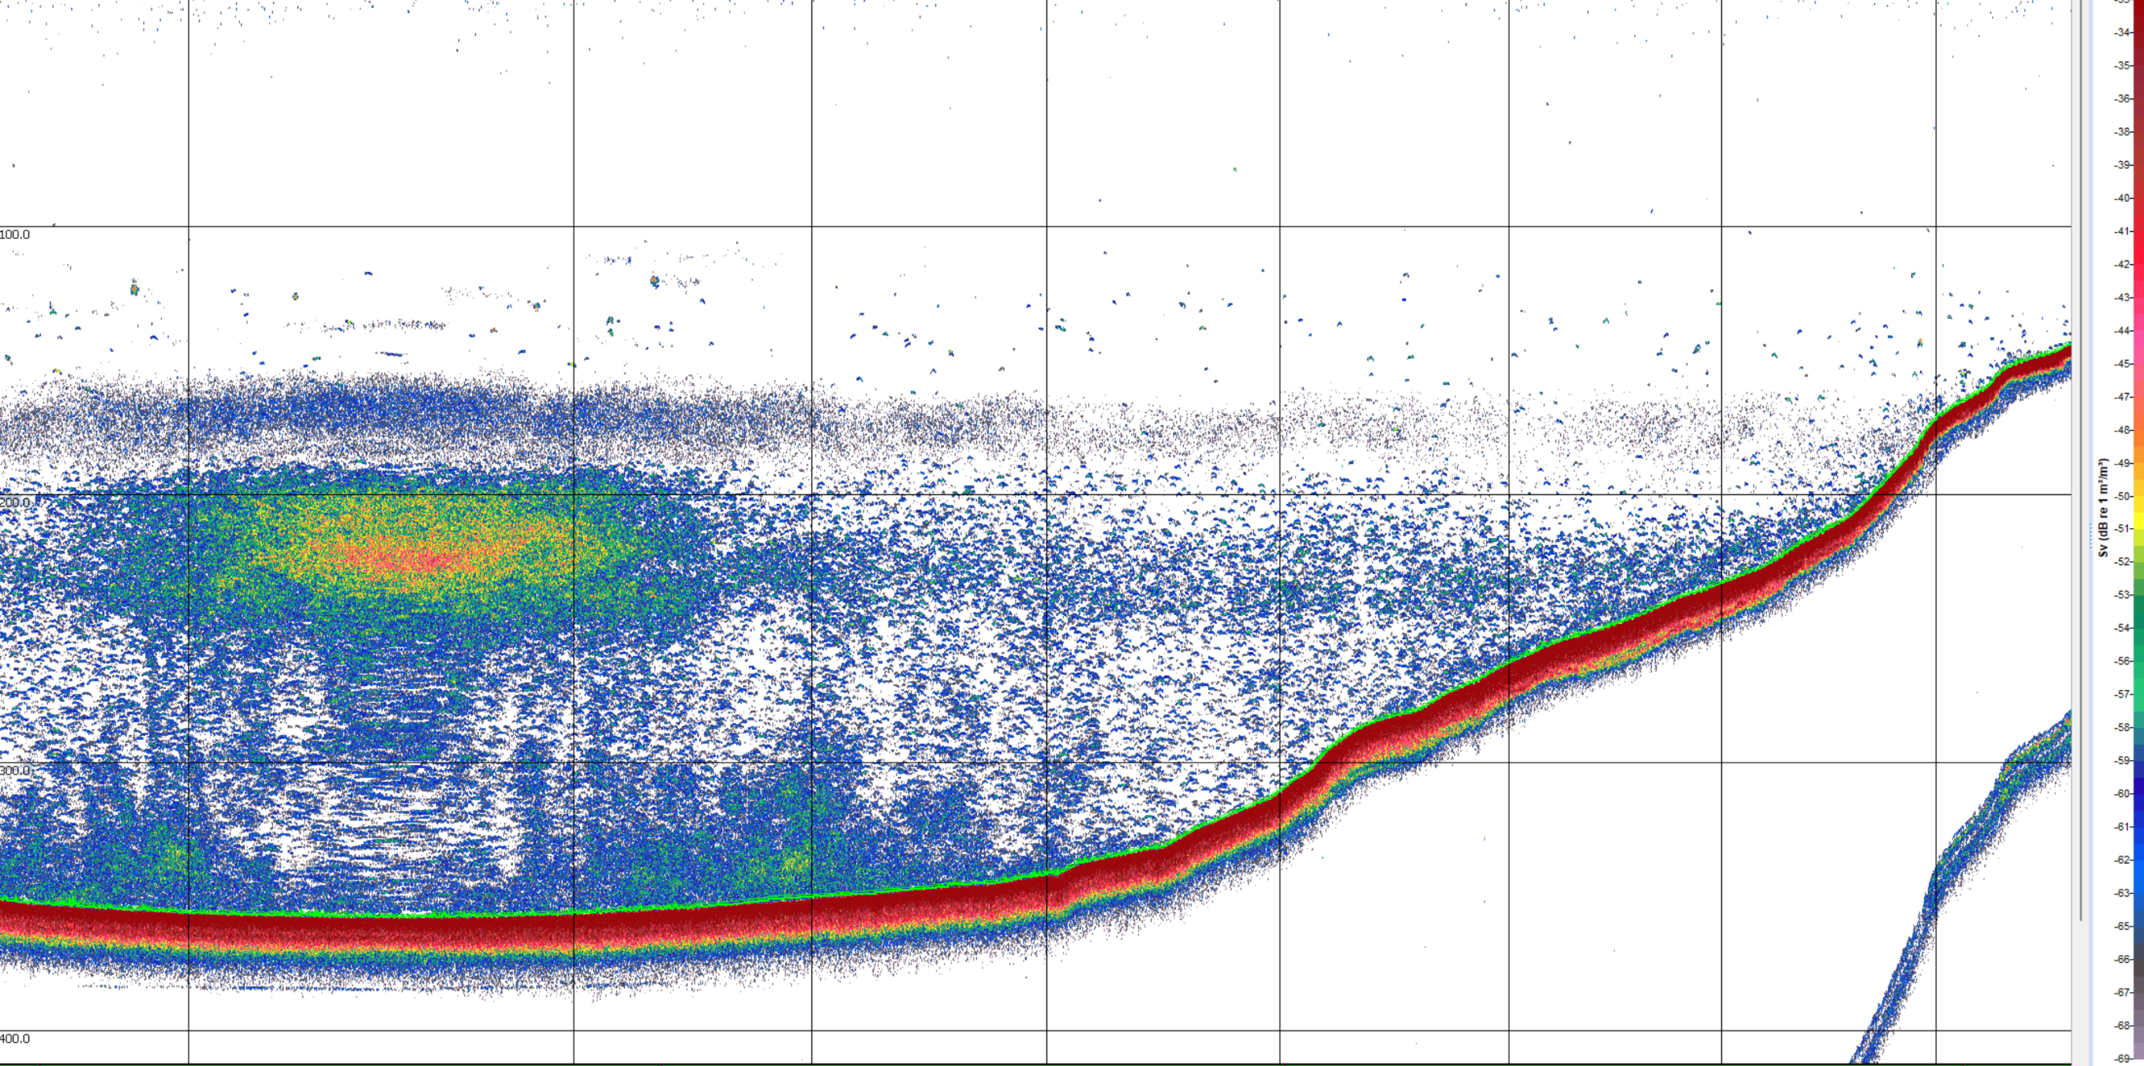
Pacific hake spawning aggregation

Slide 6
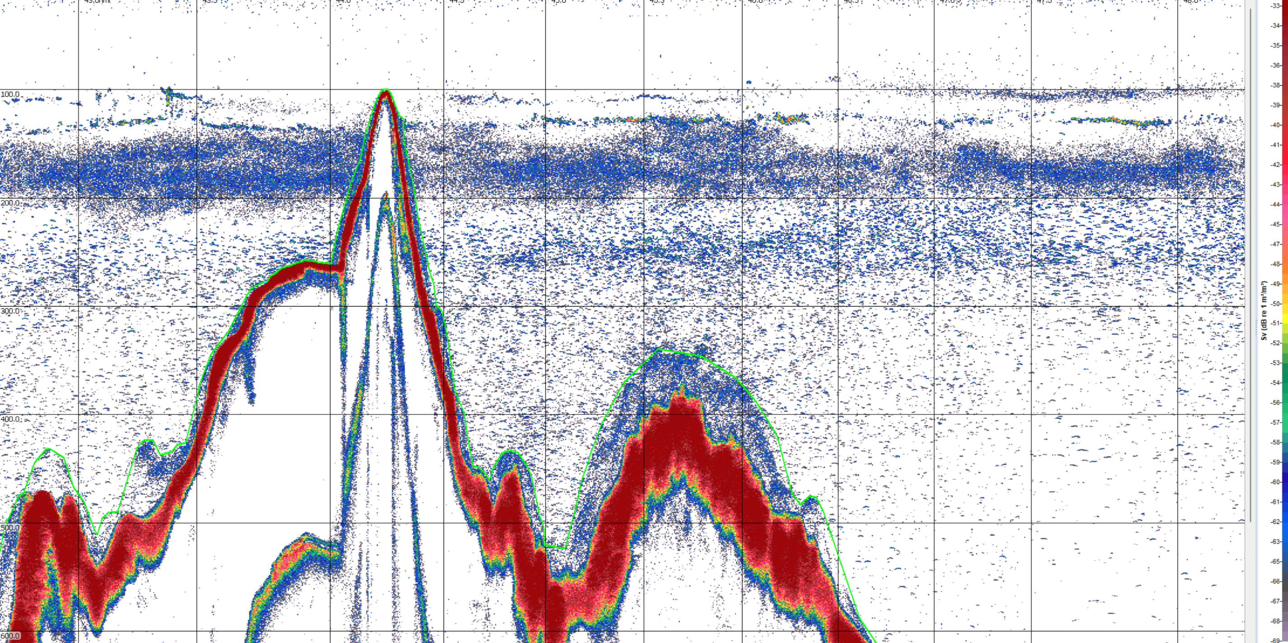
Pacific hake age-1 aggregations

Slide 7
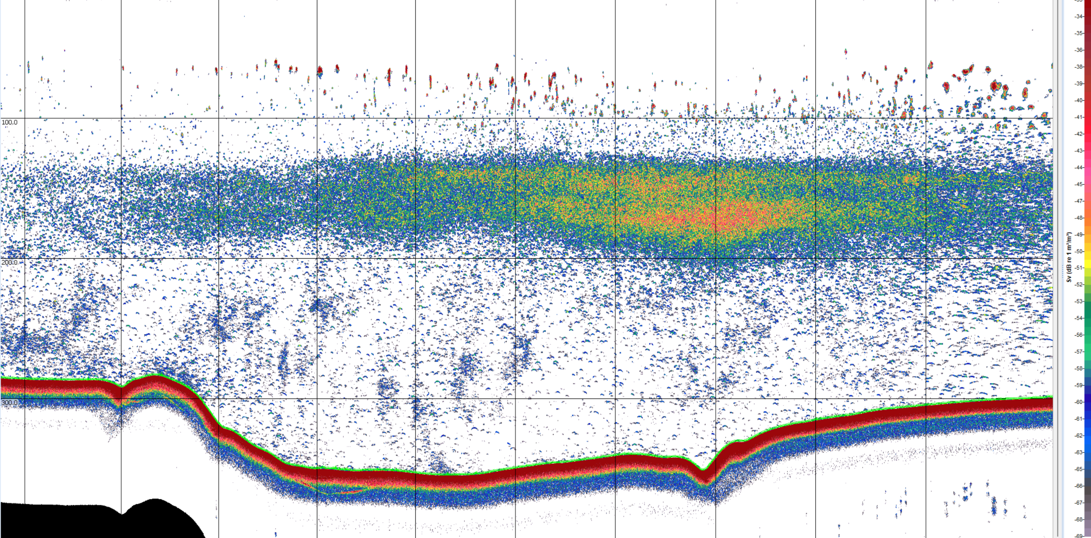
Walleye pollock spawning aggregation

Slide 8
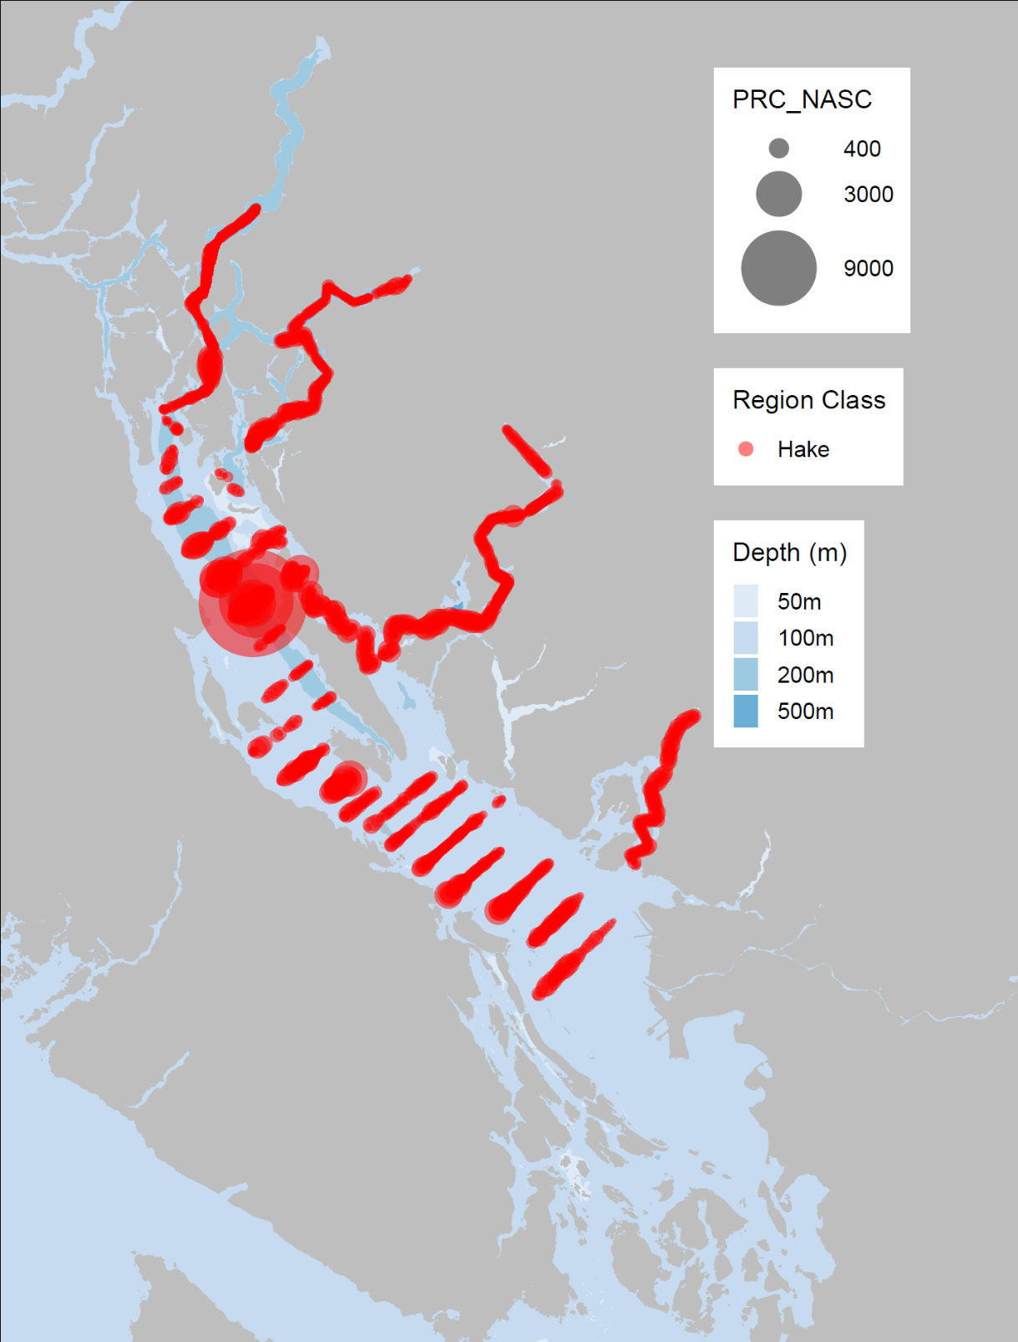
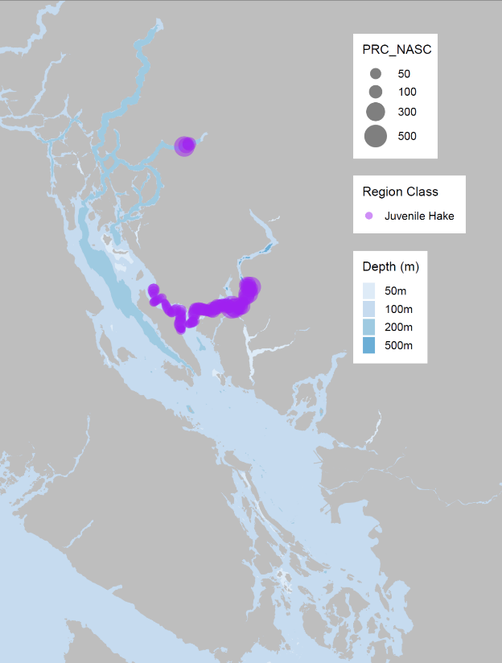
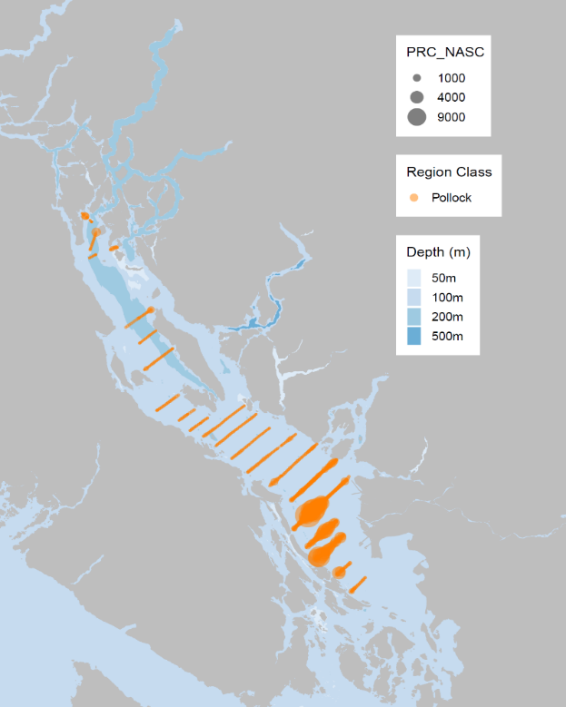
Age 2+
Age 1
Walleye pollock

Slide 9

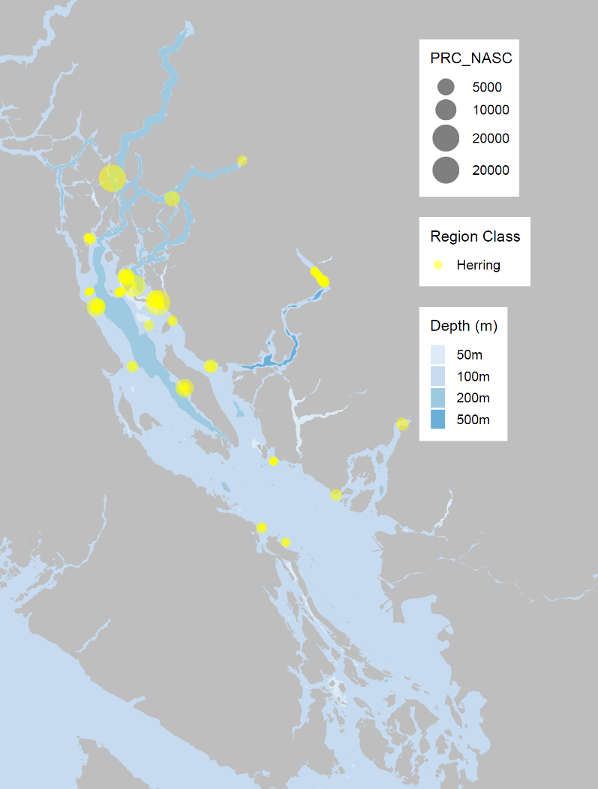
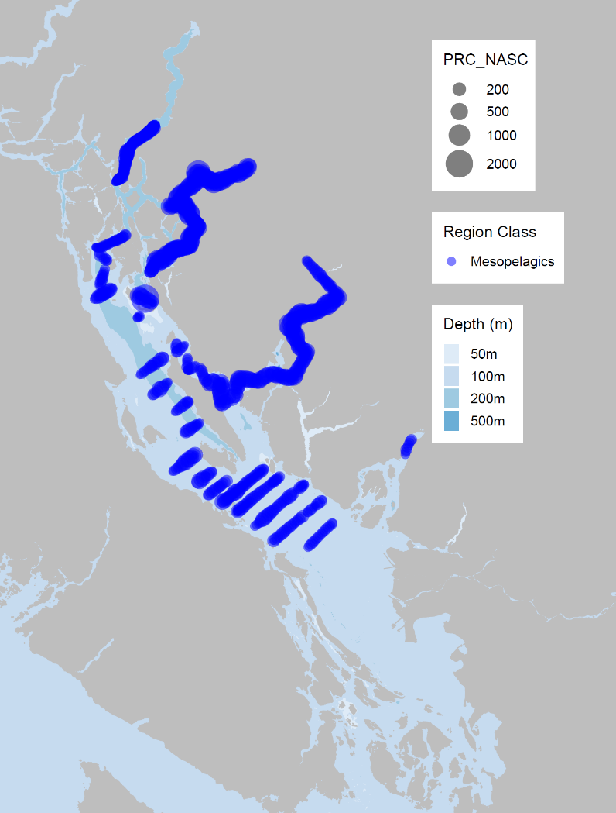
Walleye pollock
Pacific herring
Mesopelagic species

Slide 10
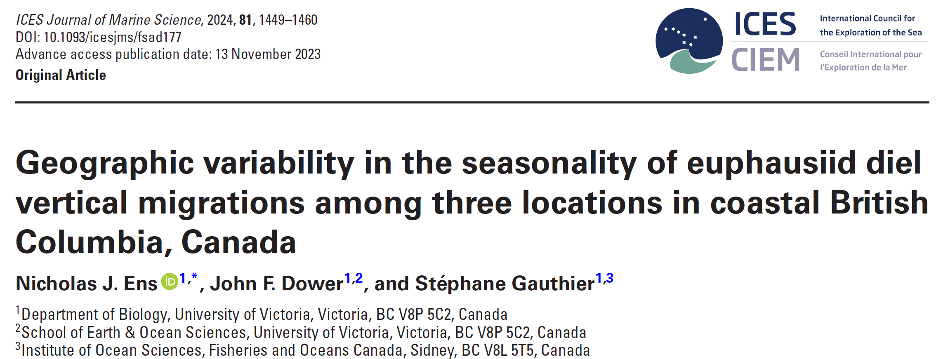
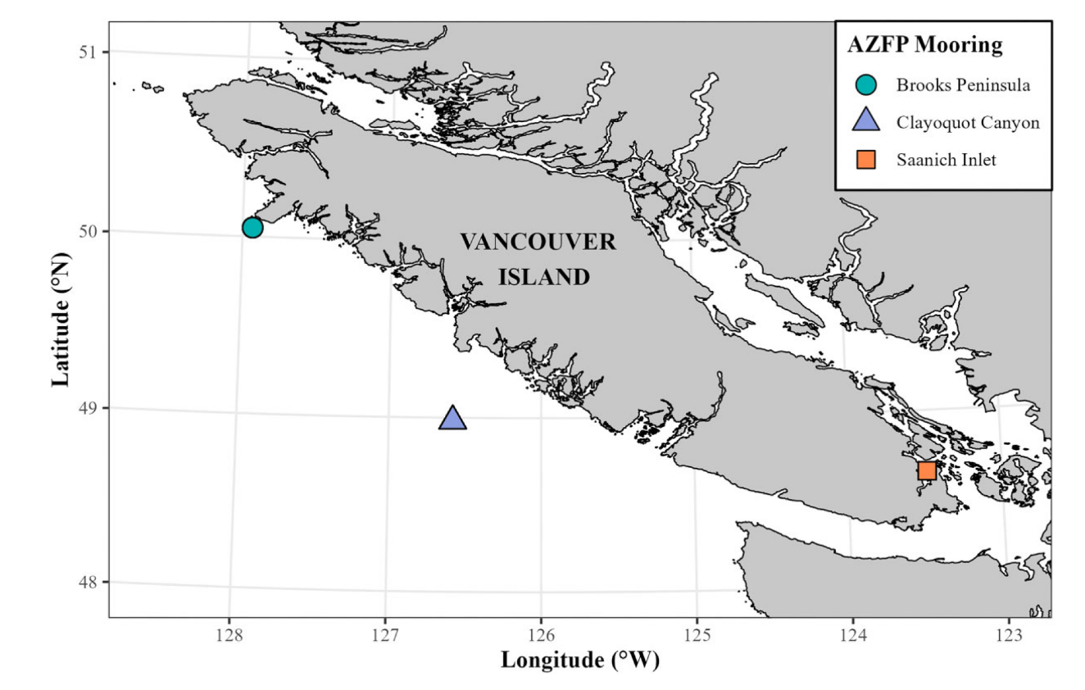
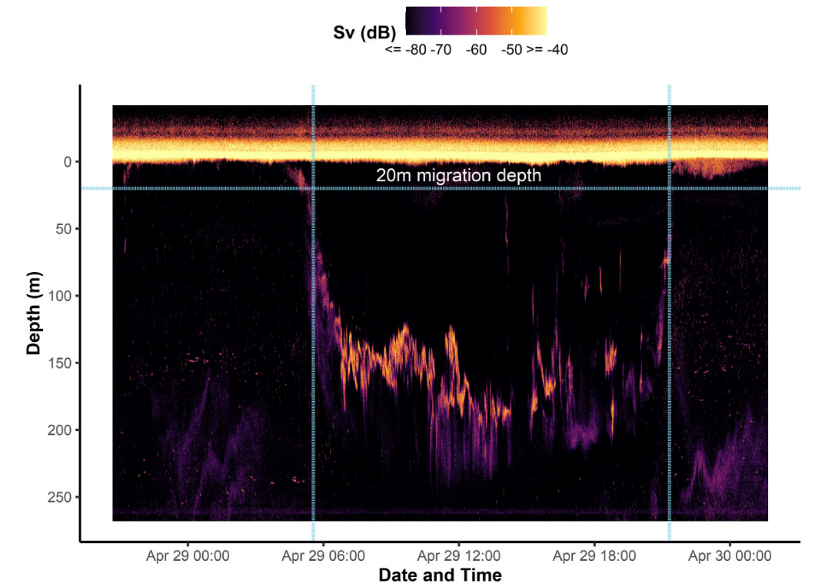
Example use of ONC data/infrastructure

