Slide 1
Integrating Planetary Boundaries thinking into the future of Salish Sea observing systems
Kohen W. Bauer
kohenbauer@oceannetworks.ca

Slide 2
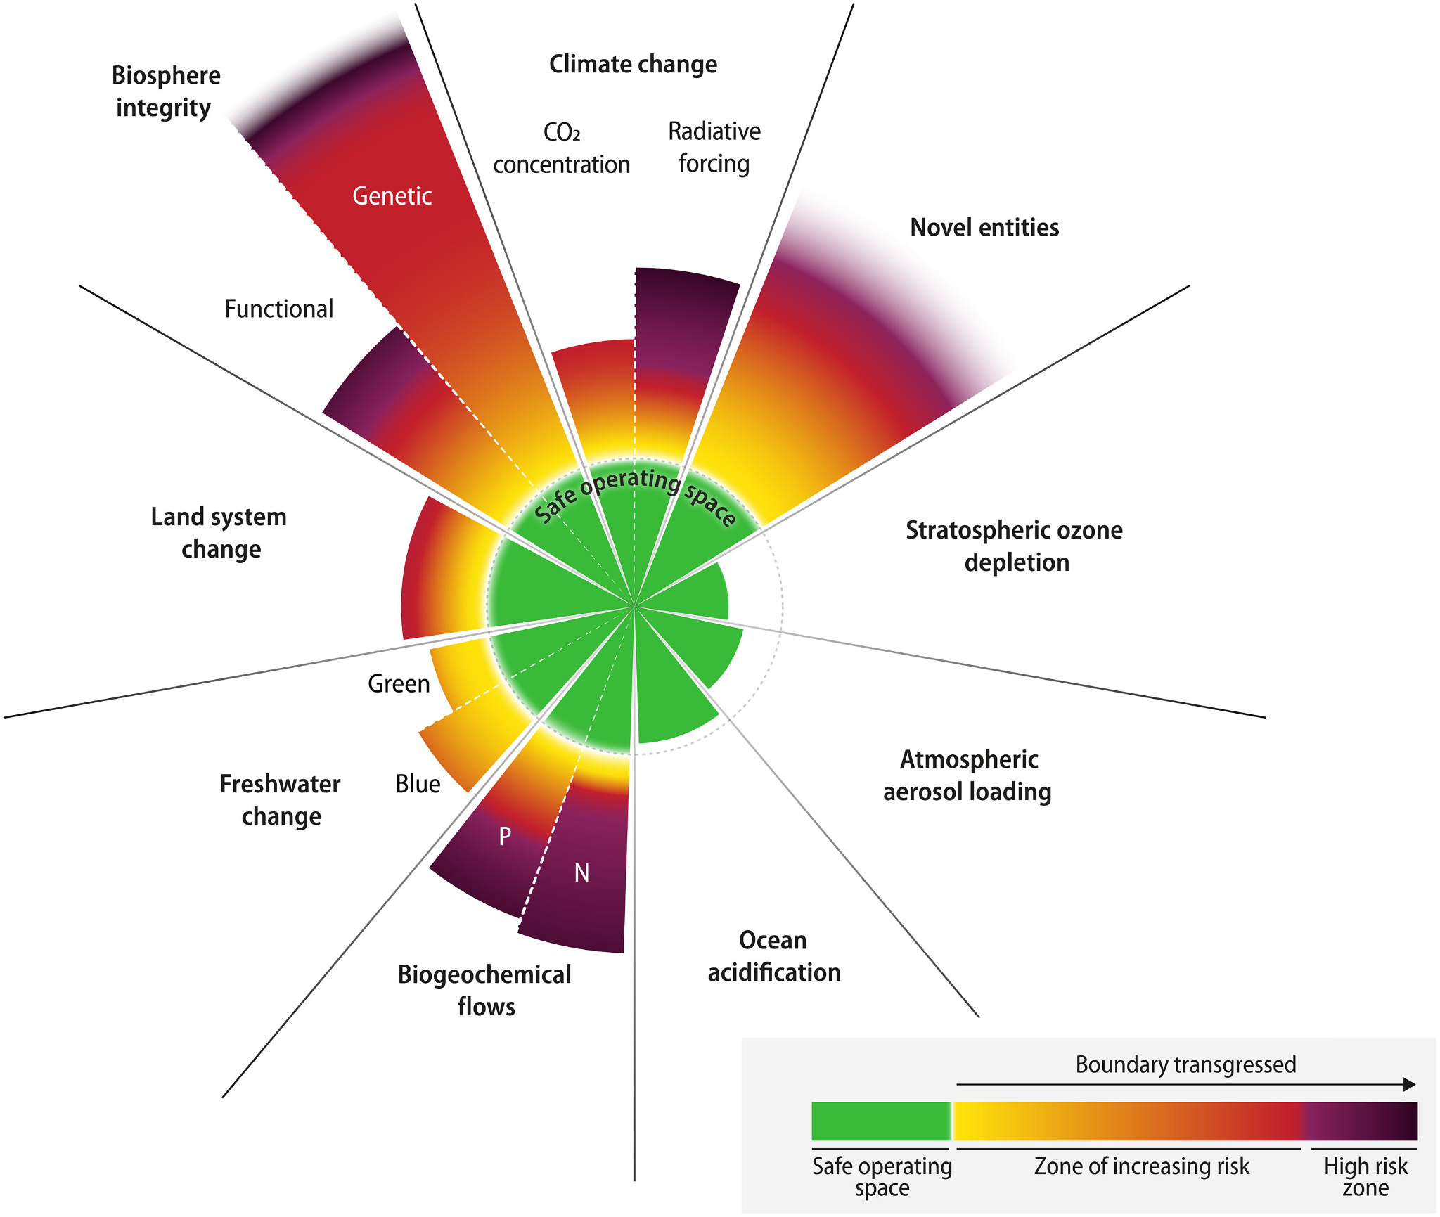
Earth beyond six of nine planetary boundaries
Humanity is placing unprecedented pressure on Earth system.
There is urgent need for robust scientific and policy tools for analyzing the whole of the integrated Earth system with reliability and regularity.
These fundamental ecological limits downscale to the Salish Sea region.
Richardson et al., (2023), Science Advances
Notes:
The planetary boundaries framework is a science-based way to define the safe operating space for humanity on Earth. It identifies nine critical Earth system processes—like climate change, ocean acidification, and biosphere integrity—and sets quantitative limits, or “boundaries,” that we should not cross to avoid destabilizing the planet.
For ocean observing, this framework is especially powerful. The ocean is central to many planetary boundaries—it regulates climate, absorbs CO₂, buffers acidification, and supports biodiversity. By monitoring the ocean in detail, we can track how close we are to crossing these boundaries, detect early warning signs of tipping points, and inform policy to keep us within safe limits.
Ocean observing systems provide essential data on temperature, pH, oxygen levels, currents, and ecosystems—making them vital tools for measuring planetary health. In short, applying the planetary boundaries framework to ocean observing helps us move from simply collecting data to using it to manage Earth’s systems sustainably for future generations.

Slide 3
An observing system for the Salish Sea grounded in the PB framework
Identify and Track Critical Biogeochemical Thresholds: Monitor essential indicators like oxygen, acidification (pH, Ω), nutrients, and carbon fluxes.
Resolve Coupled Land–Sea Processes: Capture riverine inputs, urban runoff, and nutrient flows to quantify perturbations that cross coastal boundaries.
Advance Predictive Capacity: Support real-time sensors and models that can predict threshold exceedance (e.g., hypoxia events), providing actionable information for management and mitigation.
Support Equity and Co-Governance: Include Indigenous Knowledge and coastal community priorities in observing design to ensure sustainability goals respect social foundations alongside biophysical limits.
Inform Downscaling of Global Limits: Link local observations to Earth system models, enabling translation of planetary-scale boundaries into regionally meaningful targets and management strategies.

