Slide 1
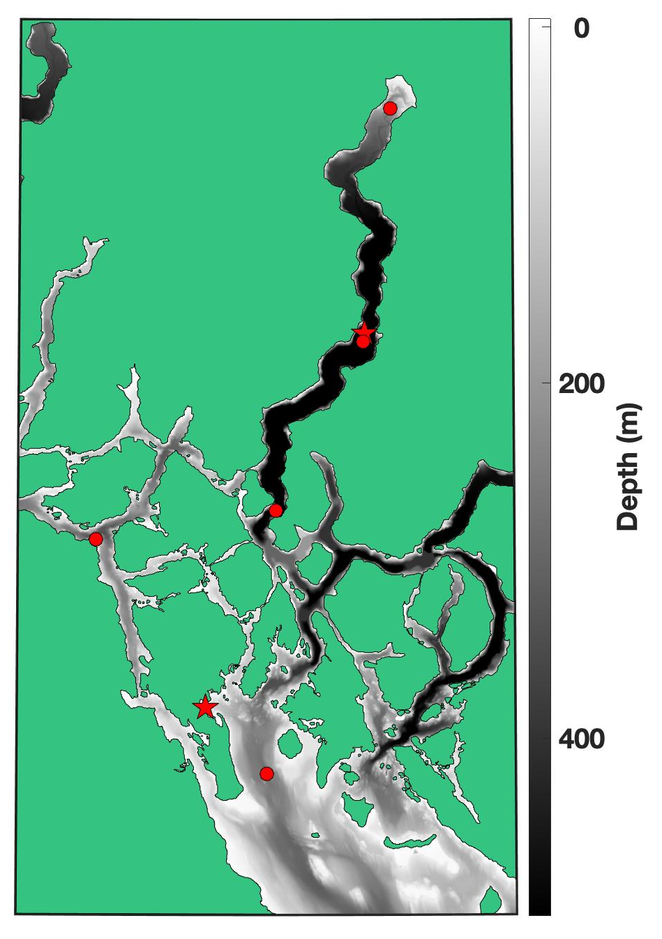
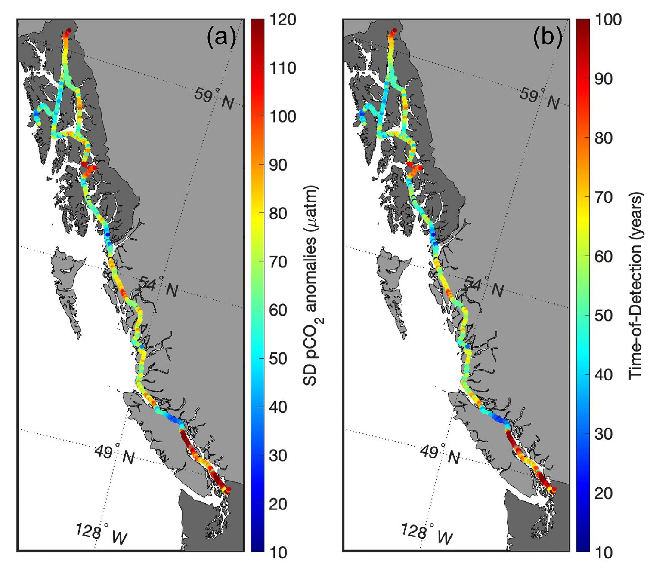

Hakai Institute’s Marine CO₂ Studies in the Northern Salish Sea
ONC VENUS Salish Sea Workshop, Wiley Evans, July 16 2025
Guiding science question:
How does the marine CO₂ system vary from event to inter-annual timescales and what are the drivers?
Current observing sites

Slide 2
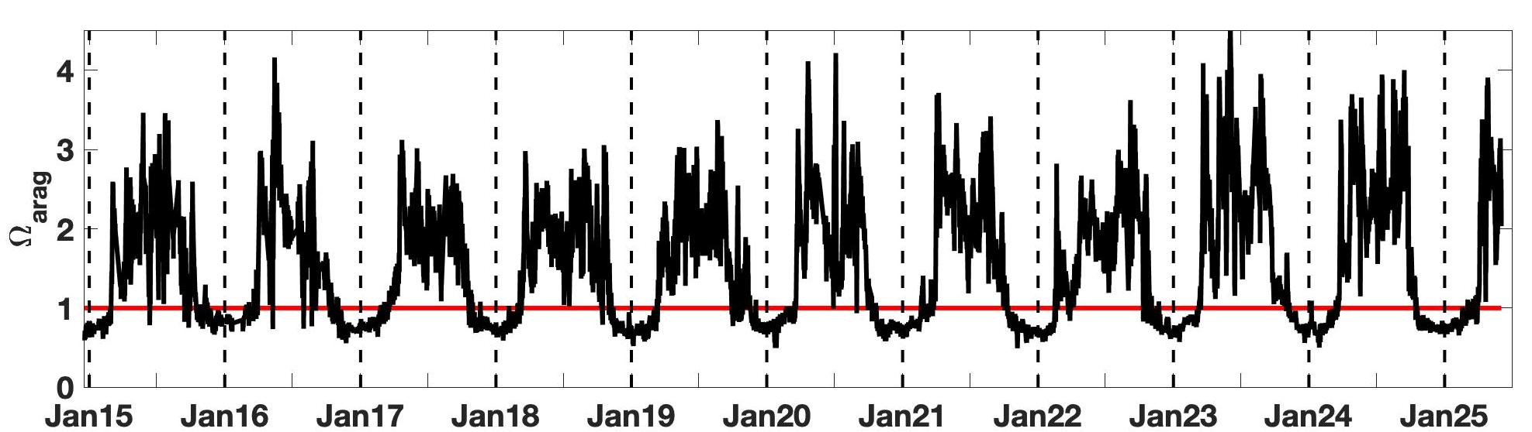
Continuous CO₂ observing at the Quadra Island Field Station
● Large amplitude variability over a range of timescales; seasonal to event during summer
● Summer variability associated with northwesterly wind events that appear to impact large areas of the Strait of Georgia
Notes:
Satellite image is 1 KM from NOAA Polar Operational Environmental Satellite (POES) Advance Very High Resolution Radiometer (AVHRR) daily average of night and day passes

Slide 3
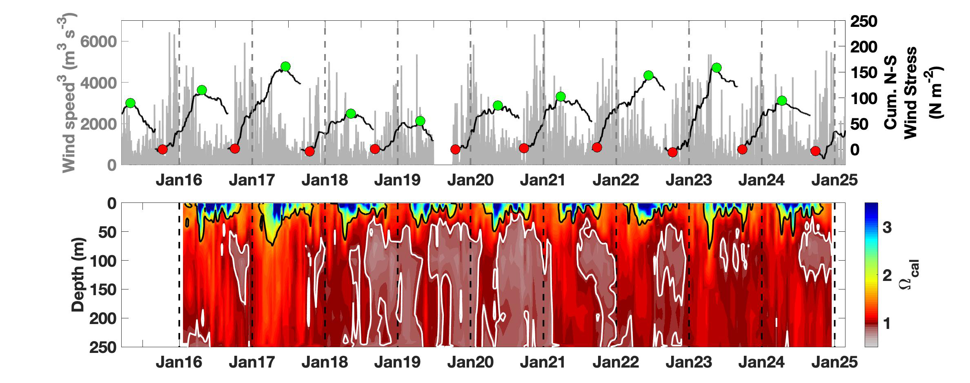
Bi-weekly CO₂ observing at oceanographic station QU39
● Corrosive conditions for calcite in intermediate water from late summer into winter
● Interannual variability correlated with storm season cumulative wind stress; weak storm season intensity = more corrosive conditions
● Extensive corrosive conditions from 2018 to 2020, then improving to 2023, then increasing again in 2024

Slide 4
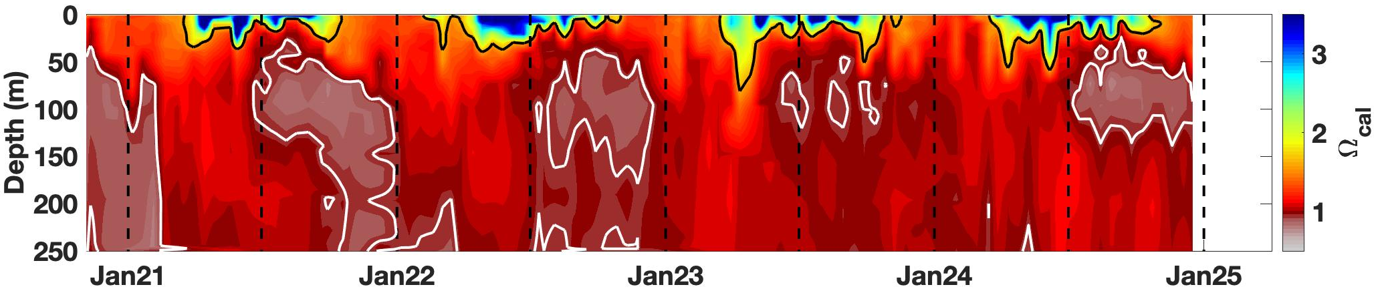
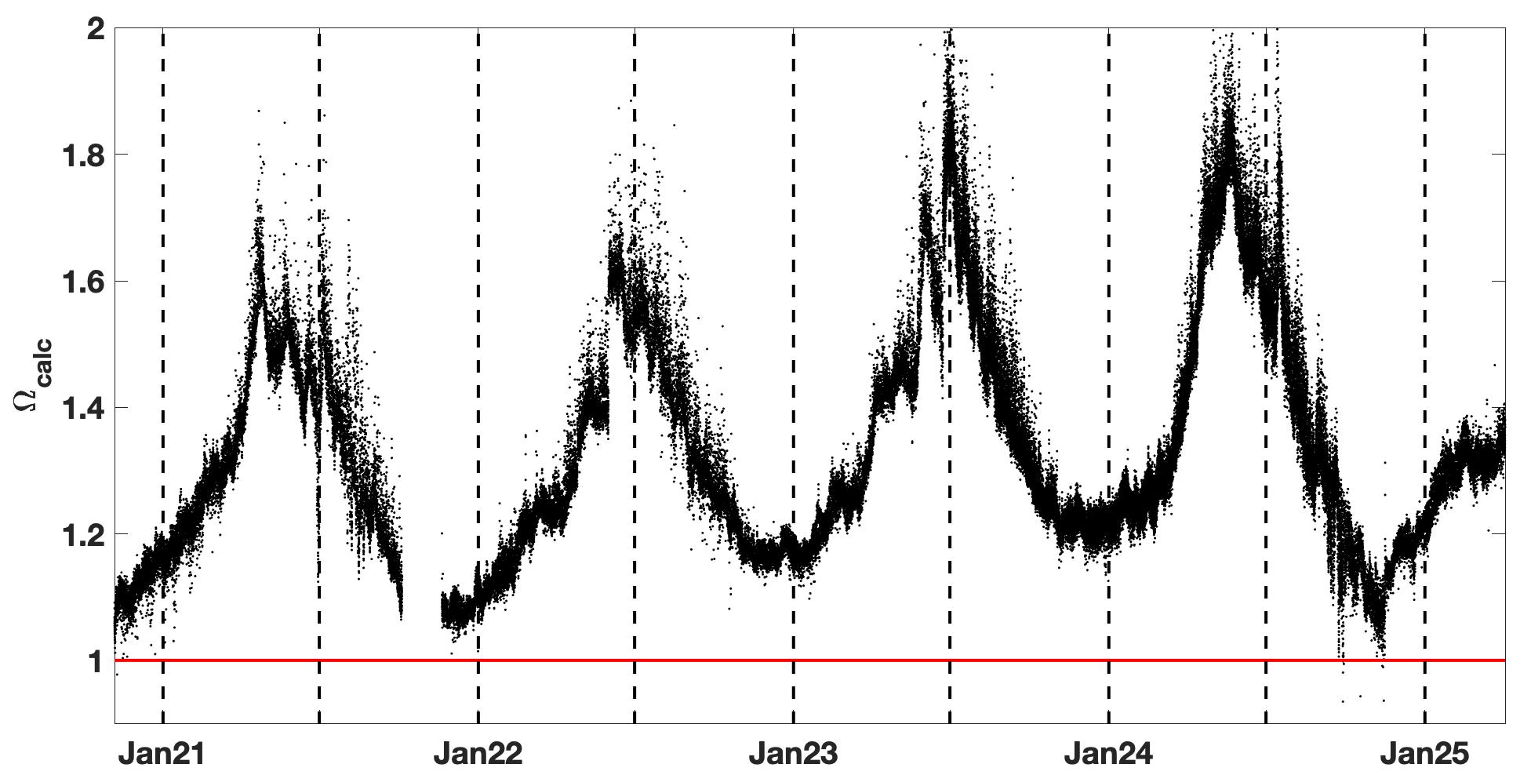
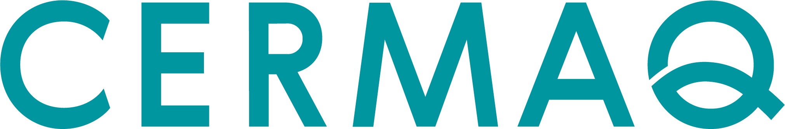
Continuous CO₂ observing in Johnstone Strait
● Similar seasonality in nSoG intermediate water and Johnstone Strait surface water
● Seasonal minima lower in 2024 than in previous years
Influence of nSoG intermediate water? Important for other peripheral areas?

Slide 5
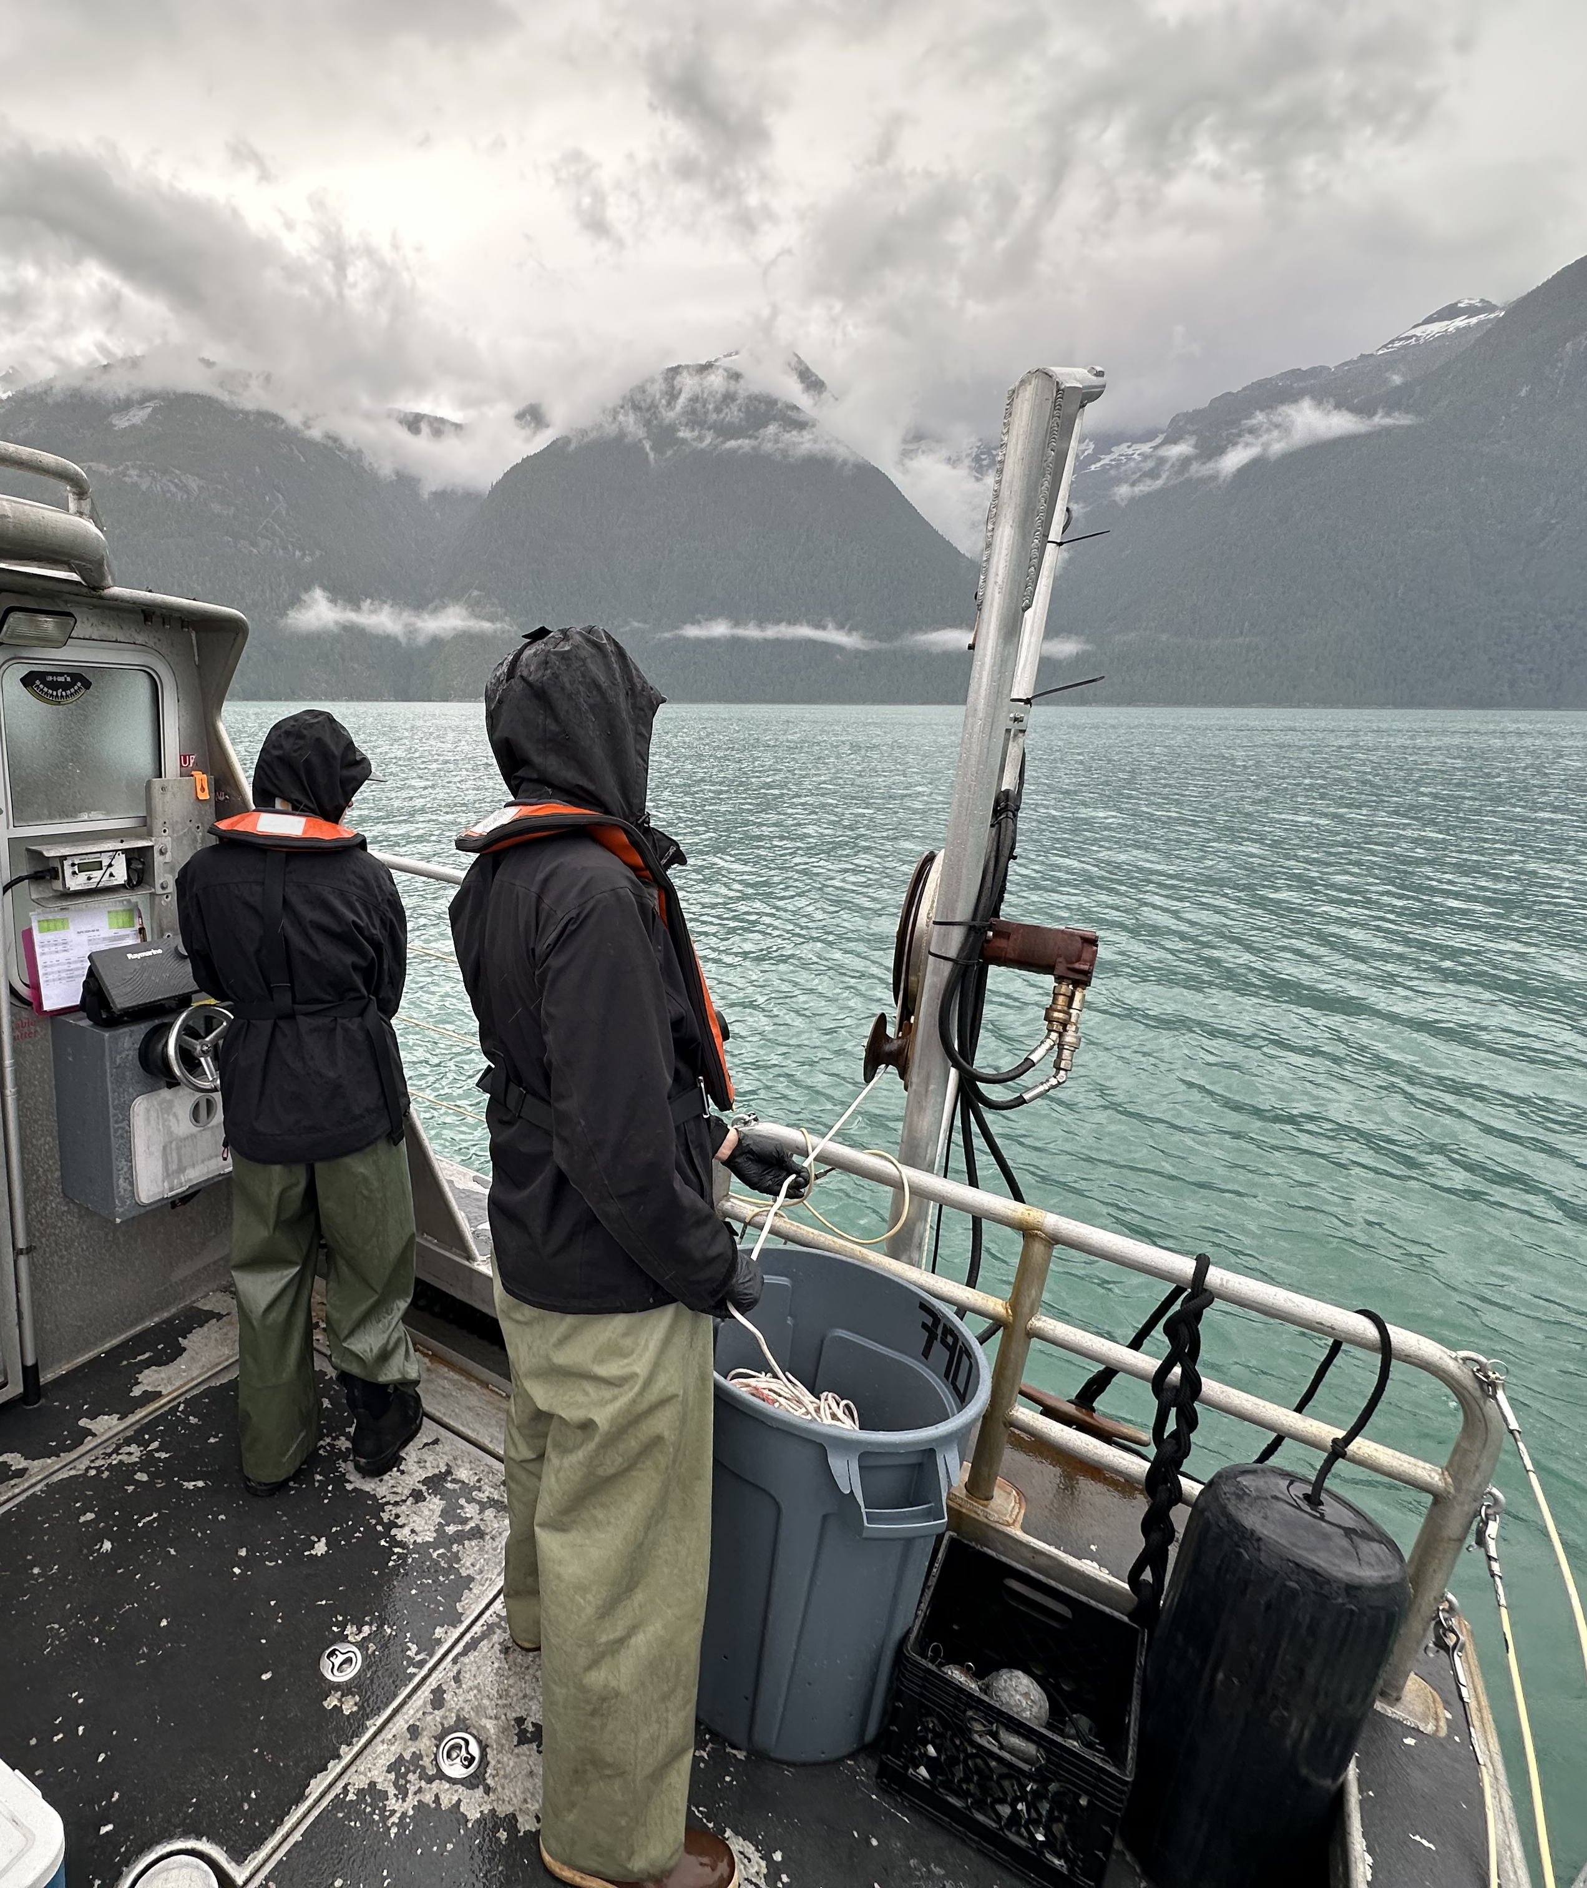
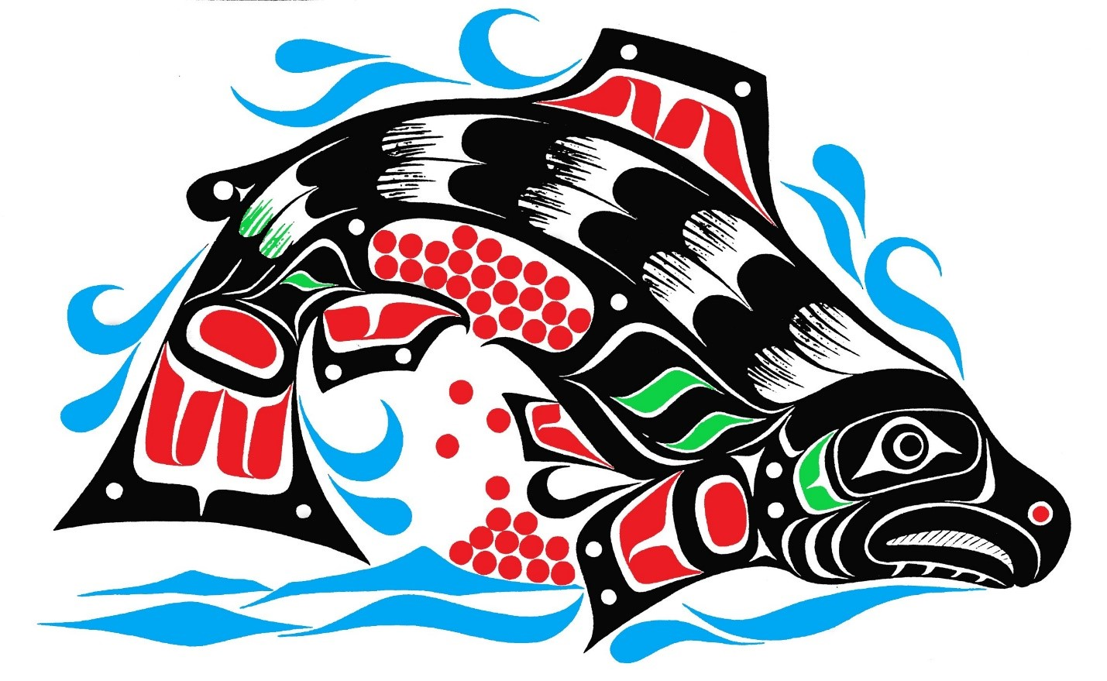
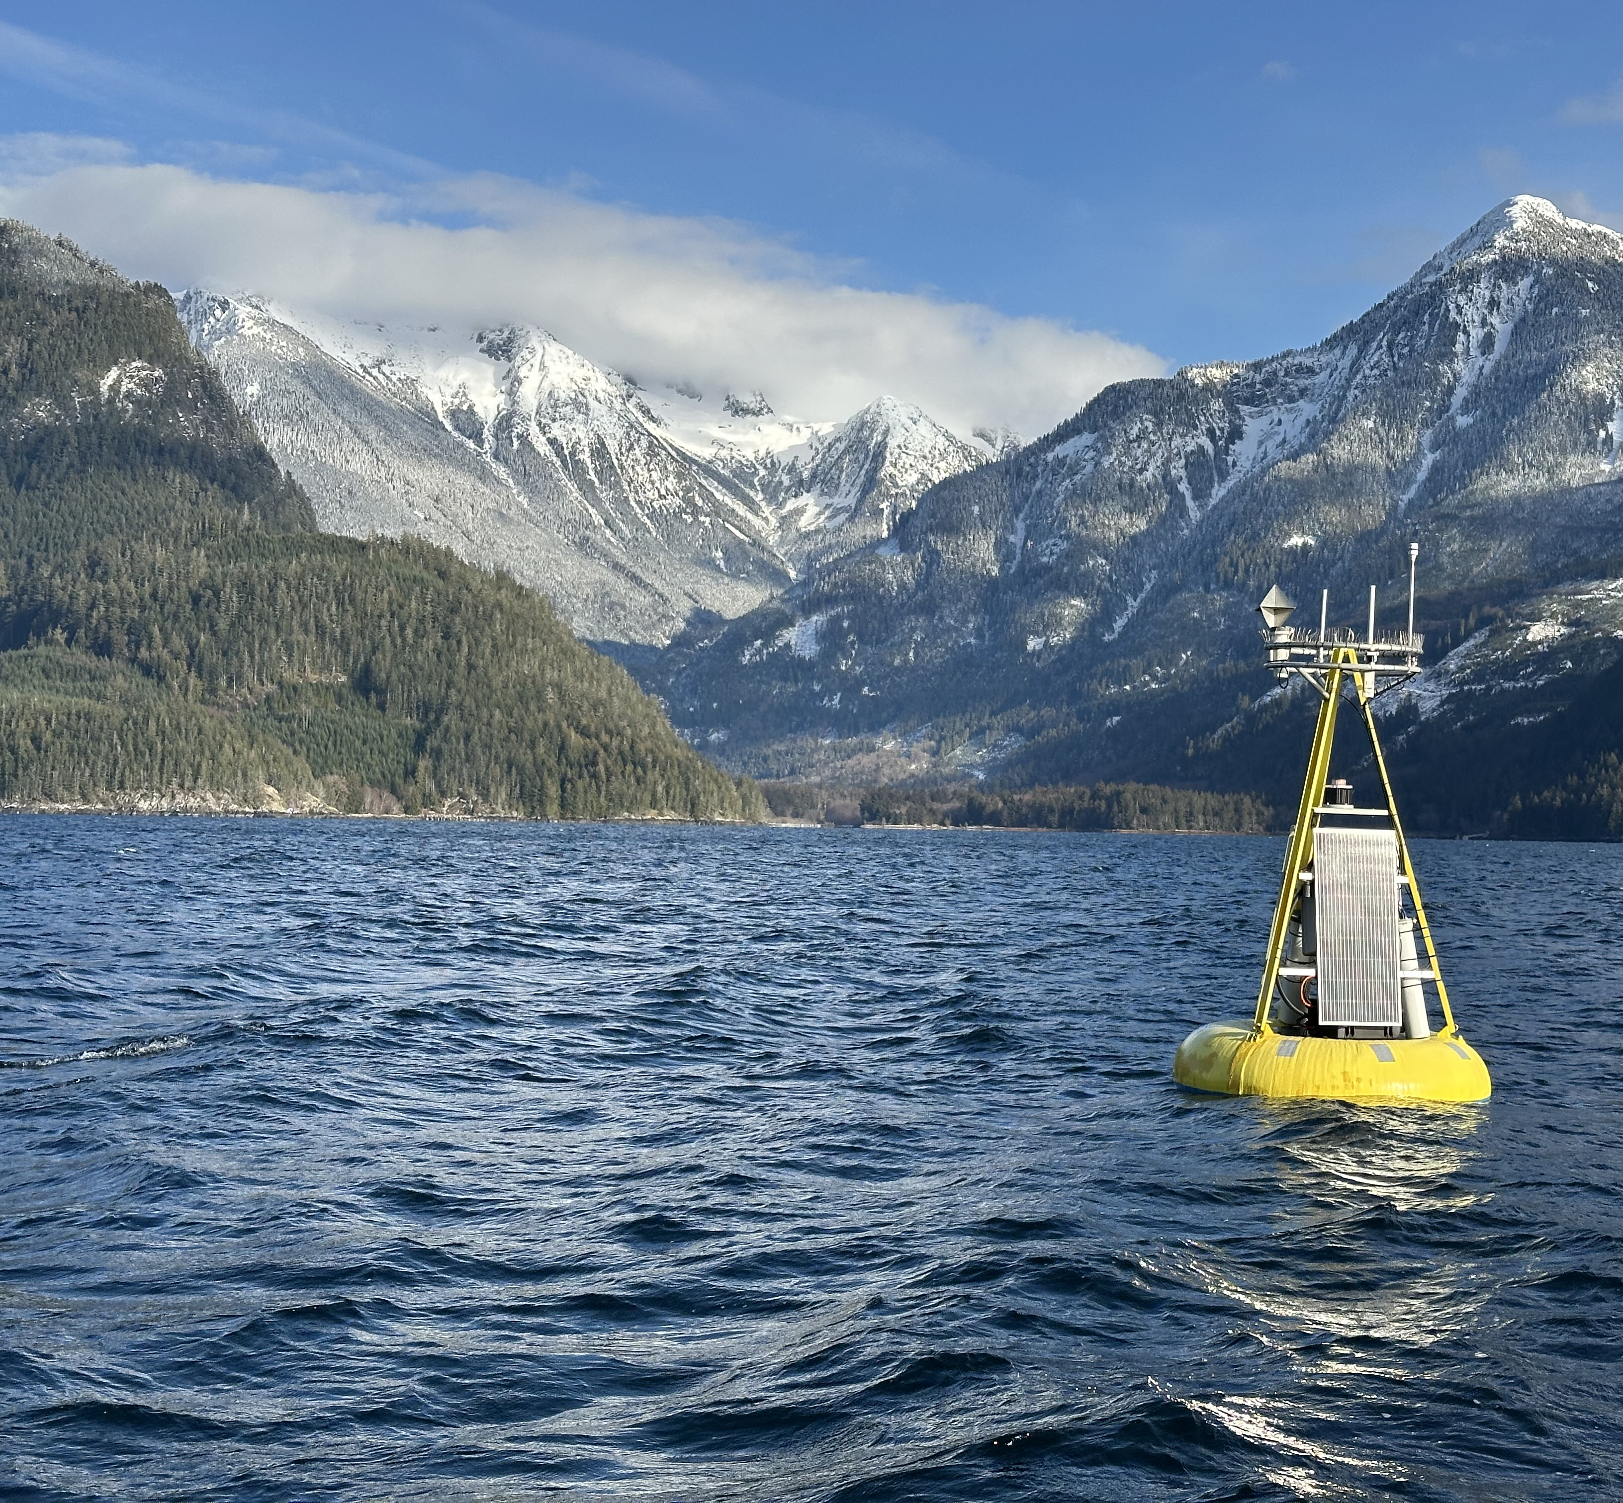
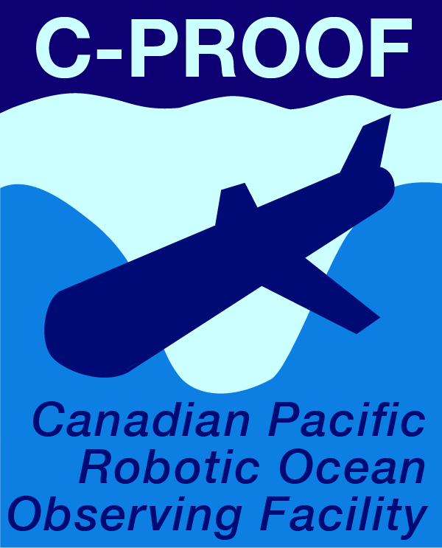
CO₂ observing from monthly surveys and a mooring in Bute Inlet
What is the interplay between marine stressors and how is habitat quality impacted?
What are the relative roles of Strait of Georgia intermediate and deep water versus local processing within Bute Inlet in shaping habitat quality?

Slide 6
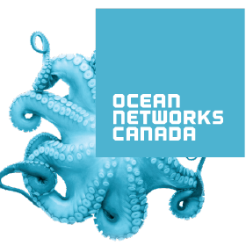
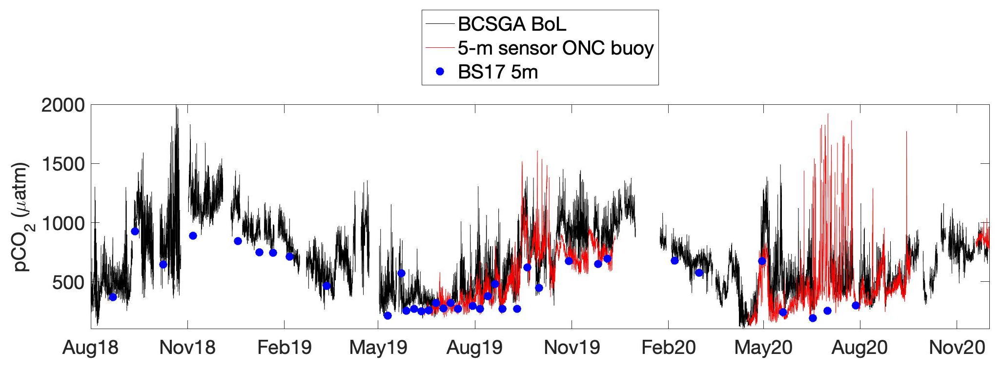
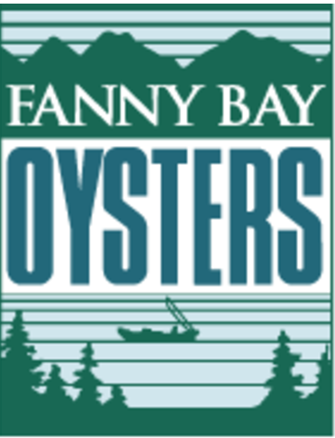
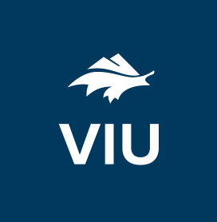
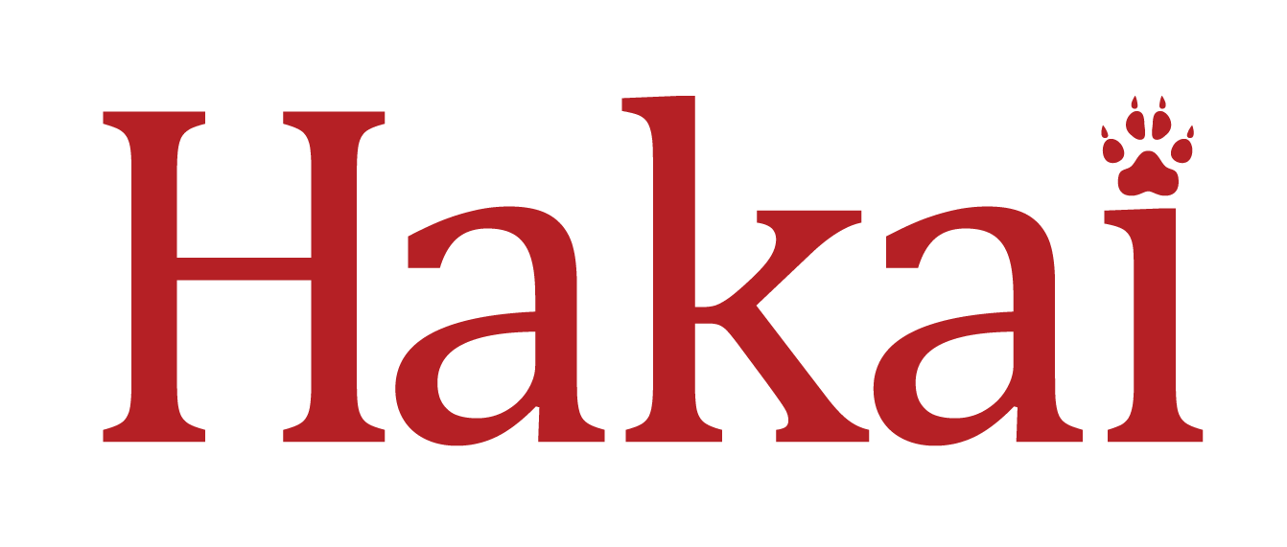

Multi-platform CO₂ Observing: Baynes Sound Example
● Multiple observing platforms operating simultaneously provide a more complete and trusted picture of habitat quality
● Systems to synthesize observations from distributed observing platforms and agencies are needed

Slide 7
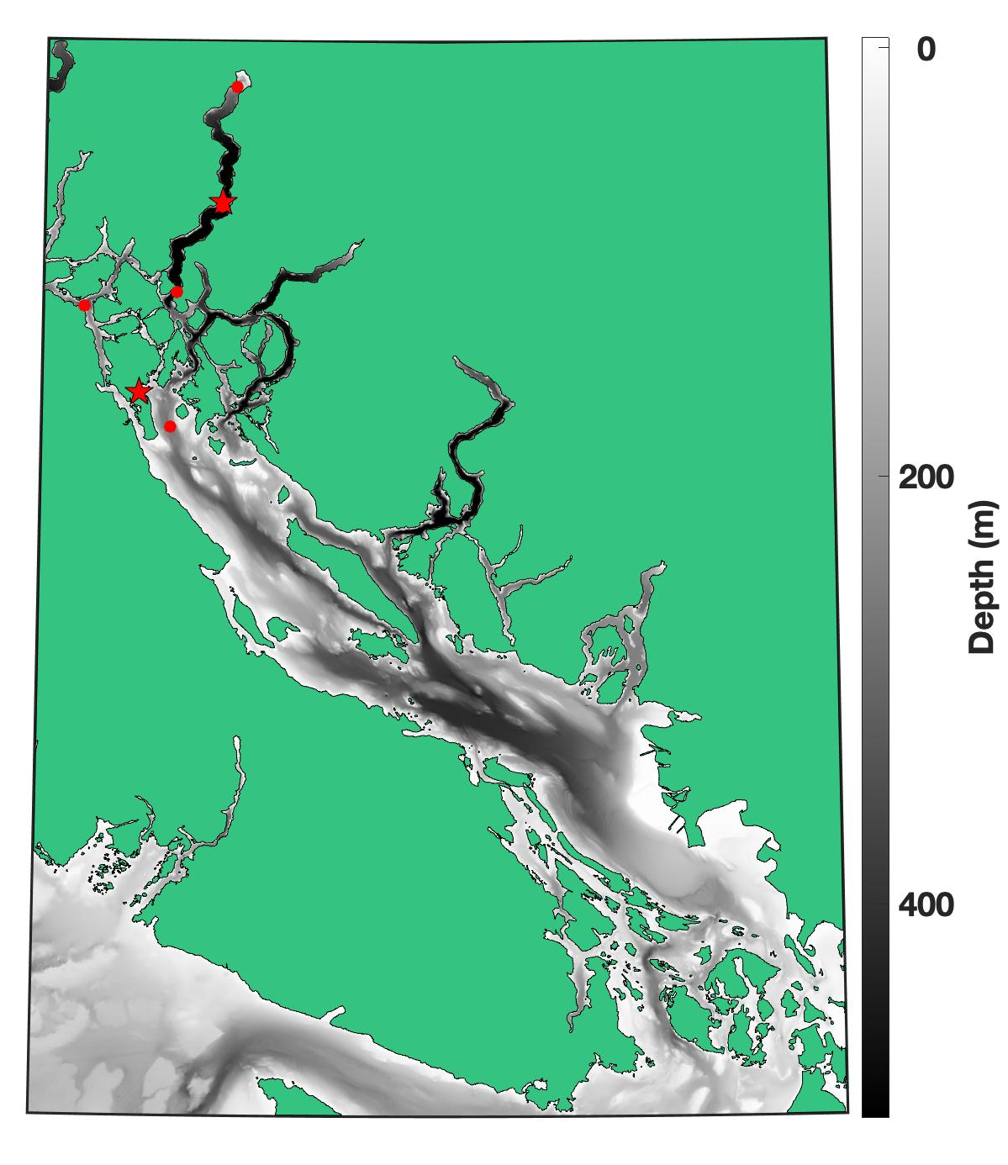
What are the opportunities for impactful BGC research ONC can support?
(1) Cross-strait surface variability in the northern Strait of Georgia resolved by the Comox/Powell River ferry
(2) Surface buoys with instrumented tethers in Haro Strait and Sabine Channel to constrain water mass characteristics through the water column / aimed at intermediate and deep water circulation
(3) Platform to synthesize ONC, Hakai, and DFO observing data in the Strait of Georgia (CIOOS App?)
(1)
(2)

