Slide 1

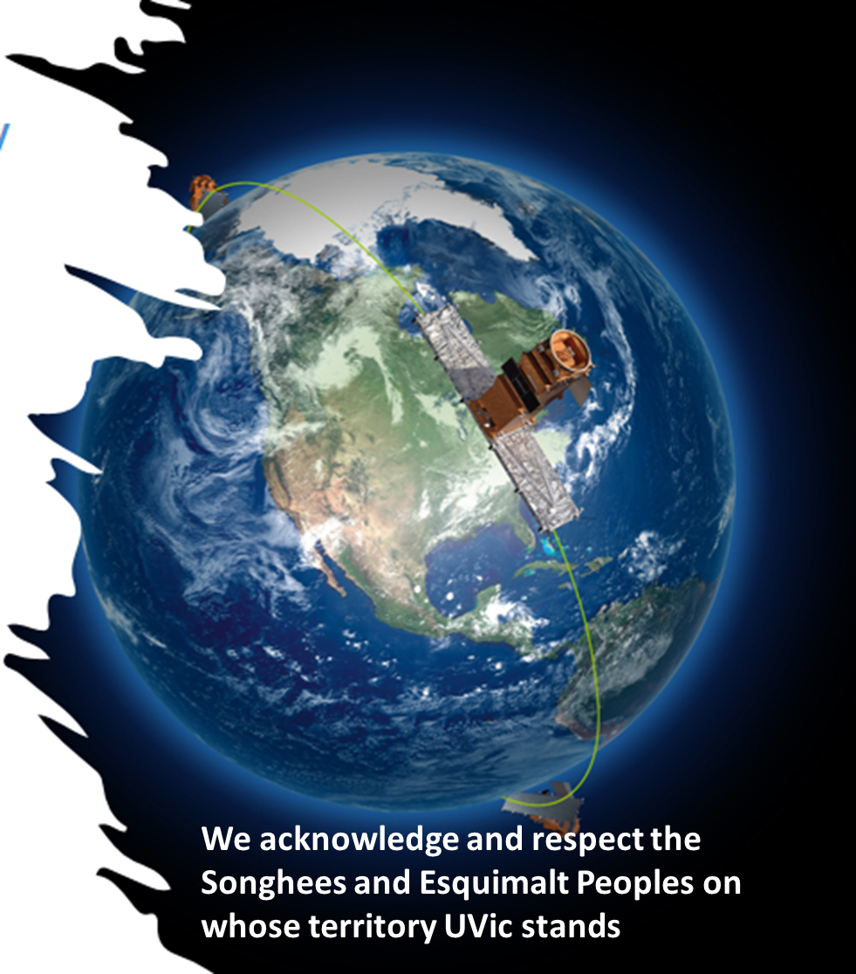
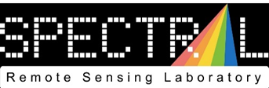








Phytoplankton bloom time and groups: interannual varibility from Sentinel 3 satellite and ferry-based reflectance data
Maycira Costa
maycira@uvic.ca
https://uvicspectral.com

Slide 2
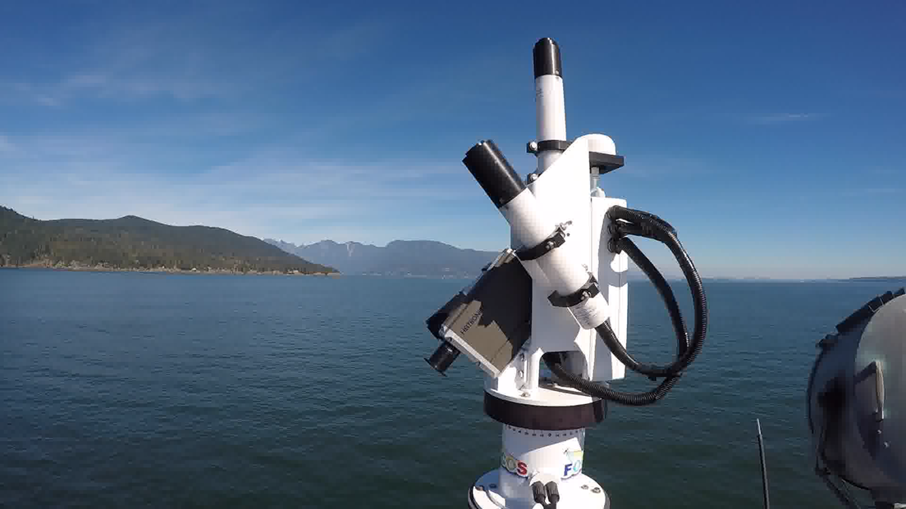
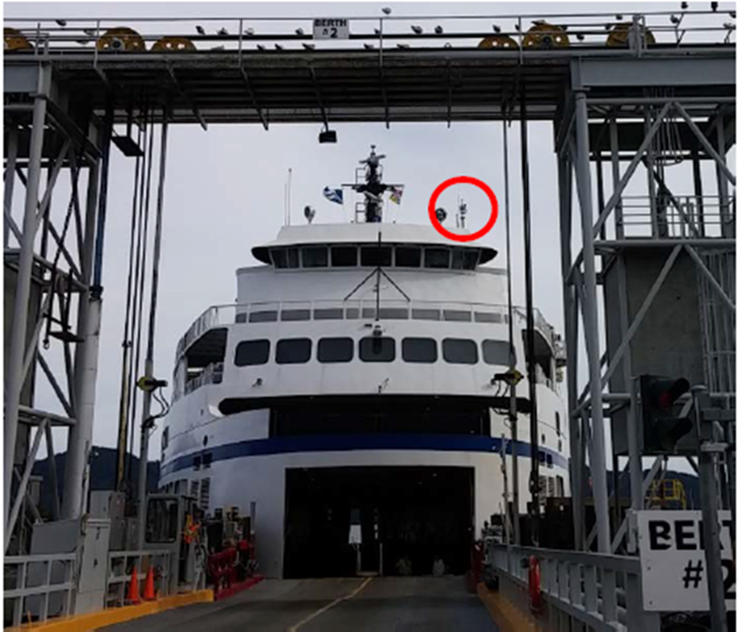
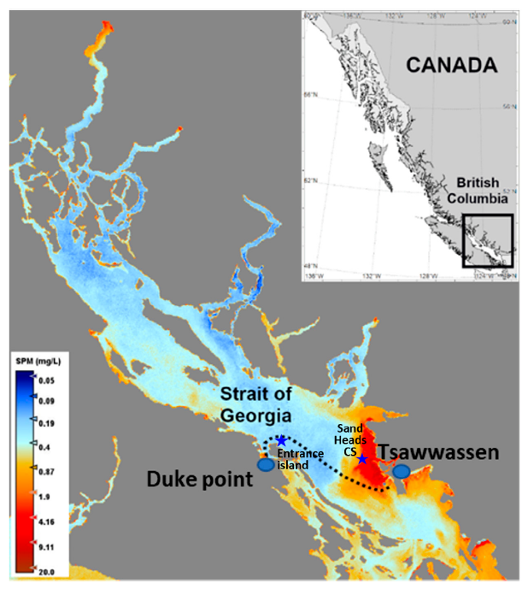
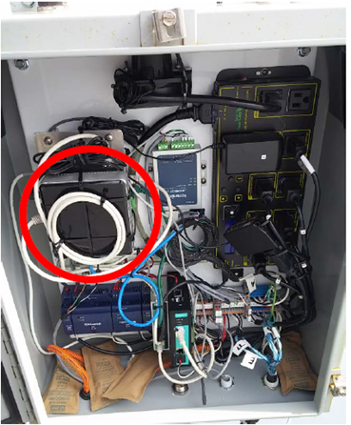
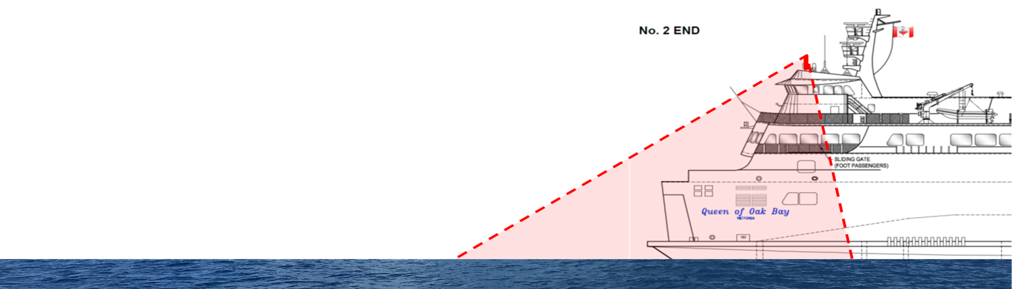
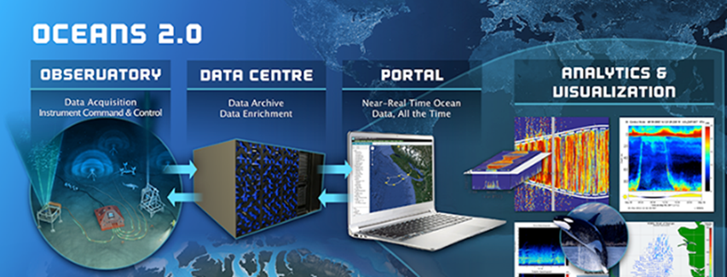
HyperSAS Solar Tracker (HyperOCR)
(Ferry Ocean Colour Observation System)
~60 km
Length 140m

Slide 3
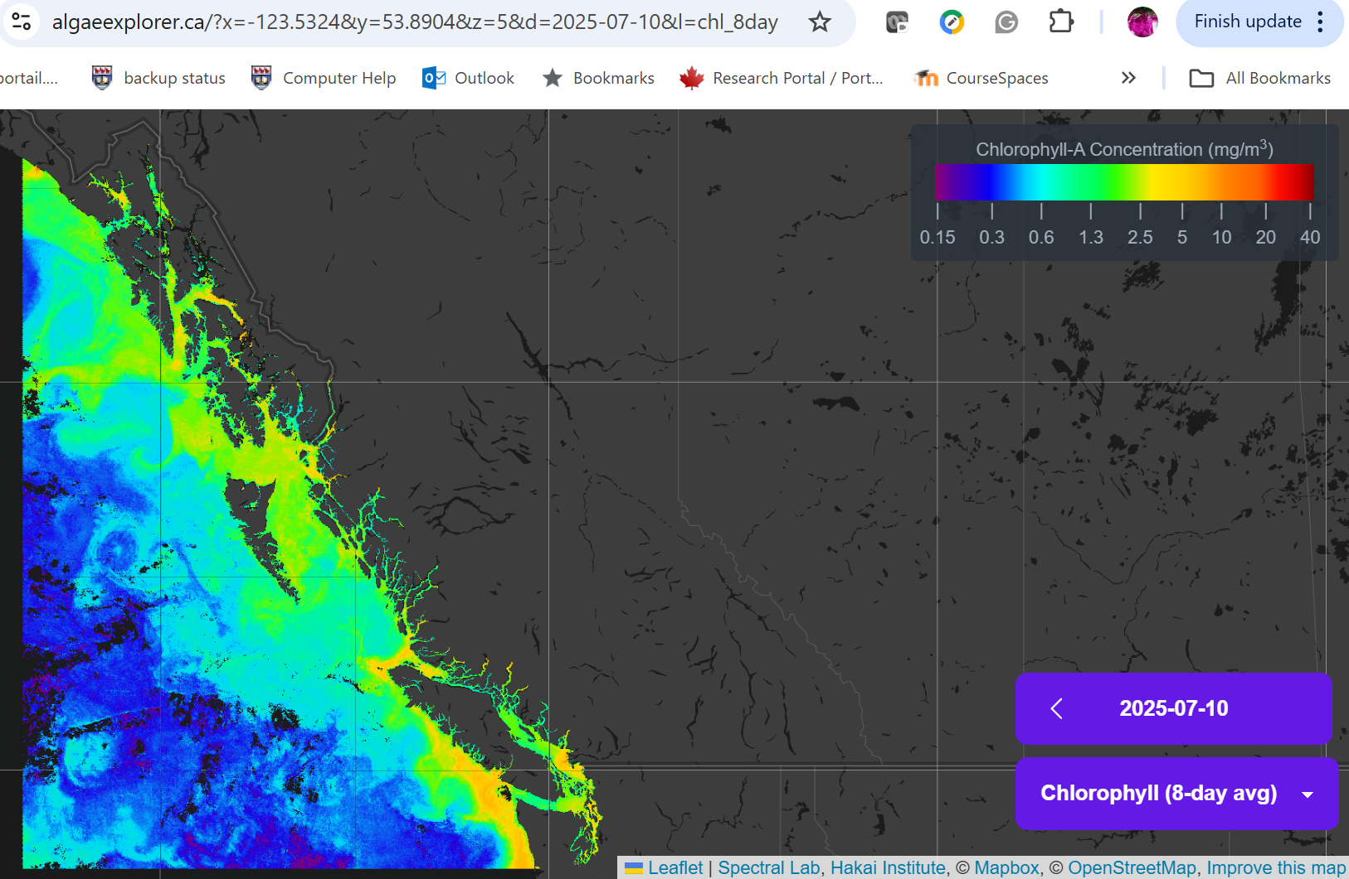
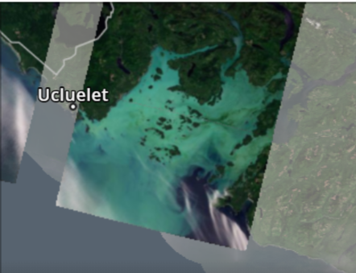
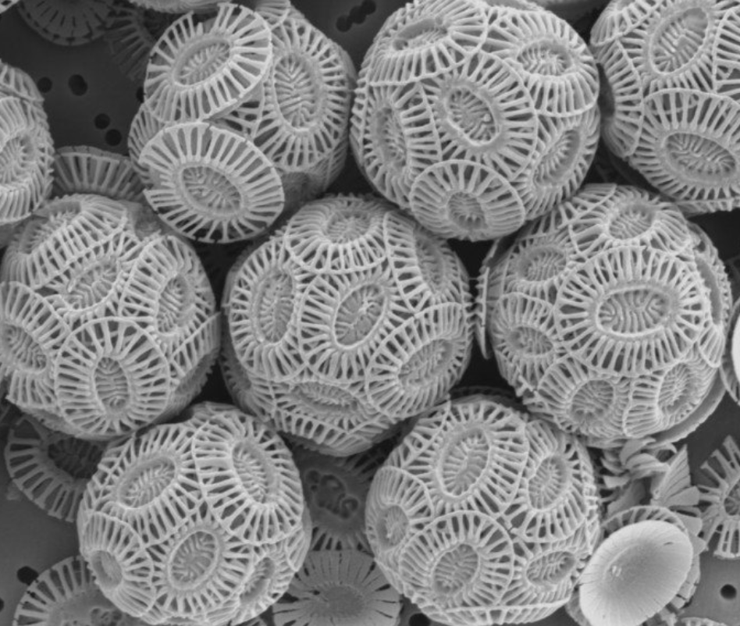
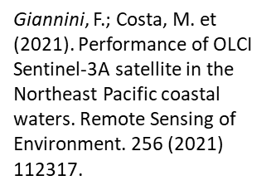
Use of the data: we developed Sentinel 3 algaeexplorer.ca
(Chla and TSM)

Slide 4
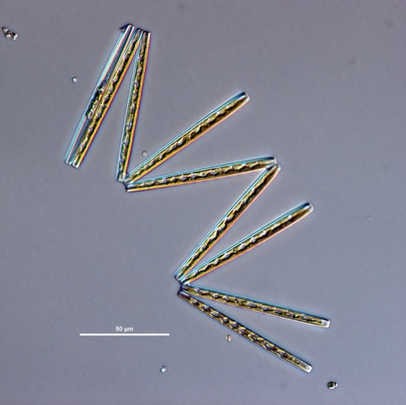
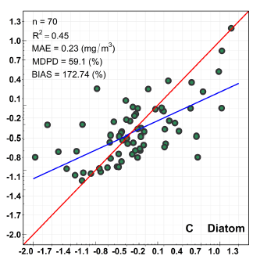
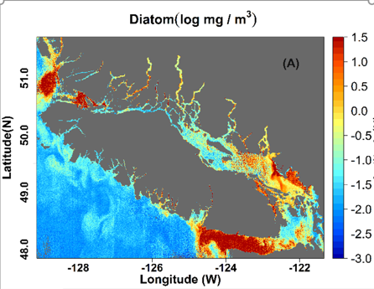
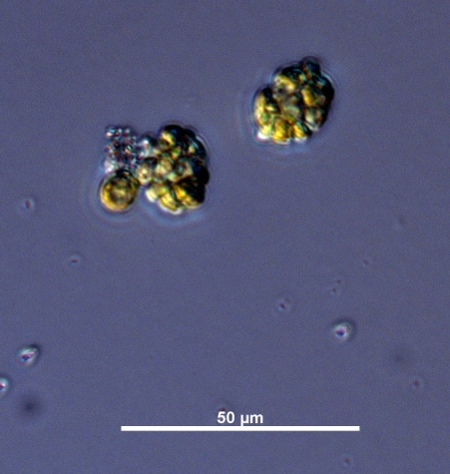
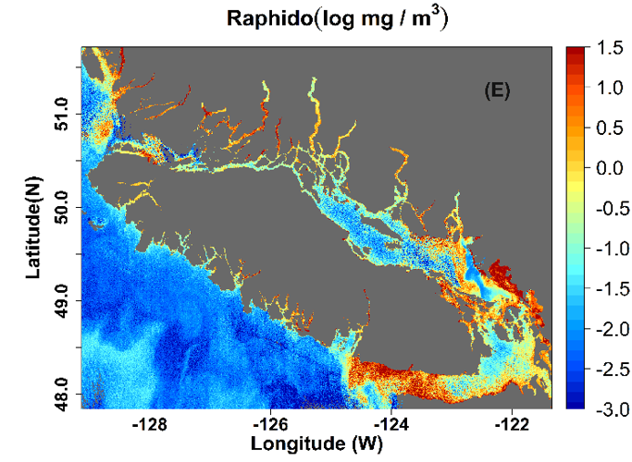
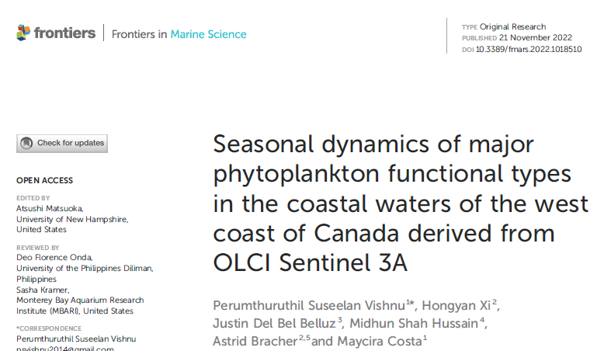
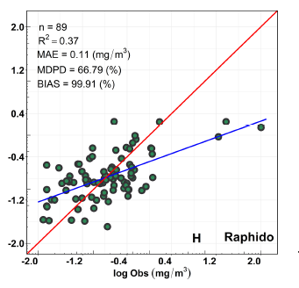
Use of the data: Sentinel 3 Phytoplankton Function Types (PFTs)
HAB
Vishnu et al,. 2022
Heterosigma akashiwo (Raphidophyceae)

Slide 5
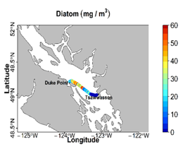
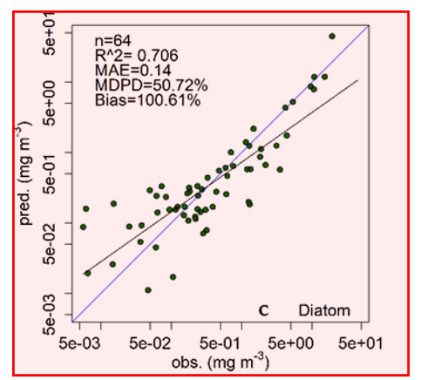
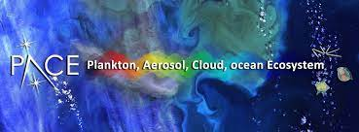
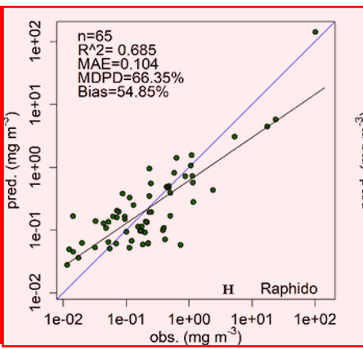
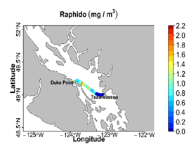

Use of the data: Ferry-Hyperspectral Rrs Phytoplankton Function Types (PFTs)
Vishnu, et al., in press

Slide 6
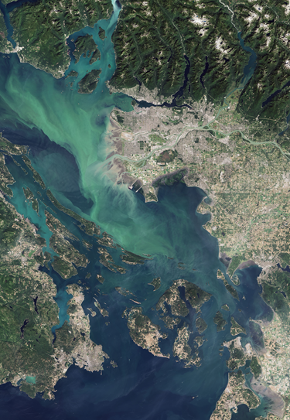
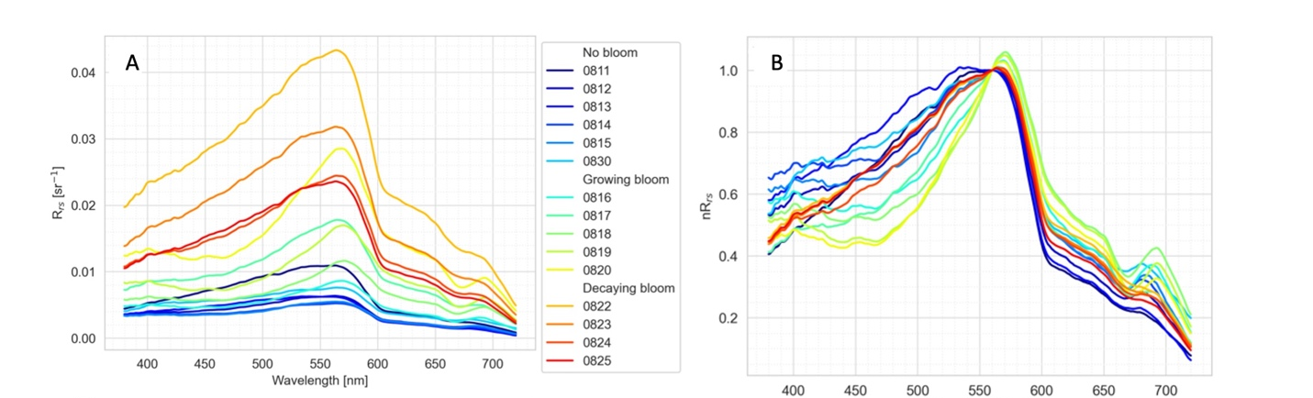
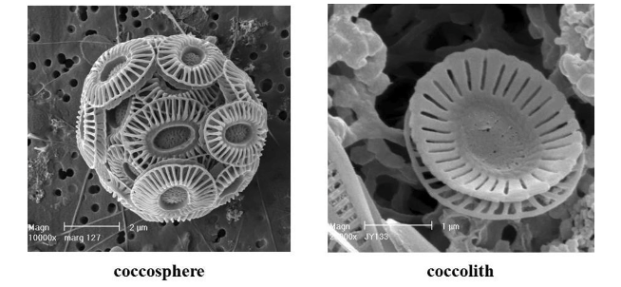
Use of the data: ferry-based Hyperspectral coccolithophore bloom development
Notes:
The growing bloom class (0816-0820) exhibited higher Rrs^{SST} values and a more irregular nRrs^{SST} shape.
If we look at the nRrs on your right, A decline of reflectance in the 400-550 nm is clearly evident in the nRrs^{SST} curves, this is associated with the strong absorption by photosynthetic pigments a tthis wavelegnths.
The secondary nRrs^{SST} pigment absorption concave around 670 nm is also representative of growing bloom days (Figure 16C). Further, the Chla fluorescence signal around 680-685 nm on those days showed evident peaks

Slide 7
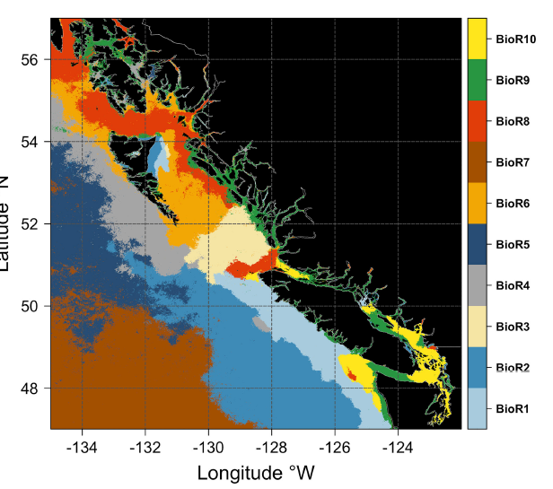
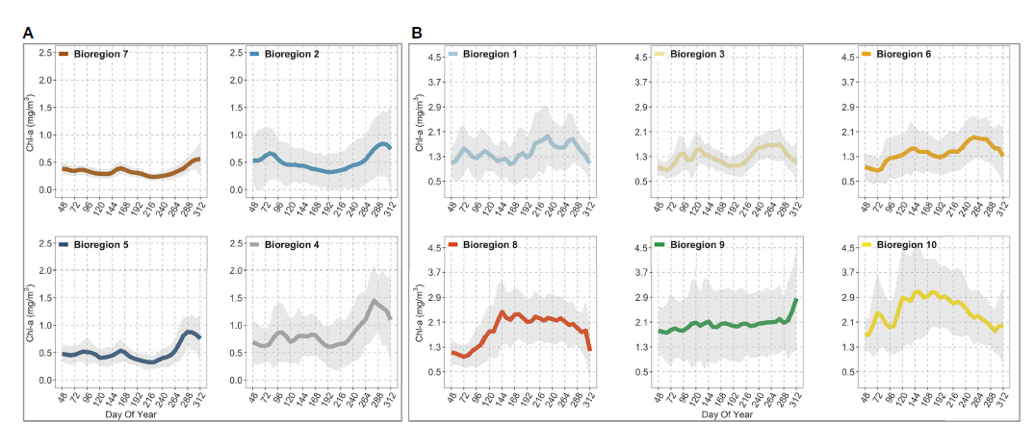
Use of the data: BC coast Bioregionalization and dynamics
Chla phenology
Marchese C, Costa M et al (2022) Bioregionalization of the coastal and open oceans of British Columbia
and Southeast Alaska based on Sentinel-3A satellite-derived phytoplankton seasonality. Front. Mar. Sci. 9:968470. doi: 10.3389/fmars.2022.968470

Slide 8
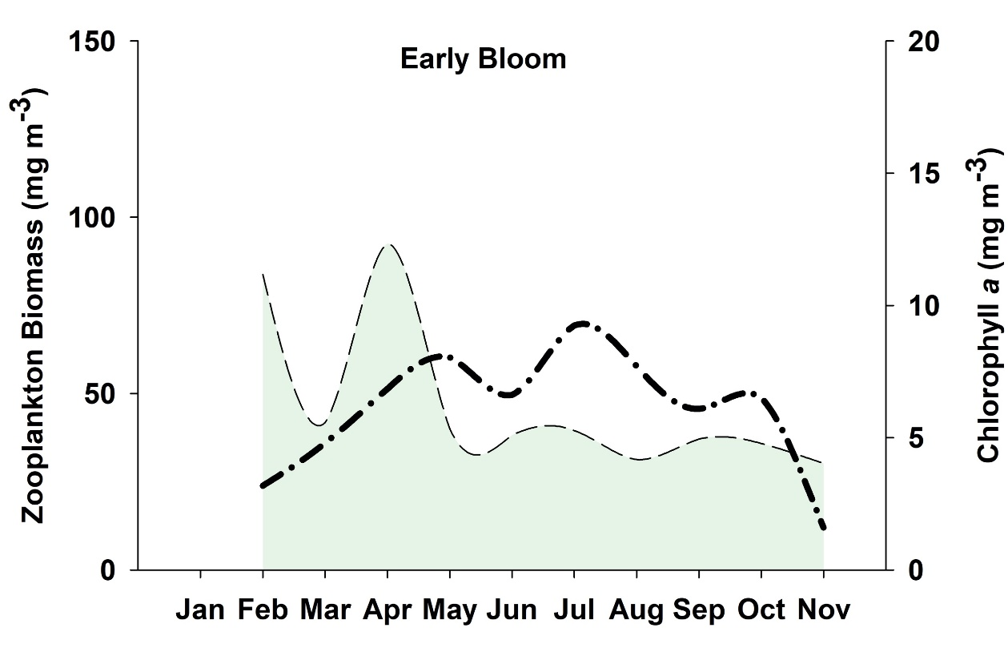
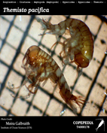

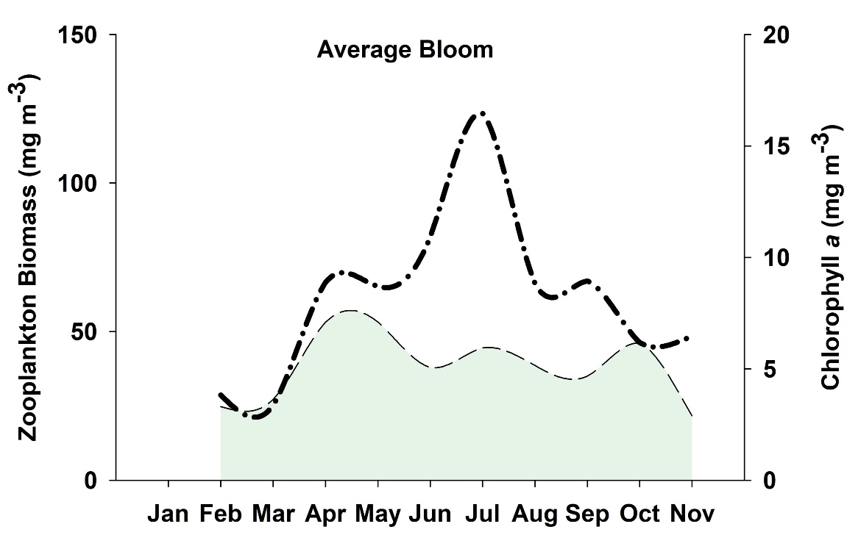
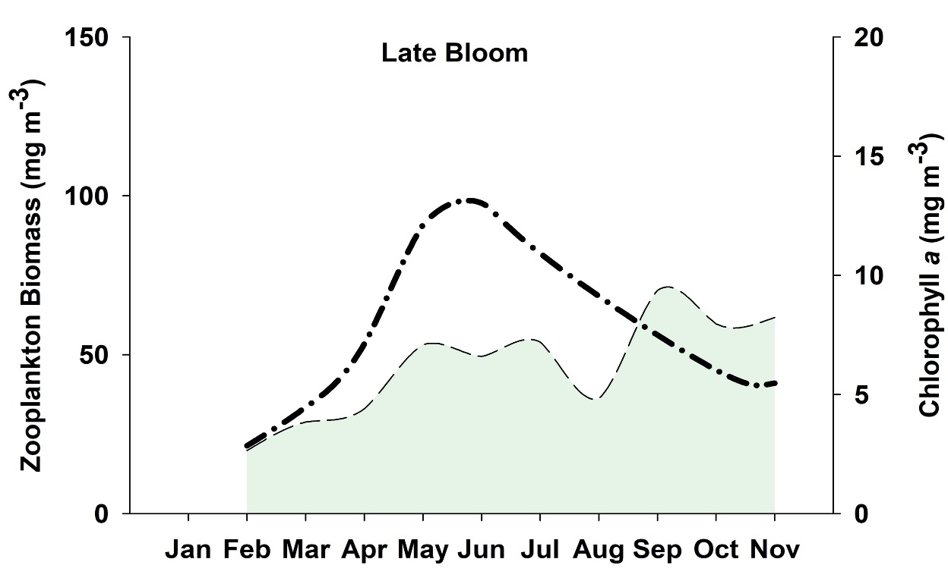
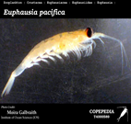

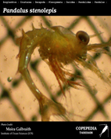
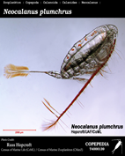
From satellite to salmon… phytoplankton/zooplankton: match/mismatch
Satellite-Phytoplankton phenology and in situ Zooplankton abundance
Early phyto bloom🡪Mismatch: small zooplankton and of lower food quality
Poor condition for salmon???
Anphipods
Average/late phyto🡪Match: higher biomass of zoop
Good conditions for salmon???
Suchy et al., 2019
Suchy et al., 2022

Slide 9
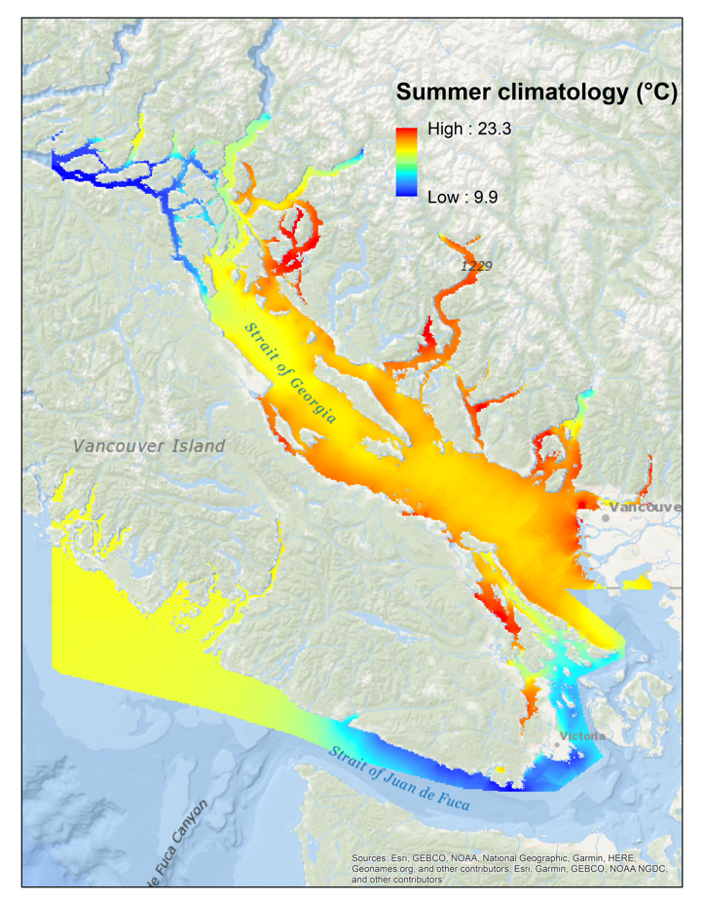
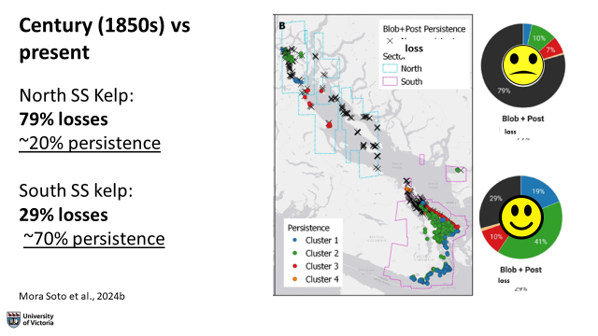
Loss of kelp in the Salish Sea
SUMMER
Mora Soto et al., 2024

Slide 10

BCG Research ONC can support
1. Ferry-based to in situ Hyperspectral to support missions:
PACE (present), SBG (NASA, 2027), (CHIME (ESA, 2029)
2. Data portal: beyond algaeexplorer
(CoastConnect – Hakai; ONC; DFO?)
satellite-derived: Phyto groups, bloom, HABs
Satellite-derived turbidity
Satellite-derived – CDOM
Satellite-derived SST (Landsat, VIIRS, Sentinel 3, etc)

Slide 11


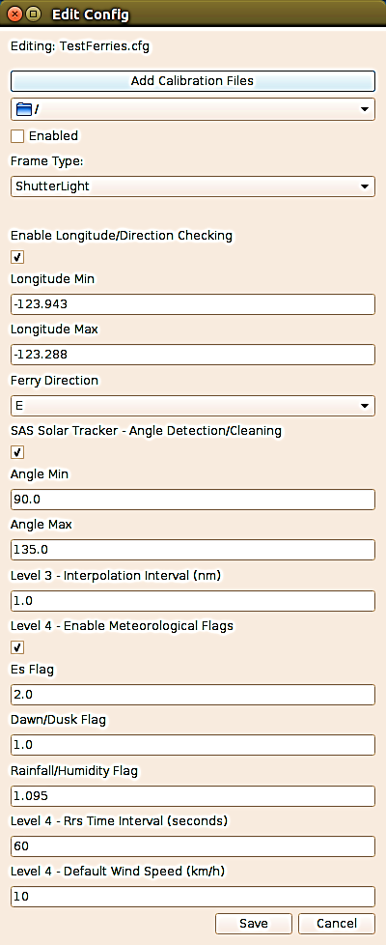
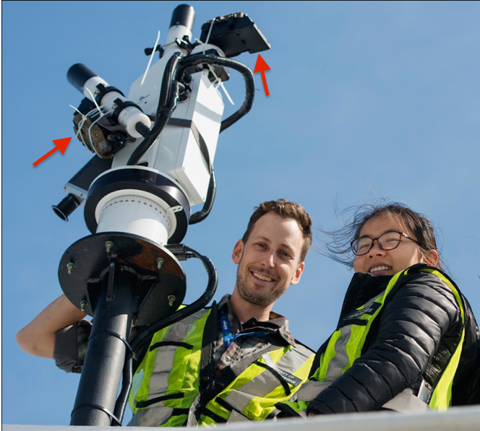

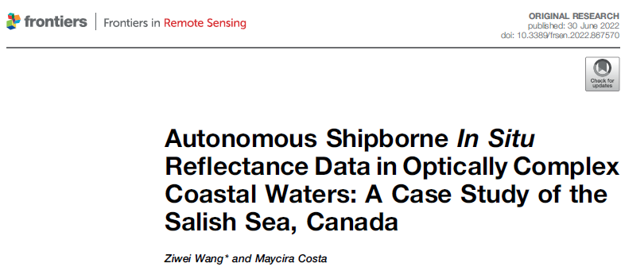

Data acquisition, processing and quality control
Installation: Geometry acquisition
Software: PySciDON
  Sensor calibration
  Lat/long flags
  Angle flags
  Meteorological flags: Ed
  Mobley 99
  Ship perturbation
  Statistics SRF (Sentinel 3, MODIS, VIIRS)
BRDF
  IOP-based
Spectral Quality
  Quality score based on a global database
Spatial Quality
  Salinity spatial variability
Wang and Costa, 2022
Nasiha and Costa, 2022
Vandenberg, Costa et al., 2017
HyperCP
Notes:
For the quality control of SAS data, we define the meteorological flags with cameras installed on the solar tracker. You can see the red arrow indicated on the diagram. One is looking at the sky, one is looking at the water. The photo together with the Ed sensor and humidity sensor installed on the ferry, sunny sky conditions can be determined with 98% accuracy.
Our lab developed a python based application called pyscidon. It can ingest a large volume of SAS Solar Tracker raw data, apply the sensor calibration, then the coordinate, meteorological and angle flags and apply the proper time binning and rho factor to process all the way to reflectance.

