Slide 1
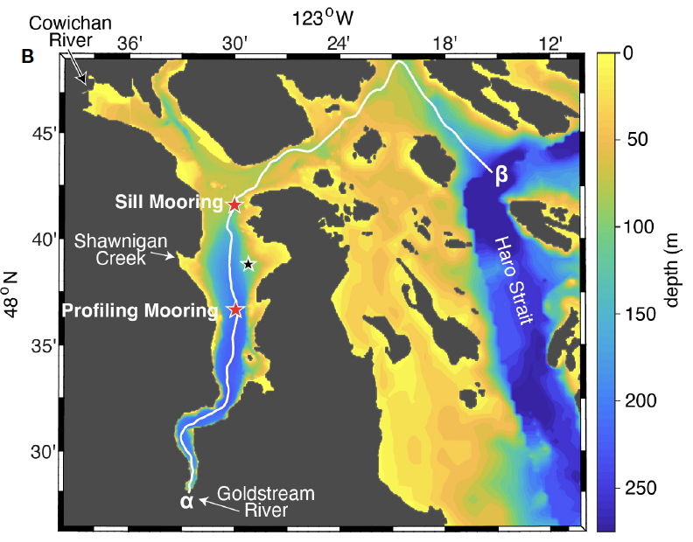


Drivers of biogeochemical changes in deep Saanich Inlet
Roberta Hamme
Pat Bay mooring
Long shallow sill separates deep Saanich from rest of Salish Sea – anoxic most of year

Slide 2
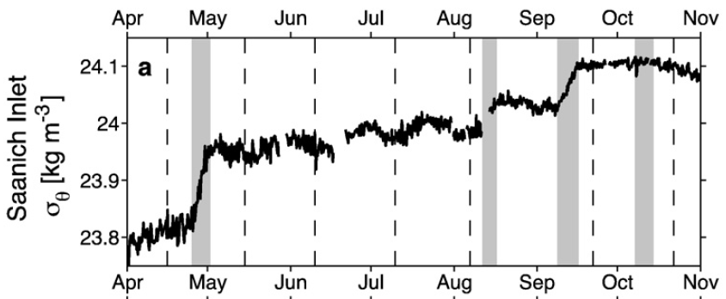
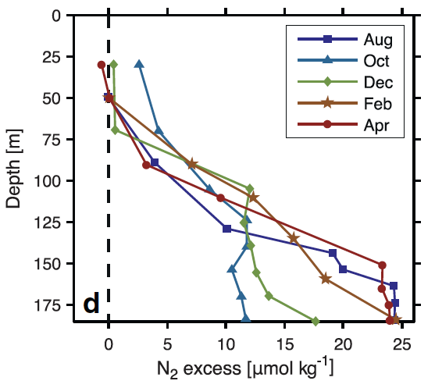
Continuous data provides important context to ship-based data
Step-like density increases in deep Saanich demonstrate new water entering from over the sill
Explains sudden decrease Aug → Oct in N₂ (only generated during anoxia)
Manning, Hamme, and Bourbonnais (2010 Marine Chemistry)

Slide 3
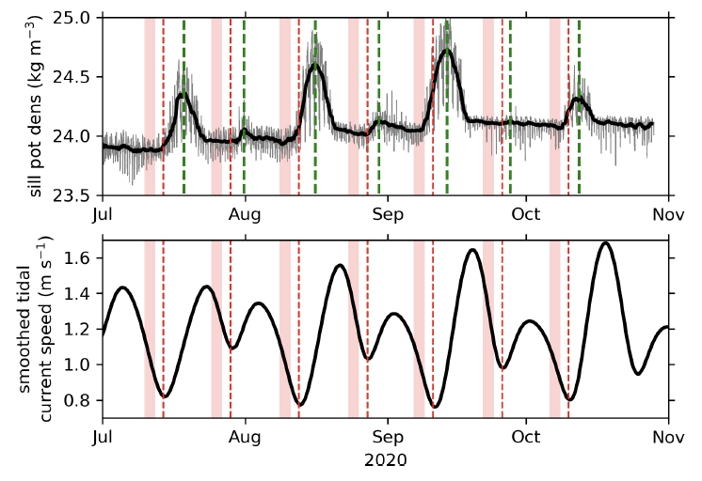
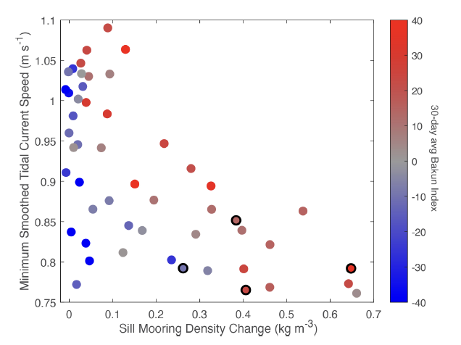
Continuous data on sill allows assessment of strength of “renewals”
Driver of renewals
Density peaks (renewal) over sill when current speeds are low
Soetaert, Hamme, Raftery (2022 Frontiers in Marine Science)

Slide 4
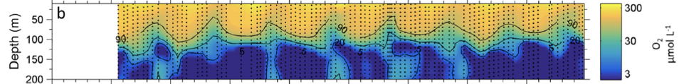
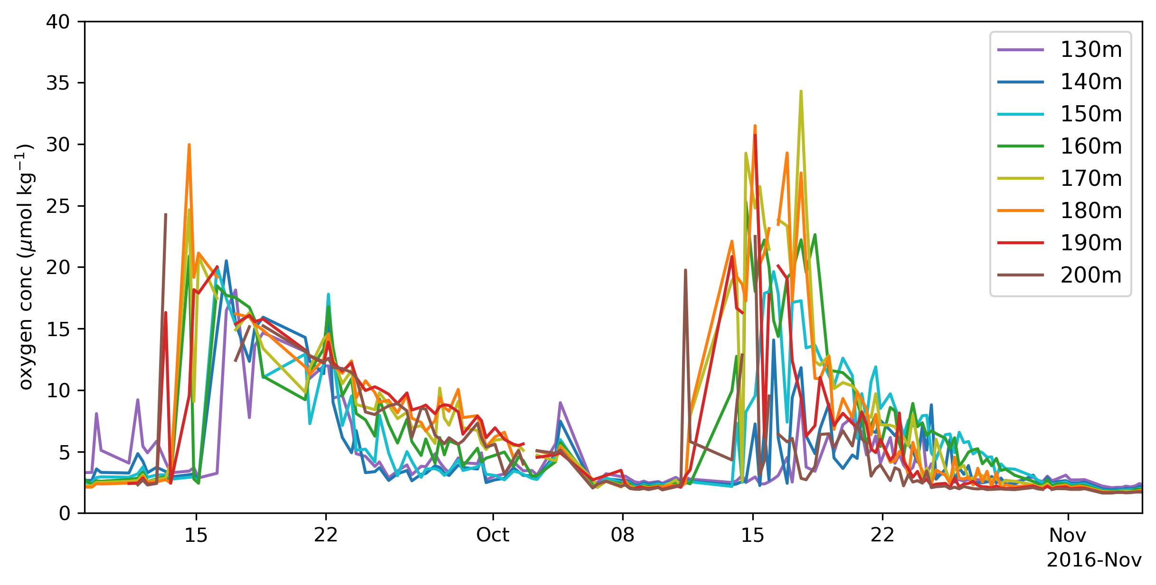
Continuous data over water column reveals renewal complexity
UBC ship-based time series of oxygen in Saanich Inlet
Capelle, Hallam, Tortell (2019 Marine Chemistry)
Profiling mooring shows oxygen delivered by each renewal is consumed within weeks
Hamme et al (in prep)

Slide 5
High frequency data provides
context to ship-based observations
evidence of driving processes
resolution of complex dynamics
Profiling mooring is especially useful to study upper water column too

