Slide 1

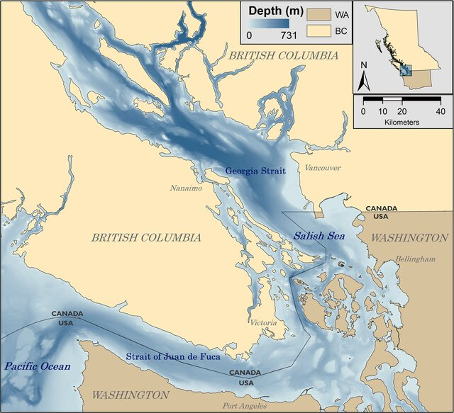
Turbulence Measurements &
British Columbia
Jean-Philippe Juteau &
Anneke ten Doeschate

Slide 2
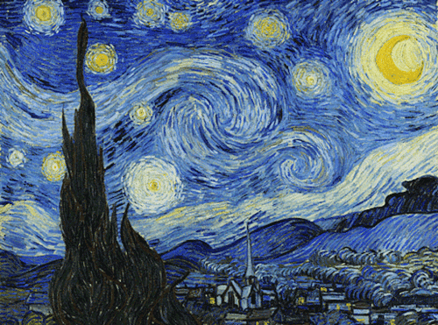

About Rockland Scientific
LOCATION
Victoria, Canada (HQ) | Halifax, NS | Seattle, USA | Marseille, France
EXPERIENCE & MARKET
Turbulence instrumentation for oceanography & limnology, since 2005
End users in academic and gov’t research
Highly skilled technical and scientific staff
Instruments operating in 30+ countries
e.g., ONC, DFO, NOC, Rutgers, WHOI, etc.
Established partnerships with platform integrators
e.g., Teledyne Webb Research, Alseamar, etc.

Slide 3
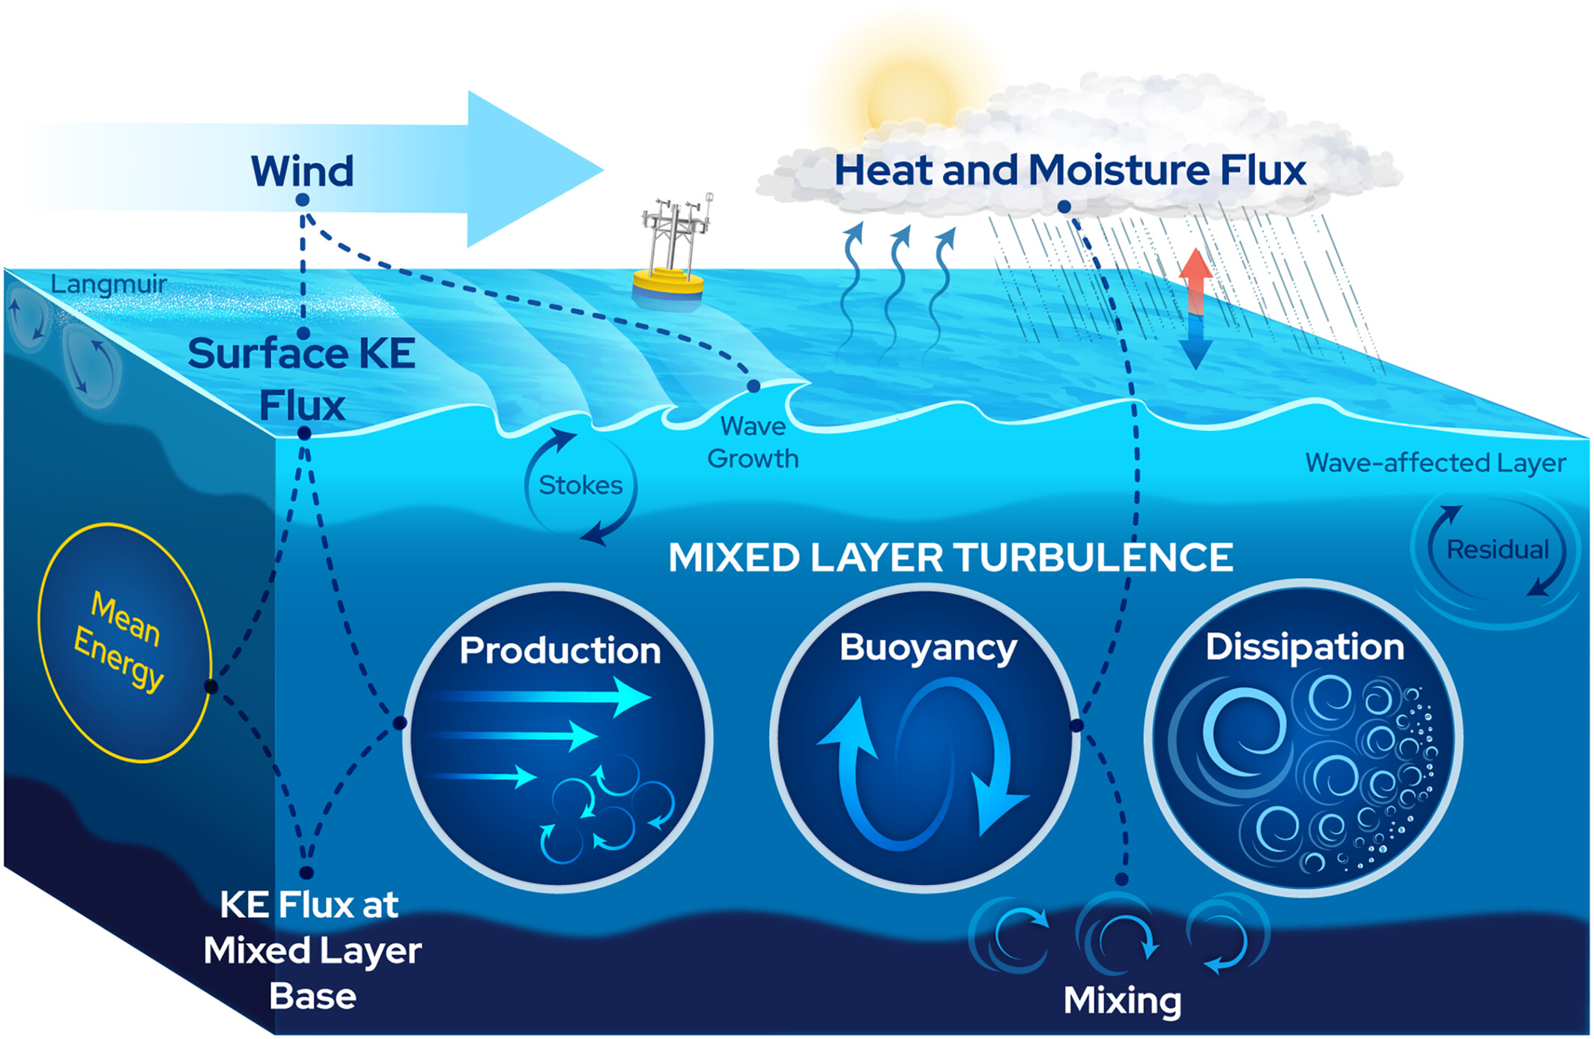
Why Turbulence ?
Most geophysical ocean flows are turbulent!
Turbulence is the dominant mechanism by which oceanic flows dissipate energy.
Turbulence drives air-sea exchange of momentum, heat, O₂, CO₂
Turbulence is the main mechanism for diapycnal mixing, and is important to determine e.g. ocean carbon and oxygen budgets.
Transfer of energy by internal waves, interaction with eddies and fronts
Bottom mixing by tide-topography interactions
Turbulence dominates mixing of anything that is in the ocean or enters the ocean (heat, salt, energy, nutrients, chemicals, micro-plastics etc.)

Slide 4
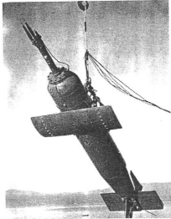
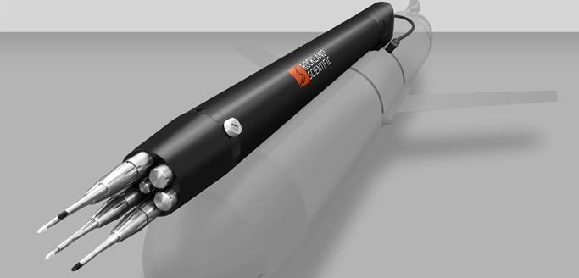
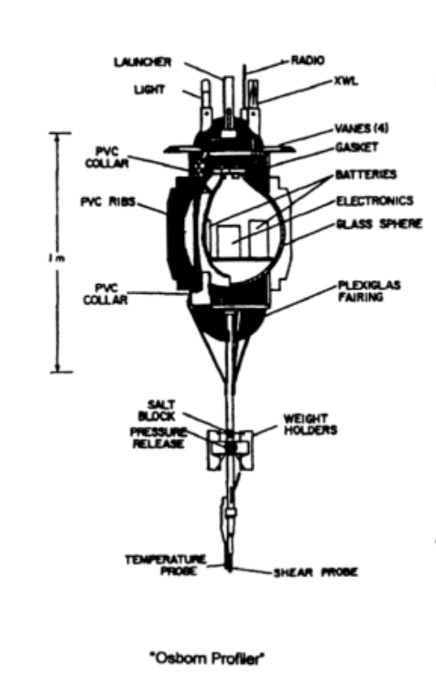
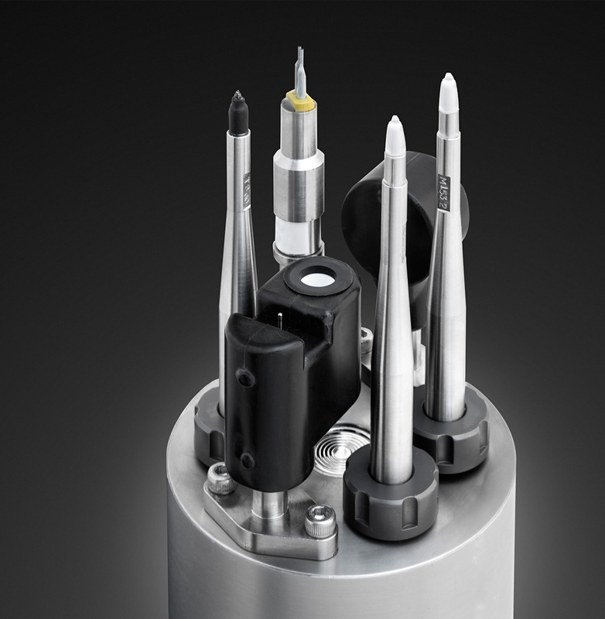
Turbulence & the Salish Sea
1970’s
Institute of Ocean Science
P. Nasmyth
1990’s
University of Victoria
Lueck & Folk
1950’s
Pacific Naval Laboratory
H. Grant
1980’s
University of British Columbia
Osborn & Lueck
Source: Lueck et al (2002)

Slide 5
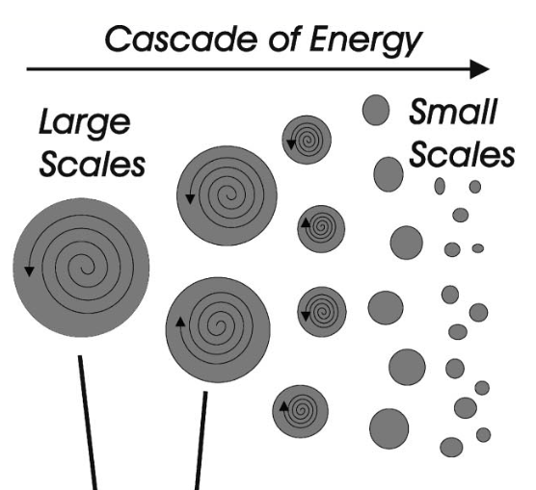

What we measure ?
TKE ∝ (velocity fluctuations)²
Dissipation rate ε is used as a direct measure of the turbulence intensity
ε is a fundamental quantity used to estimate many relevant features of a turbulent flow.
ε is used in the computation of the diapycnal mixing rate (eddy diffusivity)
ε can sometimes be inferred by measuring the turbulent fluctuations of scalars e.g. temperature
How we measure ?
$${ K}_{ρ}= Γ\frac{ε}{N^{2}}$$
Microstructure velocity and temperature sensors
Low noise electronics
Platforms that move the sensors smoothly through the ocean

Slide 6
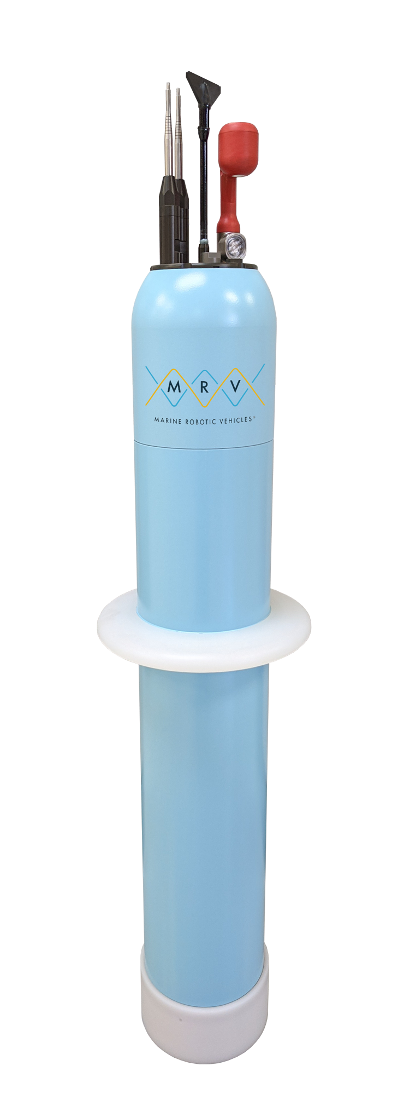
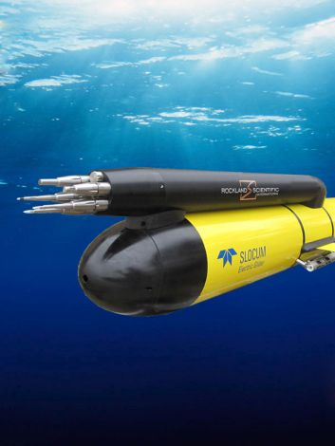
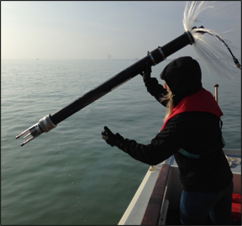
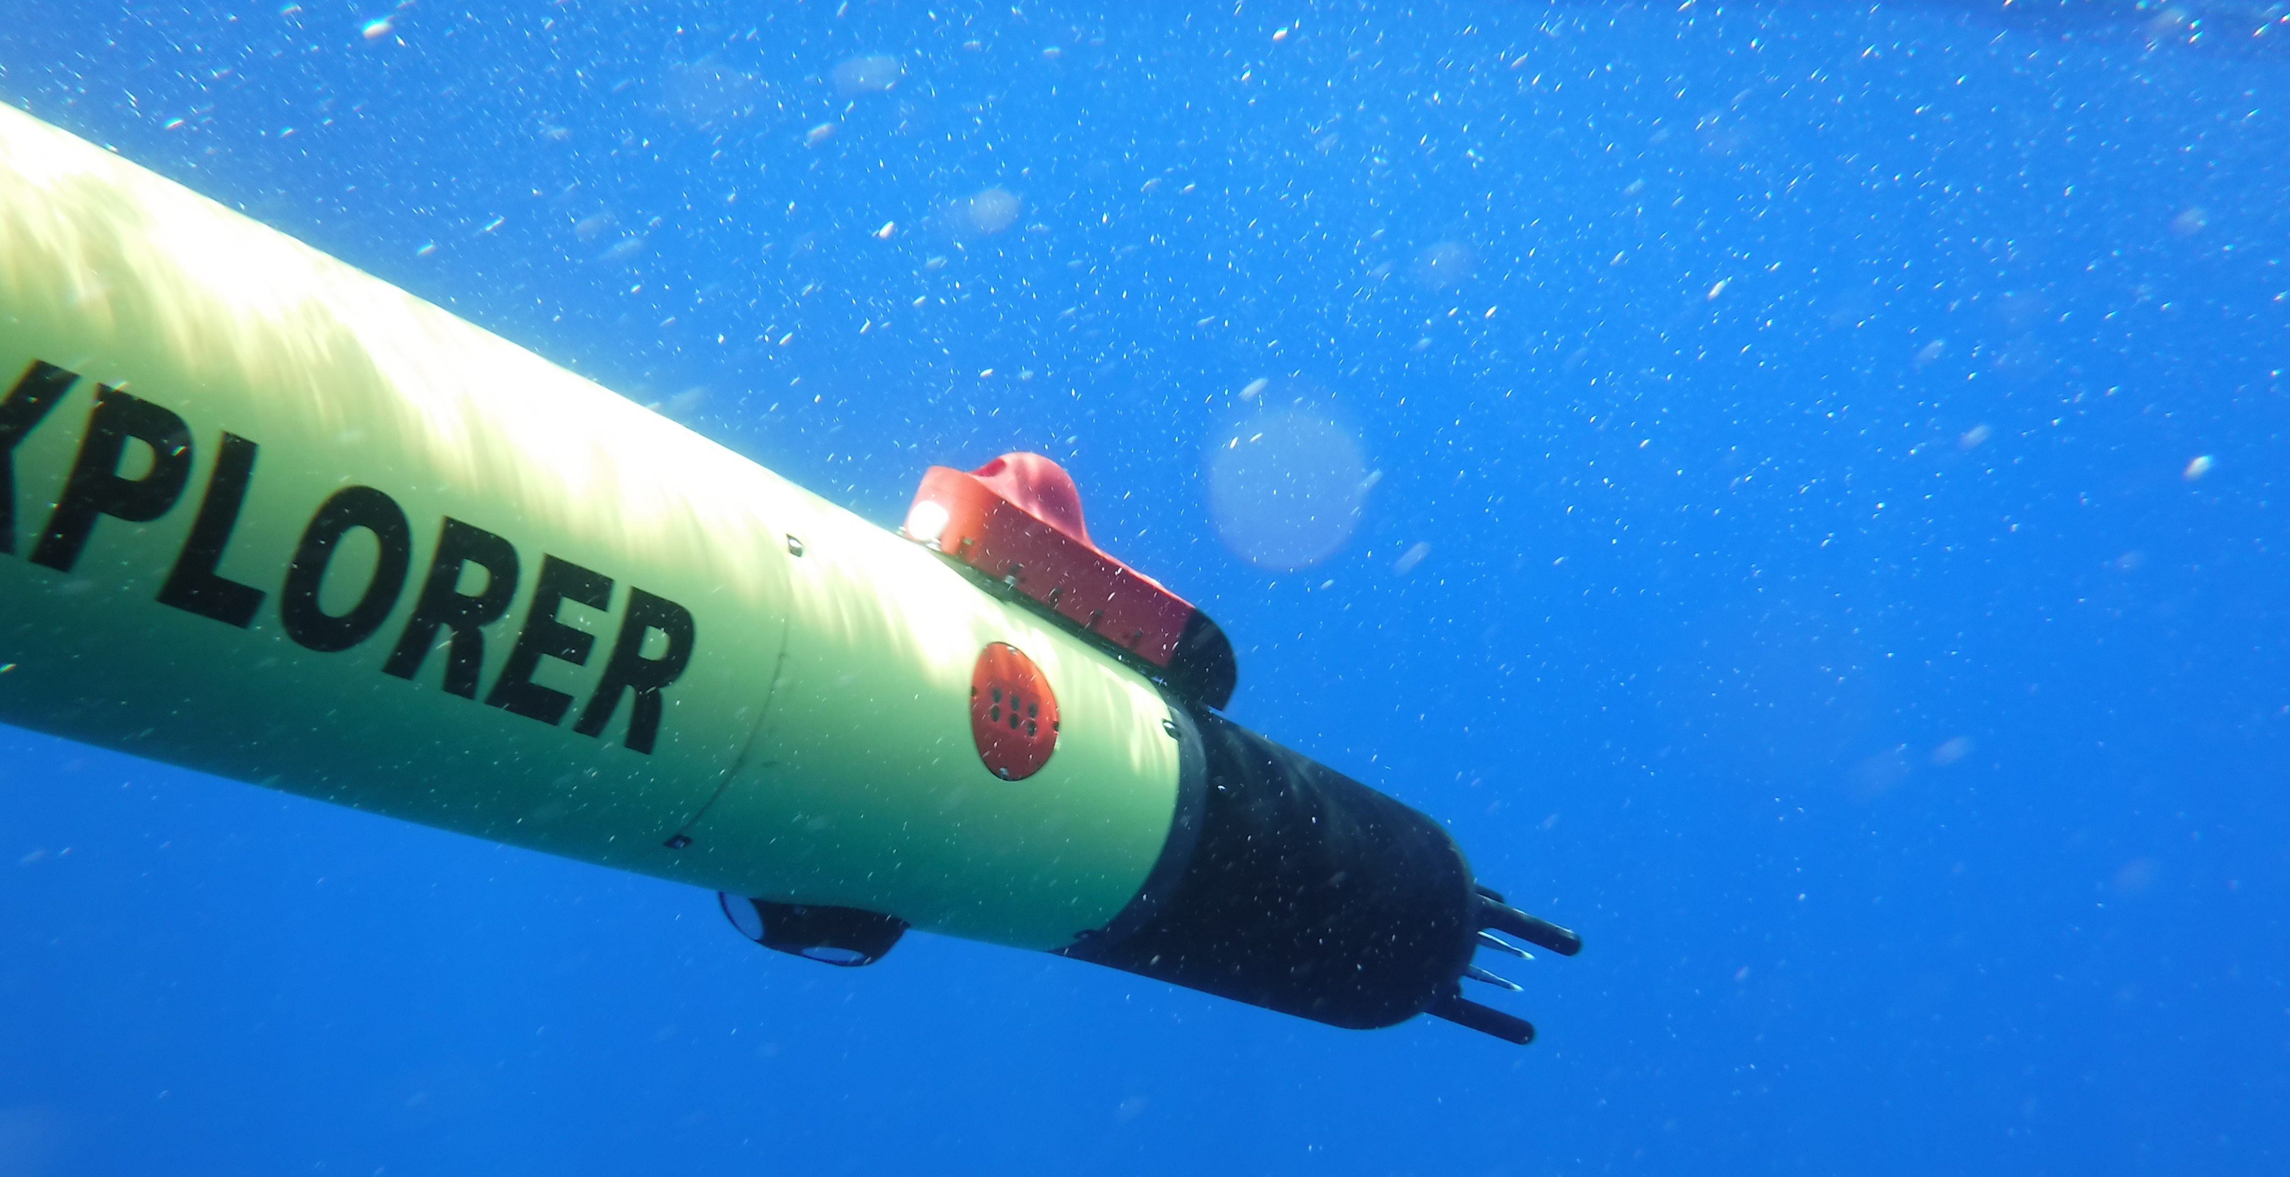
Modern measurement technology
Turbulence Profilers:
Modernized profilers
Down to 11,000 meters (HOWCOP)
Robotic platforms:
Tremendous improvement to spatial and temporal resolution
On-board processing for near real-time data products
Diverse platforms for various operation conditions and mission objectives

Slide 7
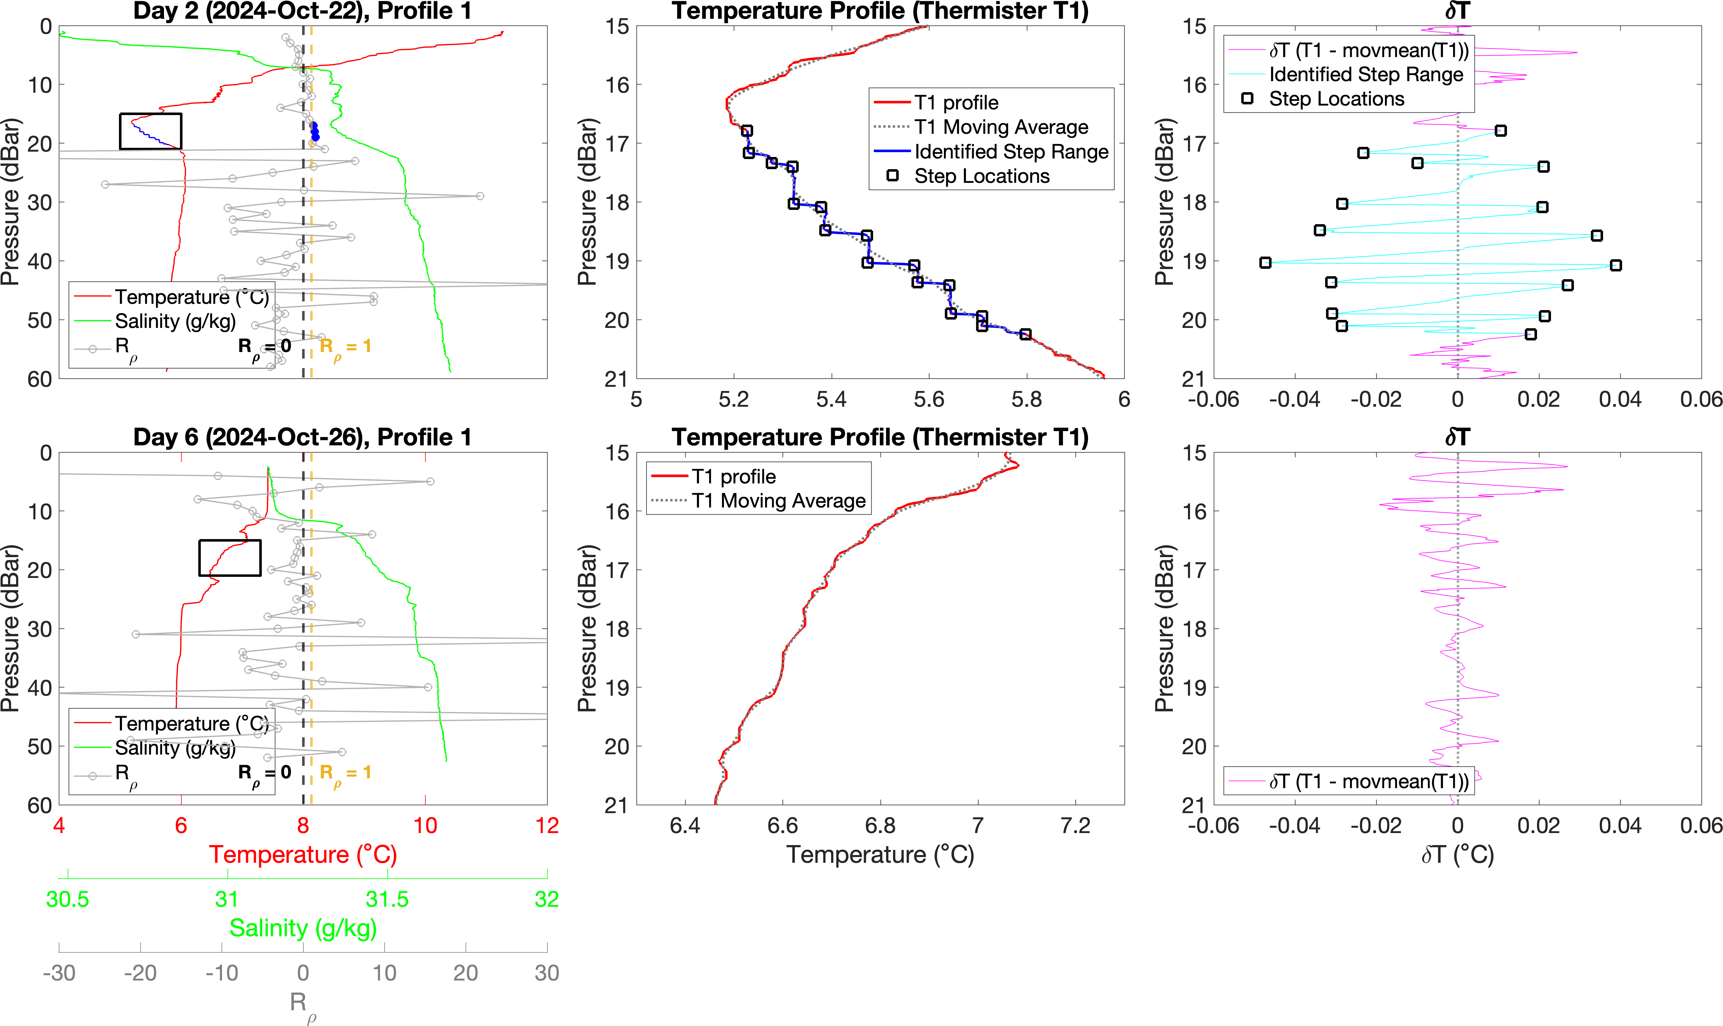

Slide 8
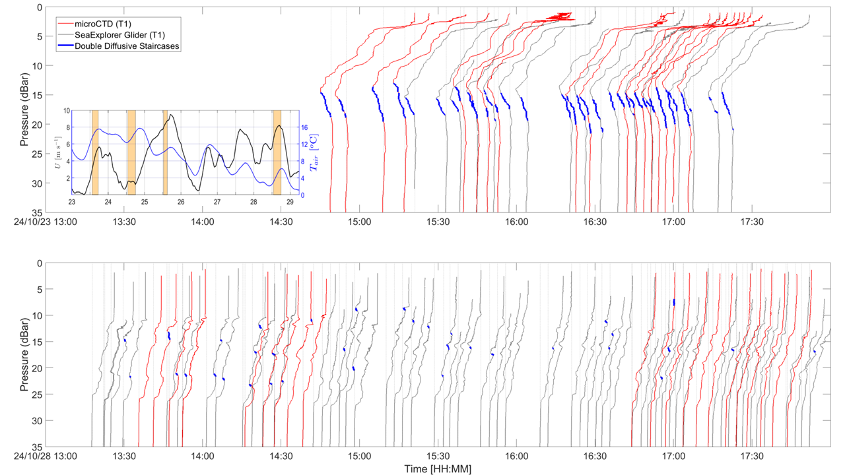

Slide 9
Why Turbulence ?
Most geophysical ocean flows are turbulent!
Turbulence is the dominant mechanism by which oceanic flows dissipate energy.
Turbulence drives air-sea exchange of momentum, heat, O₂, CO₂
Turbulence is the main mechanism for diapycnal mixing, and is important to determine e.g. ocean carbon and oxygen budgets.
Transfer of energy by internal waves, interaction with eddies and fronts
Bottom mixing by tide-topography interactions

Slide 10
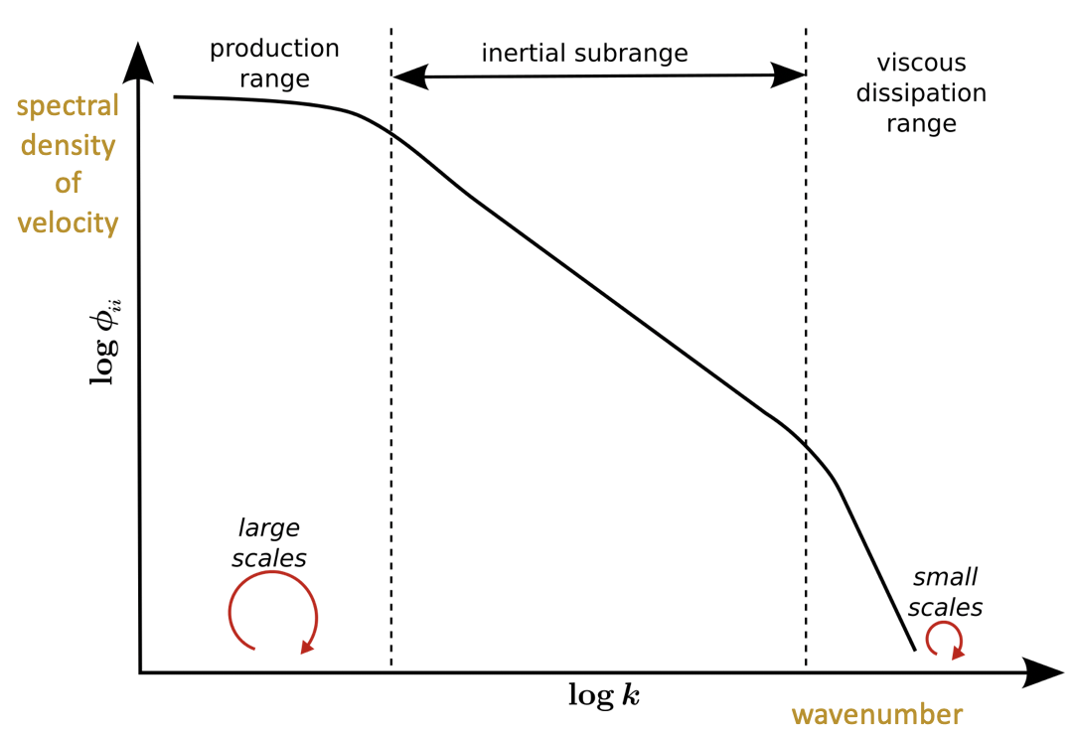

What we measure ?
ε is used as a direct measure of the turbulence intensity
ε is a fundamental quantity used to estimate many relevant features of a turbulent flow.
ε is used in the computation of the diapycnal mixing rate (eddy diffusivity)
Turbulence dominates mixing of anything that is in the ocean or enters the ocean (heat, salt, energy, nutrients, chemicals, micro-plastics etc.).
$${ K}_{ρ}= Γ\frac{ε}{N^{2}}$$

