Slide 1


Pacific salmon foundation
VENUS Salish Sea Workshop
2025-07-16
Marine Data Centre

Slide 2
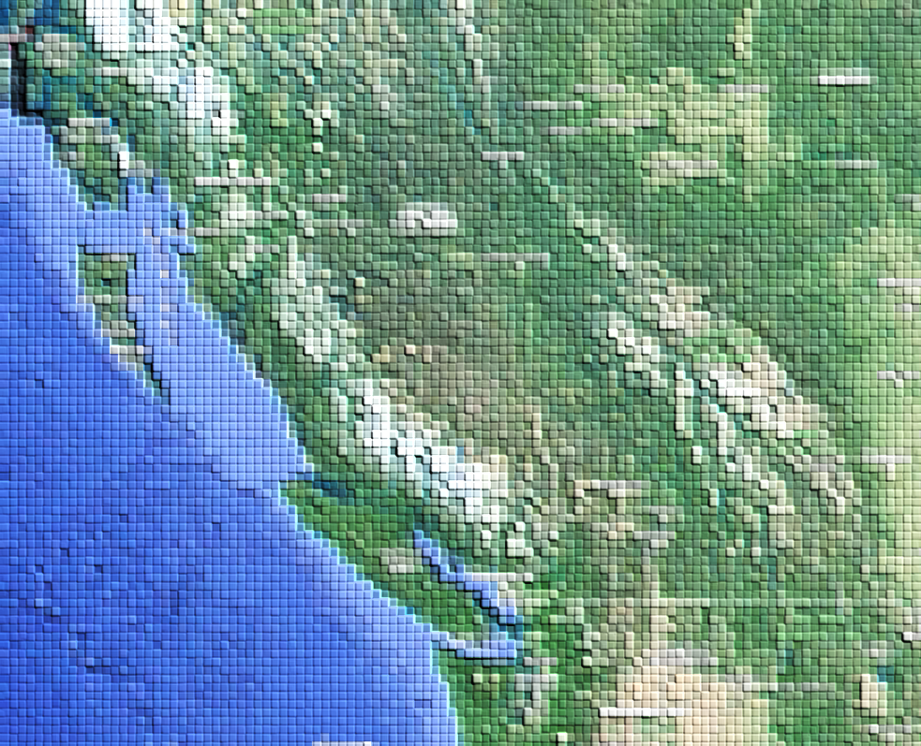
PSF Marine Data Centre Overview
Founded in 2011 as a marine data repository
Collaborative program between PSF and the Institute for the Oceans and Fisheries, UBC
Developed originally as part of the Salish Sea Marine Survival Project

Slide 3
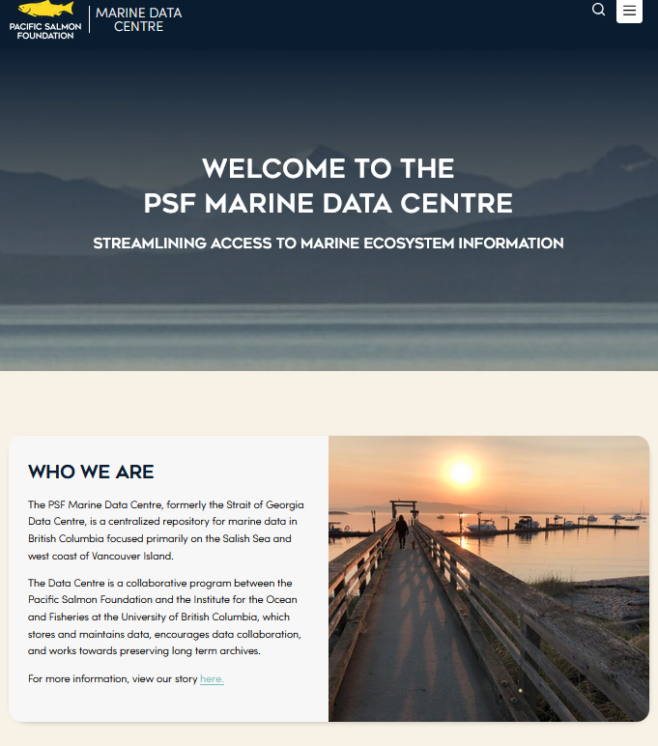
Data Centre key goals
Identify and obtain information resources relevant to the Strait of Georgia and WCVI
Create a secure archive for the data
Create an open access data system
Provide map-based displays of the data
Notes:
I believe this coordinated data collection effort is an inspirational conservation initiative.

Slide 4
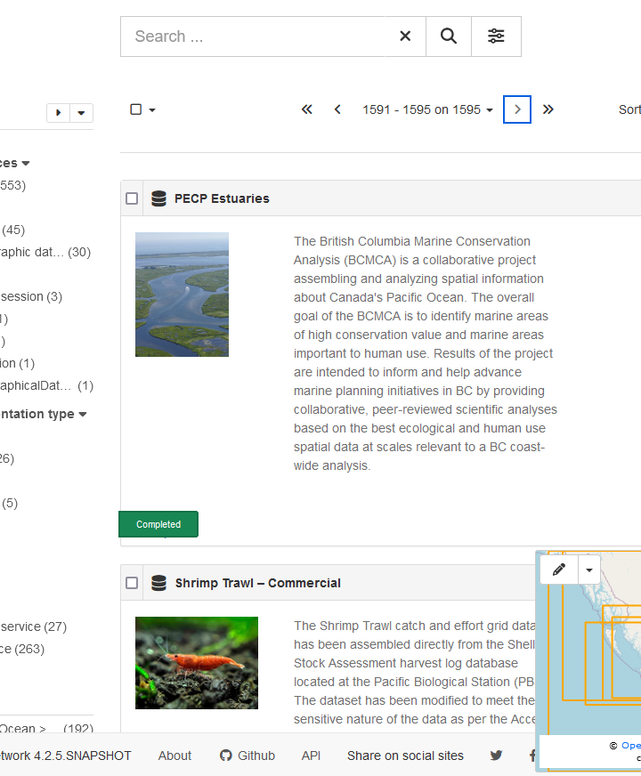
Marine Data BC Portal
1500+ datasets referenced
Includes data from 200+ organizations
Metadata follow ISO-9000 standards
Adoption of Darwin Core data standard

Slide 5
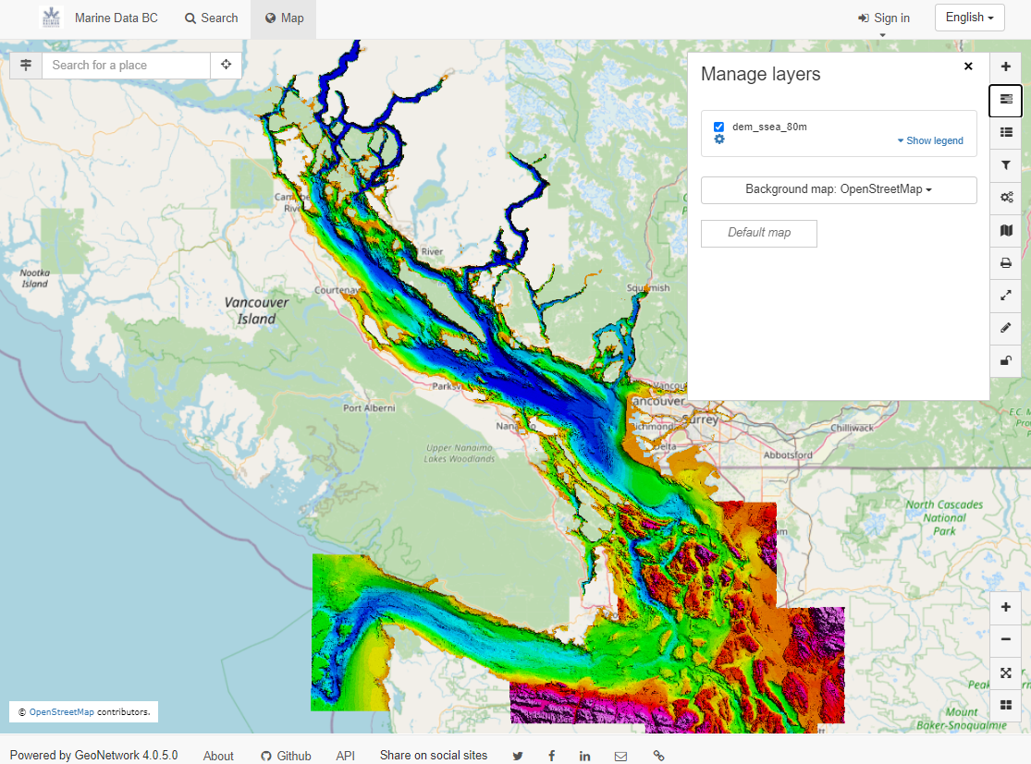
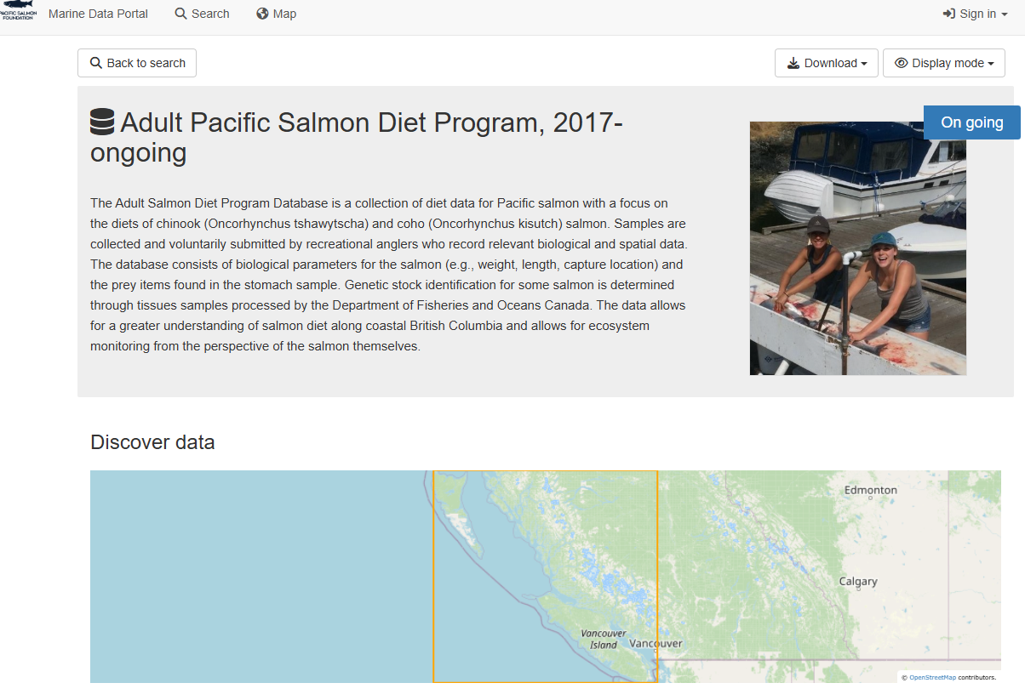
Marine Data BC Portal Cont’d
Image-left: Make-your-own-map
Image-below: Metadata record

Slide 6
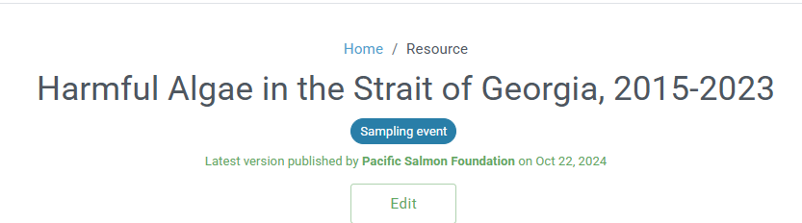
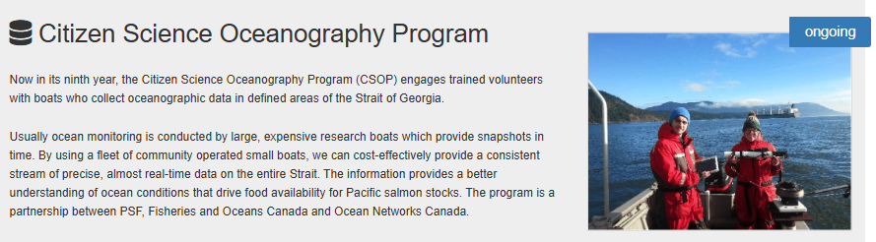
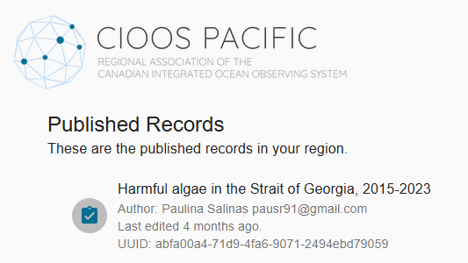
Strait of Georgia Sampling Data

Slide 7
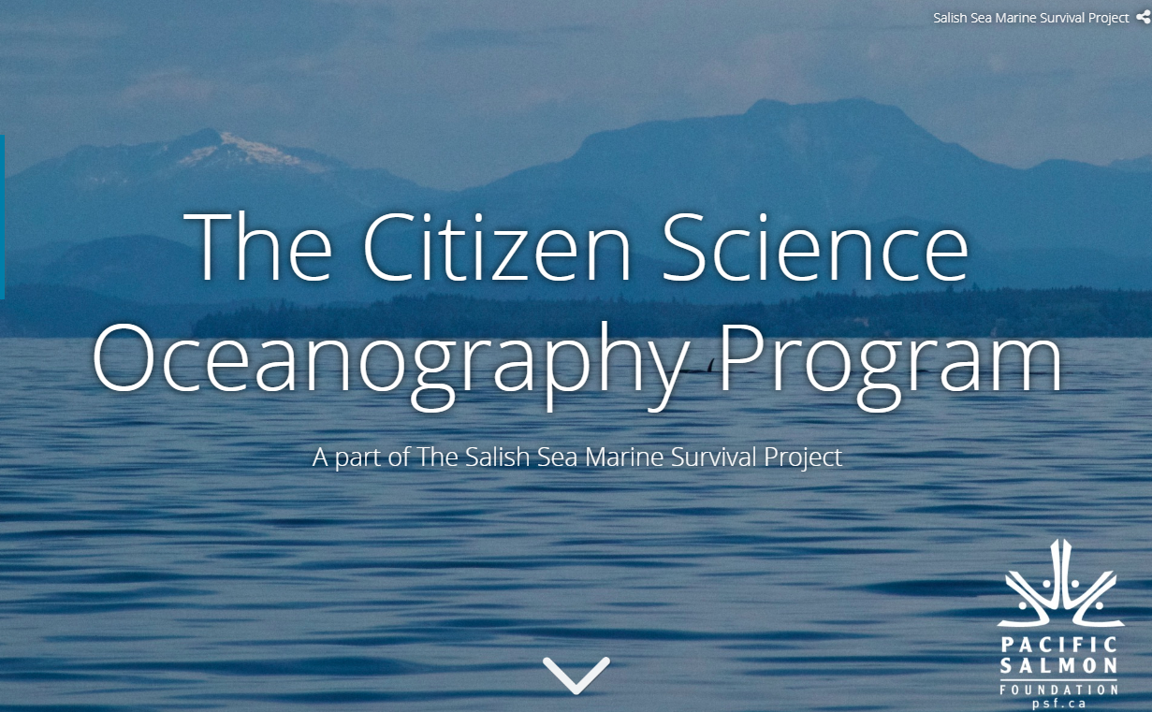
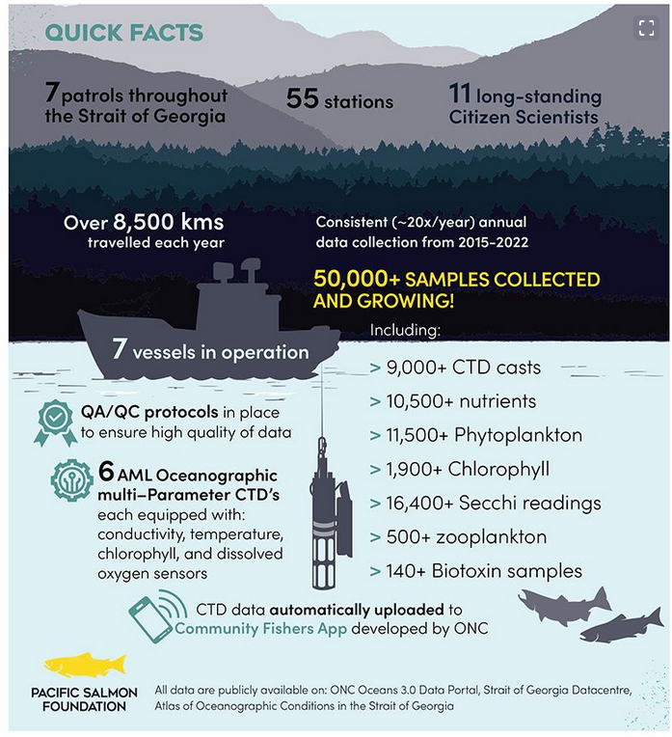
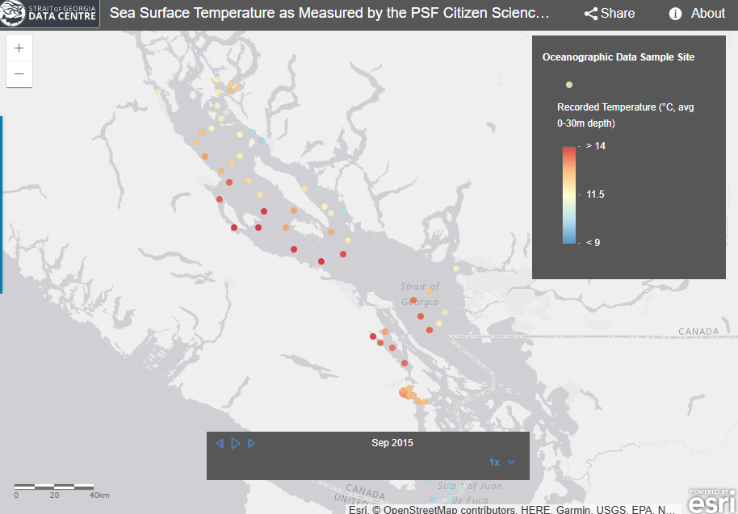
Educational Products

Slide 8
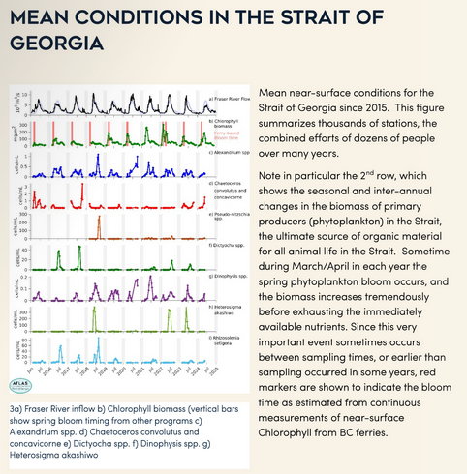
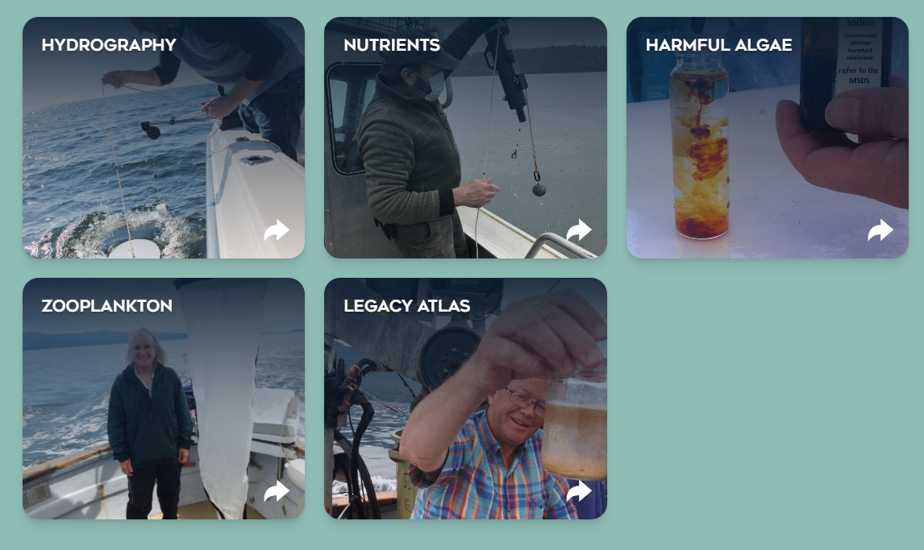
Oceanographic Conditions Atlas

Slide 9
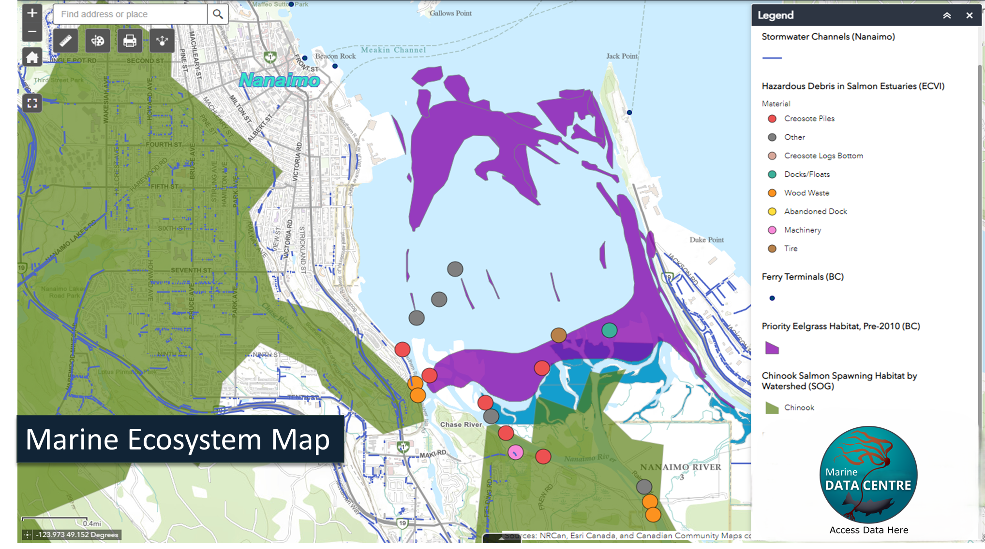

Slide 10
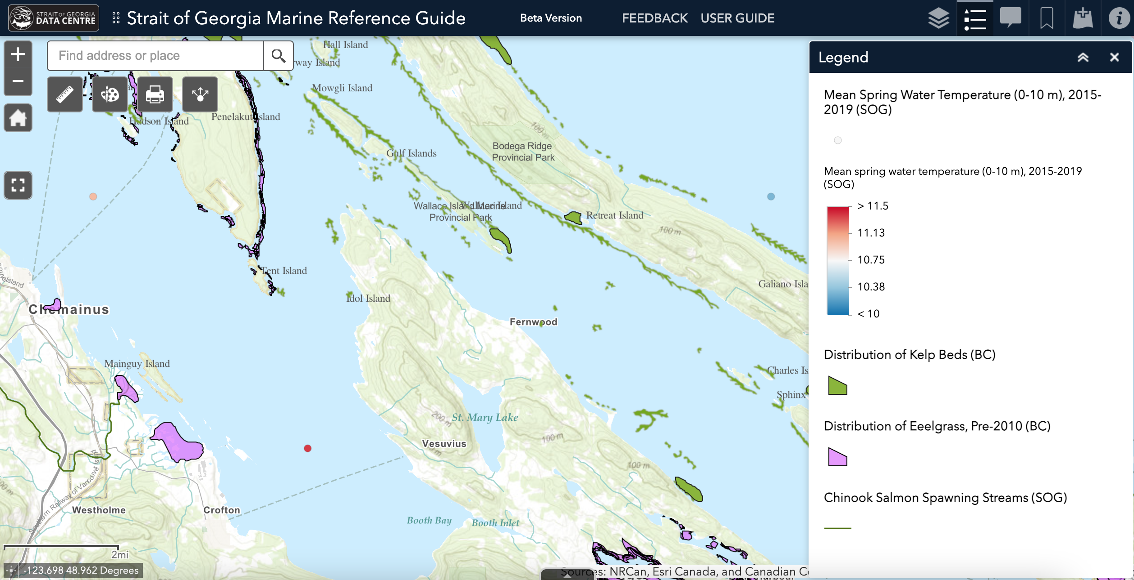
Marine Ecosystem Map

Slide 11

7/11/2025
CONTACT US
Ben Skinner
GIS Specialist
Marine Science Program
Pacific Salmon Foundation
bskinner@PSF.CA
THANK
YOU
11
Name of Presentation

