Slide 1

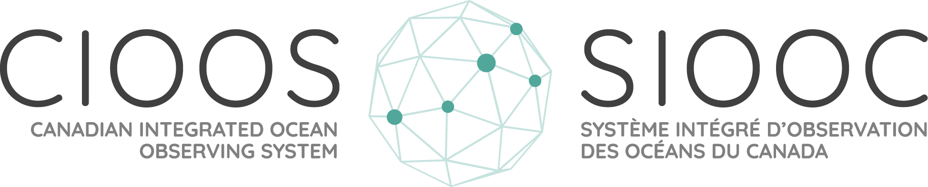
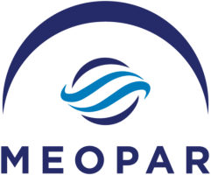
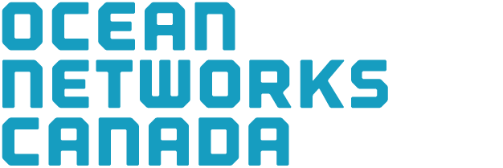
CIOOS Pacific - Expanding west coast ocean data and information
Brad deYoung
July 2025
Funded by :

Slide 2
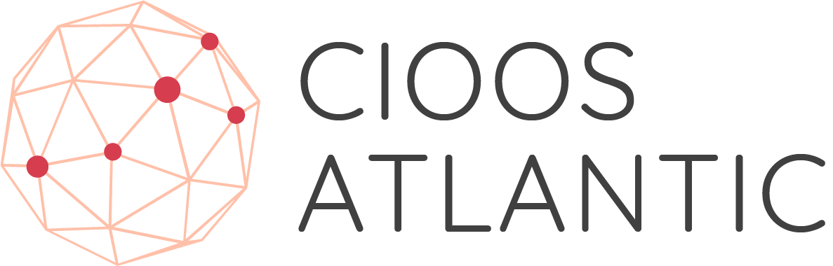
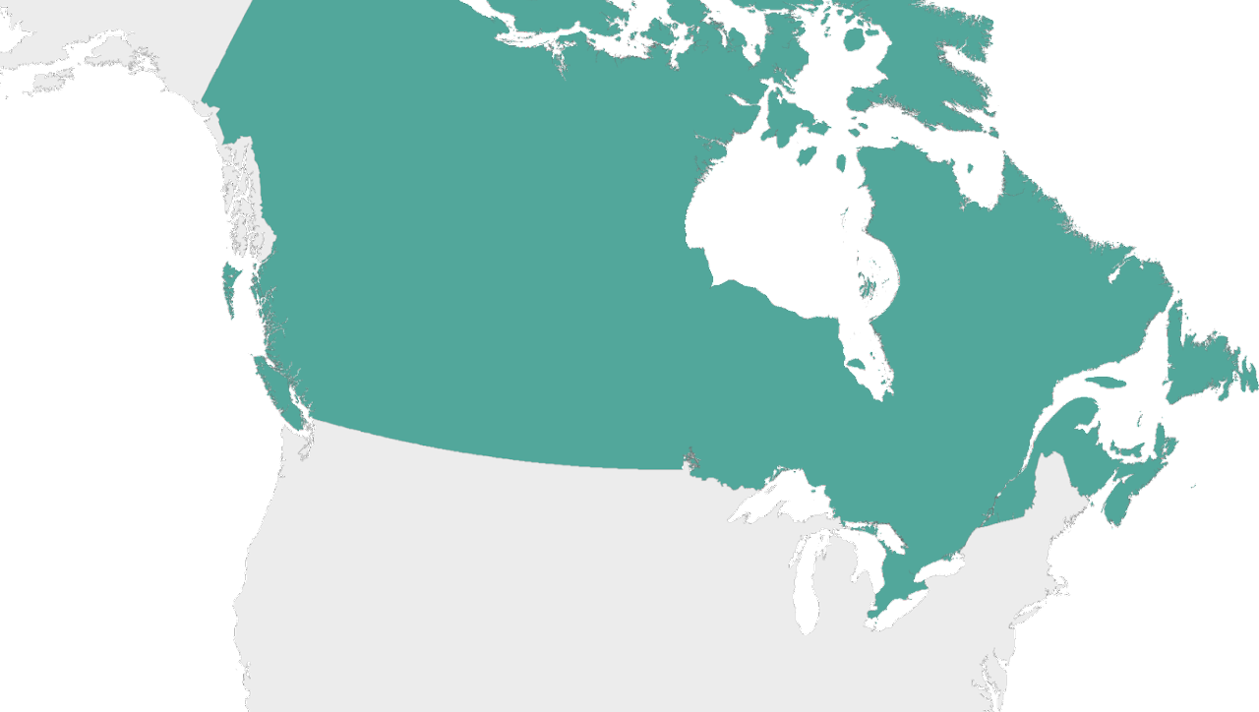

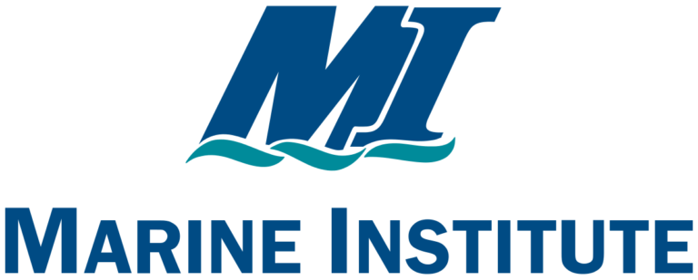


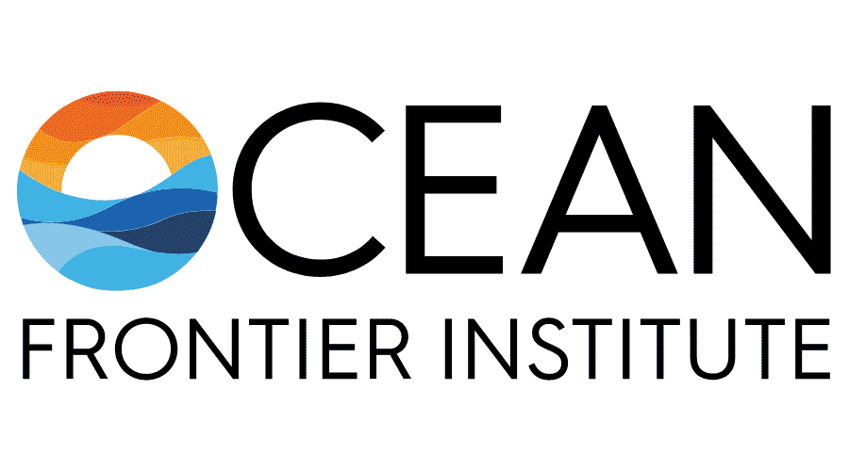
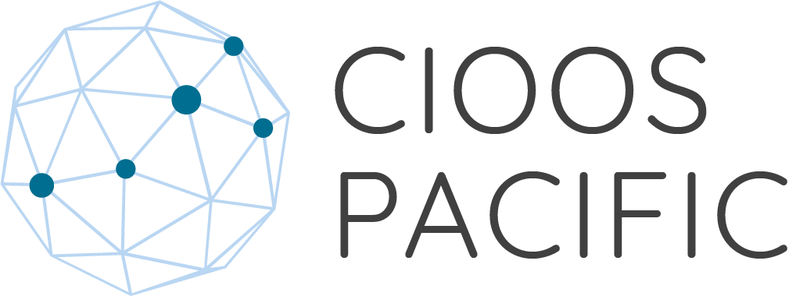
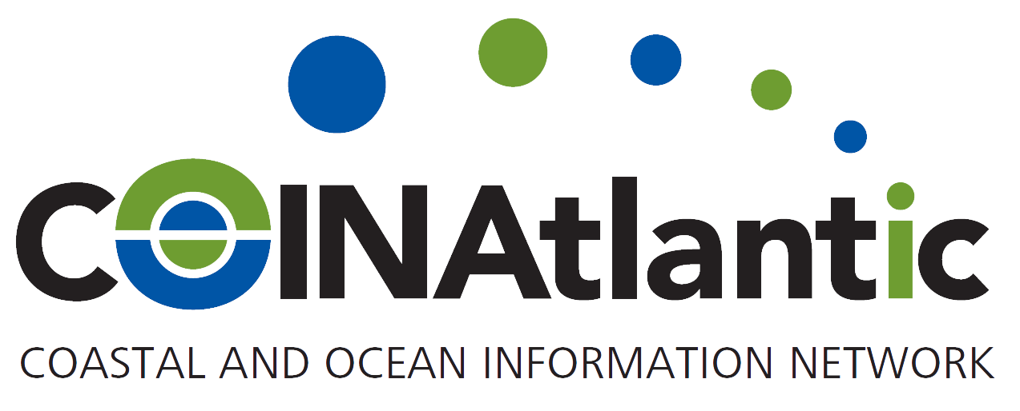
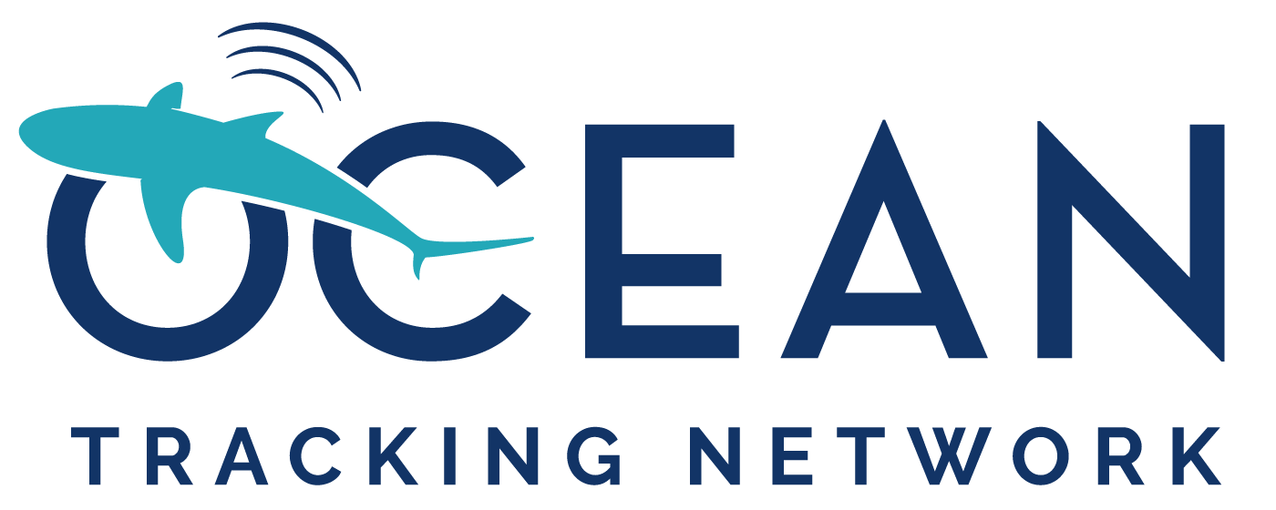
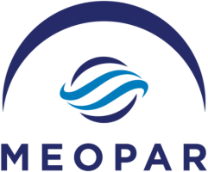

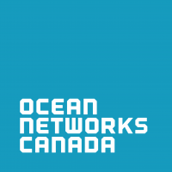

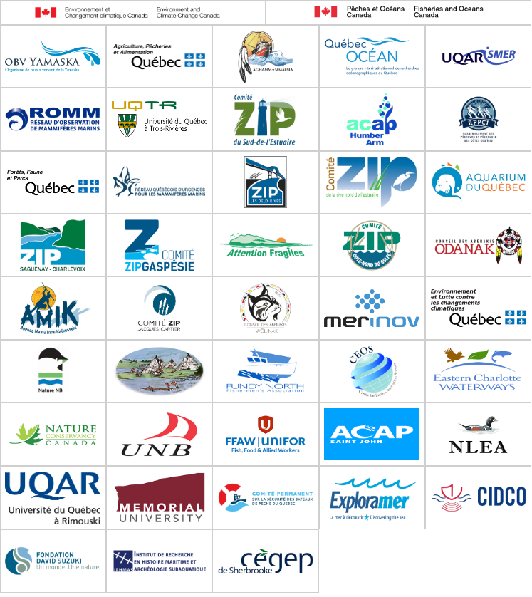
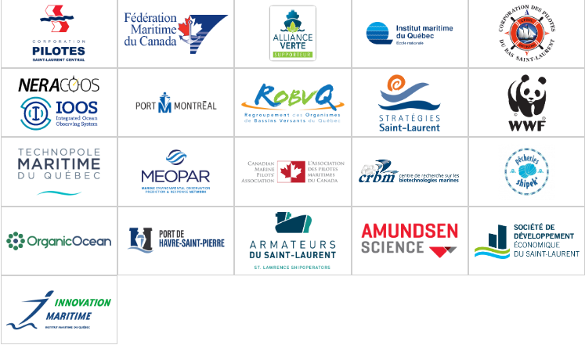
A National Collaboration
Notes:
From the start, before CIOOS even existed, the Canadian Department of Fisheries and Oceans,
MEOPAR and others had a vision for a made-in-Canada ocean observing system that is both
led and implemented by a community of collaborators from across the country
….essentially a bottom up approach where the core funders, although obviously critical to CIOOS,
are not directly involved in all of the day-to-day operations of CIOOS. As you can see, CIOOS was
founded by organizations from across the country, including many government, academic and NGO partners.

Slide 3

A Brief CIOOS History
Pilot Funding
August 2018 - March 2020
Infrasturcture
development
Strategic Plan
2021 - 2026
Targeting: Partnerships, Data, Tools, Models
GOOS RA
June 2023
CIOOS is recognized as a GOOS Regional Alliance
Coordinating Office
April 2025 .... more national integration
2019
2020
2021
2022
2023
2024
2025
2026
Expansion
March 2020 - March 2024
Expansion of data catalogue, visualization and data tools, targeted engagement
Reorganization
April 2024 - ...
Centralized management, continued integration

Slide 4
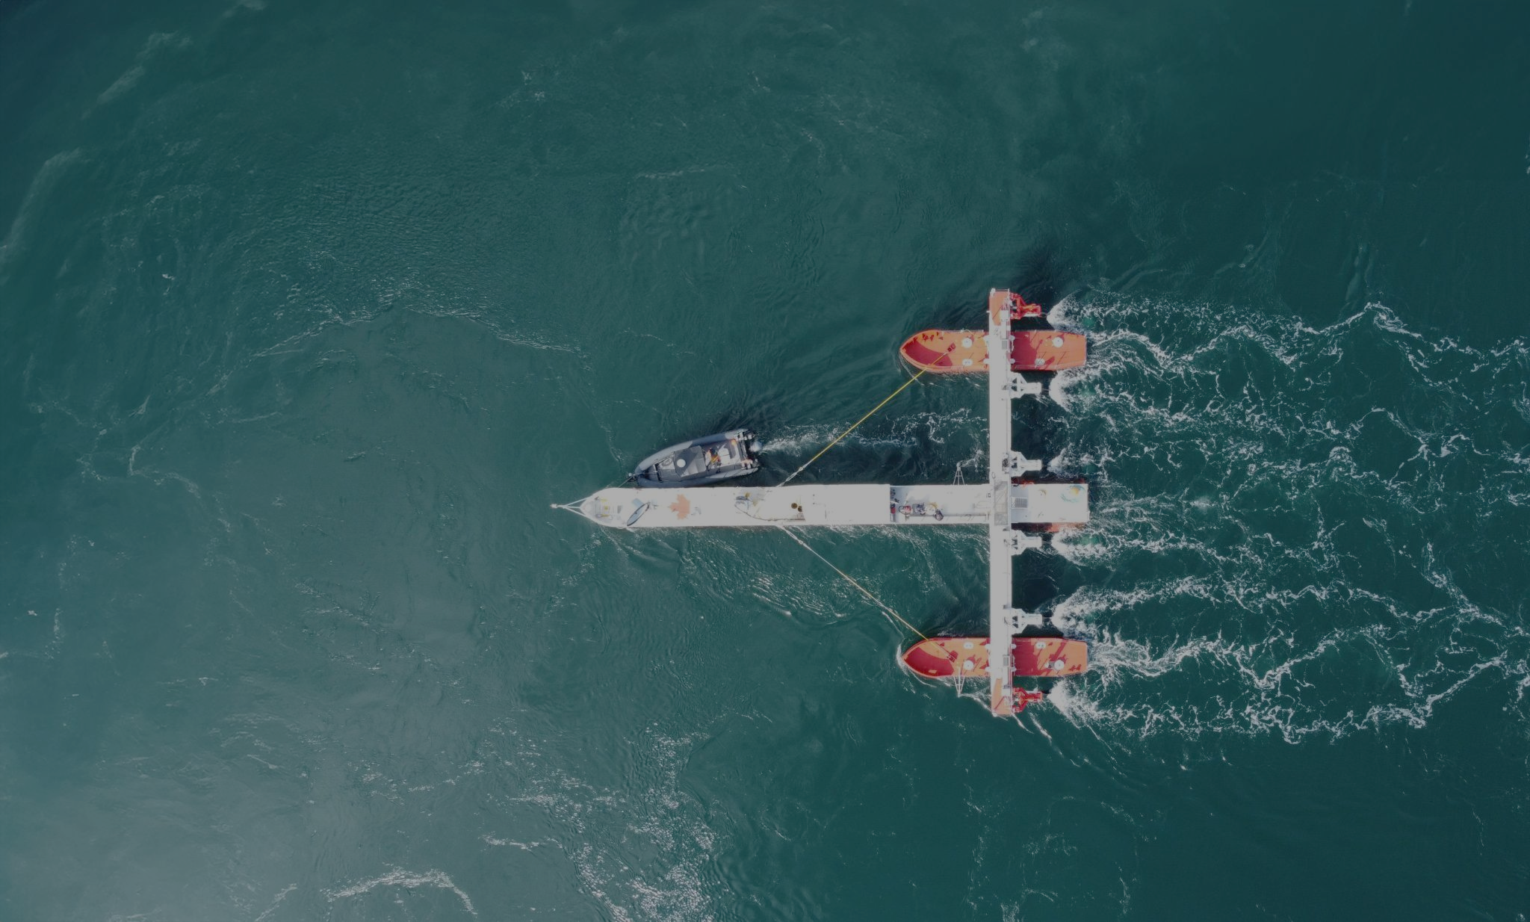
How are we doing?
3566 datasets* (+1796 since 2023 + > 1000 just this year)
100+ partner organizations
24 data applications (+3)
EOVs in alignment with GOOS
  Integrating biological + model data

Slide 5
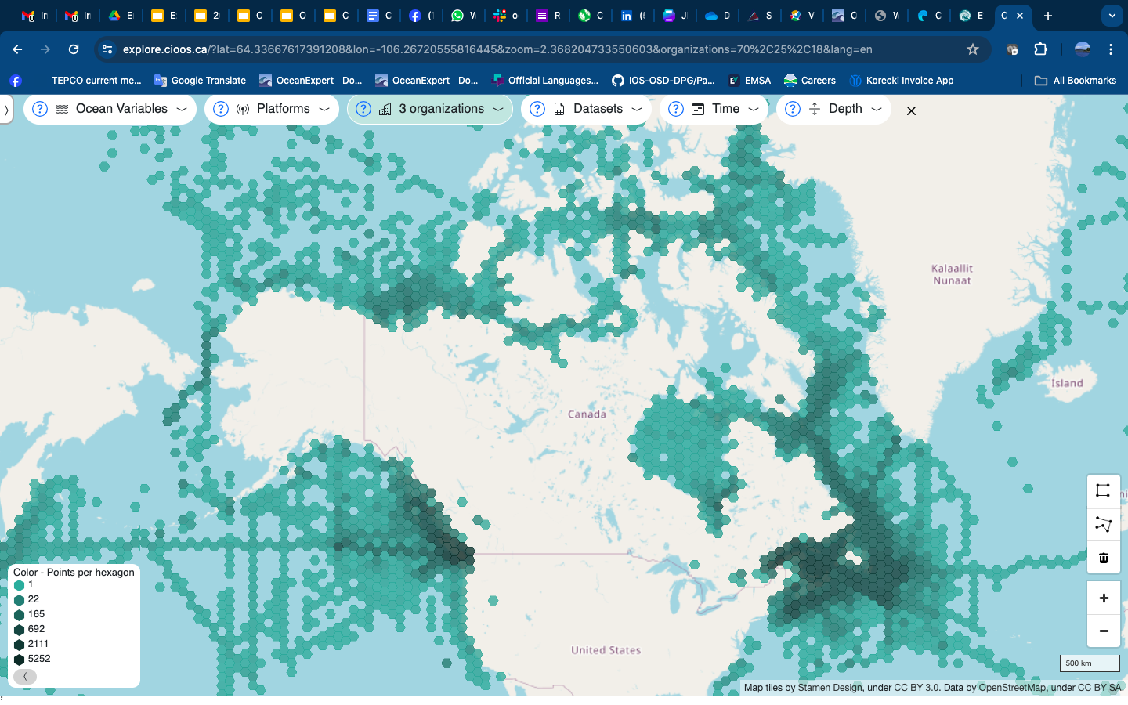

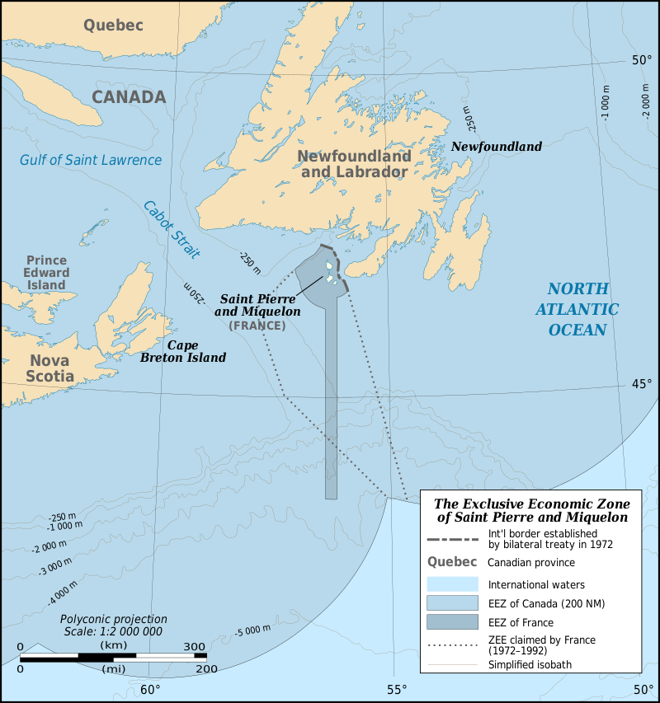
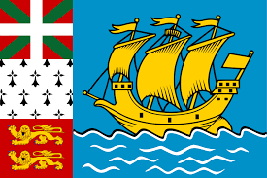
NEW Data!
AZMP + AZOMP
Oceanographic Data Management System
Canadian OA data (1TB)
Ocean Glider Data
Notes:
Data Explorer allows users to search geographically across datasets.
Asset Map allows users to search geographically to access complete datasets.
Data Catalogue allows users to search by keyword and refine using the metadata.

Slide 6
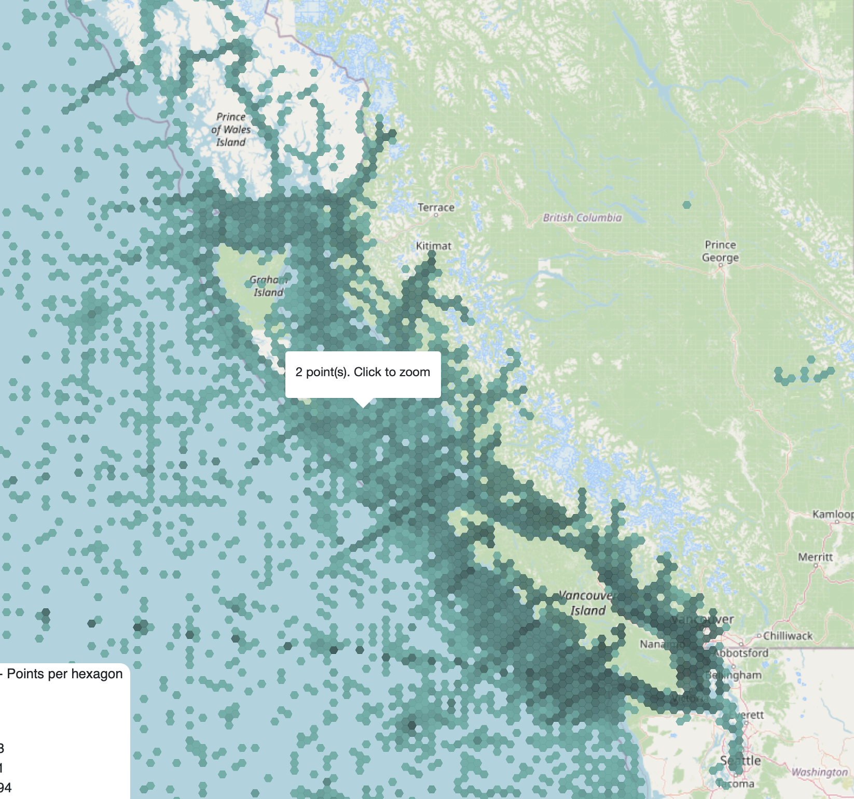
West coast data
House all the DFO data
Expanding other partner data, including academic
Also expanding data types - ocean acidification and model data

Slide 7
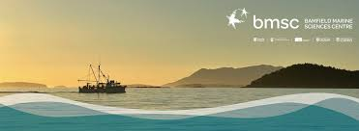
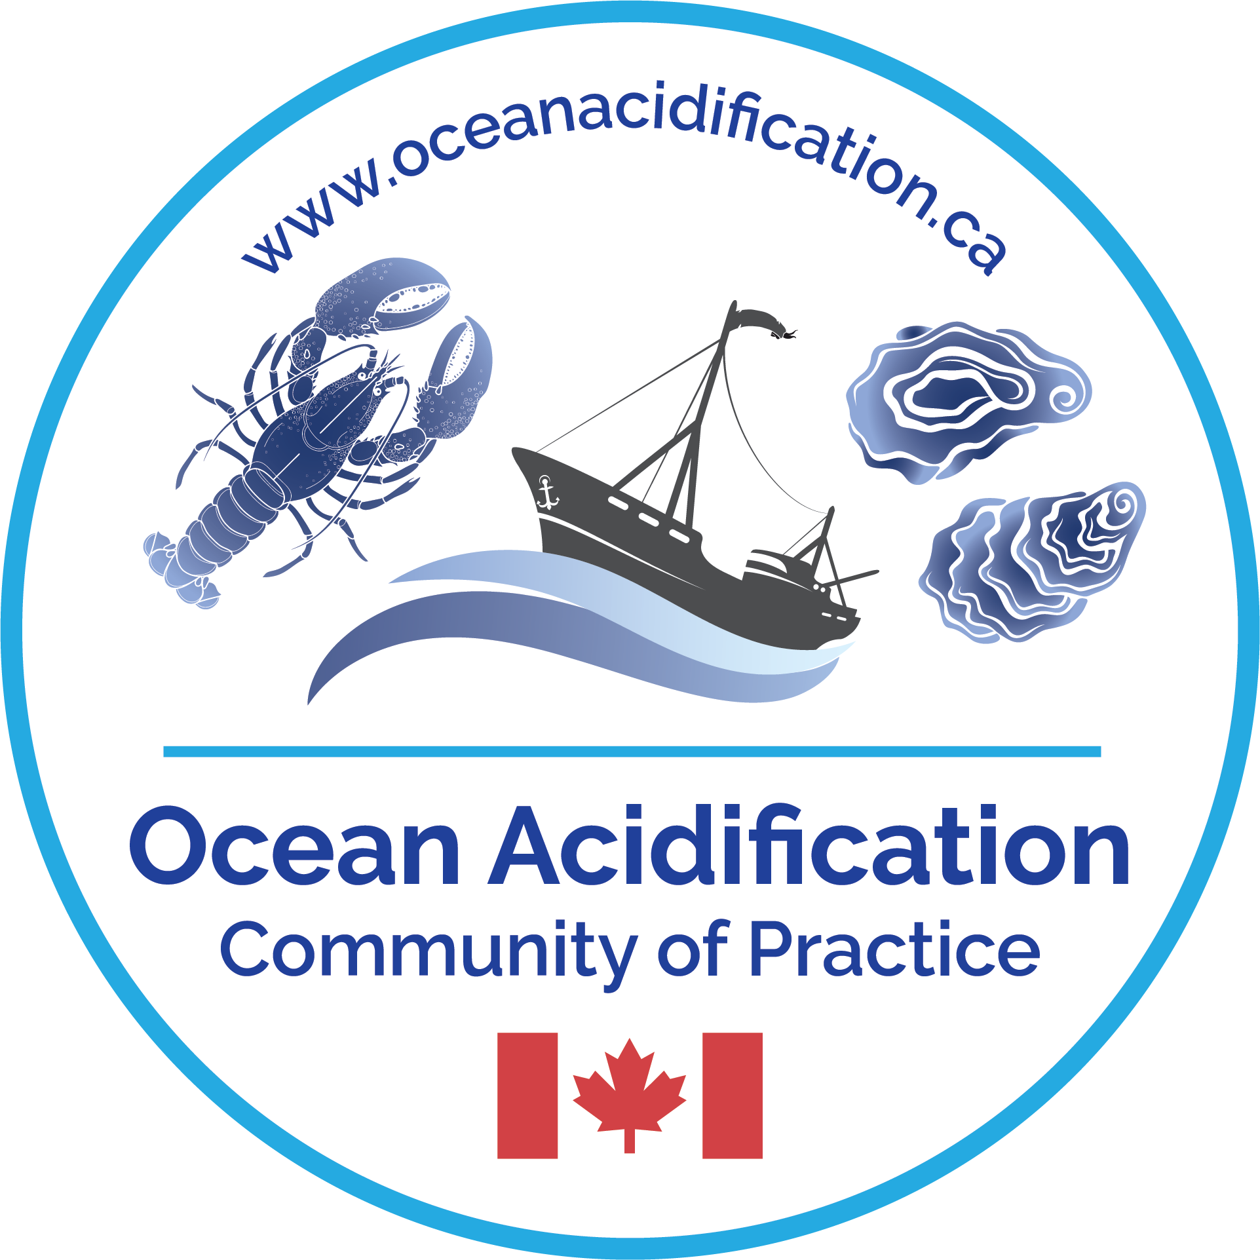
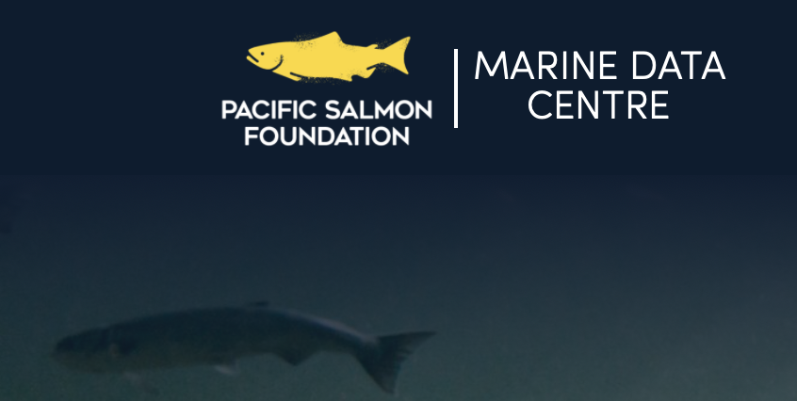
Building new partnerships and expanding data access

Slide 8
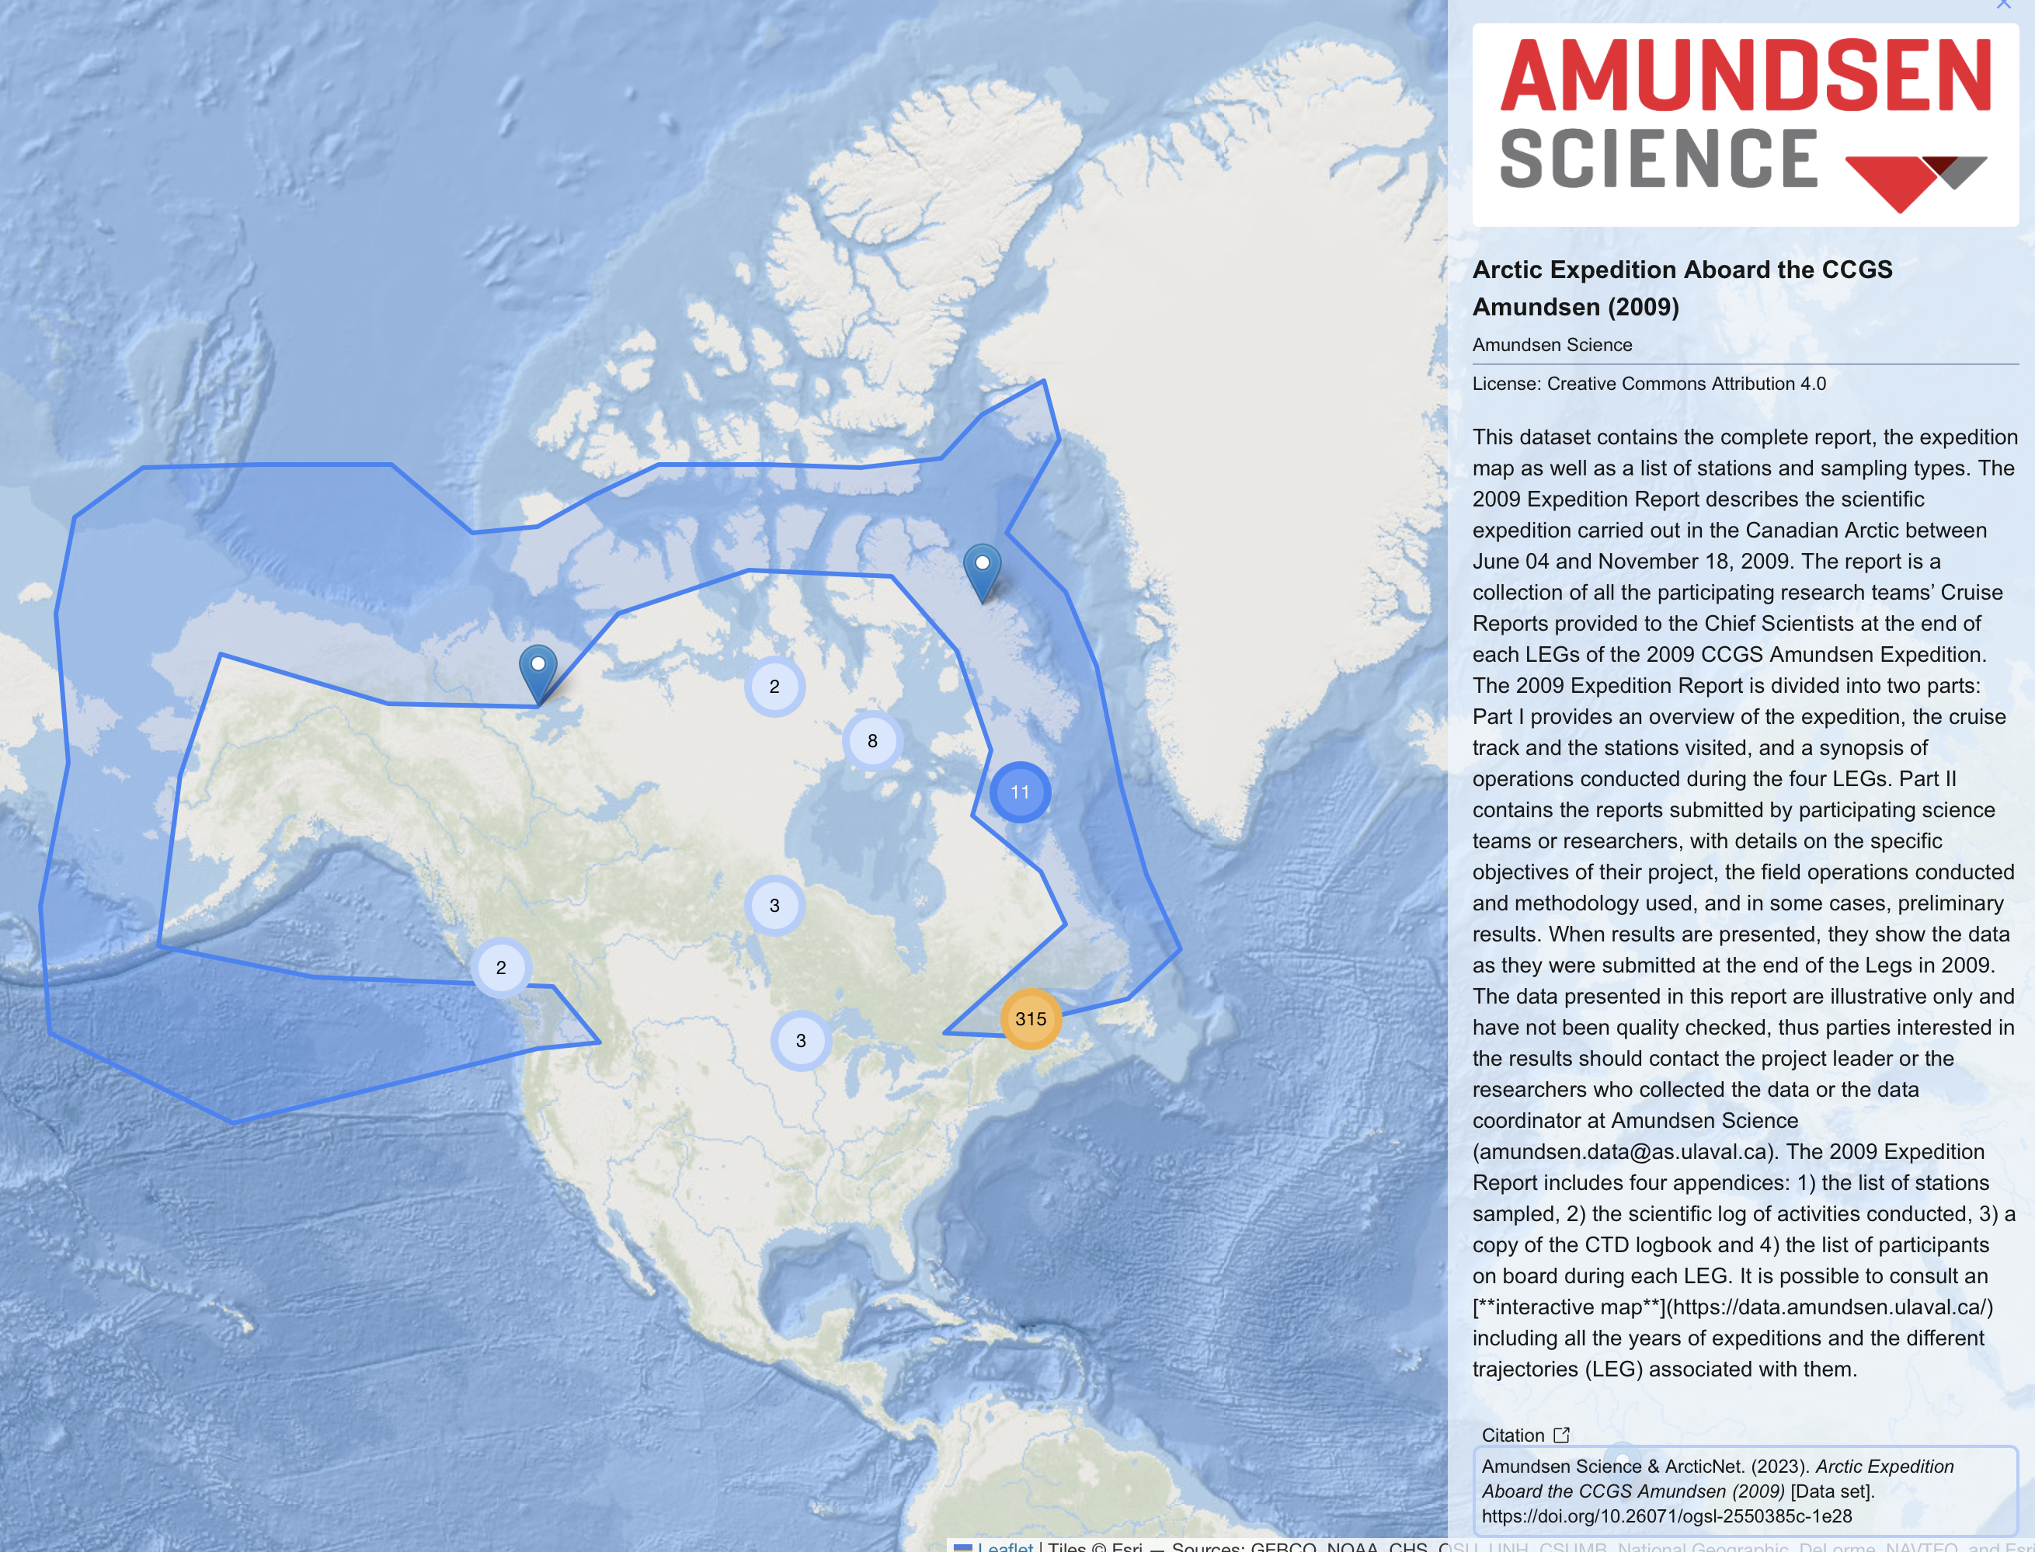
Tracking partner metadata contributions :
Preview of all CIOOS Partner’s Data in a lightweight map viewer
Offers ability to show and explore contributions from different partners (here showing Amundsen Science)
Will be flexible and allow different partner tracking
Should be ready soon

Slide 9
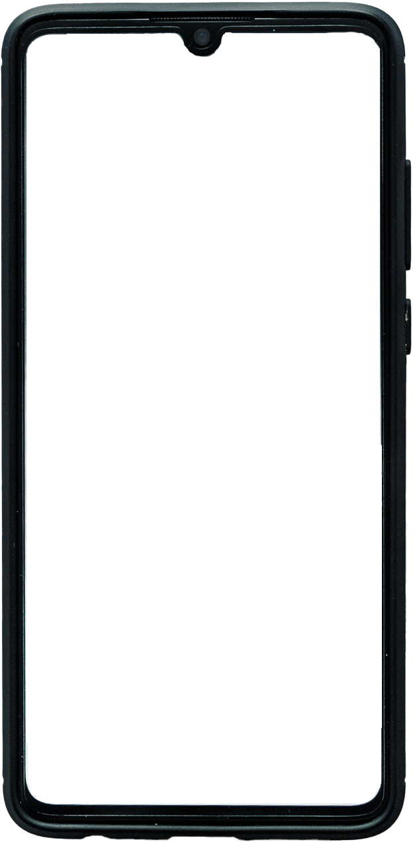
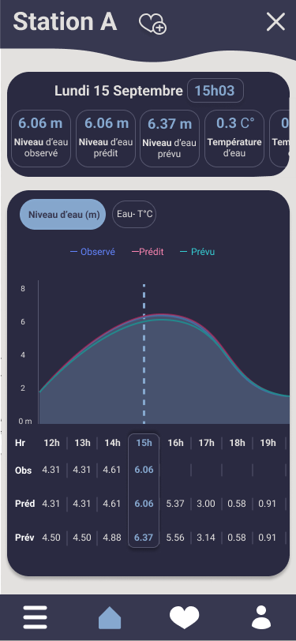
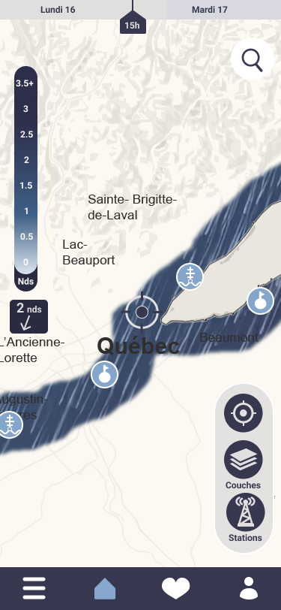

Tools and Information Services - OGSL
Nautilo - Maritimes Conditions
Application for real-time visualization of information relating to navigation conditions (weather conditions, currents, tides, water levels, etc.) on the estuary and the St. Lawrence River.
Additional Data:
Water Levels
Wave Height and Ice
Winds and Wind Gusts
Expanded Data Coverage
Increased dashboard personalization
AI-based data recommendation system
Improved mobile mode

Slide 10

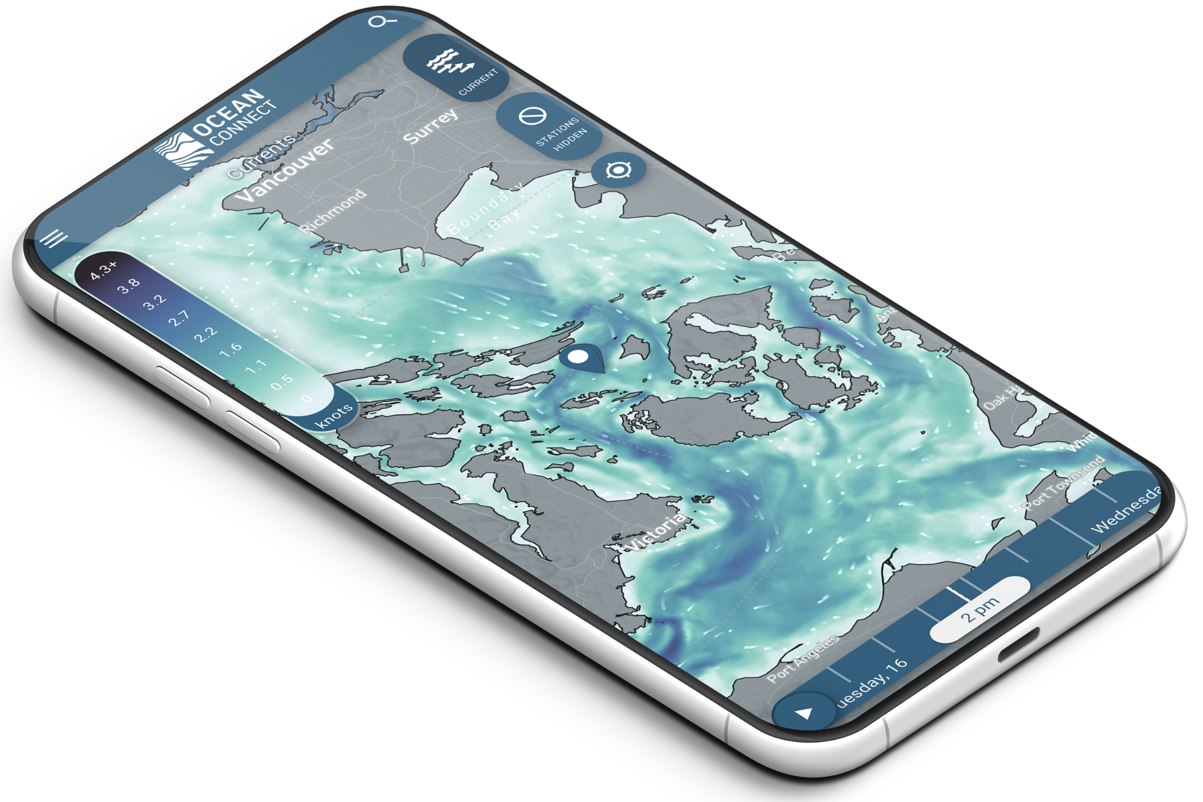

Tools and Information Services – CIOOS Pacific
Now maintained by Hakai

Slide 11
CIOOS and the Salish Sea
Provide the hub for available data
Support new information services
New, expanded partnership with MEOPAR (OA data) and TCA (CIOOS Atlantic and OGSL)
Develop new tools to make it easier to ingest data and metadata
Support integration of new partners providing and accessing data
Enable wider links with the modelling community
Notes:
We expect an increase in overall funding in this cycle enabling us to achieve many goals that we have had but that were resource limited
When looking at the bigger picture of broader ocean data across Canada, vast amounts of data are being collected across multiple sectors for project based work, operational monitoring, regulatory requirements and operational decisions, however, much of it is used in isolation and/or for a limited time. This data is often used by the source organization and then shelved or stored with no ability for it to be discovered and potentially reused by other users. There is minimal long term value of data often a duplication of efforts, simply because of a lack of awareness that the datasets you need are already out there.
The gap = a coordinated system that brings together and leverages existing Canadian and international ocean observing dat

Slide 13
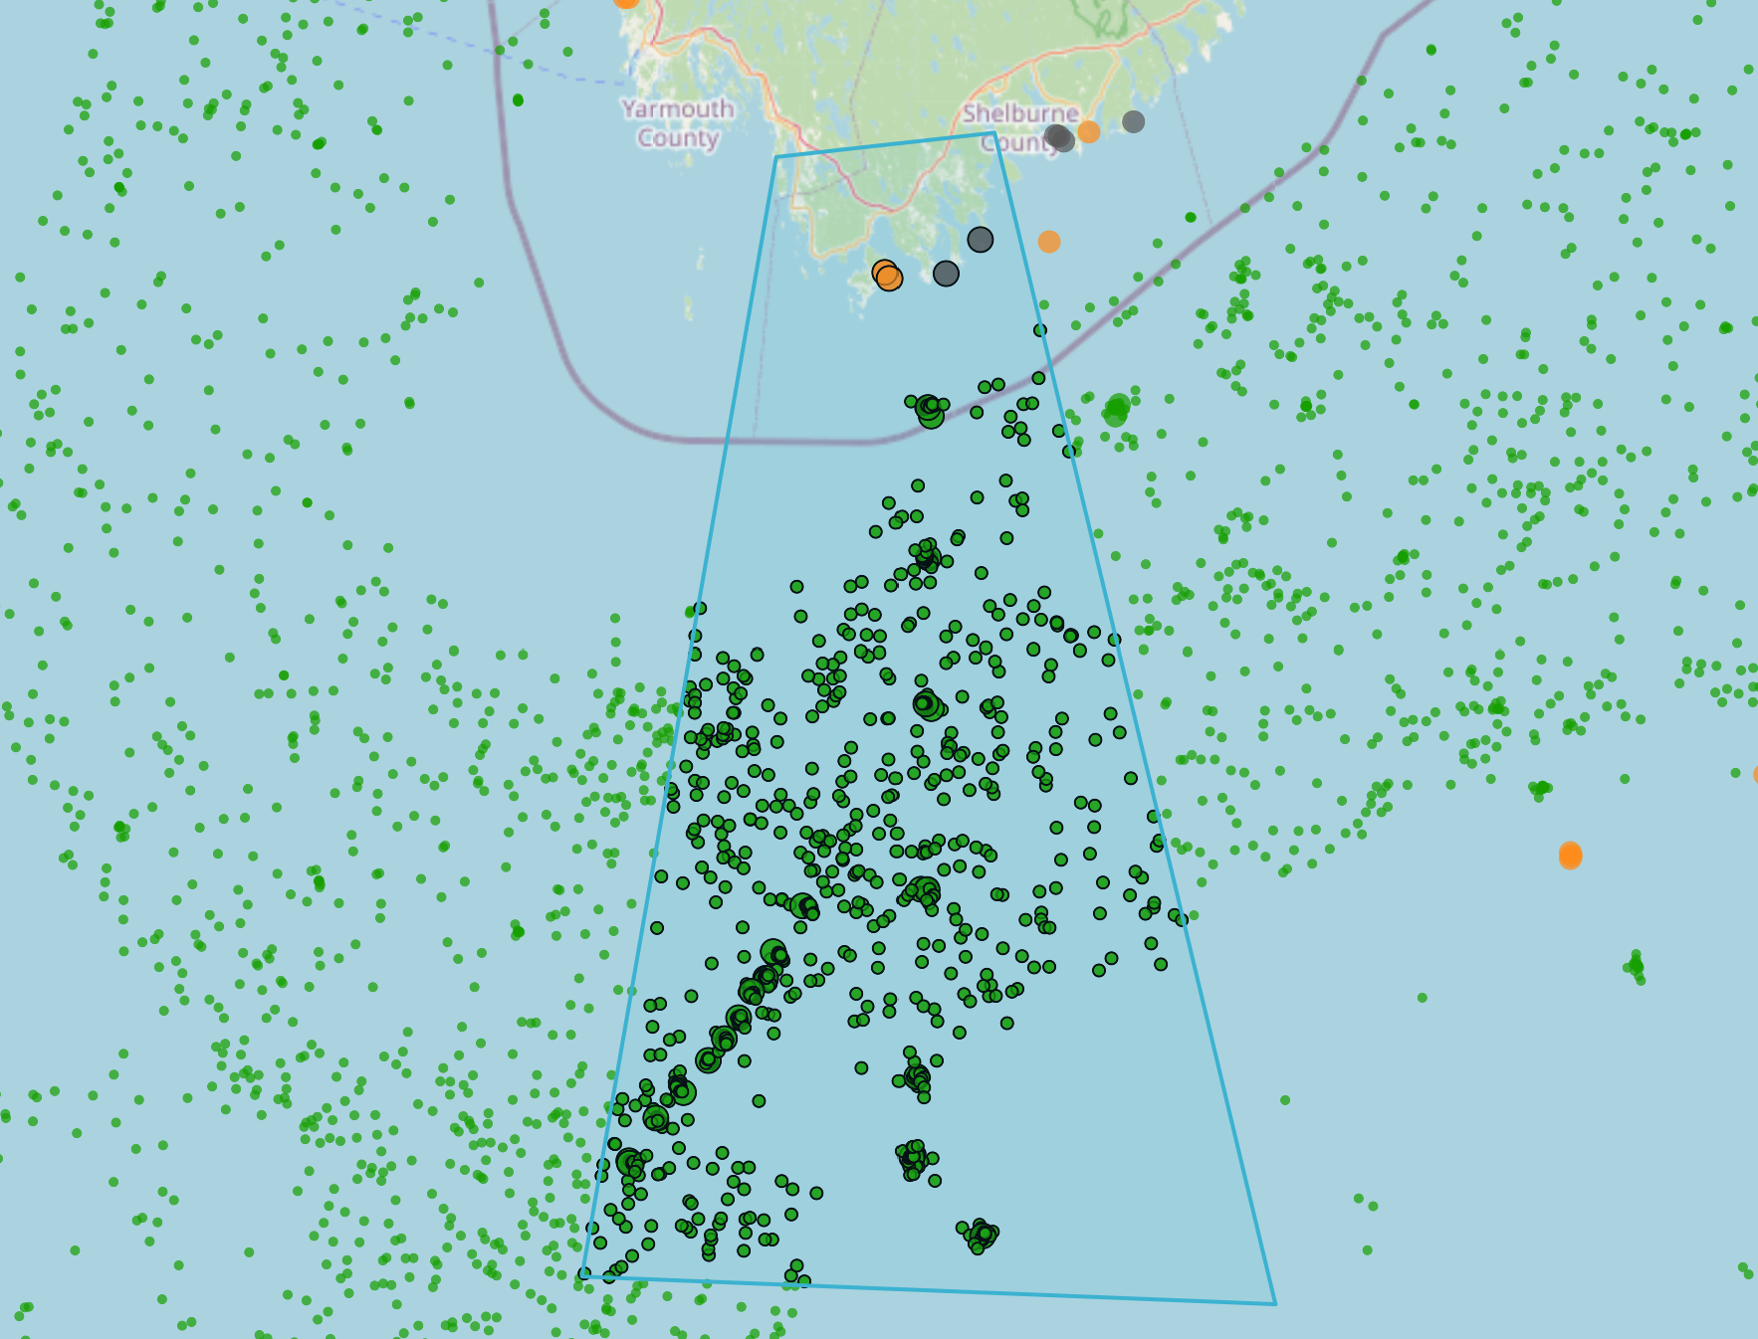
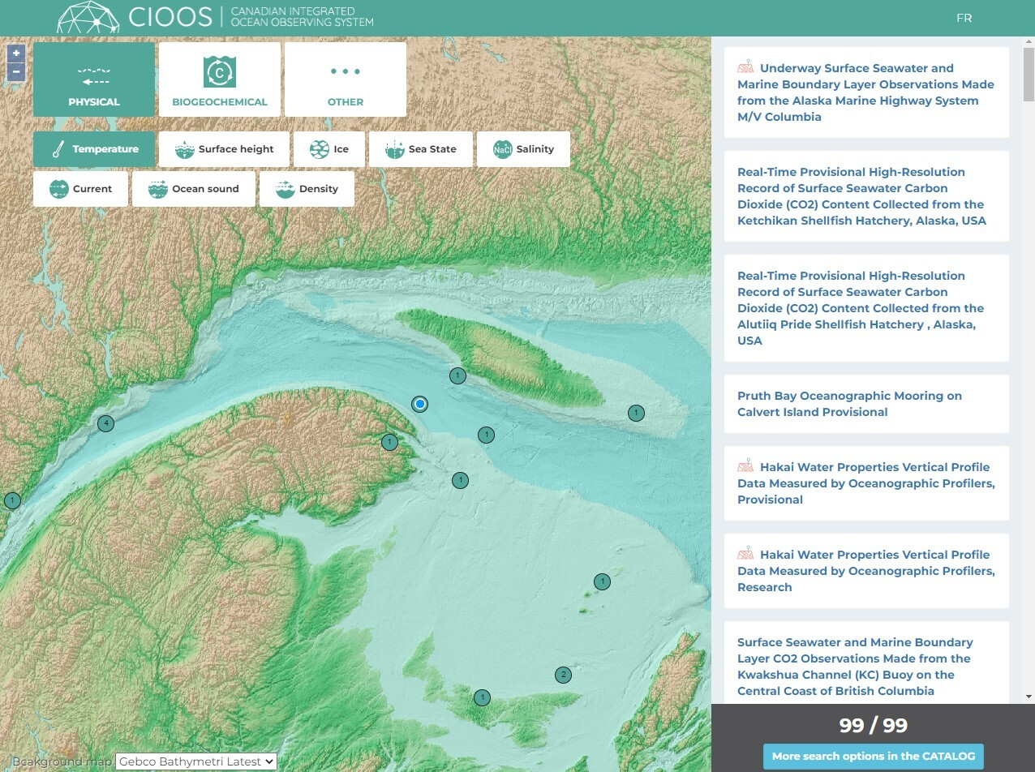
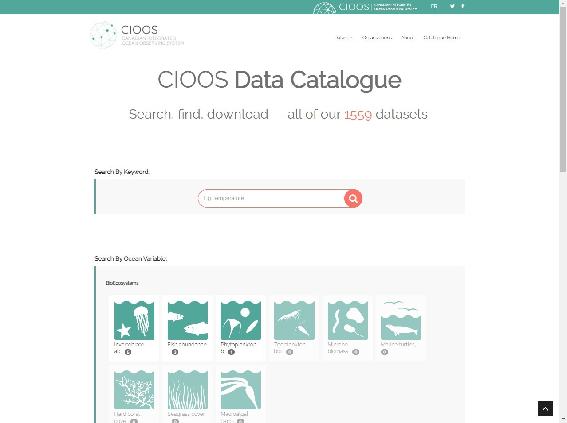
Data Exploration Tools
Data Explorer
Catalogue Map
Data Catalogue
Notes:
Data Explorer allows users to search geographically across datasets.
Asset Map allows users to search geographically to access complete datasets.
Data Catalogue allows users to search by keyword and refine using the metadata.

Slide 14
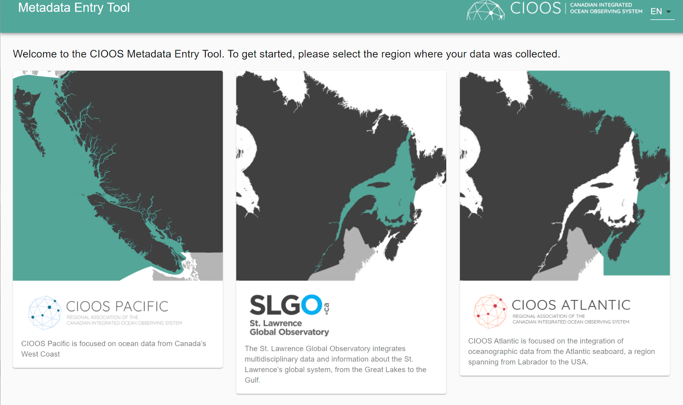
Metadata Entry Tool
Ensures required fields are completed and does automatic translations
Added features for region selection, bilingual translations
Notes:
CIOOS has a metadata entry tool that aids data holders through the data ingestion process. This web tool requires essential information and has built in translation through Amazon Web Services for bilingual fields. CIOOS data ingestion specialists in each region will work with data providers to complete this form as part of getting their data ingested to the system.

