Slide 1
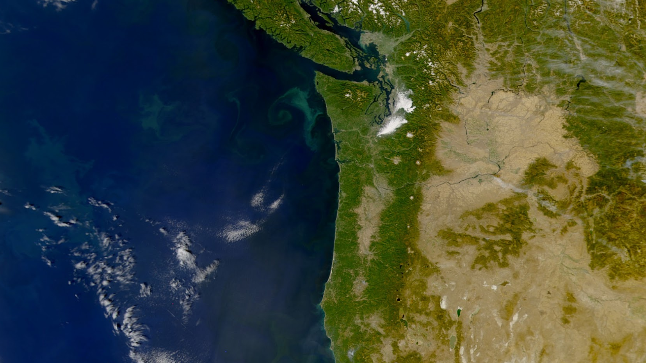
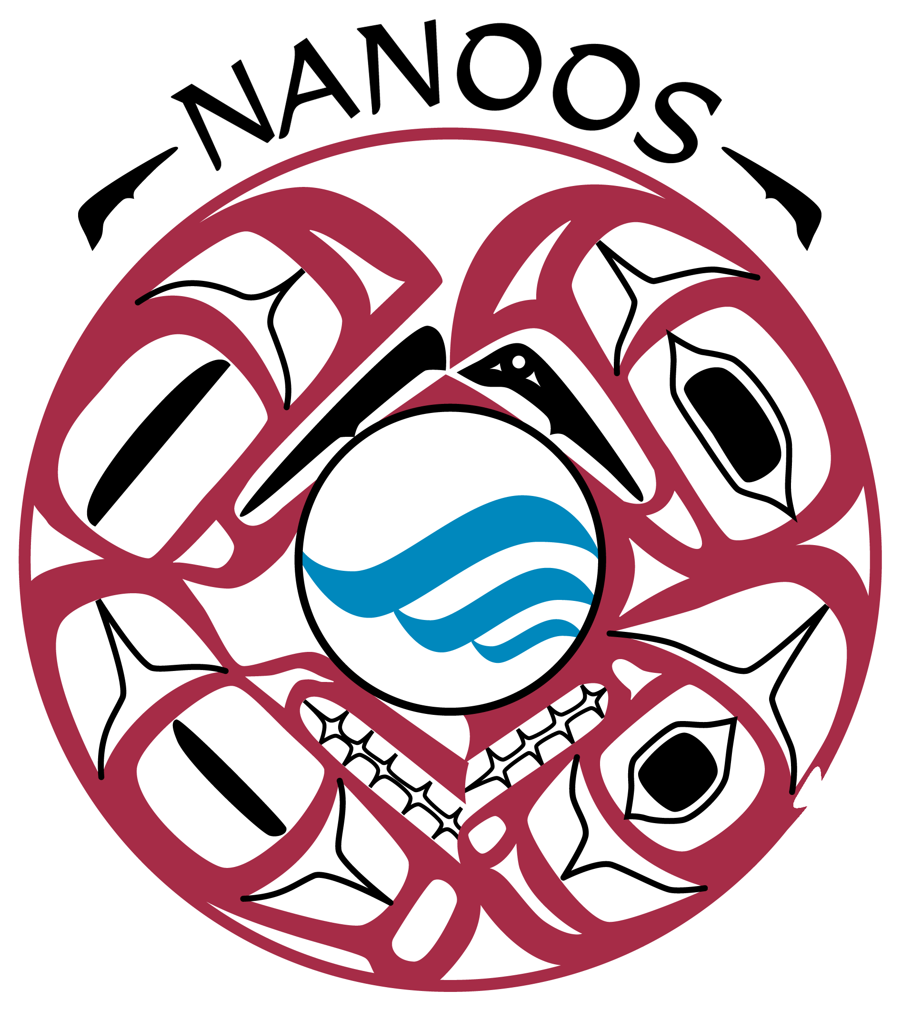

NANOOS Observing System and science observations from it
Salish Sea Workshop
16 July 2025
Jan Newton
University of Washington

Slide 2
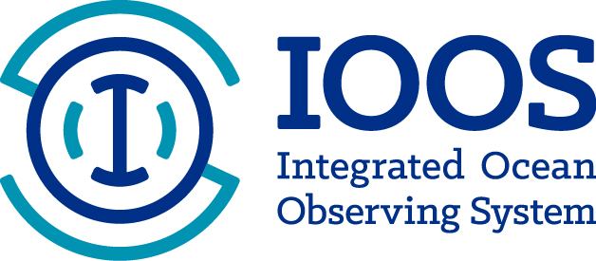
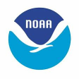


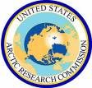






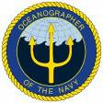
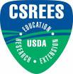
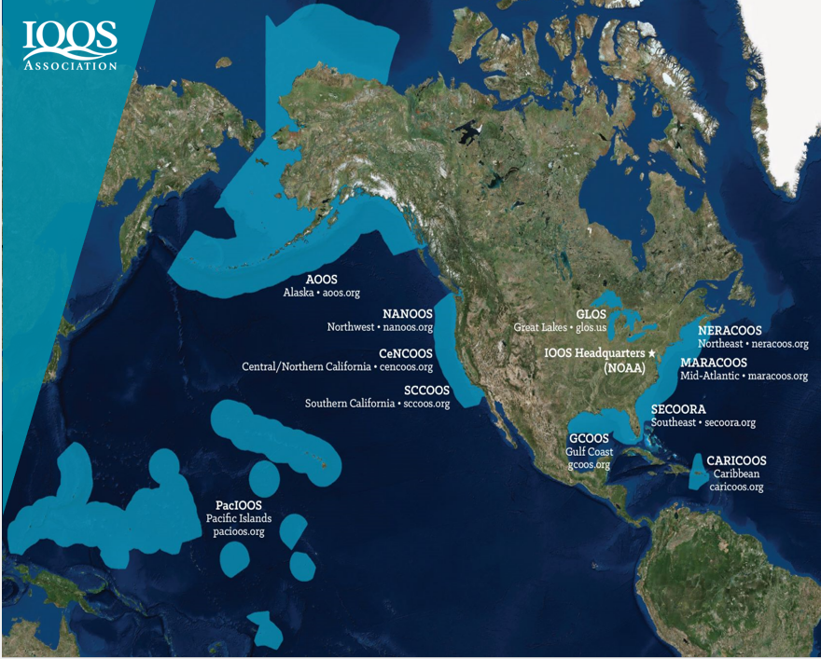



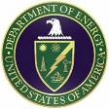

WHAT IS IOOS?
The U.S. Integrated Ocean Observing System (IOOS)
is a national-regional partnership working
to provide new tools and forecasts to improve
safety, enhance the economy, and protect health.
Integrated ocean information is available in near
real-time, as well as retrospectively to understand
and predict coastal events and conditions
IOOS funds coastal observing infrastructure,
modeling, products, and connections to users

Slide 3
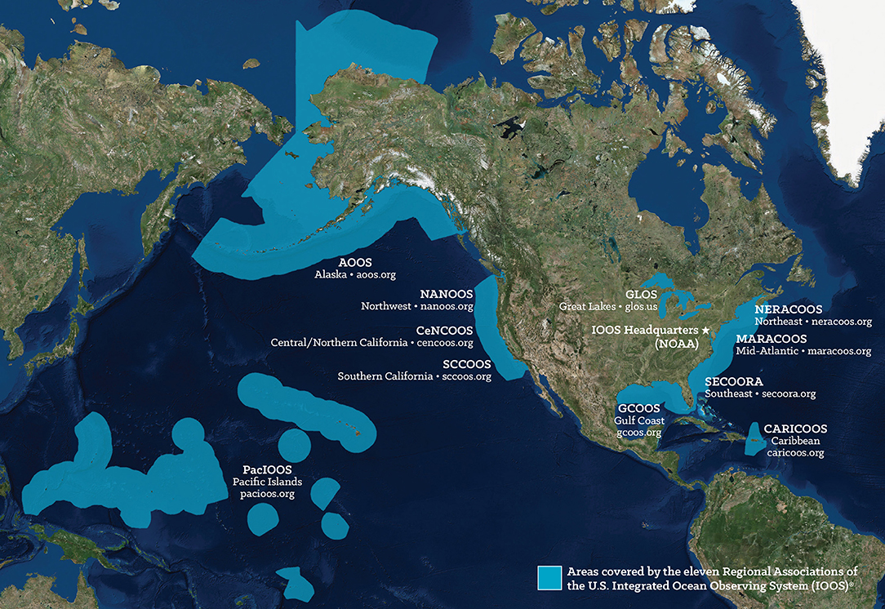
WHAT IS NANOOS, NATIONALLY?
U.S. Integrated Ocean Observing System (IOOS)
ICOOS Act Authorization
Federal - non-federal partnership
NOAA IOOS Program Office within National Ocean Service
11 Regional Associations housed at universities or are non-profits
IOOS Association
Notes:
Our nation’s security, environment, and economy all depend on our ability to understand, monitor, and adapt to changes in our oceans, coastal waters, estuaries, shorelines, and Great Lakes.
U.S. Integrated Ocean Observing System (IOOS®) is a national effort designed to enable the broadest access to ocean data, tools, products, and knowledge.
IOOS provides coordination of people, technology, and data from eleven Regional Associations around the country so that information is comprehensive, consistent, usable, and freely available to inform decision making.
Many technologies used in coastal ocean observing allow us a round-the-clock look at what is happening above and below the water.

Slide 4
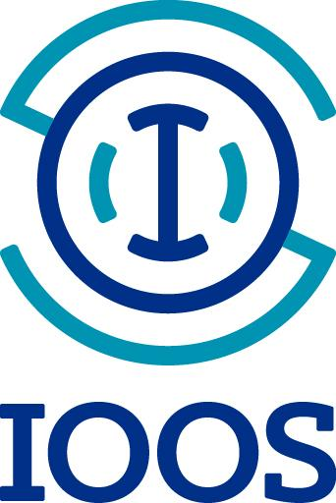
IOOS & NANOOS VALUE PROPOSITION
Identify user needs
Determine system requirements
Operate long-term observation and forecast systems & leverage existing regional assets
Co-design data tools and information products that help users make responsive and responsible decisions about safety, livelihoods, and stewardship
Build, sustain, and evolve regional ocean observing systems to meet user needs
Regionally relevant, nationally coordinated
Notes:
NANOOS has strong partnerships throughout the Pacific Northwest, nationally with sister IOOS Regional Associations, and with observing networks in British Columbia, Canada.

Slide 5
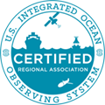
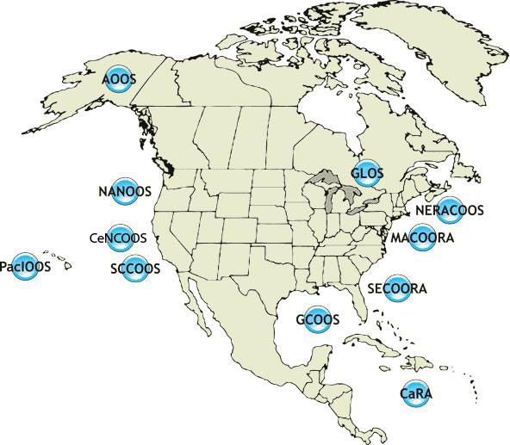
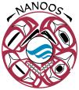
CONSISTENT NATIONAL CAPABILITY
assure
Observations
Forecasts/Modeling
Data Management
User Products
Outreach
Leverage and Link
Regional Associations
engage
DIVERSE LOCAL STAKEHOLDERS

Slide 6
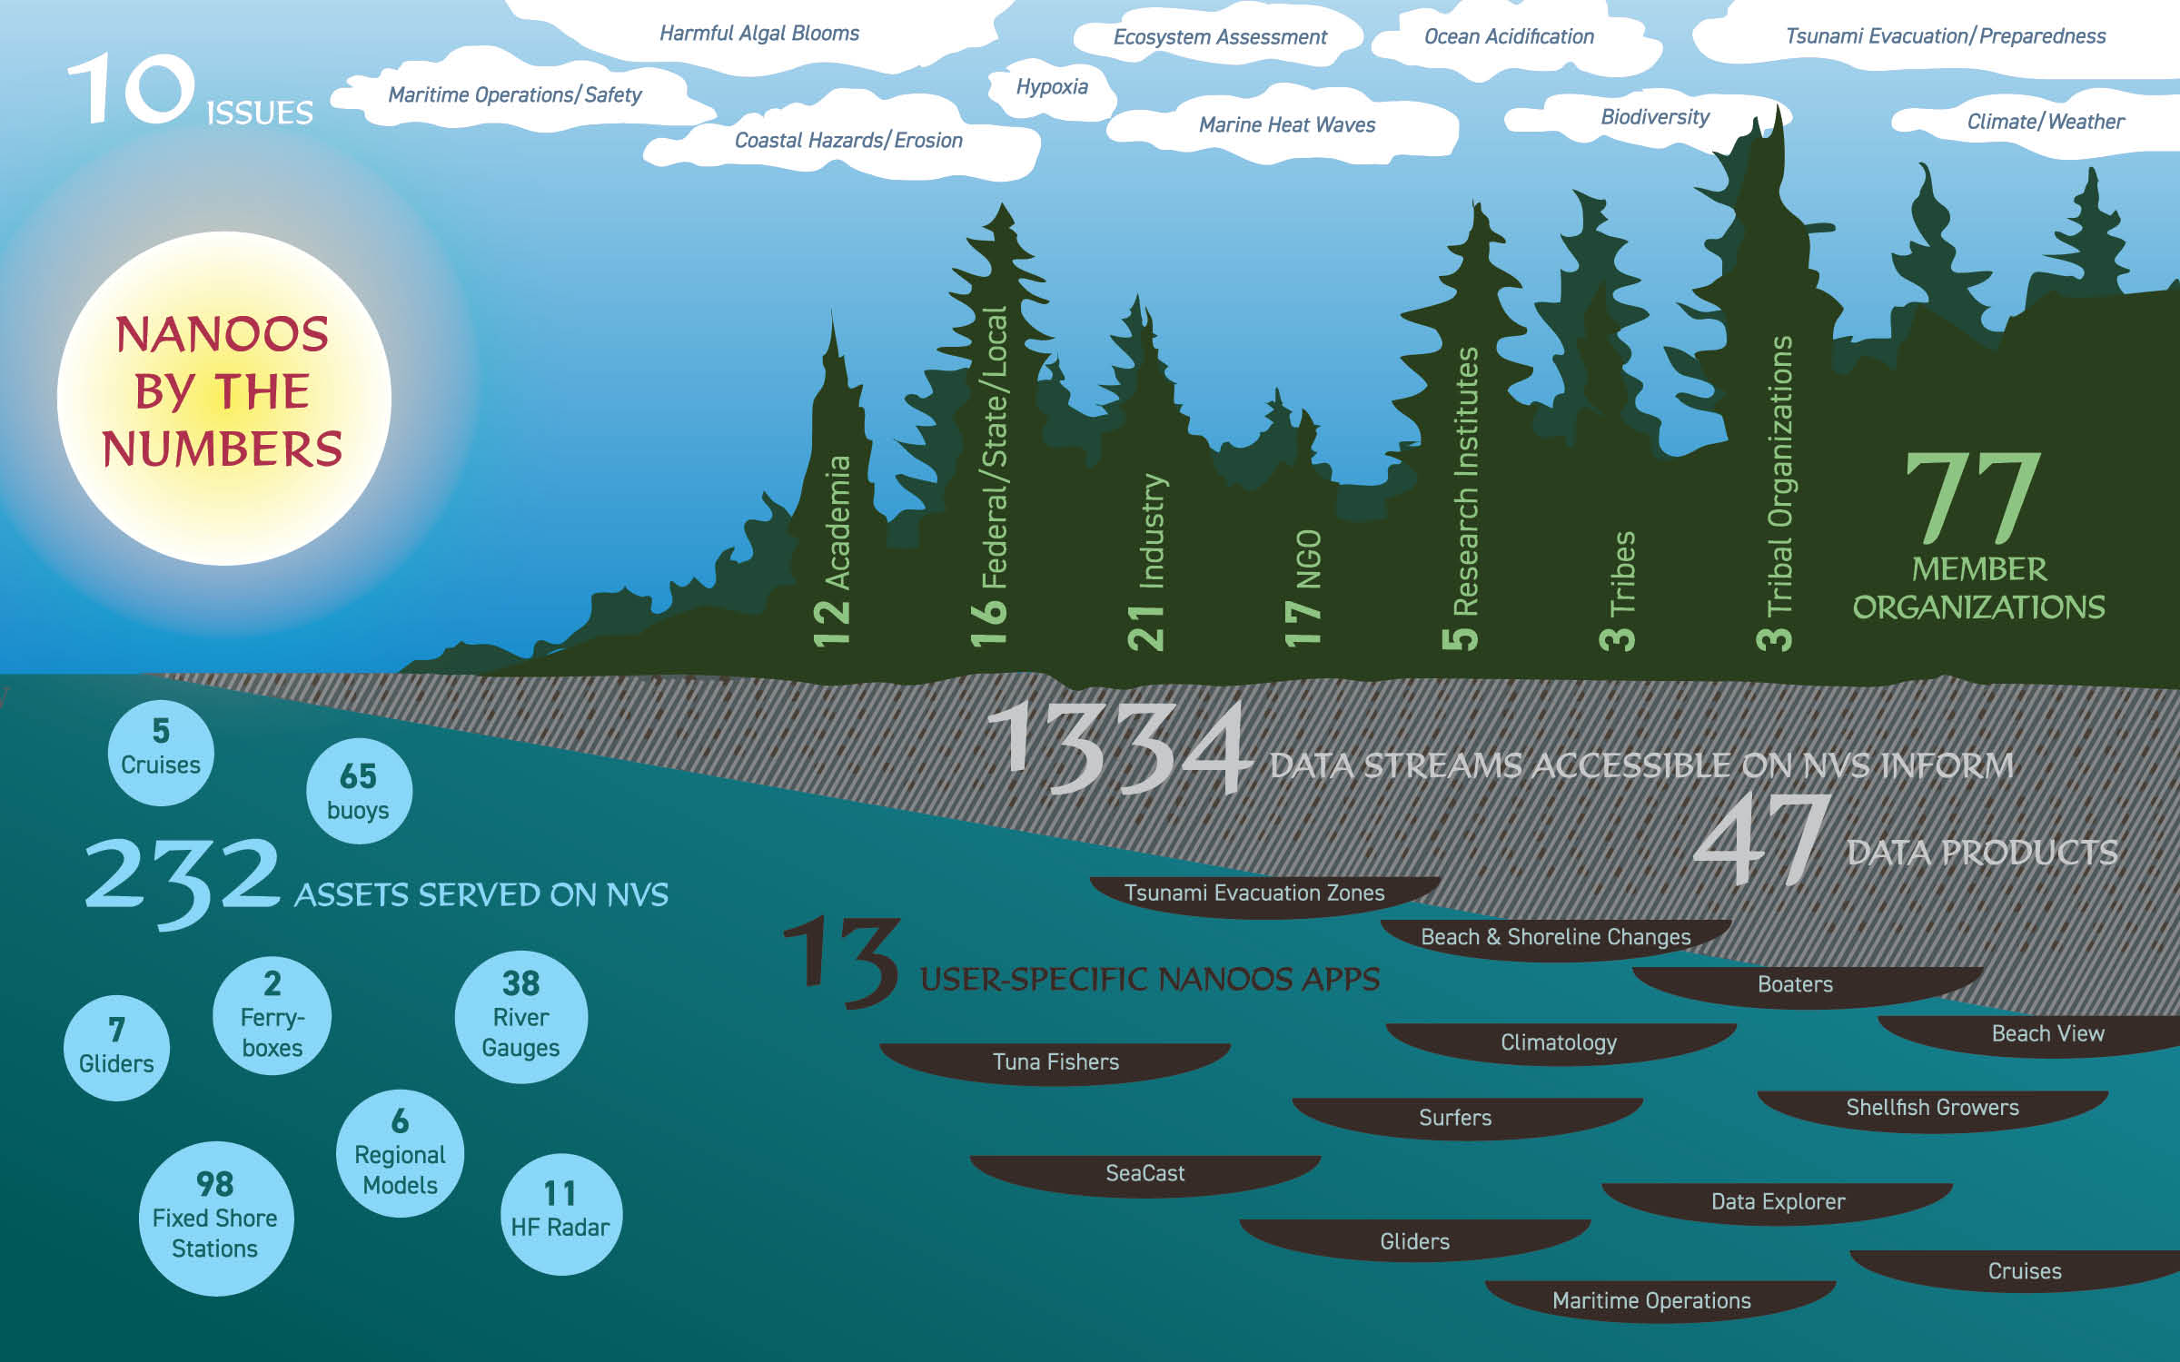

Slide 7
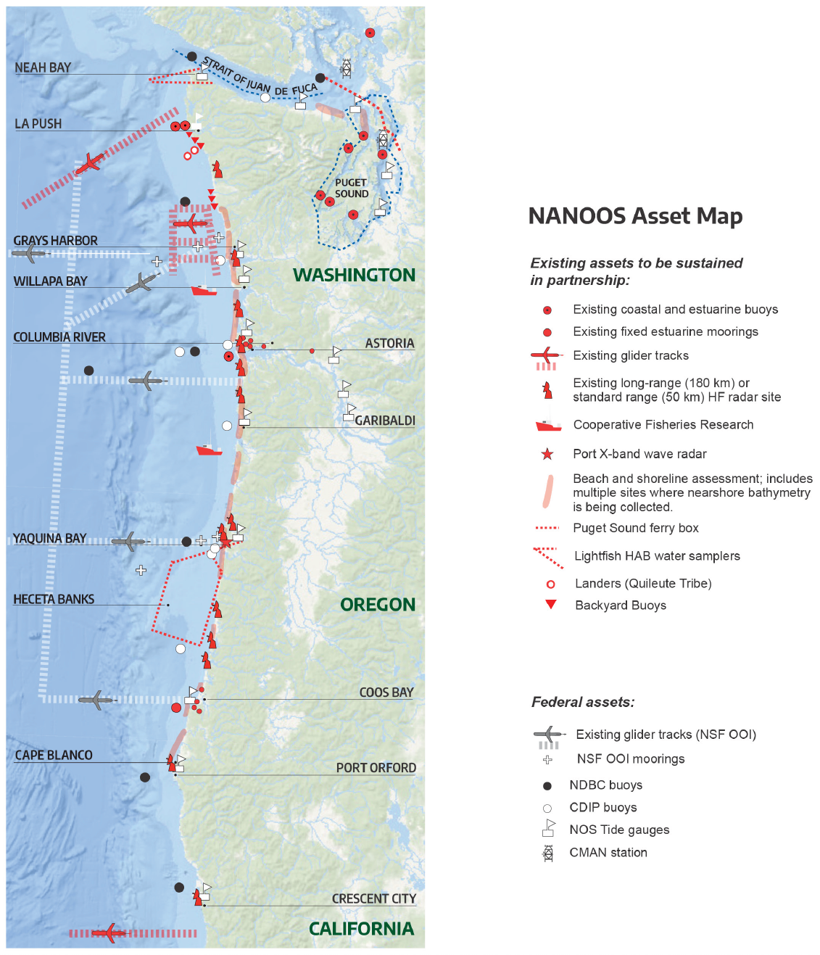
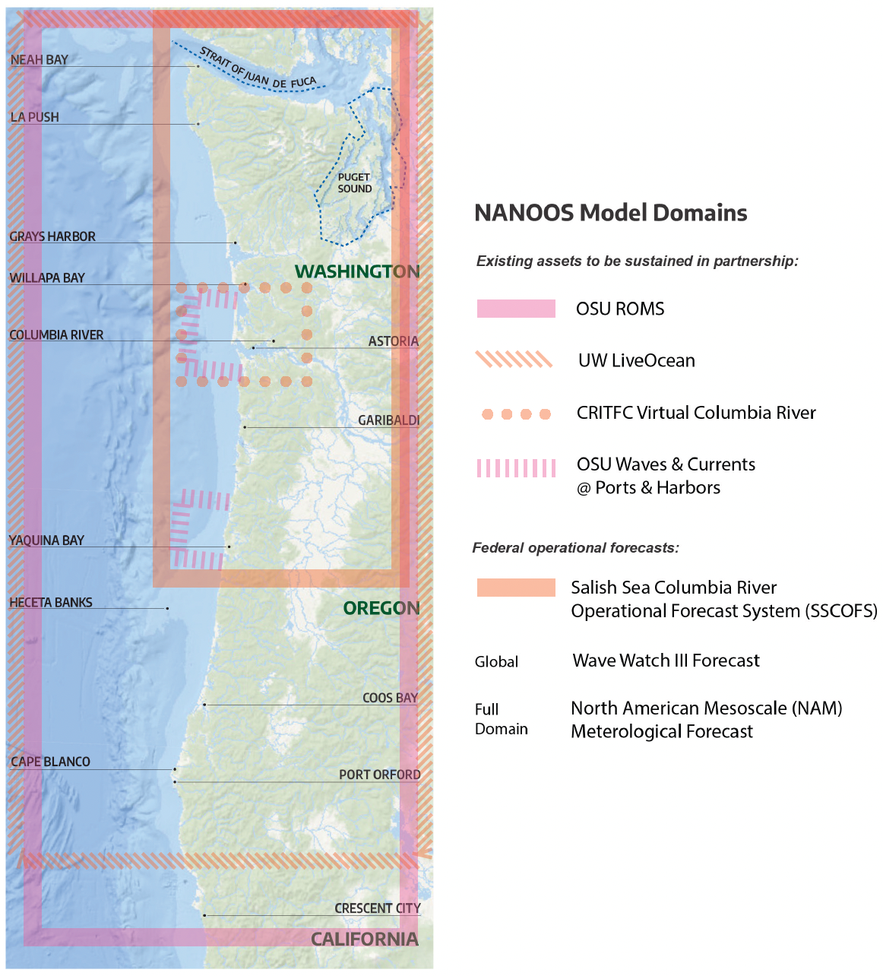

Slide 8
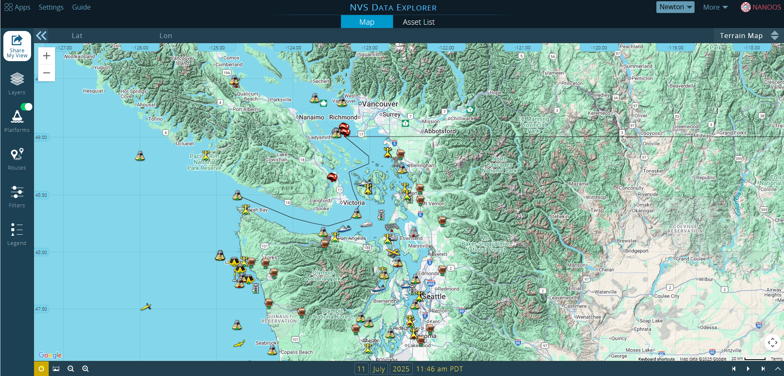

Slide 9
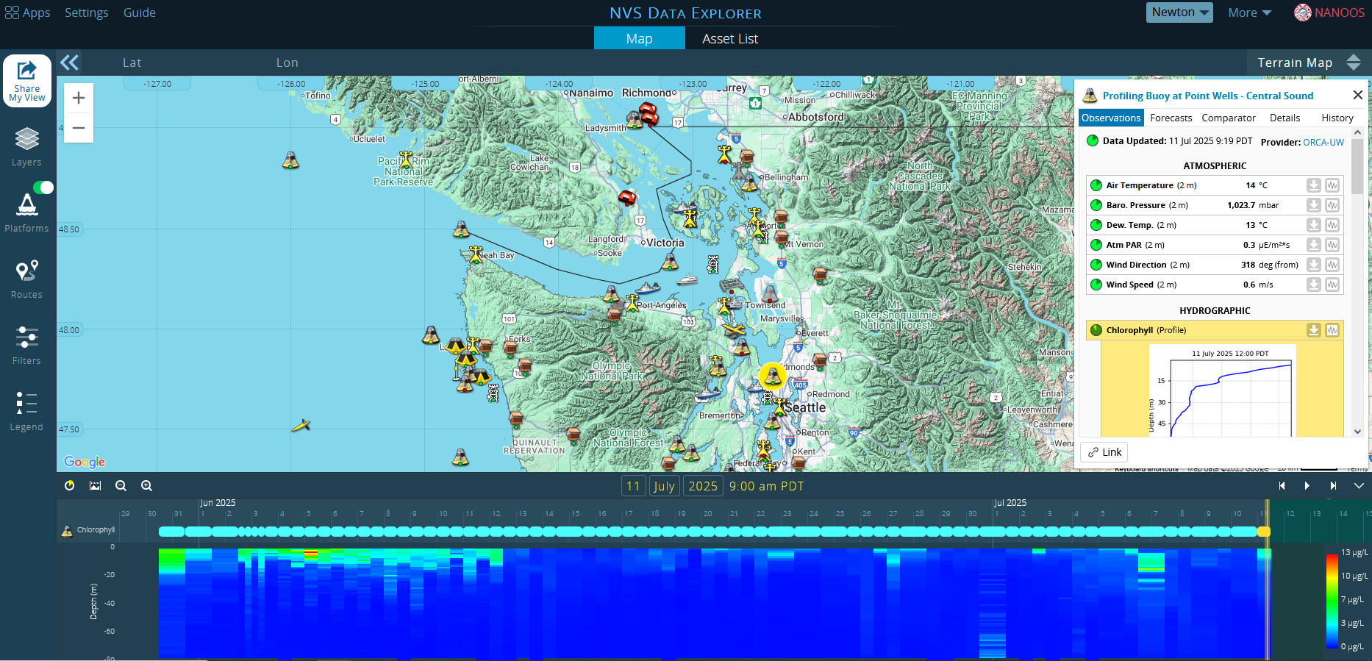

Slide 10
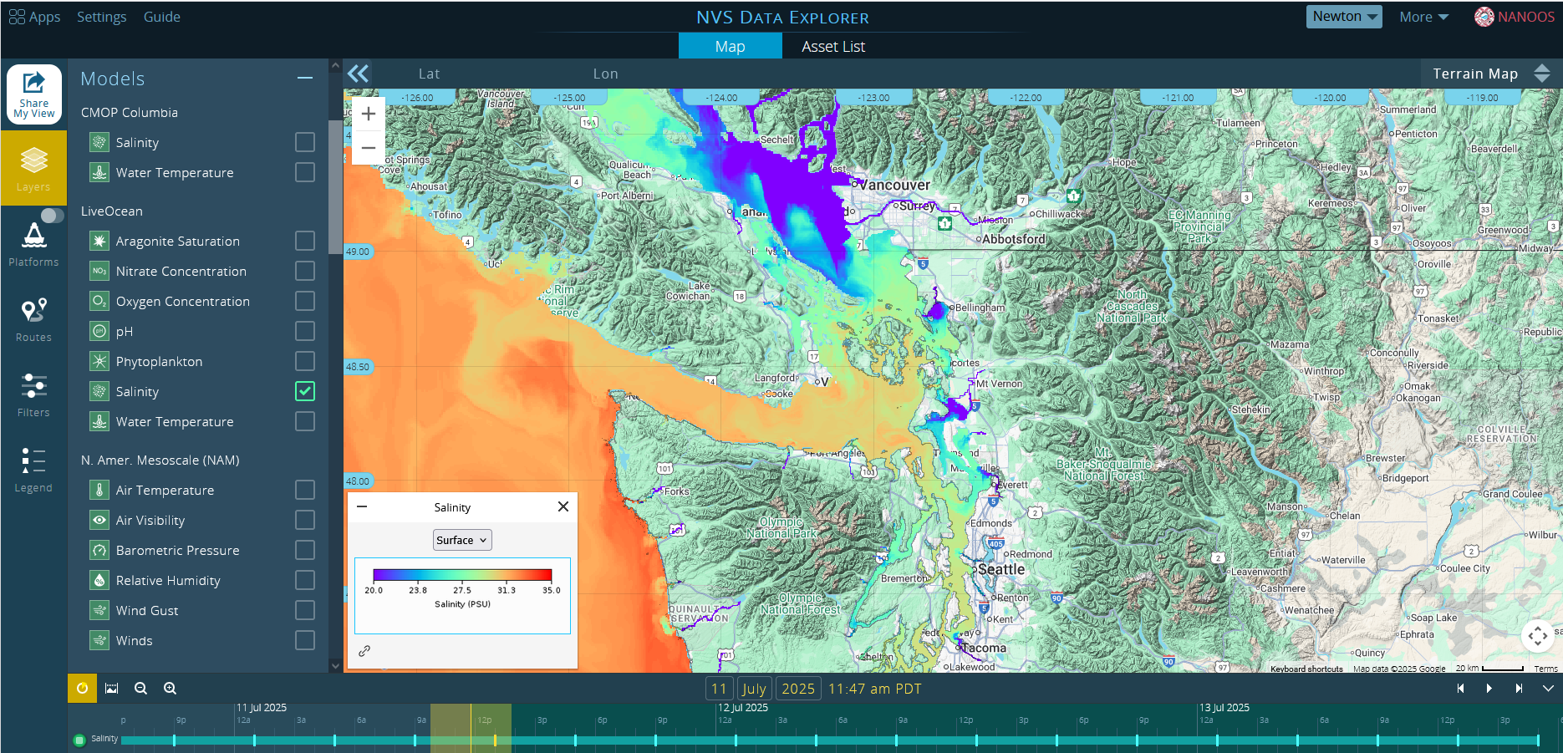

Slide 11
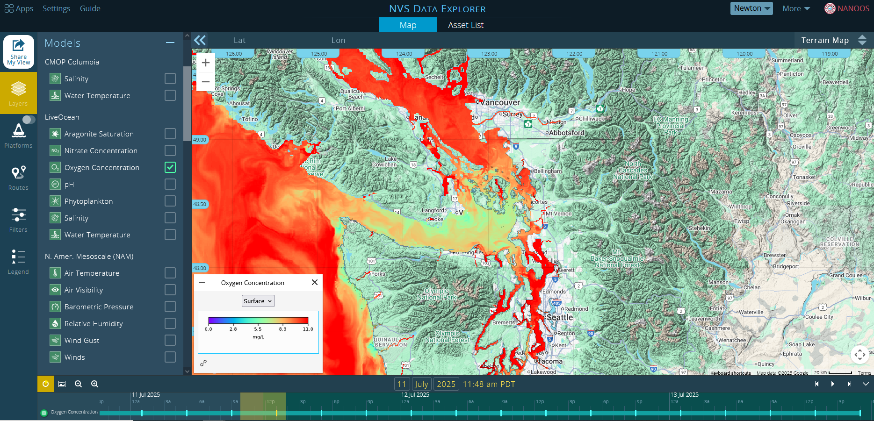

Slide 12
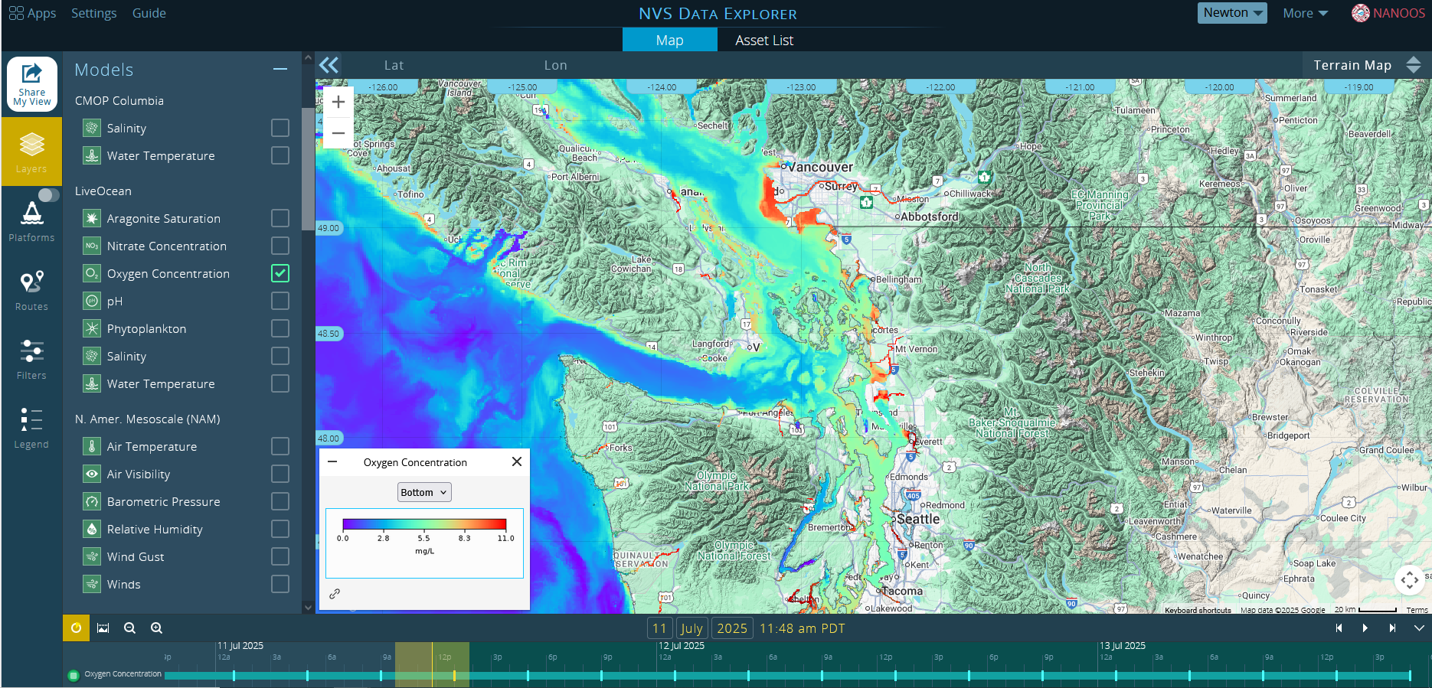

Slide 13
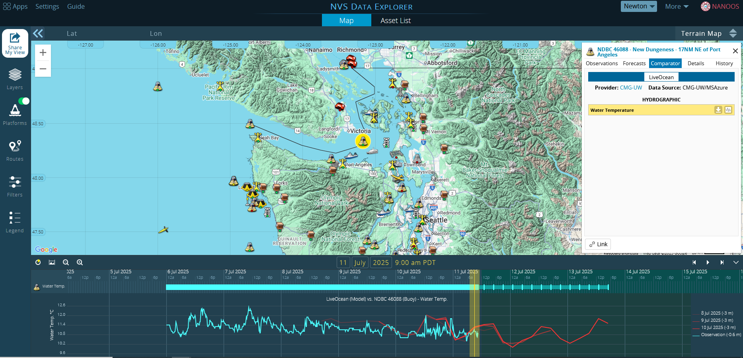

Slide 14
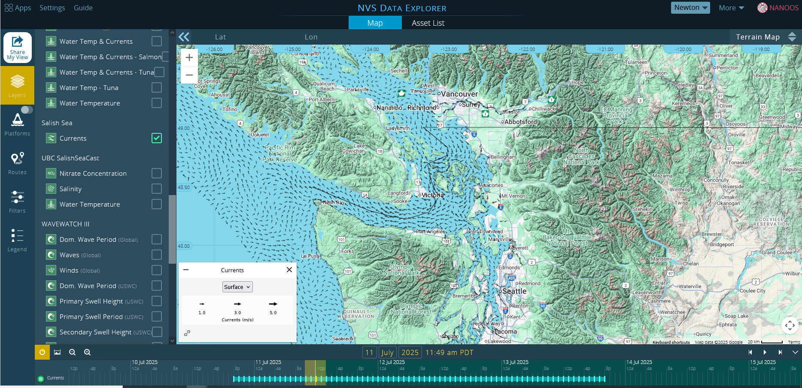

Slide 15
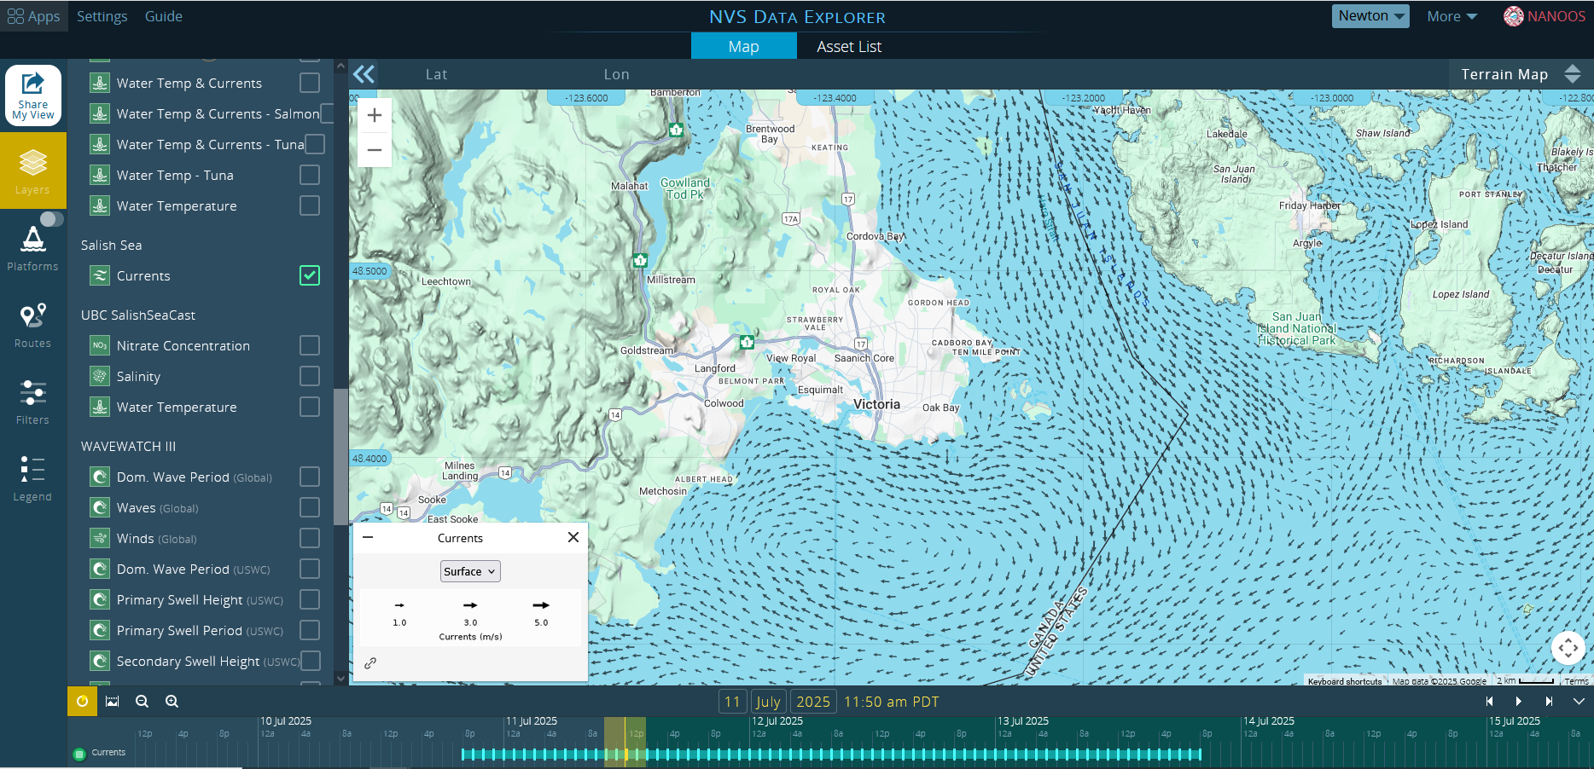

Slide 16
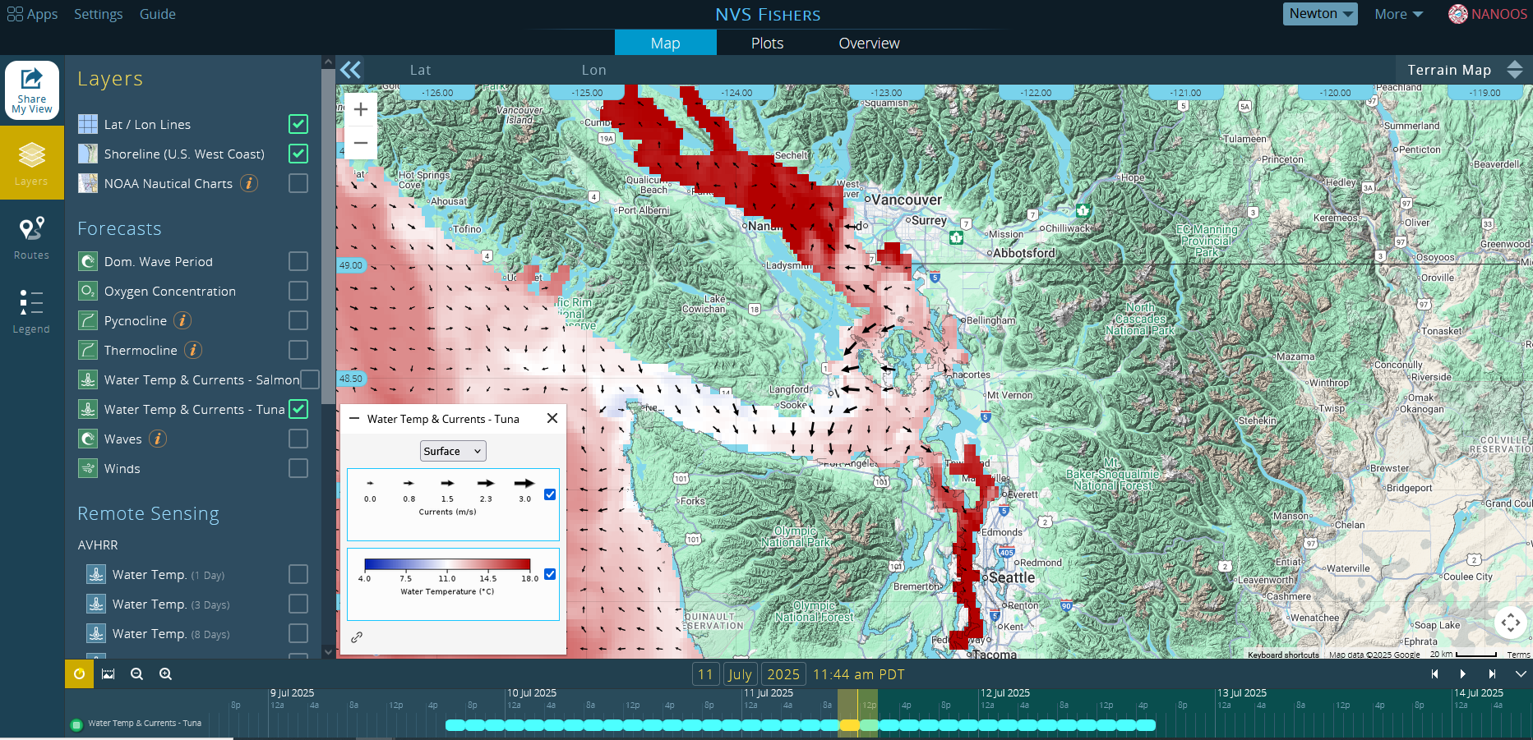

Slide 17
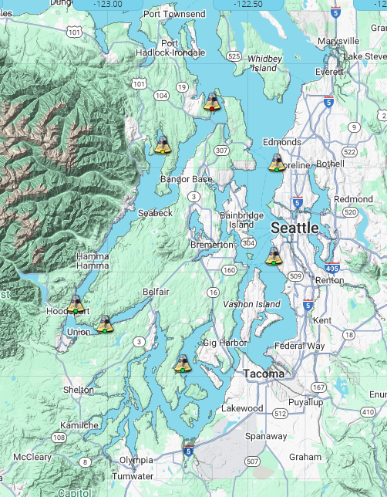
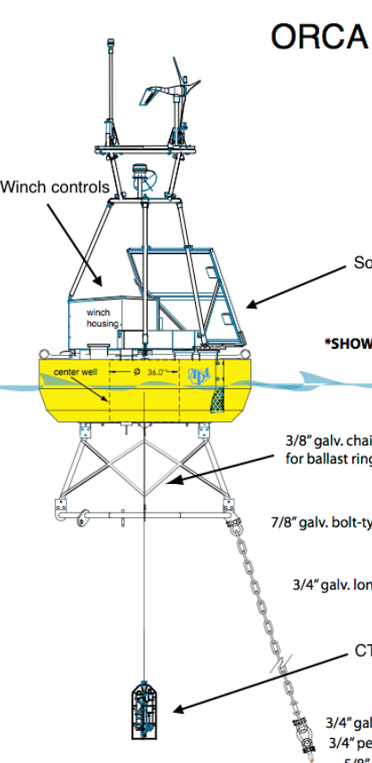
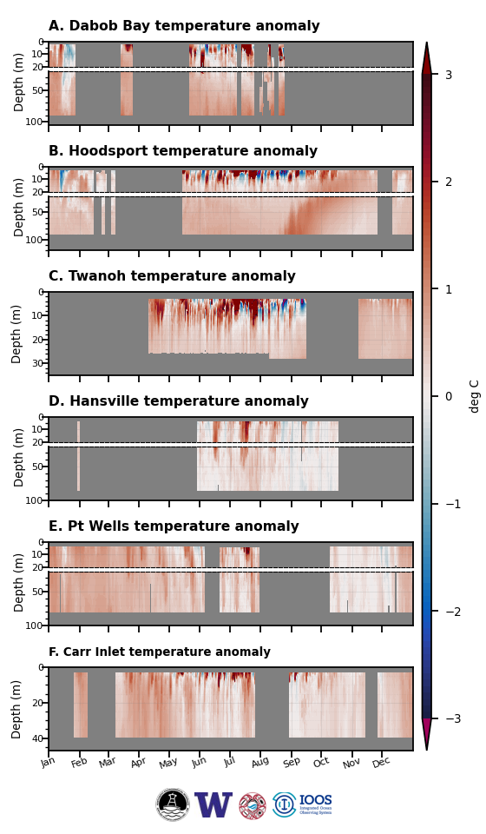
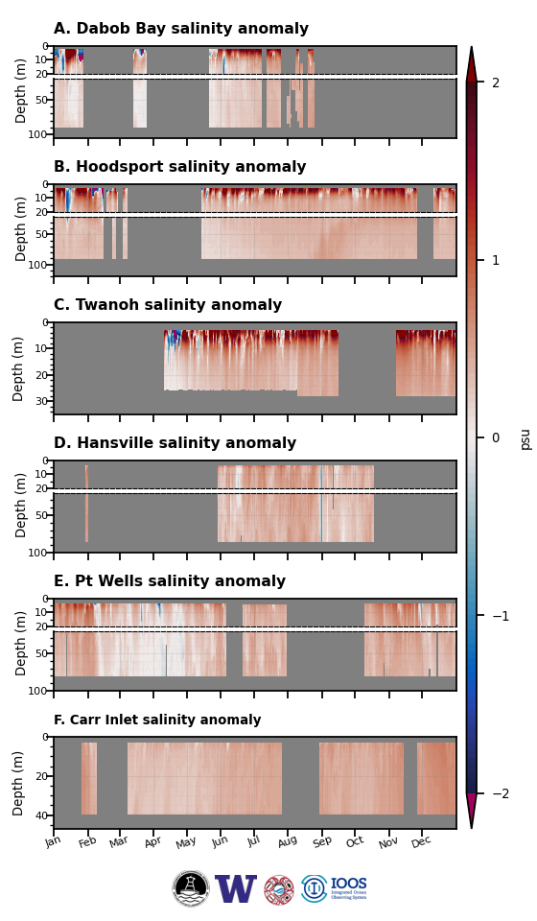
PUGET SOUND ORCA* BUOYS
*Oceanic Real-time Chemical Analyzer
Science Highlights - 2024
Warm temperature anomalies (15-year climatology 2010-2024) were observed in all basins for most of the year, likely driven by heat fluxes for the first half of the year.
In all basins salinity was higher than normal, likely due to reduced river and rainfall input. This continues a several-year trend of higher salinity that results in higher density, reduced stratification, and increased mixing.

Slide 18
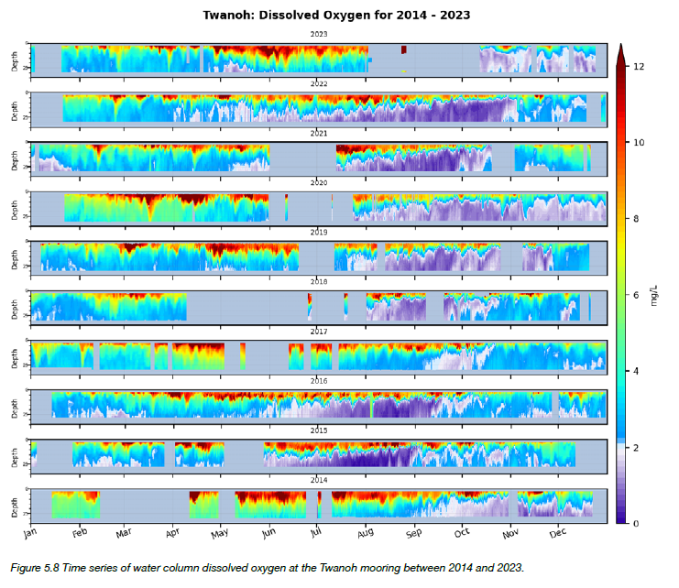
PUGET SOUND ORCA BUOYS
Science Highlights - 2024
Modest dissolved oxygen anomalies were observed in most basins, alternating between periods of positive and negative anomalies.
Hypoxia was observed at Twanoh in late summer, before modulating, but staying low to end the year.

Slide 19
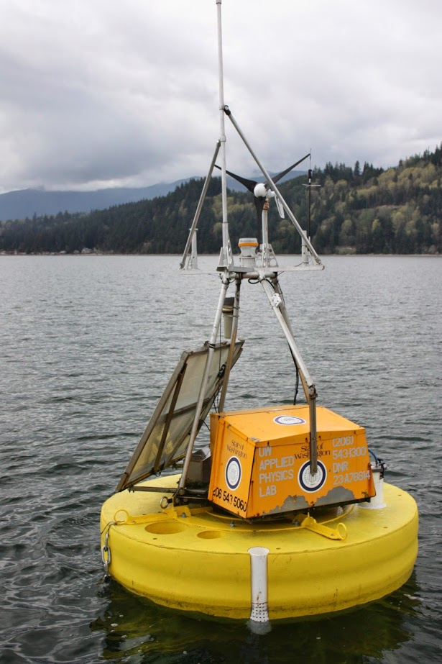
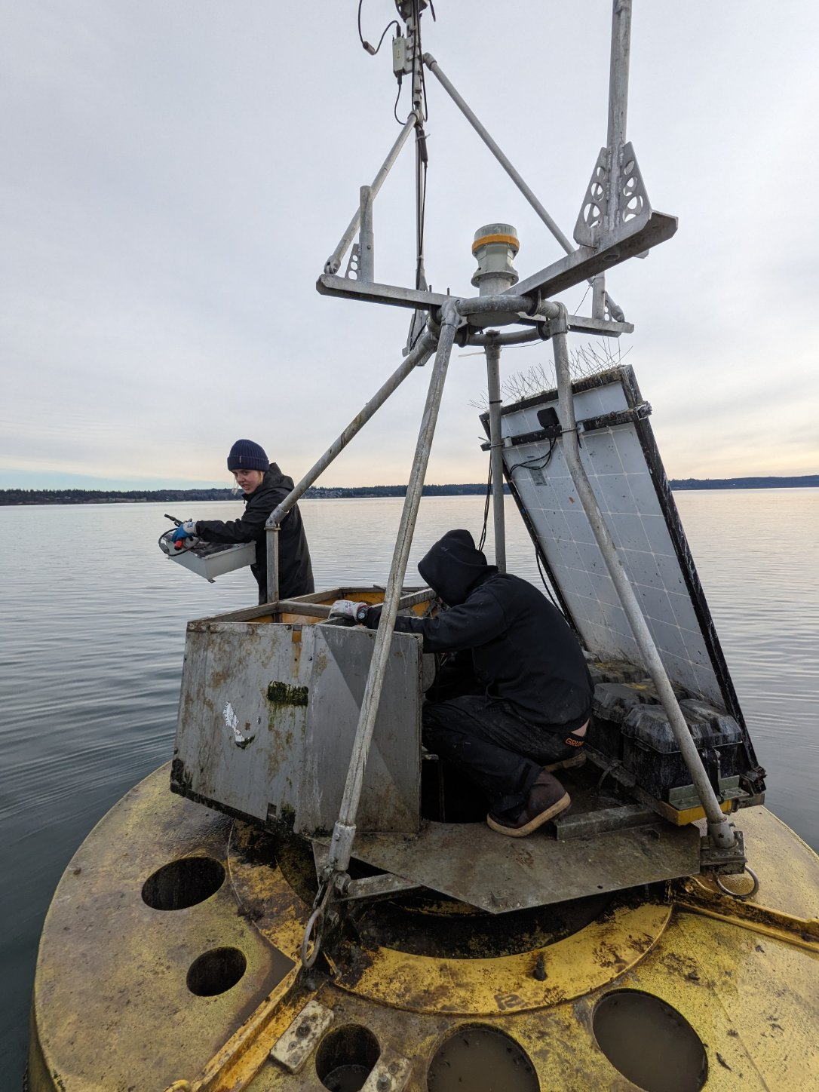
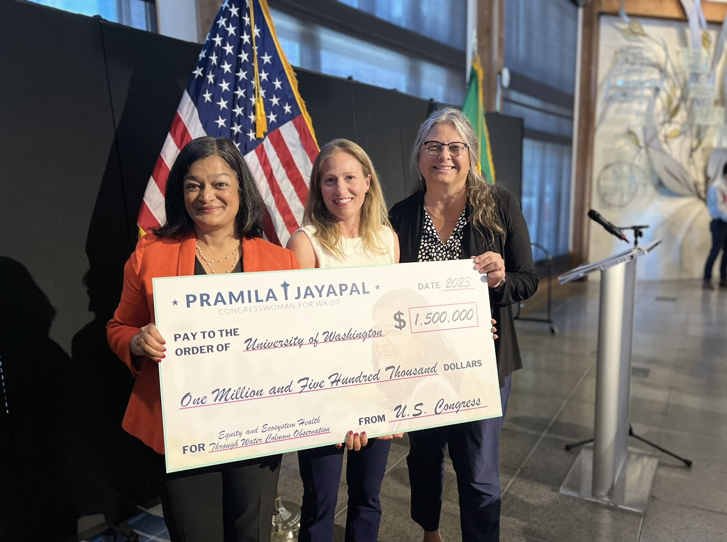
PUGET SOUND ORCA BUOYS
2008
2022
ORCA led by Seth Travis, John Mickett, formerly Dana Manalang, Beth Curry, Mathew Alford
2025
2023
ORCA 2.0 Led by Dana Manalang

Slide 20
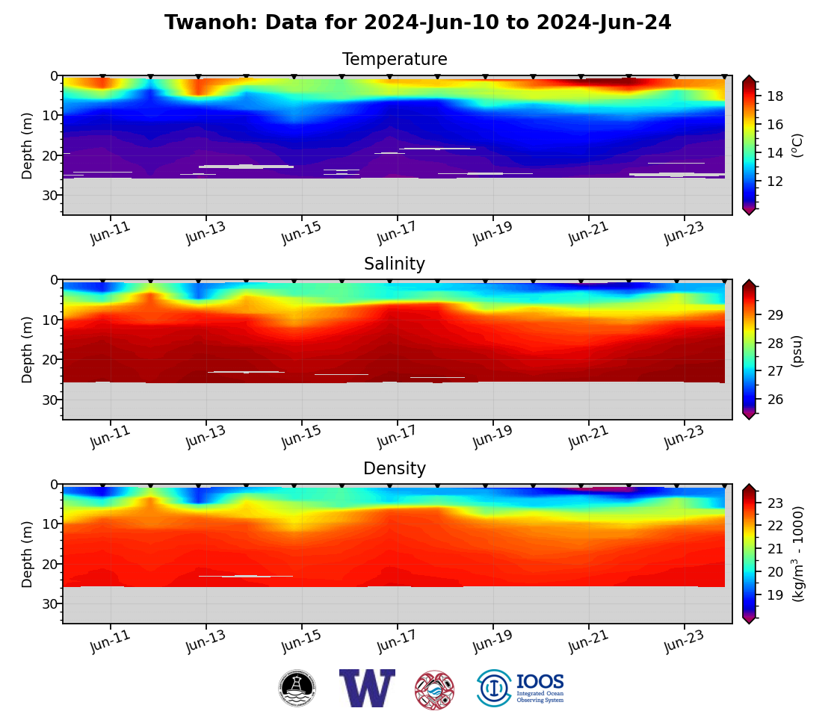
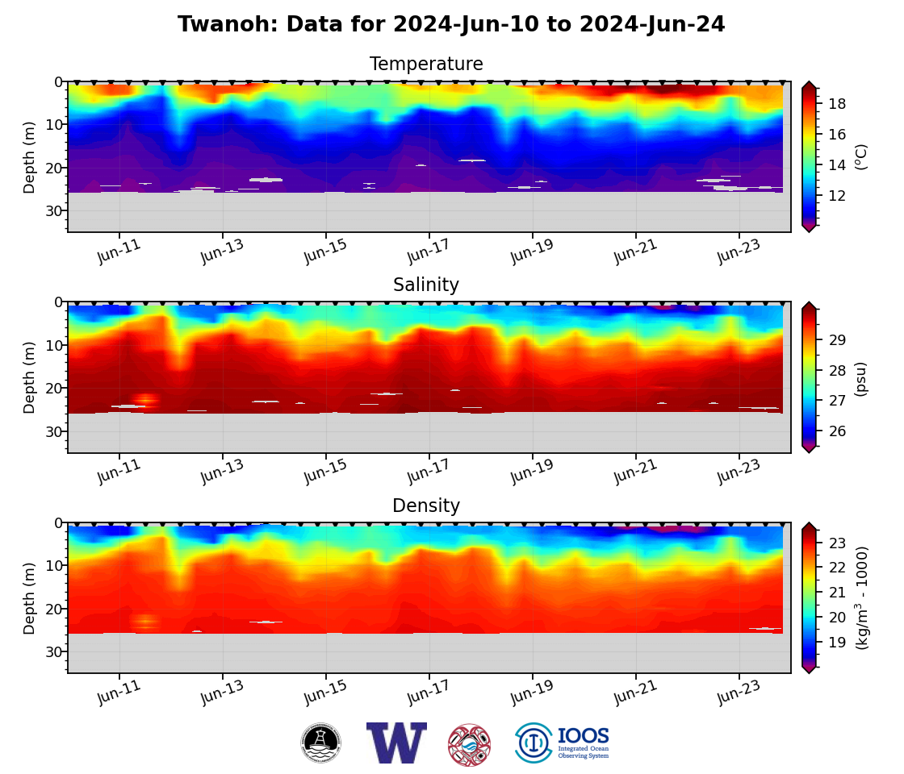
PUGET SOUND ORCA BUOYS
ORCA 2.0 involves Dana Manalang, John Mickett, Seth Travis

Slide 21
Future collaboration opportunities with ONC
              Restore broken links and highlight shared data
              Data product, e.g., temperature anomalies ?
Future observing infrastructure and ocean monitoring in the Salish Sea

Slide 22
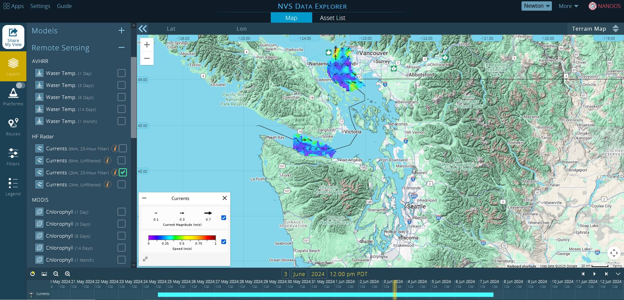

Slide 23
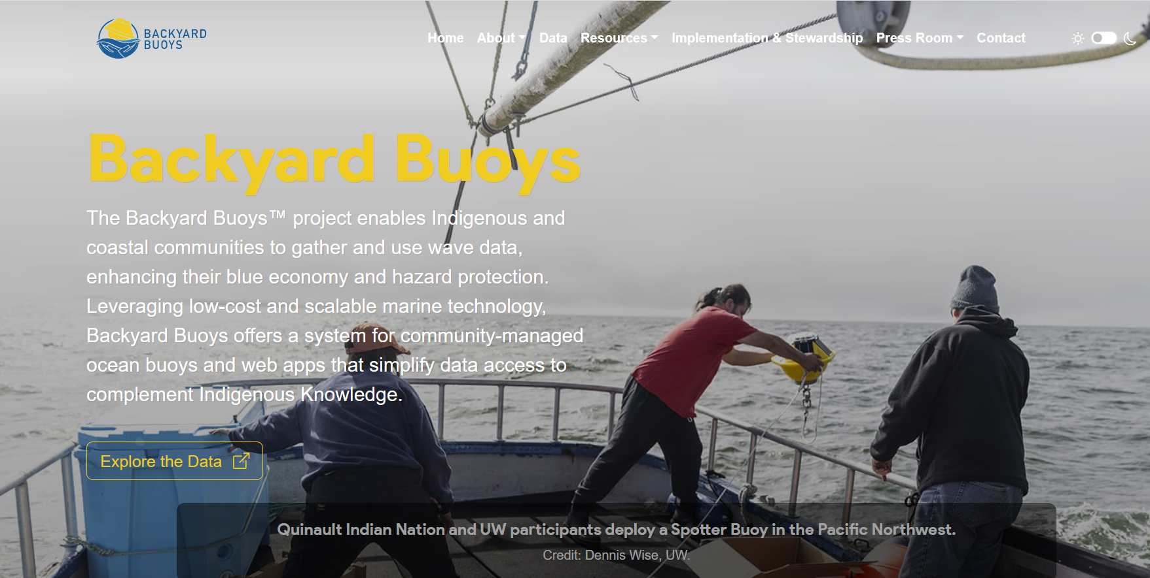
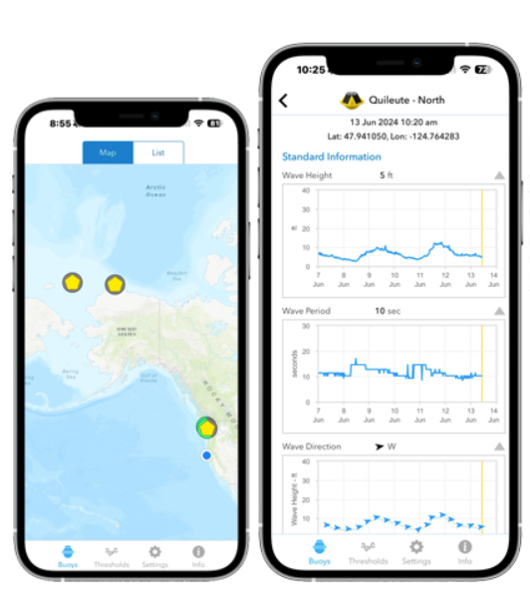

Slide 24
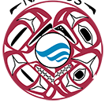


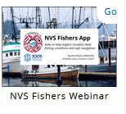
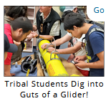
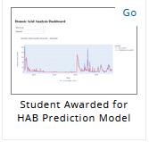
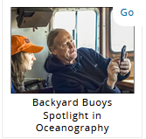
WAYS TO ACCESS NANOOS
Northwest Association of Networked Ocean Observing Systems
NANOOS Website: https://www.nanoos.org/home.php
NANOOS Visualization System (NVS): https://nvs.nanoos.org/
NANOOS ERDDAP Data Server: https://erddap.nanoos.org/erddap/index.html

Slide 25
OUR LOGO
NANOOS logo Artist Tom Guthrie, former APL employee, is a member of the Tsimshian Tribe whose art illustrates tribal and clan stories and their relationship to nature.
The logo depicts a Circle of Protectors. Clockwise from the top are Eagle, Killer Whale, Wolf, and Raven. Both Raven and Eagle are protectors of the sky. Wolf protects the land and Killer Whale the ocean. Together the four protect the entirety of the environment in which we live.
They are also in a continuous circle of red, the color of life and their interconnectivity includes all of life including our own.
Within the center of the logo are Tsimshian-stylized ocean waves, the very heart of NANOOS.
Notes:
The stewardship of the oceans is behind all of the goals of the Integrated Ocean Observing System (IOOS), of which NANOOS is a part. IOOS goals also involve the protection and restoration of marine ecosystems, the maintenance of public health, the mitigation of natural disasters, and the sustainable management of our natural resources. Native Americans, the original protectors of the Pacific Northwest, are appropriately represented in the NANOOS logo that symbolizes the preservation of the coastal ocean ecosystem and the living beings that depend upon that ecosystem.

Slide 26
Questions & Discussion
www.nanoos.org
janewton@uw.edu

